Slide 1
Aerobic Cellular Respiration
AP Biology, Mrs. Jensen

Slide 2
Cellular Respiration Equation
C₆H₁₂O₆ + 6O₂ → 6CO₂ + 6H₂O + Energy (ATP + heat)

Slide 3
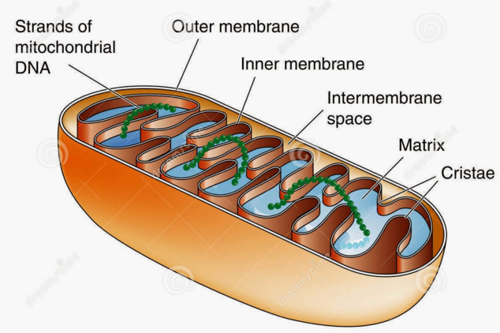
Mitochondrion

Slide 4
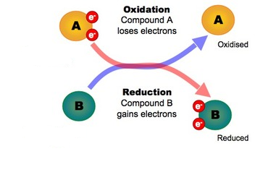
Redox Reactions
Oxidation = loss of electrons and H+
Reduction = gain of electrons and H+
OIL RIG = Oxidation is Loss, Reduction is Gain
-Cell Respiration involves a series of Redox Reactions where one molecule is oxidized and the other is reduced!

Slide 5
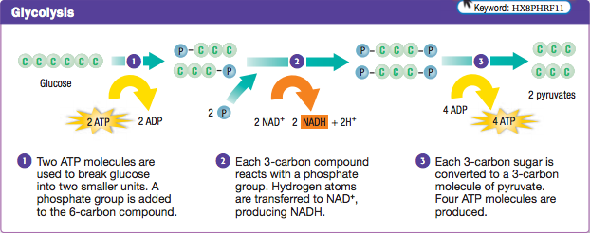
1st Step - Glycolysis
Location: Cytoplasm
Purpose: Glucose (C₆H₁₂O₆) → 2 pyruvate (C₃H₄O₃)

Slide 6
1st Step - Glycolysis
2 ATP created by substrate-level phosphorylation (taking a “P” directly from a molecule and sticking it on ADP)
2 NADH produced by adding electrons and H+ to NAD+
NADH is an electron carrier… it takes high energy electrons to the Electron Transport Chain

Slide 7
1st Step - Glycolysis
Glucose is oxidized (loses electrons and H+)… how do we know this based on the formulas of glucose and pyruvate?
NAD+ is reduced (gains electrons and H+)

Slide 8
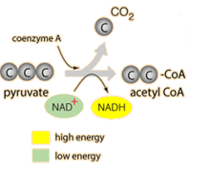
Intermediate Step – The Creation of Acetyl CoA
Location: Cytoplasm and Matrix (because pyruvate is transported from the cytoplasm into the matrix)
Purpose:
-To break pyruvate (C₃H₄O₃) down into an acetyl group (COCH₃) and a single carbon dioxide molecule (CO₂)
-Acetyl joins to Coenzyme A to create acetyl CoA

Slide 9
Intermediate Step – The Creation of Acetyl CoA
2 NADH produced by adding electrons and H+ to NAD+

Slide 10
Intermediate Step – The Creation of Acetyl CoA
Pyruvate is oxidized (loses electrons and H+)… how do we know this based on the formulas of pyruvate and acetyl CoA?
NAD+ is reduced (gains electrons and H+)

Slide 11
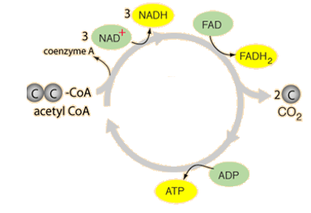
2nd Step – The Krebs Cycle
AKA The Citric Acid Cycle
Location: Mitochondrial matrix
Purpose: Break Acetyl CoA down into CO₂ and make LOTS of electron carriers (NADH and FADH₂)

Slide 12
2nd Step – The Krebs Cycle
2 ATP created by substrate-level phosphorylation (taking a “P” directly from a molecule and sticking it on ADP)
6 NADH produced by adding electrons and H+ to NAD+
2 FADH₂ produced by adding electrons and H+ to FAD
FADH₂ is another electron carrier that travels to the electron transport chain!

Slide 13
2nd Step – The Krebs Cycle
Acetyl CoA is oxidized (loses electrons and H+)… how do we know this based on the formulas of acetyl CoA and CO₂?
NAD+ and FAD are reduced (gain electrons and H+)

Slide 14
Before we talk about the Electron Transport Chain… a quick review from Pre-AP Bio
Concentration gradient = a difference in the concentration of a substance (aka sugar) across a distance (ex: across a membrane)… in other words, the substance has a higher concentration on one side of the membrane than the other side
Substances naturally “want” to move from the side that has a higher concentration to the side that has a lower concentration to “even out” their concentrations… another way to say this is that substances naturally move down their concentration gradient

Slide 15
During the electron transport chain…
We will discuss an H+ (proton) gradient across the inner mitochondrial membrane
This is an example of an electrochemical gradient. An electrochemical gradient includes two things…
-A difference in the concentration across the membrane
-A difference in electrical charge across the membrane
In addition to moving from an area of high concentration to an area of low concentration, the H+ ions “want” to move to even out charges across the membrane.

Slide 16
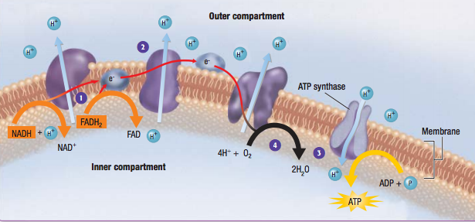
3rd Step – The Electron Transport Chain

Slide 17
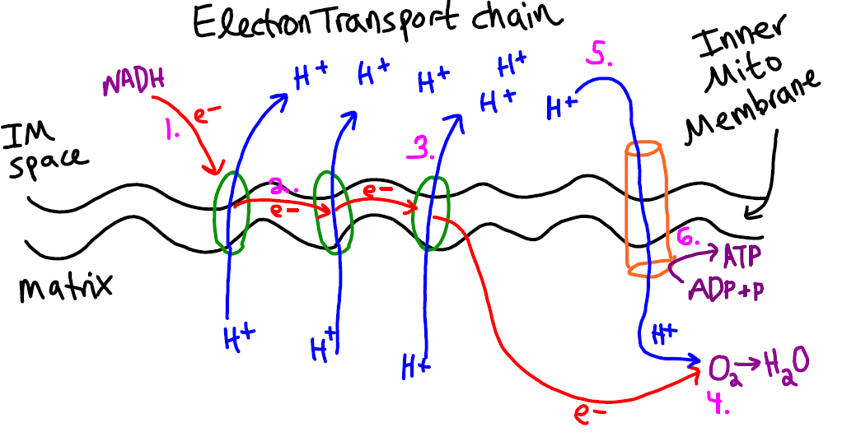
3rd Step – The Electron Transport Chain

Slide 18
3rd Step – The Electron Transport Chain
How does ATP synthase work?
https://www.youtube.com/watch?v=lOgea89L1UY

Slide 19
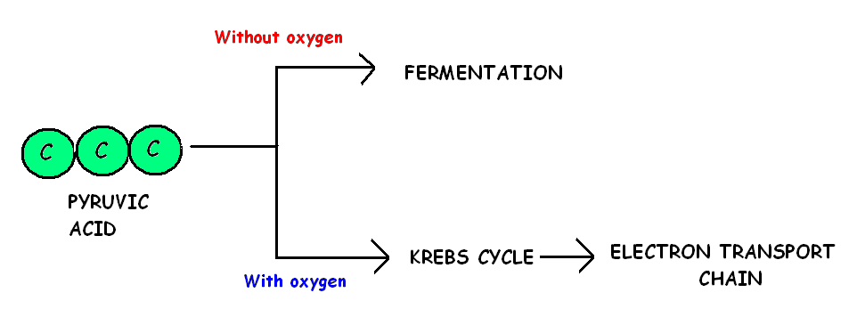
WHAT IF THERE IS NO OXYGEN?
IF THERE IS NO OXYGEN (______________)
IF THERE IS OXYGEN (_____________)
= ANAEROBIC
= AEROBIC

Slide 20
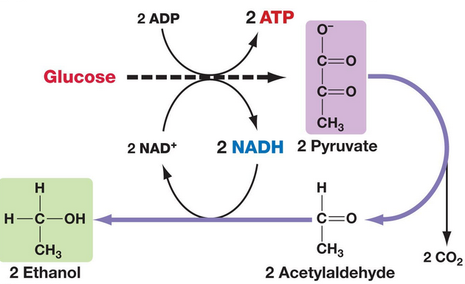
Alcoholic Fermentation
Pyruvate is split into acetaldehyde and CO₂
Acetaldehyde

Slide 21
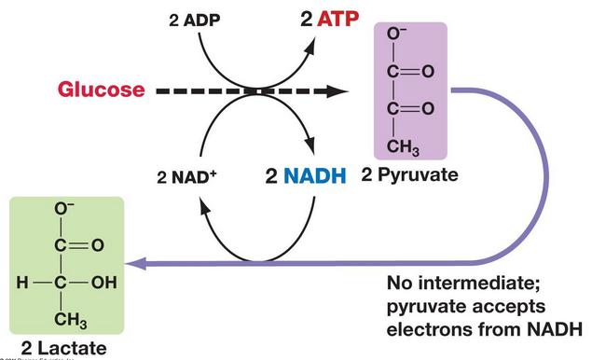
Lactic Acid Fermentation

