Slide 1
Unit 5, Part 1 Notes – Basics of Cell Signaling
AP Biology, Mrs. Jensen

Slide 2
Comparing Cell Signaling in Unicellular vs. Multicellular Organisms

Slide 3
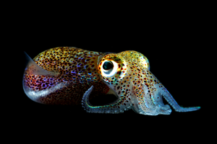
Unicellular Organisms
Purpose of cell signaling = responding to the environment & communicate to others
Ex: Quorum sensing in bacteria
Bozeman Science: Evolutionary Significance of Cell Communication
Bonnie Bassler TED Talk: How Bacteria “Talk”

Slide 4
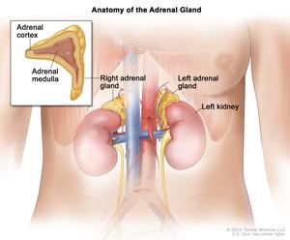
Multicellular Organisms
Purpose of cell signaling = coordinating the activities of the whole organism
Ex: Fight or flight response
-Fear → epinephrine released from adrenal glands
-Epinephrine binds to receptors on liver cells
-Liver cells release glucose into the bloodstream
-Glucose fuels muscle cells → fight or flight!

Slide 5
Discuss Notes Question #5

Slide 6
Types of Cell Signaling in Multicellular Organisms

Slide 7
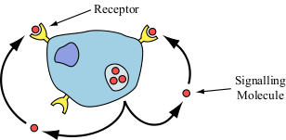
Autocrine Signaling
Cell responds to its own signaling
T cell secretes growth factor in response to pathogen → division of T cell to create more T cells → stronger immune response
Overproduction of growth factor → cells divide too frequently → formation of a tumor (cancer)

Slide 8
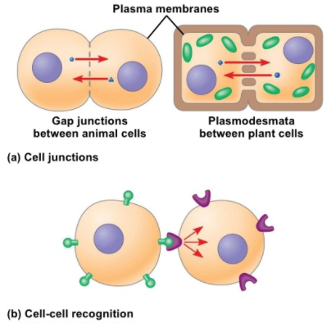
Juxtacrine Signaling
Signaling between cells that are physically connected to each other
Gap junctions and plasmodesmata

Slide 9
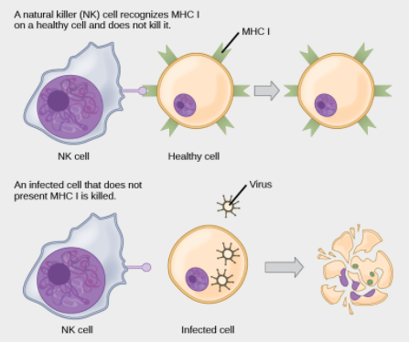
Juxtacrine Signaling
Cells can bind to each other if they have complementary proteins on their cell surfaces

Slide 10
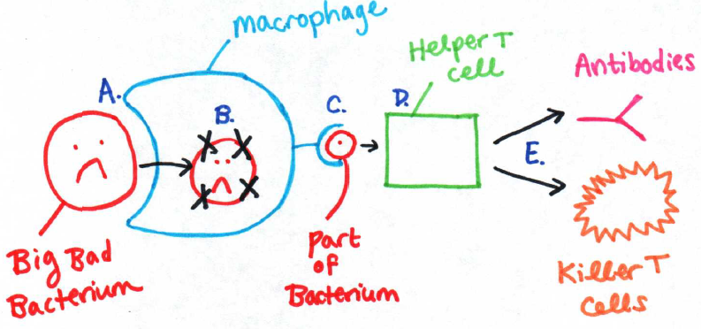
Juxtacrine Signaling

Slide 11
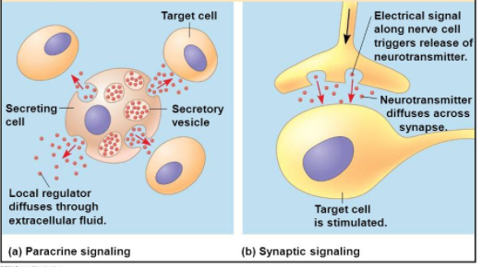
Paracrine Signaling
Cell communication over short distances
Ex: Synaptic signaling between neurons

Slide 12
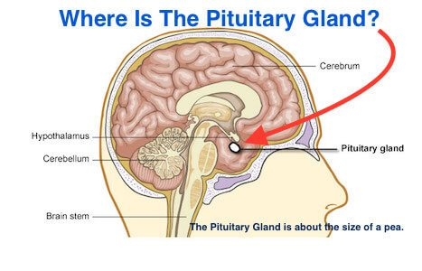
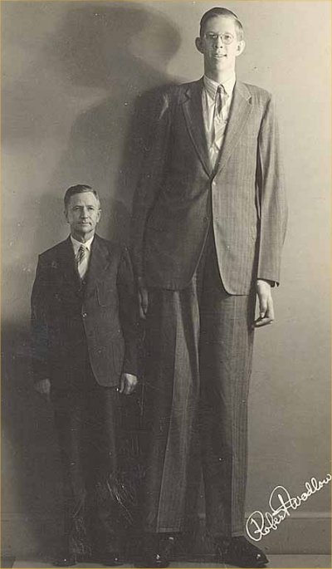
Endocrine Signaling
Cell communication over long distances (glands secrete hormones into the bloodstream → responses by multiple target cells)
Pituitary giantism in Robert Wadlow

Slide 13
Pros and Cons of Different Types of Signaling
Autocrine, Juxtacrine, and Paracrine
-Pro = fast
-Con = only one (or a few) target cells
Endocrine
-Pro = many target cells
-Con = slow (has to travel the whole body)
Notes Question #2 & 3

Slide 14
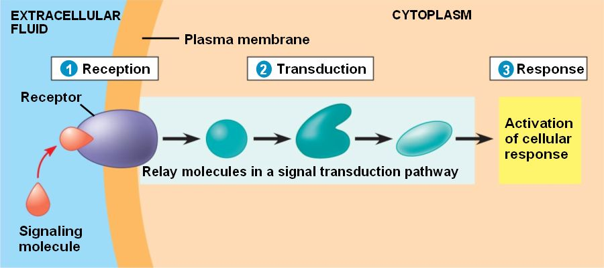
Steps of Cell Signaling
Reception
Transduction
Response

Slide 15
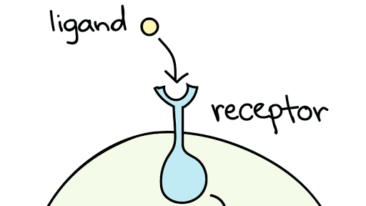
Reception
Plasma Membrane Receptor – think chemistry!! What kind of molecules CAN’T pass straight through the membrane?
-Type of Ligand?
Intracellular Receptor
-Type of Ligand?
Notes Question #1

Slide 16
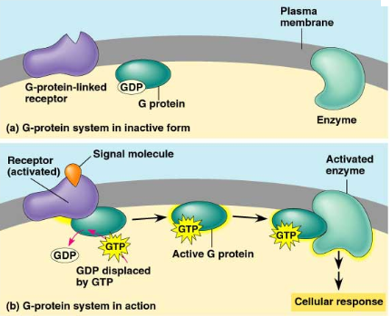
Example of a plasma membrane receptor = G protein-coupled receptor
Temporary activation of G protein

Slide 17
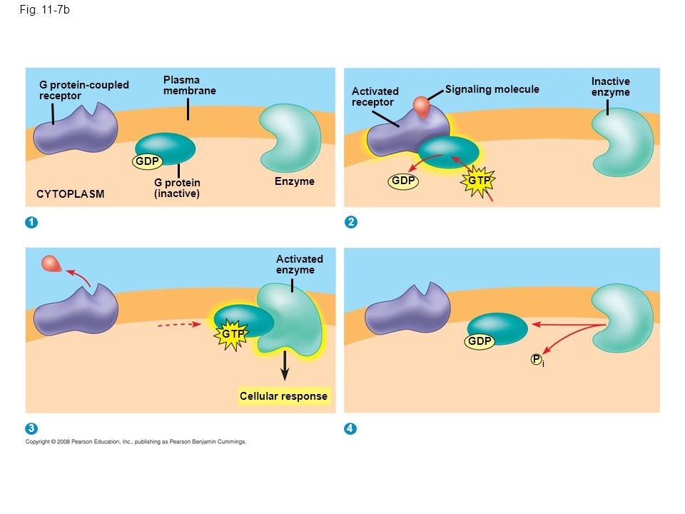

Slide 18
G protein-coupled receptor animation

Slide 19
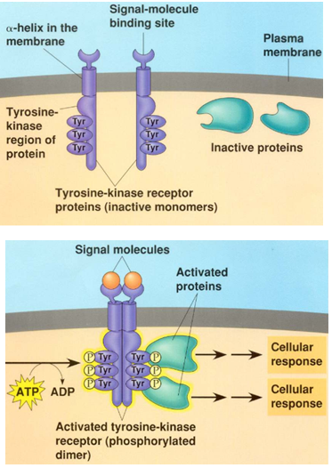
Another example of a plasma membrane receptor = receptor tyrosine kinase
What is a kinase?

Slide 20
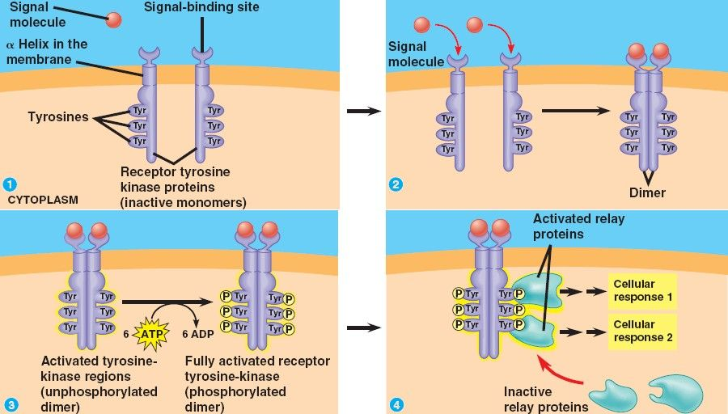

Slide 21
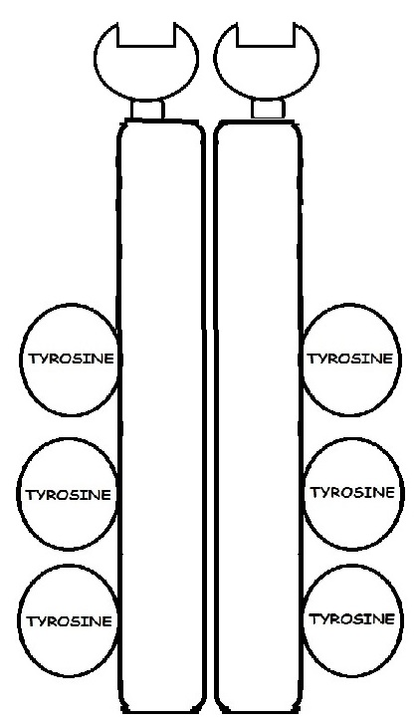
http://slideplayer.com/slide/8089512/25/images/10/Figure+14-2A.jpg
LIGAND fits receptor
like “lock & key”
TYROSINE KINASE

Slide 22
http://slideplayer.com/slide/8089512/25/images/10/Figure+14-2A.jpg
LIGAND fits receptor
like “lock & key”
TYROSINE KINASE

Slide 23
http://slideplayer.com/slide/8089512/25/images/10/Figure+14-2A.jpg
TYROSINE KINASE

Slide 24
http://slideplayer.com/slide/8089512/25/images/10/Figure+14-2A.jpg
TYROSINE KINASE
Forms a DIMER

Slide 25
http://slideplayer.com/slide/8089512/25/images/10/Figure+14-2A.jpg
TYROSINE KINASE
ATP provides the phosphate
KINASES- enzymes that ADD PHOSPHATES to other molecules

Slide 26
http://slideplayer.com/slide/8089512/25/images/10/Figure+14-2A.jpg
TYROSINE KINASE
Adding phosphates ACTIVATES molecules

Slide 27
http://slideplayer.com/slide/8089512/25/images/10/Figure+14-2A.jpg
TYROSINE KINASE
Adding phosphates ACTIVATES molecules

Slide 28
http://slideplayer.com/slide/8089512/25/images/10/Figure+14-2A.jpg
TYROSINE KINASE

Slide 29
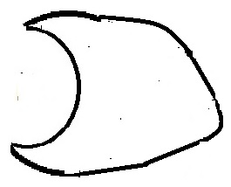
http://slideplayer.com/slide/8089512/25/images/10/Figure+14-2A.jpg
TYROSINE KINASE

Slide 30
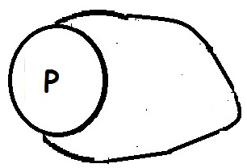
http://slideplayer.com/slide/8089512/25/images/10/Figure+14-2A.jpg
TYROSINE KINASE

Slide 31
http://slideplayer.com/slide/8089512/25/images/10/Figure+14-2A.jpg
TYROSINE KINASE

Slide 32
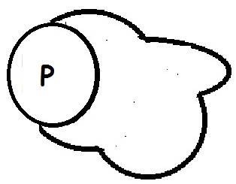
http://slideplayer.com/slide/8089512/25/images/10/Figure+14-2A.jpg
TYROSINE KINASE

Slide 33
Receptor Tyrosine Kinase Video

Slide 34
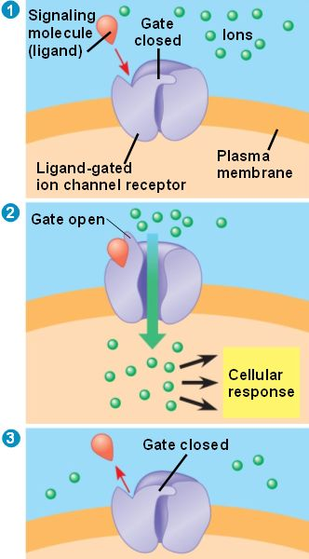
Another example of a plasma membrane receptor = ligand-gated ion channel
Ligand-gated ion channel video

Slide 35
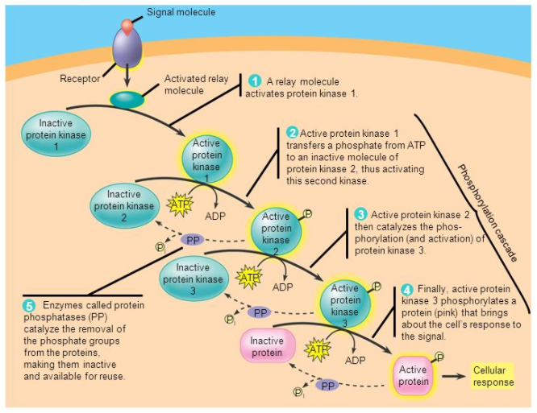
Transduction
Conversion of the signal to a form that the cell can respond to
Phosphorylation Cascade → signal is amplified

Slide 36
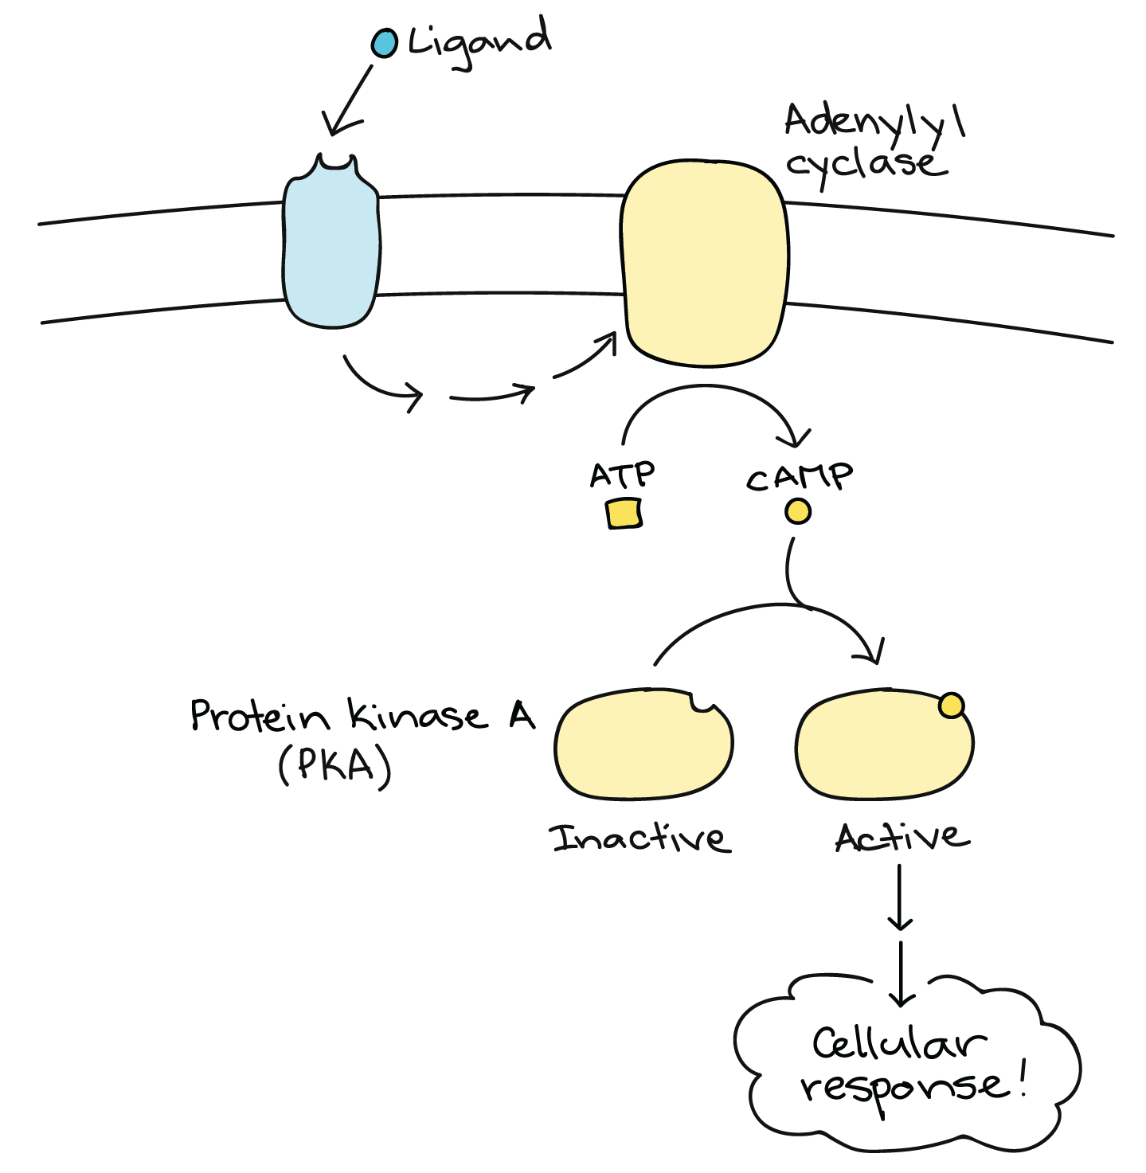
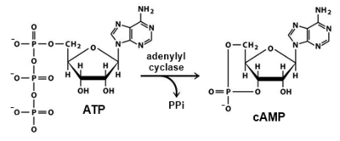
Second Messengers
-Cyclic AMP (cAMP)
-Ca²⁺
Also cause signal amplification
Notes Question #4

Slide 37
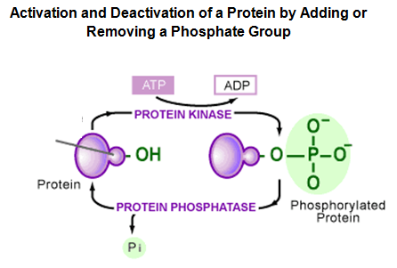
Turning off signal transduction pathways
Protein phosphatases (opposite job of protein kinases)

Slide 38
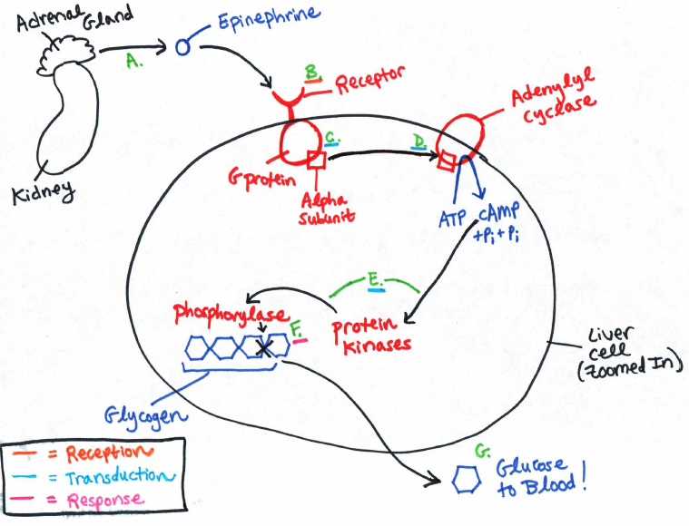
Epinephrine Signaling Pathway (Fight or Flight) Notes Question #6

Slide 39
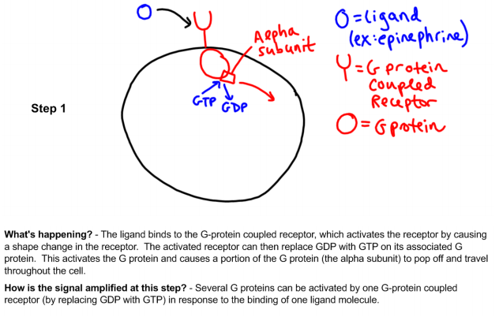
Signal Amplification During Transduction

Slide 40
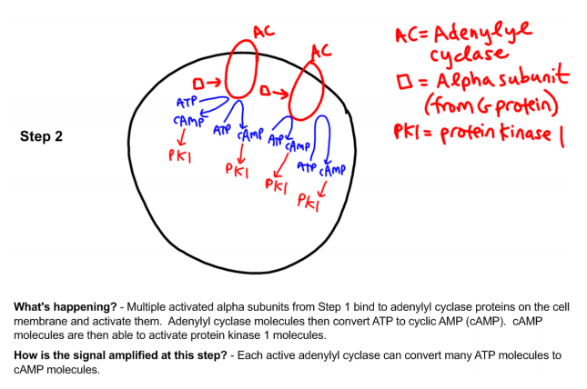
Signal Amplification During Transduction

Slide 41
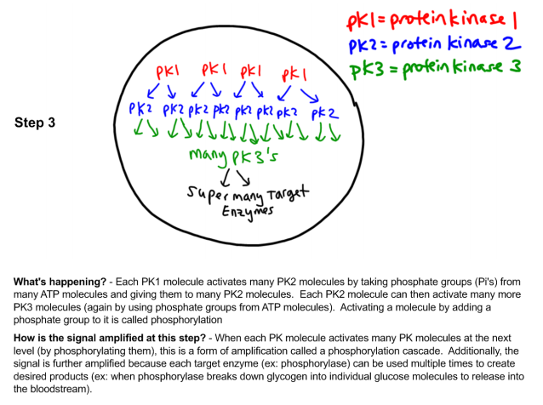
Signal Amplification During Transduction

Slide 42
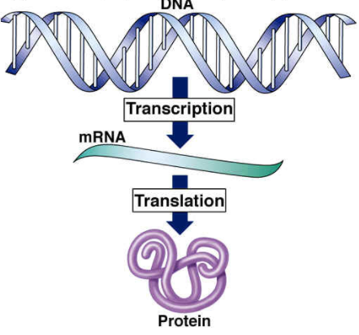
Response
Review from freshman bio
-Genes
-mRNA
-Transcription
-Amino acids → protein
-Translation

Slide 43
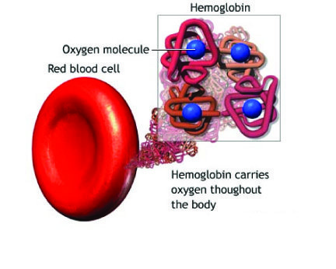
Differences in Gene Expression between Different Cell Types
Same DNA in different cell types, but different genes used
Ex: Hemoglobin gene used in red blood cells but not skin cells
Transcription factors
Nuclear Response

Slide 44
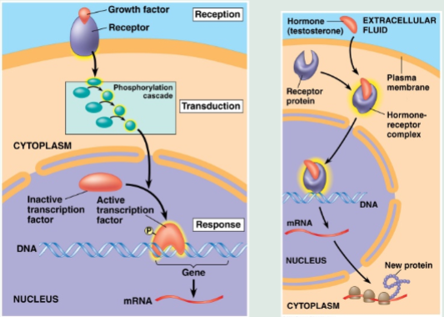
Plasma membrane receptor → signal transduction pathway (phosphorylation cascade and/or second messengers) → activation of a transcription factor
Intracellular receptor → hormone-receptor complex acts as a transcription factor

Slide 45
Cytoplasmic Response = activation of an enzyme in the cytoplasm
-Ex: Epinephrine signaling pathway activates glycogen phosphorylase

Slide 46
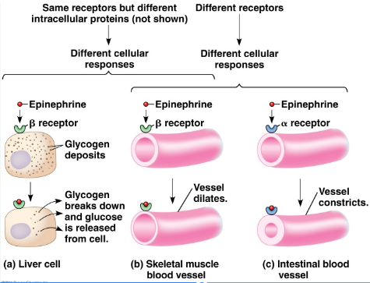
Different Cell Types → Different Responses to the Same Signal
May have different receptor proteins
May have different intracellular proteins

Slide 47
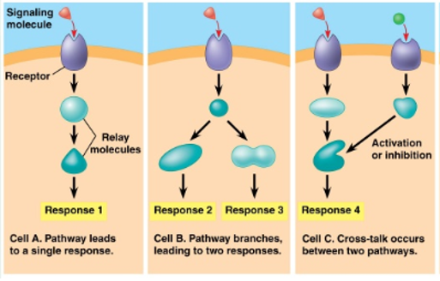
Interaction between signaling pathways within a cell
Branching signaling pathways → multiple responses within the same cell

Slide 48
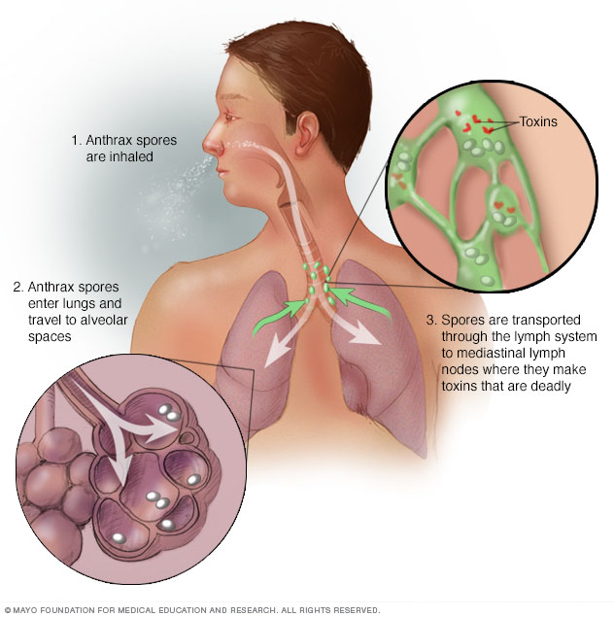
Changes in Signaling Pathways
Anthrax → shape change in adenylyl cyclase

Slide 49
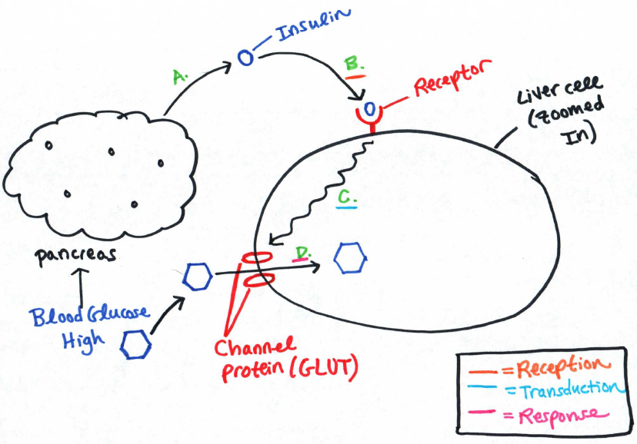
Changes in Signaling Pathways
Diabetes (normal pathway shown to the right)

