Slide 1
Unit 8, Part 3 Notes: Chromosomal Genetics
AP Biology, Mrs. Jensen

Slide 2
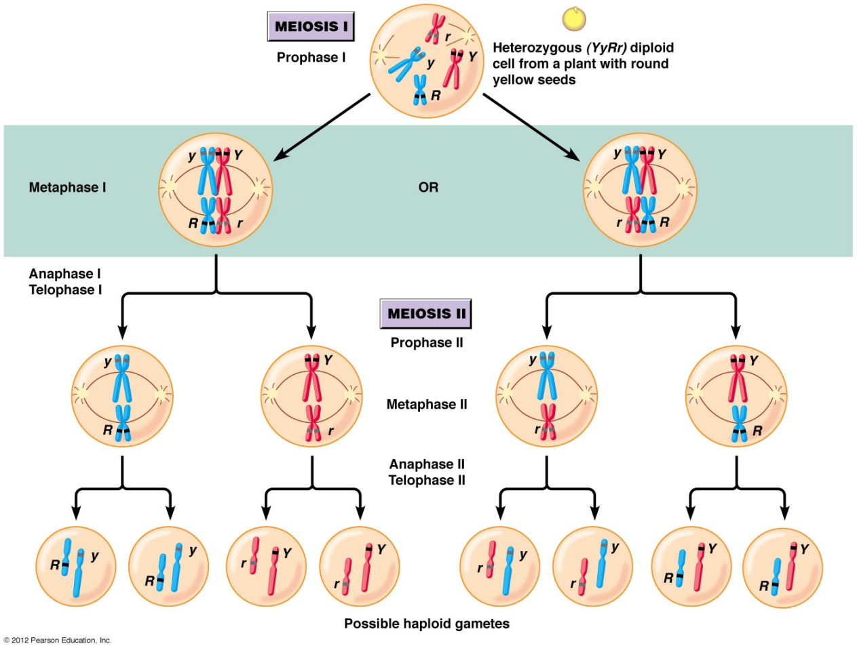
Law of Segregation and Independent Assortment Images

Slide 3
In the image of independent assortment we annotated (on the front of the first page of your notes), the plant could make four possible combinations of paternal and maternal chromosomes and therefore alleles in its gametes (R/Y = round/yellow, R/y = round/green, r/Y = wrinkled/yellow, and r/y = wrinkled/green)
We can find out the number of possible combinations in the gametes by doing the following calculation, 2^{Number of homologous} ^{chromosome pairs}
For the plant example, there are two pairs of homologous chromosomes, so the calculation would be 2² = 4 combinations
In human cells, there are 23 pairs of homologous chromosomes, so the calculation would be 2²³ = 8,388,608 possible combinations
Independent assortment is one of the reasons that no two sperm created by the same man contain the same genetic information and no two eggs created by the same woman contain the same genetic information… so this is one of the reasons you look different from your siblings (you were created from two different sperm and eggs!)

Slide 4
Law of Segregation Alternate Definitions
(aka principle of segregation)… two alleles must separate into gametes during formation of eggs and sperm
Each allele in a pair separates into a different gamete during gamete formation
The members of each pair of genes on homologous chromosomes end up in different gametes during meiosis

Slide 5
Law of Independent Assortment Alternate Definitions
(principle of independent assortment) Alleles of different genes are transmitted independently of one another
Each pair of alleles segregates independently during gamete formation… applies when genes for two traits are located on different pairs of homologous chromosomes
During meiosis, members of a pair of genes on homologous chromosomes tend to be distributed into gametes independently of other gene pairs

Slide 6
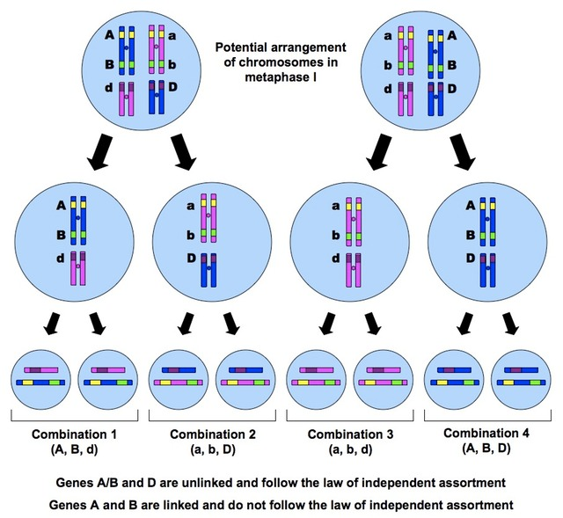
Linked Genes AND Unlinked Genes Image
This image is on the back of the first page of the notes
If A = Tall and a = short
If B = Brown eyes and b = blue eyes
If D = curly hair and d = straight hair
The genes for height and eye color appear to be linked (found on the same chromosome)… in this picture, it shows that A/B are linked and a/b, so they always end up together in the gametes (unless crossing over happens)
The gene for hair texture appears to be unlinked to the genes for height and eye color (found on a different chromosome), so D can end up with A/B or a/b (same with d)

Slide 7
Unlinked Genes
Follow the Law of Independent Assortment
If you cross two parents and track the inheritance of two unlinked genes using a dihybrid Punnett square, the offspring frequencies you get from the square will approximately match what you would find in a real mating (ex: a real man and woman have babies)
So we can use dihybrid Punnett squares to track the inheritance of two unlinked genes

Slide 8
Linked Genes
Do not follow the Law of Independent Assortment
The real offspring phenotype frequencies will NOT match what we would expect from a dihybrid Punnett square
Two phenotypes (ex: Tall/brown and Short/blue) are much more common than the other two (ex: Tall/blue and Short/brown)
The less common phenotypes are created through crossing over (Prophase I)
So… we can’t use a dihybrid Punnett square to predict offspring frequencies for two linked genes

Slide 9
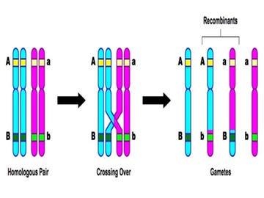
Crossing Over to Create “Recombinant” Chromosomes and Offspring Phenotypes
If no crossing over occurred, we would only have babies that are tall with brown eyes (A/B) and babies that are short with blue eyes (a/b)
If crossing over does occur, it can separate linked genes, which could result in a small number of babies that are tall with blue eyes (A/b) and short with brown eyes (a/B)

Slide 10
For an example of linked vs. unlinked genes in rabbits…
Please view the image posted to the Wiki page

