Slide 1
Unit 7, Part 1 Notes - DNA
AP Biology, Mrs. Jensen

Slide 2
DNA History
Griffith experiment (animation)
Avery, McCarty, and Macleod experiment (same animation as Griffith)
Hershey and Chase experiment (animation)
Franklin, Wilkins, Watson, and Crick

Slide 3
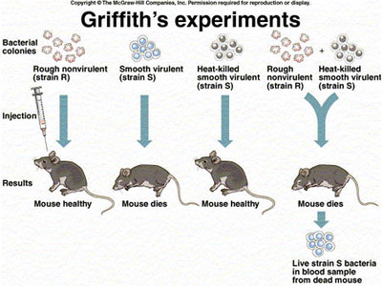

Slide 4
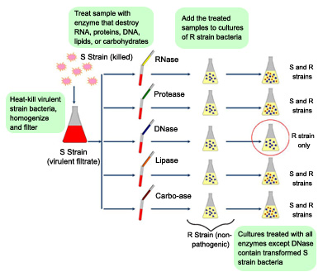
Avery, McCarty, and Macleod Experiment

Slide 5
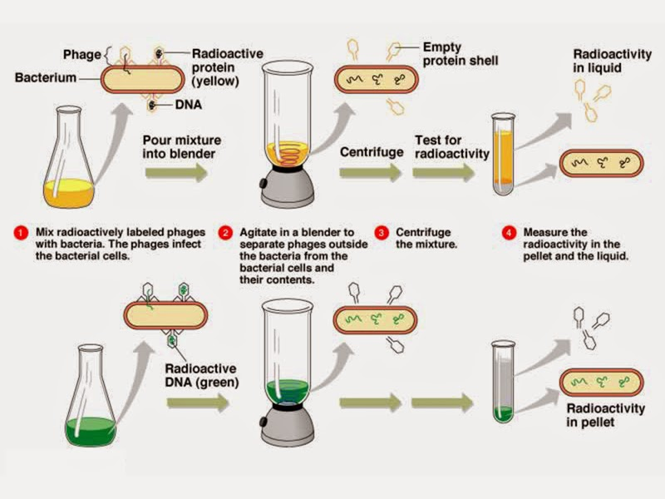
Hershey and Chase Experiment

Slide 6
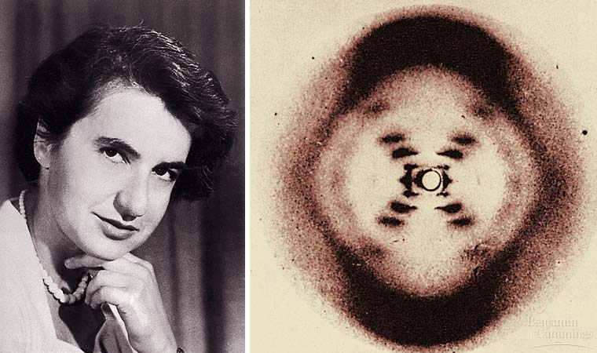
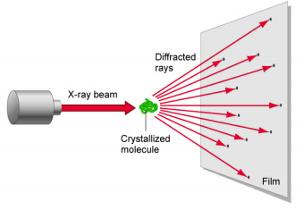
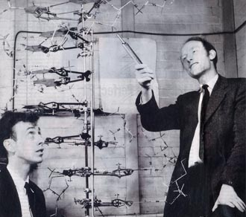
Franklin, Wilkins, Watson, and Crick

Slide 7
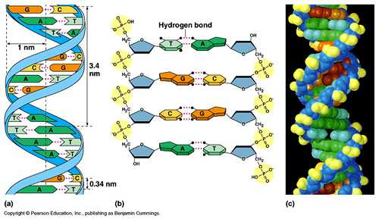
DNA Structure
Any questions from the notes packet? Questions 5-7
nucleotide
5’ vs. 3’ end
antiparallel
Chargaff’s rule
Purines vs. Pyrimidines

Slide 8
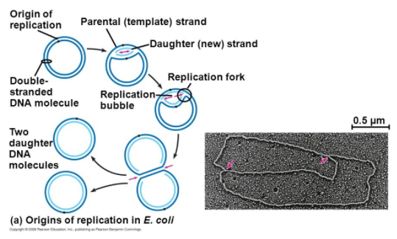
DNA Replication in Bacteria
1 Origin of replication
Replication bubble
Replication fork
Animation

Slide 9
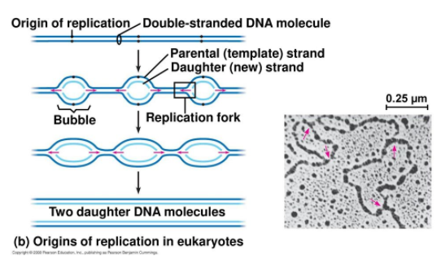
DNA Replication in Eukaryotes - #8

Slide 10
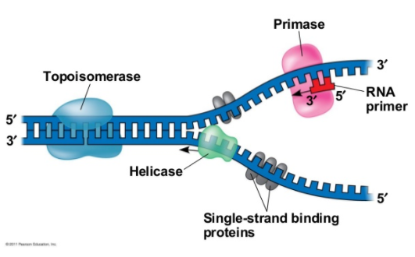
DNA Replication
Helicase
Single-strand binding proteins
Topoisomerase
Primase
Primer

Slide 11
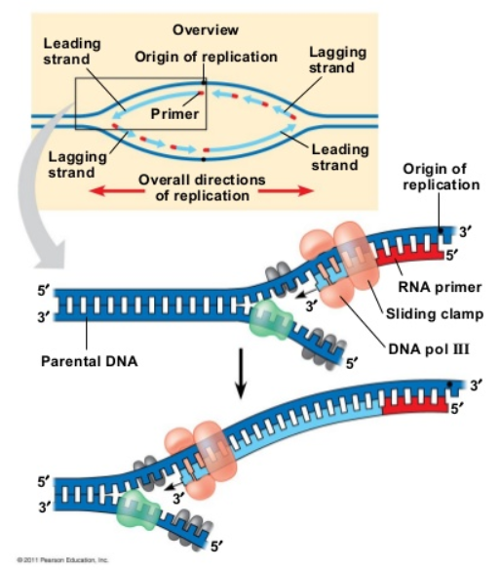
DNA Replication
DNA polymerase III
Can only build from 5’ -> 3’
The reason for this is because it
can only add to the 3’ end of a strand
5’ → 3’ 3’ 3’ 3’ 3’ 3’
Leading Strand
Built 5’ → 3’ INTO the replication fork

Slide 12
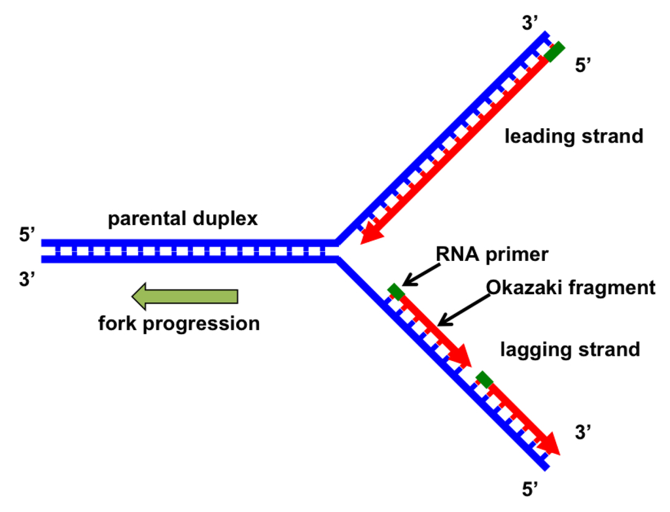
DNA Replication
Lagging Strand
Builds 5’ → 3’ OUT OF the replication fork
Okazaki fragments
DNA polymerase I removes
RNA & adds DNA in it’s place
Ligase

Slide 13
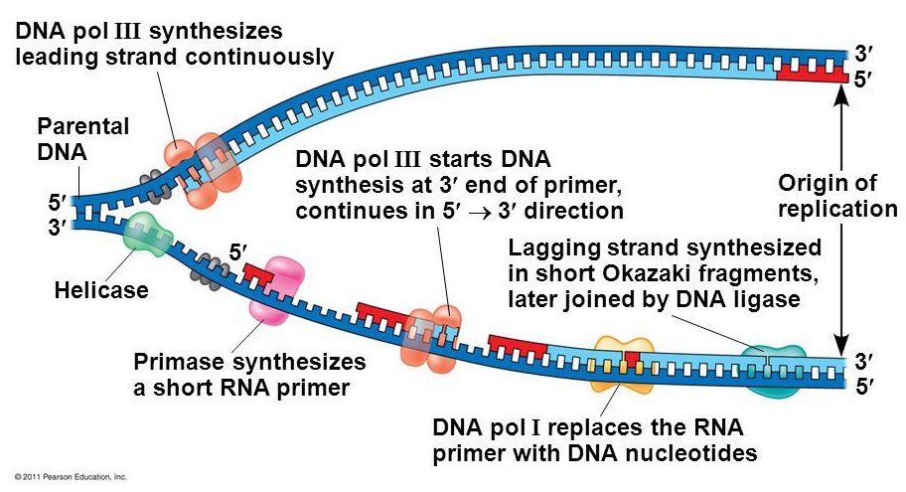
DNA Replication

Slide 14
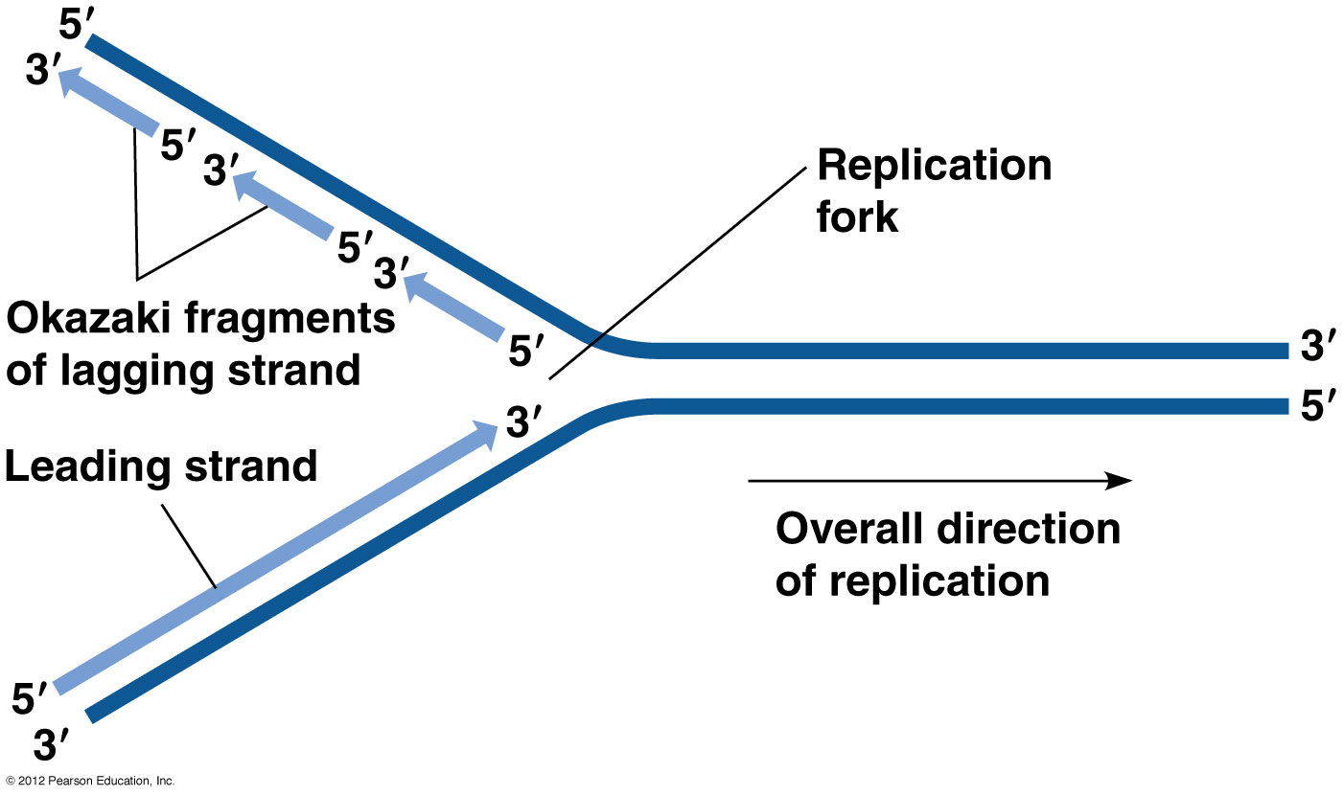
Leading vs. Lagging Strand: Close-Up of the Replication Bubble

Slide 15
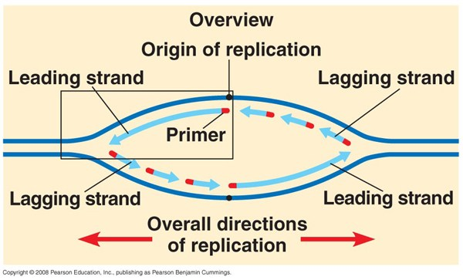
Leading vs. Lagging Strand: View of the Entire Replication Bubble – label all 5’ and 3’ ends

Slide 16
DNA Replication Animations
https://www.youtube.com/watch?v=Cw8GAPuhAk4
http://highered.mheducation.com/sites/0072507470/student_view0/chapter3/animation__dna_replication__quiz_1_.html

Slide 17
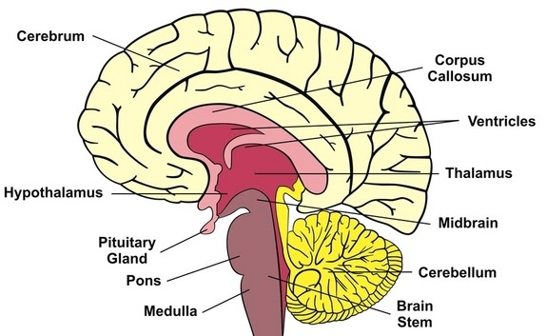
A genetic disorder relating to DNA replication: SCA1
Spinocerebellar ataxia type 1
Video of symptoms (begin at 13:30)
Genetics Home Reference Article
Affects the cerebellum (coordinates movements related to posture, balance, coordination, and speech)

Slide 18
CAG Repeats

Slide 19
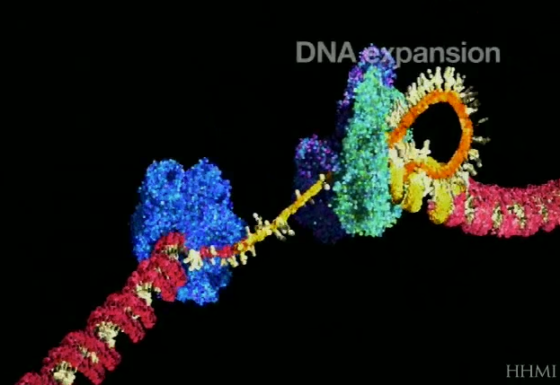
Slip by DNA Polymerase → more CAG repeats
Video (begin at 22:05)

Slide 20
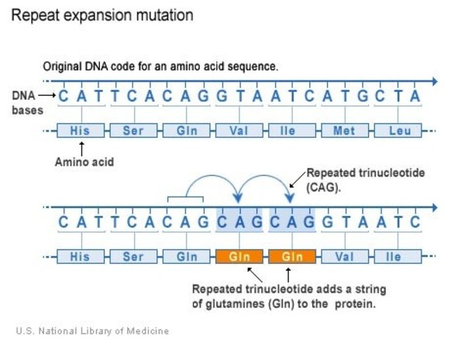
Effect on Protein
Polyglutamine

Slide 22
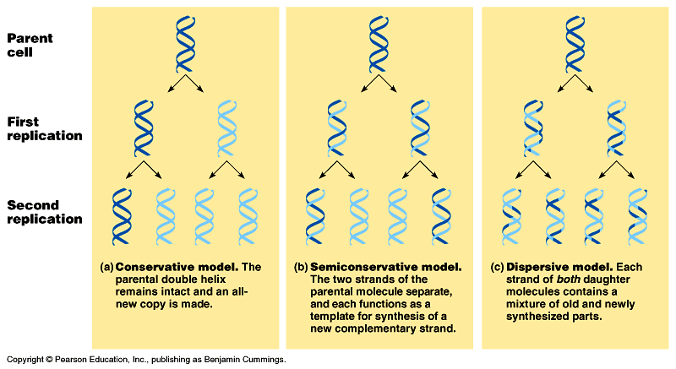
Models of DNA Replication

Slide 23
Meselson and Stahl Experiment*
Animation

Slide 24
DNA Proofreading & Repair
DNA Polymerase makes about 1 in 100,000 base pairing errors (mismatches) but then PROOFREADS AS IT’S BUILDING
Reduces rate to 1 in 10,000,000,000 base pairs
Nucleases / exonucleases

