Slide 1
Unit 7 Part 2 Notes: From Gene to Protein
AP Biology, 2017-2018

Slide 2
The Central Dogma of Molecular Biology
Gene on DNA → mRNA → polypeptide (all organisms!)
DNA vs. RNA
Transcription and Translation in Prokaryotic vs. Eukaryotic Cells

Slide 3
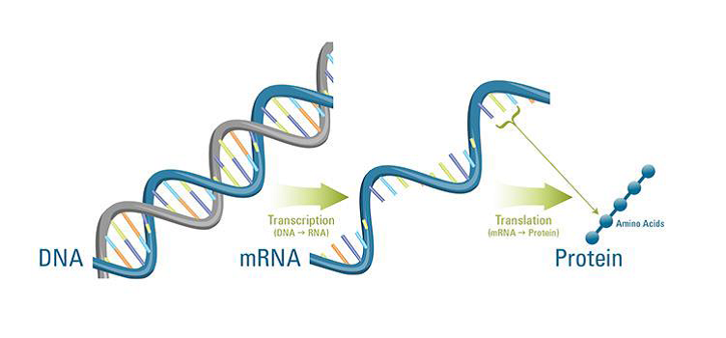
Gene on DNA → mRNA → polypeptide

Slide 4
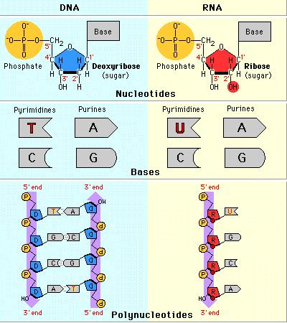
DNA vs. RNA

Slide 5
Transcription and Translation in Prokaryotic vs. Eukaryotic Cells

Slide 6
Types of RNA

Slide 7
Transcription: DNA → mRNA
DNA is used as a template to make a “copy” of the gene (instructions to make a protein) in mRNA form that can leave the nucleus.
Vocab Terms: Initiation (Promoter), Elongation (RNA Polymerase), Termination (Terminator Site)
McGraw-Hill Animation: Transcription
Read the DNA from its 3’ end, Build the RNA from its 5’ end
Important Distinction (see image on next slide):
-Template/Noncoding/Antisense
vs.
-Non-template/Coding/Sense

Slide 8
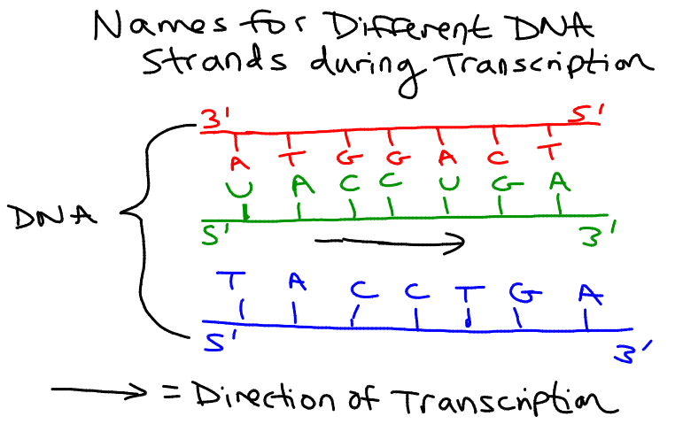

Slide 9
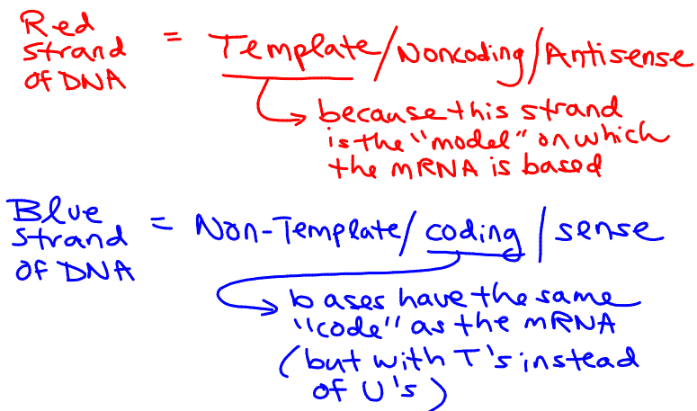

Slide 11
mRNA Processing
Vocab Terms: GTP cap, PolyA tail, intron, exon, small nuclear riboprotein (snRNP), spliceosome, alternative splicing, ribozyme
GTP “cap” → added to 5’ end to prevent degradation and allow it to bind to ribosome
PolyA “tail” → added to 3’ end to prevent degradation and allow mRNA to pass through nuclear pore

Slide 12
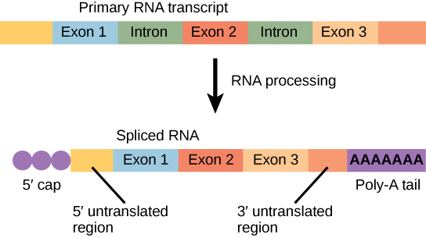
mRNA Processing – intron vs. exon
Removal of Introns from “pre-mRNA”

Slide 13
mRNA Splicing using a Spliceosome (groups of snRNPs)

Slide 14
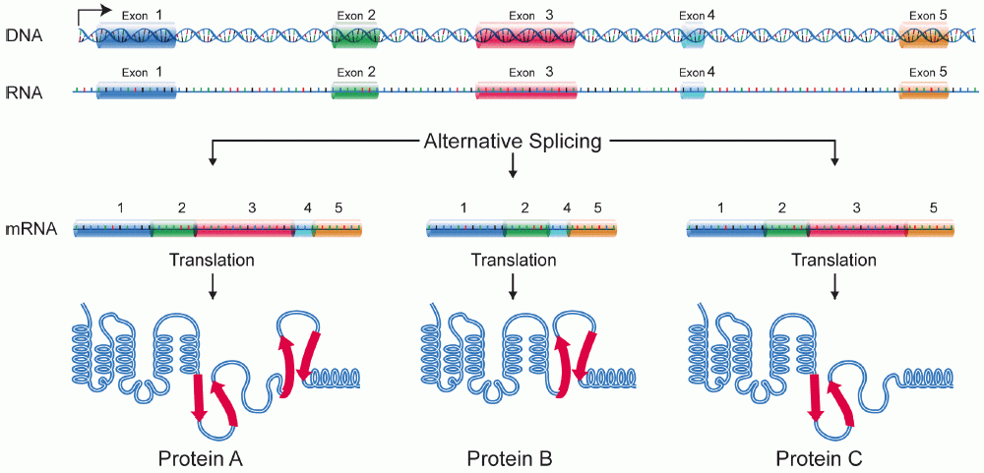
Alternative Splicing → different proteins!
https://highered.mheducation.com/sites/9834092339/student_view0/chapter16/animation_-_exon_shuffling.html

Slide 15
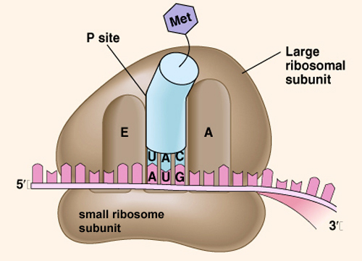
Translation (mRNA → Protein)
mRNA is “read” or translated by tRNA to make chains of amino acids (polypeptides) in the ribosome

Slide 16
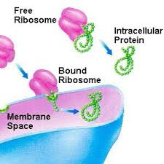
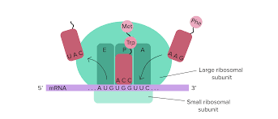
Translation: mRNA → polypeptide
Vocab: Ribosome (large and small subunits), attached/bound ribosomes, free/unbound ribosomes, A site, P site, E site, initiation, elongation, termination, codon, start codon, stop codon, anticodon, peptide bond, amino acid, polysomes

Slide 17
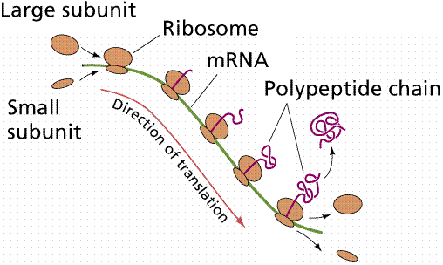
Polysomes
Multiple ribosomes translating an mRNA molecule at the same time…. First ribosome starts at the 5’ end of the mRNA and moves towards the 3’ end, leaving the 5’ end available for another ribosome to begin
Results in more efficient translation → more polypeptides created in a given amount of time from the same mRNA

Slide 18
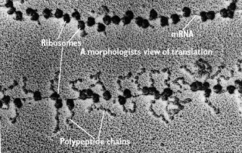
Polysomes

Slide 19
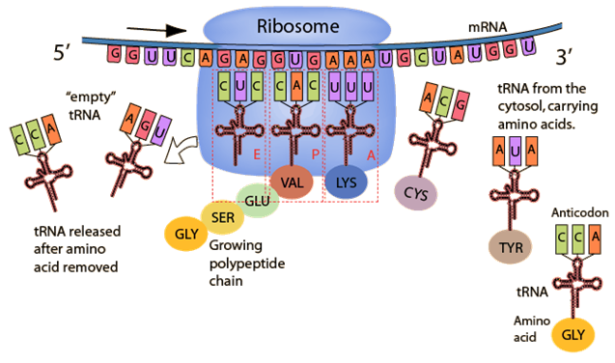
Translation – Initiation, Elongation, Termination
McGraw-Hill Animation: Translation

Slide 20
Translation Animation

Slide 21
Let’s See Translation in Action!
aa2
aa1
G
A
U
U
A
C
A
U
G
C
U
A
C
U
U
C
G
A
Notes:
21

Slide 22
peptide bond
aa3
aa1
aa2
G
A
A
U
A
C
G
A
U
A
U
G
C
U
A
C
U
U
C
G
A
Notes:
22

Slide 23
aa3
aa1
aa2
G
A
A
(leaves)
G
A
U
A
U
G
C
U
A
C
U
U
C
G
A
Notes:
23

Slide 24
aa1
aa4
aa2
aa3
G
C
U
G
A
U
G
A
A
A
U
G
C
U
A
C
U
U
C
G
A
A
C
U
Notes:
24

Slide 25
aa1
aa4
aa2
aa3
(leaves)
G
C
U
G
A
A
A
U
G
C
U
A
C
U
U
C
G
A
A
C
U
Notes:
25

Slide 26
aa5
aa1
aa2
aa4
aa3
U
G
A
G
A
A
G
C
U
G
C
U
A
C
U
U
C
G
A
A
C
U
Notes:
26

Slide 27
aa1
aa5
aa2
aa3
aa4
U
G
A
(leaves)
G
C
U
G
C
U
A
C
U
U
C
G
A
A
C
U
Notes:
27

Slide 28
aa5
aa4
Stop Codon says STOP TRANSLATING!
aa199
aa3
aa200
aa2
aa1
A
C
U
C
A
U
G
U
U
U
A
G
Notes:
28

Slide 29
“Redundancy in the Genetic Code”
64 different codons code for 20 different amino acids → redundancy in the genetic code – several codons will code for the same amino acid
3rd base “wobble” = codons for the same amino acid often differ in the 3rd base
AUG = start codon, begins translation of mRNA (initiation);
UAA, UAG, and UGA are stop codons; ends translation of mRNA (termination)

Slide 30
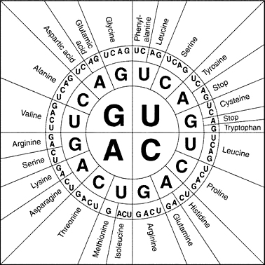
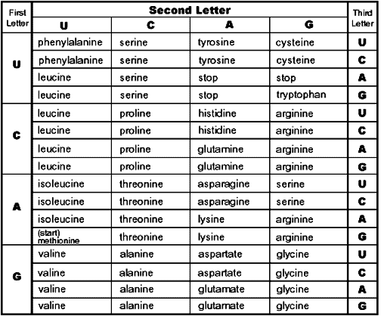
USE THE mRNA CODONS TO READ THESE!!!
3rd Base Wobble

Slide 31
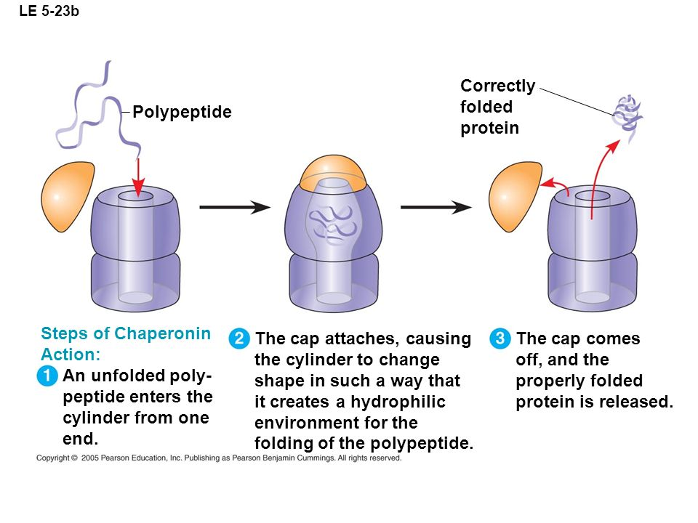
Post-Translational Modifications (modifying the polypeptide after it’s been created)
Chaperonins

Slide 32
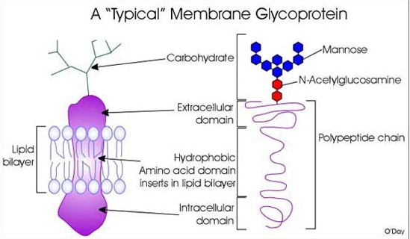
Post-Translational Modifications
Adding molecular groups (ex: adding a carbohydrate chain to a protein to create a glycoprotein, which is used to help cells recognize each other)

Slide 33
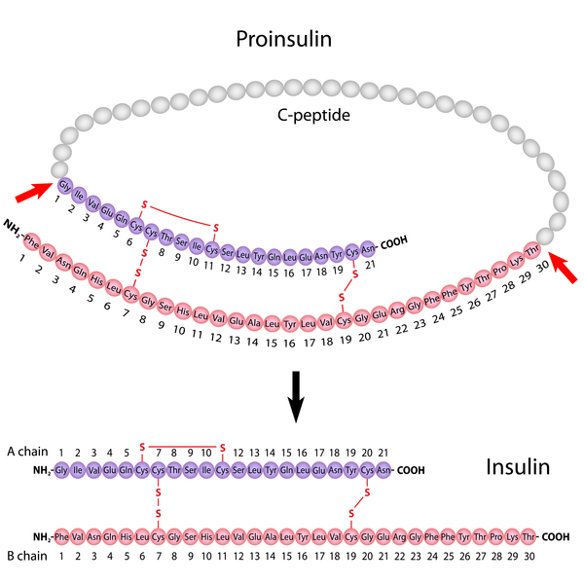
Post Translational Modifications
Removal of amino acids from pro-insulin to create insulin

Slide 34
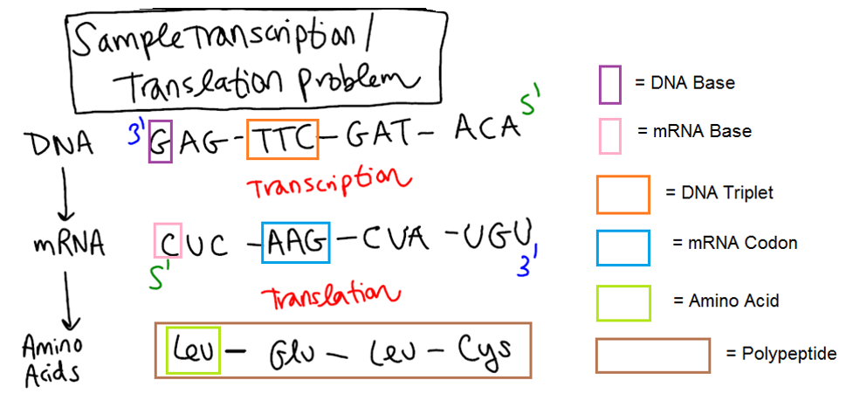
Vocabulary Clarification

Slide 35
Direction of DNA Replication, Transcription and Translation Clarification -DNA is always built in the 5’ → 3’ direction by DNA polymerase III

Slide 36
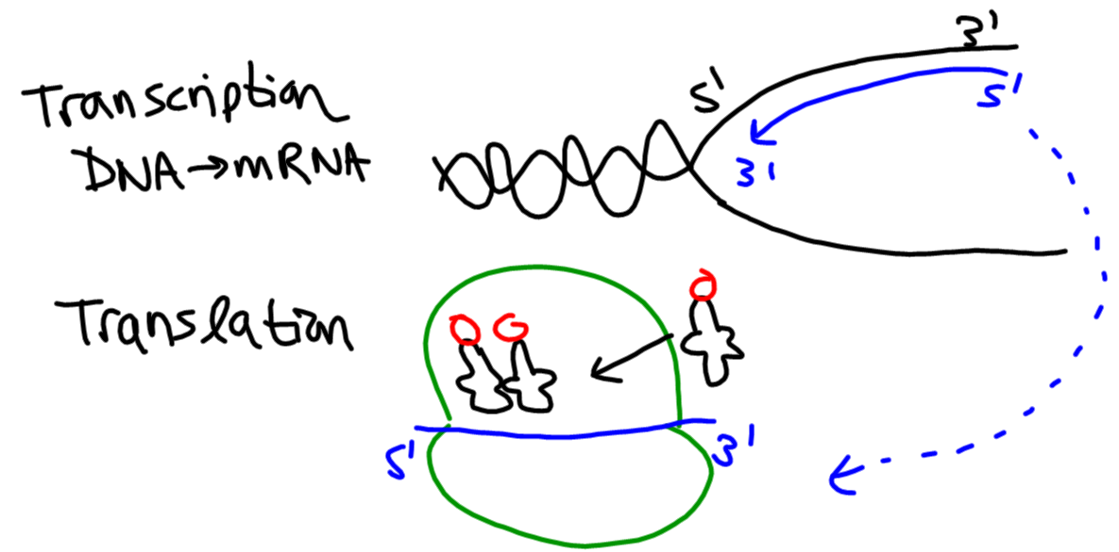
Direction of DNA Replication, Transcription and Translation Clarification mRNA is also built in the 5’ → 3’ direction by RNA polymerase – the ribosome then starts at the 5’ end of the mRNA to make an amino acid.

Slide 37
Errors in the DNA, RNA, and Protein Sequence
Vocab Terms: Mutation, mutagen, carcinogen (cancer-causing mutagen)
Major Chromosomal Mutations: Duplication, inversion, insertion, translocation, deletion (add this one)
Base Change / Gene Mutations:
-Point Mutation (aka substitution): silent, missense, nonsense
-Frameshift Mutation: insertion, deletion

Slide 38
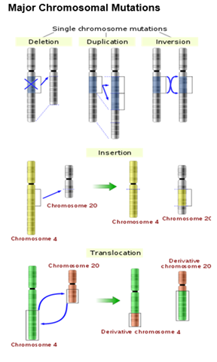
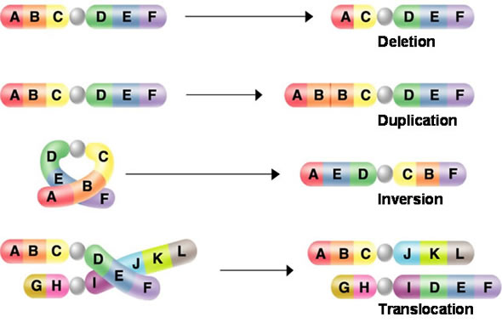
Major Chromosomal Mutations

Slide 39
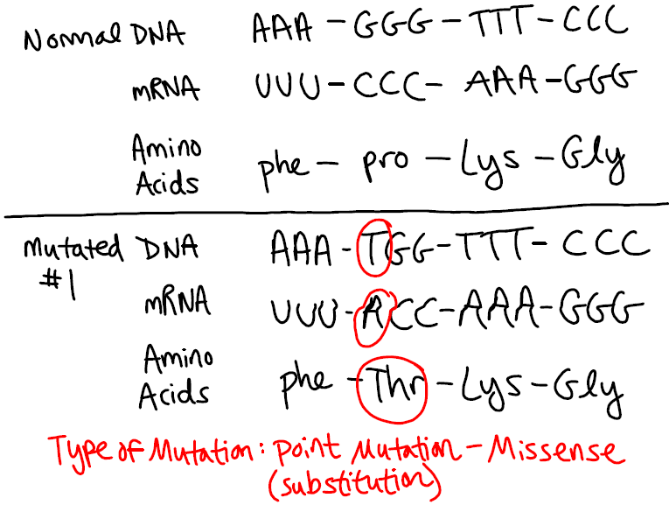
Point Mutation – an incorrect base is substituted for the correct one.

Slide 40
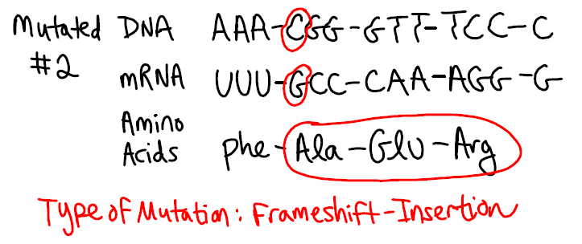
Frameshift Mutation – a new nucleotide is added to or deleted from the existing nucleotides

