Slide 1
The Immune System
Unit 5 Part 4 – A Brief Overview

Slide 2
Purpose of the Immune System
Protect from internal attacks from abnormal body cells (cancerous cells)
Protect from external pathogens
Can enter the body through any systems that have openings on the exterior of the body
Can travel though the circulatory AND lymphatic system

Slide 3
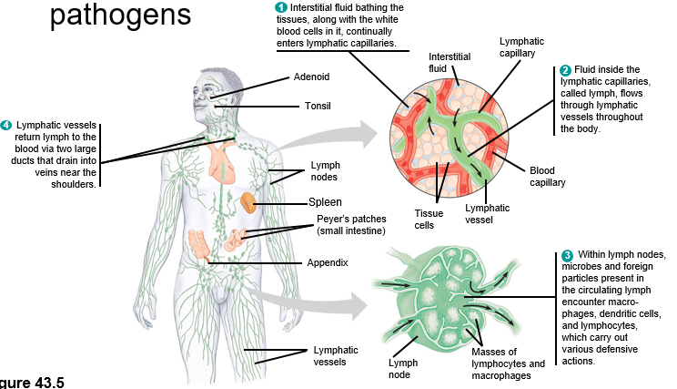
Parts of the Immune System
Lymph Vessels
Lymph Nodes
Spleen
Adenoids
Bone Marrow
Thymus

Slide 4
Two types of Immune Responses
Innate – immune responses that an organism is born with
Very general, and will attack any “foreign” substance (pathogens)
Specific – developed over time in response to encounters with pathogens

Slide 5
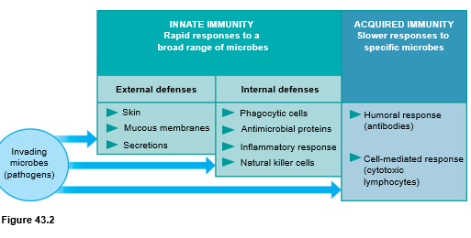

Slide 6
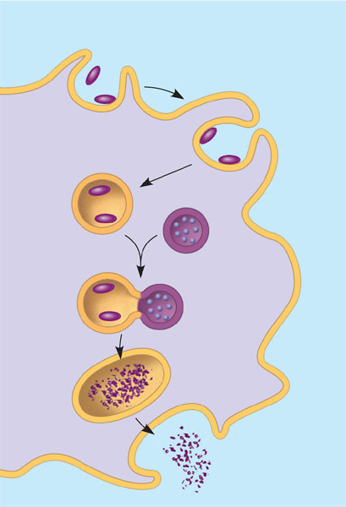
Innate Immune Responses
Pseudopodia
surround
microbes.
1
Phagocytic Cells (cells that consume and destroy any pathogens)
Macrophages (Antigen Presenting Cells)
Microbes
Microbes
are engulfed
into cell.
2
MACROPHAGE
Vacuole
containing
microbes
forms.
3
Vacuole
Lysosome
containing
enzymes
Vacuole
and lysosome
fuse.
4
Toxic
compounds
and lysosomal
enzymes
destroy microbes.
5
Microbial
debris is
released by
exocytosis.
6

Slide 7
Specific Immune Response - Helper T Cell
APC (innate immune response) will “eat,” chop up, and “present on its membrane” any pathogen it encounters.
The APC will then bind with a Helper T Cell, which then initiates the specific immune response
Helper T Cells are the connection between Innate and Specific Responses.
Helper T Cells trigger the activation of lymphocytes (WBC):
B Cells
T Cells

Slide 8
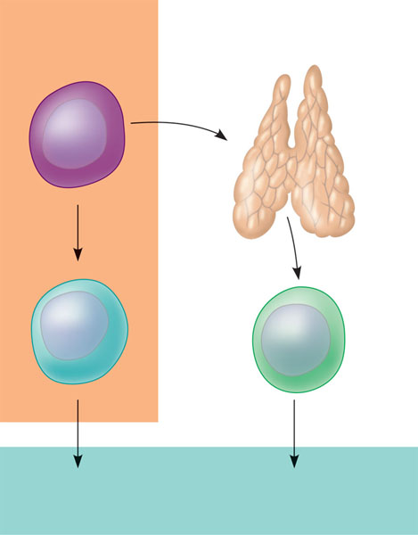
Newly formed lymphocytes are all alike
But they later develop into B cells or T cells, depending on where they continue their maturation
Bone marrow
Lymphoid
stem cell
Thymus
B cell
T cell
Blood, lymph, and lymphoid tissues
(lymph nodes, spleen, and others)
Figure 43.10

Slide 9
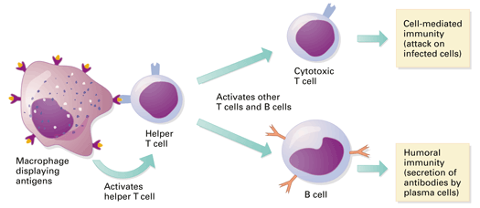
Activation of Specific Immune Response

Slide 10
B Cells (lymphocytes)
HUMORAL IMMUNITY: patrols the liquids (“humors”) of the body & neutralize naked/free-floating pathogens
PURPOSE OF B CELLS: create ANTIBODIES (Y-shaped proteins that bind to specific pathogens and cause them to clump together)
Plasma B Cells = actively making antibodies that match the pathogen presented by the APC
Memory B Cells = “powered down robots” ready to go for the next infection. They don’t do anything during 1st infection, but quickly convert to plasma B cells upon a “return” of the pathogen so antibodies can be made right away.

Slide 11
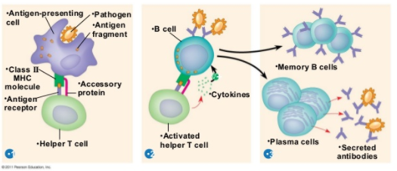

Slide 12
T Cells (lymphocytes)
CELL-MEDIATED IMMUNITY: regulates destruction of cells already infected
PURPOSE OF T CELLS: find and kill cells that have been infected
Active Cytotoxic/Killer T Cells = bind to antigens displayed on the infected body cells and release perforins that break apart the cell membrane (induce cell death!)
Memory Cytotoxic/Killer T Cells = “powered down robots” ready to go for the next infection. They don’t do anything during 1st infection, but quickly convert to cytotoxic T cells upon a “return” of the pathogen.

Slide 13
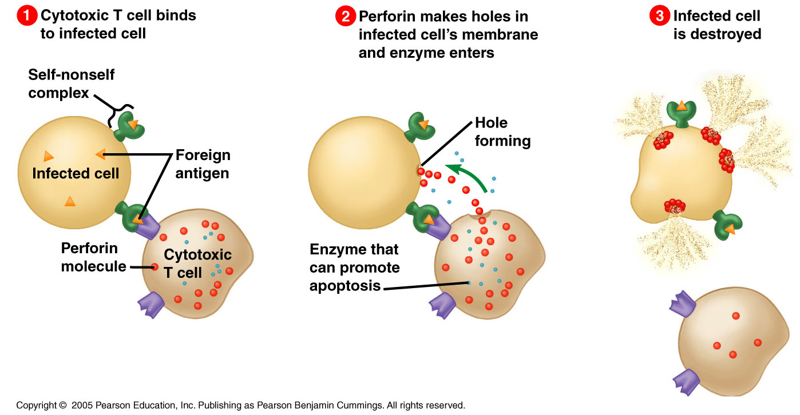

Slide 14
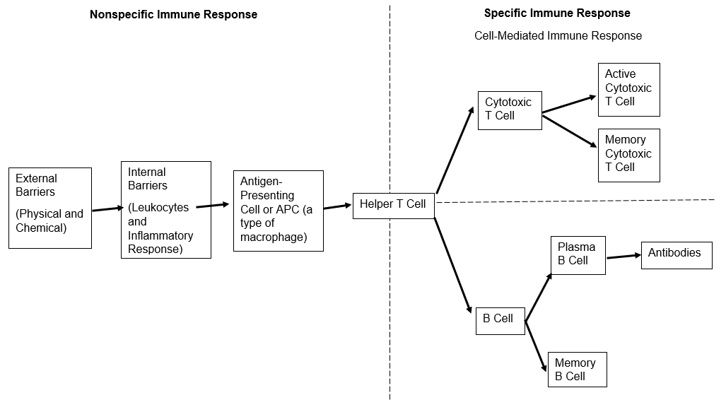
Summary of Immune System Interactions

Slide 15
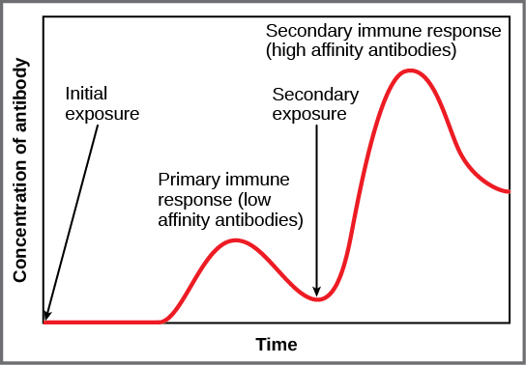
Secondary Immune Response (AKA Immunological Memory)
Secondary Immune Responses are always faster and stronger than the initial response from first exposure.
Memory B Cells and Memory T Cells are already made and ready to go!

Slide 16
Active vs. Passive Immunity
ACTIVE IMMUNITY
Individual making their own antibodies
Long-lasting
Natural – antibodies made from real exposure to infection
Artificial – antibodies made from exposure to a vaccine
PASSIVE IMMUNITY
Antibodies are transferred from another organism
Short-lasting
Natural – mothers pass on antibodies through placenta/ breast milk
Artificial – made in one organism, then injected into another

Slide 17
Autoimmune Diseases
“Auto” = self
When T cells and B cells fail to recognize the body cells as “self cells” and attack them as they would a pathogen.
Examples: AIDS, Type 1 Diabetes, Lupus, Multiple Sclerosis (MS), Rheumatoid Arthritis, Psoriasis

