Slide 1
Meiosis

Slide 2
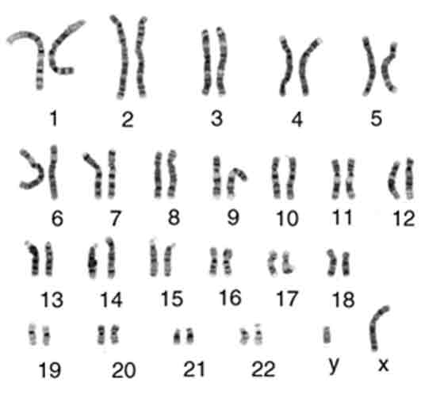
Vocabulary
Karyotype
Sex Chromosome vs. Autosomes
Homologous Chromosomes
Gamete vs. Zygote

Slide 3
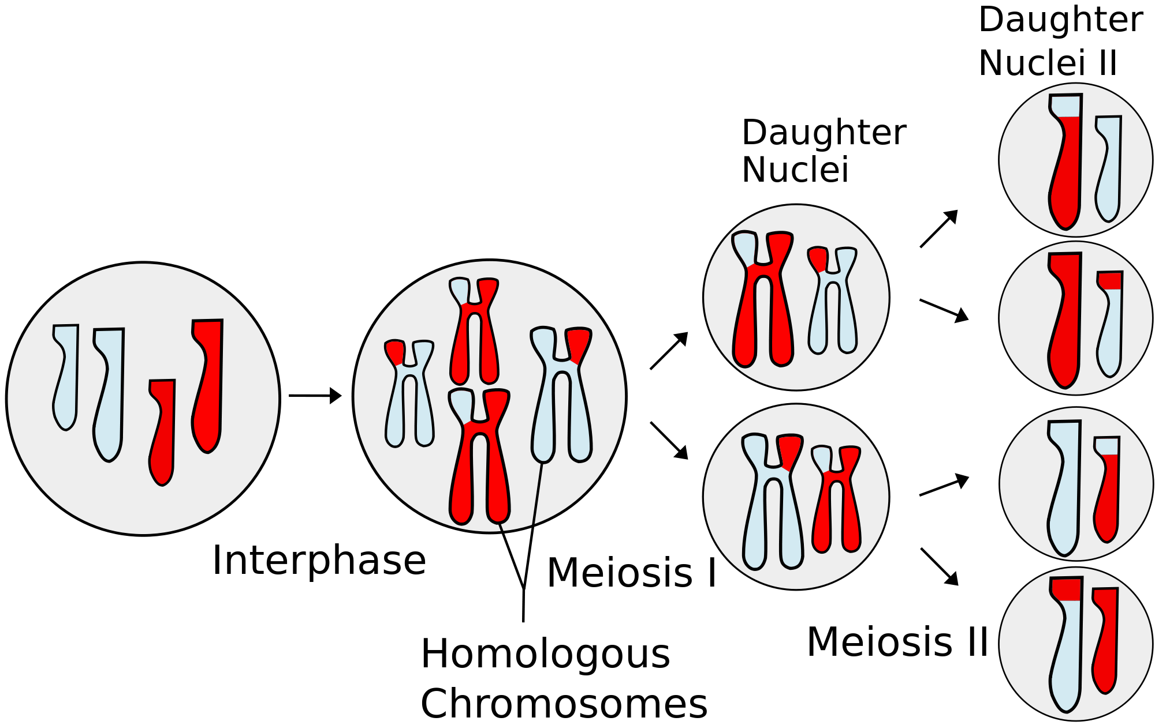
Meiosis
Produces four genetically unique gametes with half of the normal amount of genetic material
Required for sexual reproduction
We call it “Reduction Division”

Slide 4
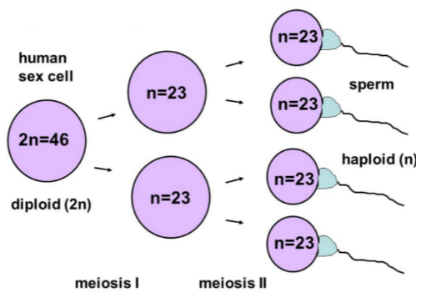

Slide 5
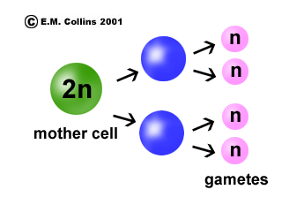
Mitosis vs. Meiosis Comparison
Characteristic | Mitosis | Meiosis
Goal | Making new body cells (somatic cells) ; asexual reproduction ; growth and replacement of dead cells | Making sex cells (gametes) ; sexual reproduction
Ends with (Daughter Cells) | Two diploid cells (2n) that are genetically identical to the parent cell | Four haploid cells (n) that are genetically different from the parent cell and each other
# of Divisions | One | Two (meiosis I and II)
Location | In all body cells | In the gonads (ovaries or testes)
Picture

Slide 6
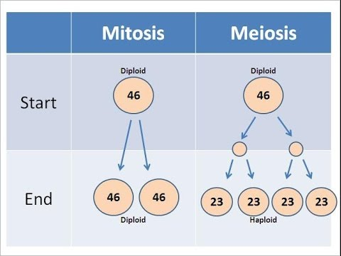

Slide 7
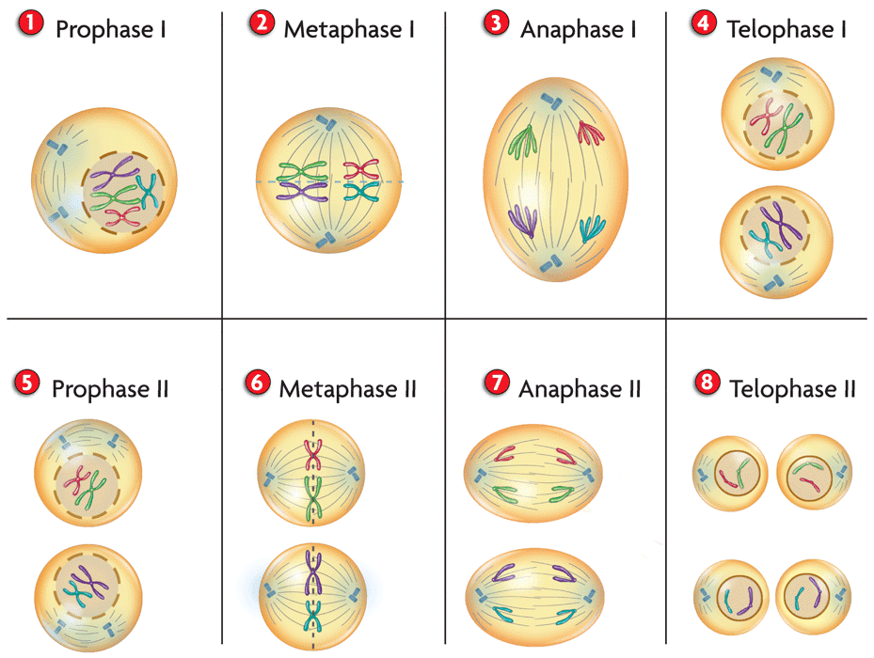

Slide 8
Starting Material for Meiosis - Interphase

Slide 9
Prophase I -“synapsis” = chromosome pairing -“tetrad” -“crossing over” -“chiasma”

Slide 10
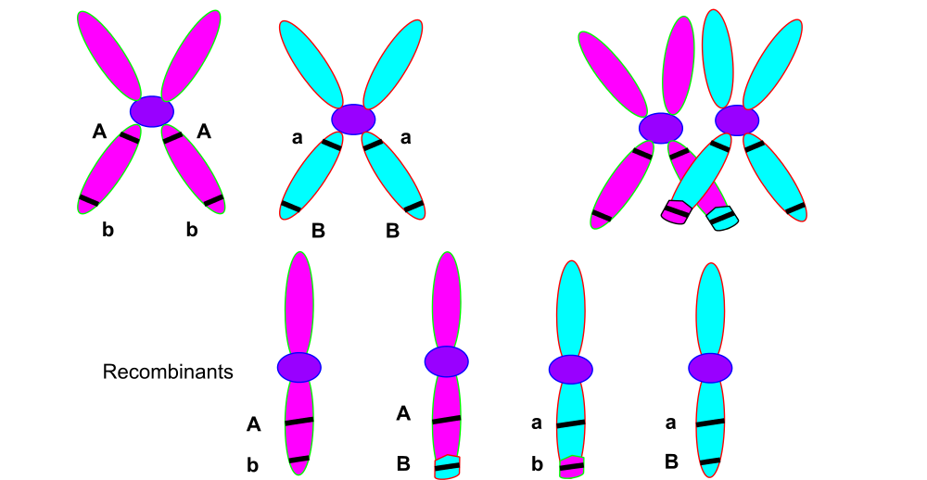
Crossing Over (prophase I)
Homologous pairs of chromosomes exchange DNA.
Produces genetically unique chromosomes.

Slide 11
Metaphase I -homologous chromosomes line up in PAIRS (different from mitosis) -Independent Assortment

Slide 12
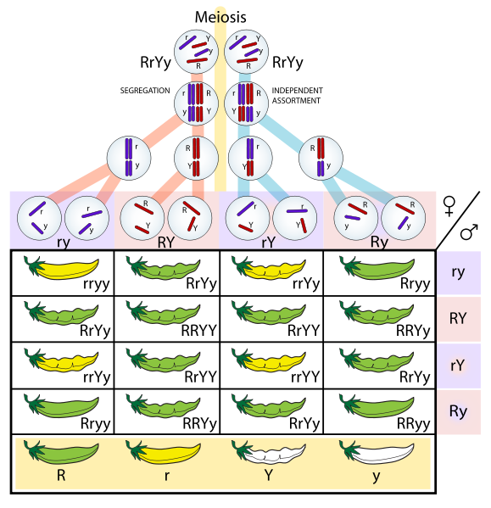
Independent Assortment
During metaphase 1, homologous pairs line up together on the metaphase plate.
The alignment of one pair has no effect on any other pair
(how each pair lines up is RANDOM and does NOT depend on any other).

Slide 13
Anaphase I -The homologous chromosome pairs are separated and pulled to opposite sides of the cell. (notice that each chromosome remains duplicated)

Slide 14
Telophase I

Slide 15
Cytokinesis
Cytoplasm of cells actually divide and form 2 HAPLOID daughter cells
Remember: plant cells use cell plates, while animal cells form cleavage furrows.

Slide 16
Meiosis II
NO INTERPHASE before Meiosis II
Next stages are identical to Mitosis, except it would be happening twice because two cells were made from Meiosis I

Slide 17
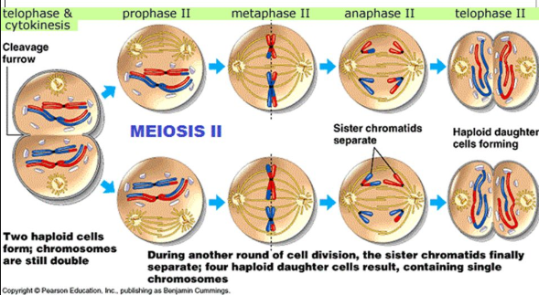

Slide 19
Meiosis I is the “REDUCTIVE DIVISION”

Slide 20
Advantages of Sexual Reproduction
Crossing Over
Independent Assortment
Which Sperm Fertilizes which egg
“genetic variation”

Slide 21
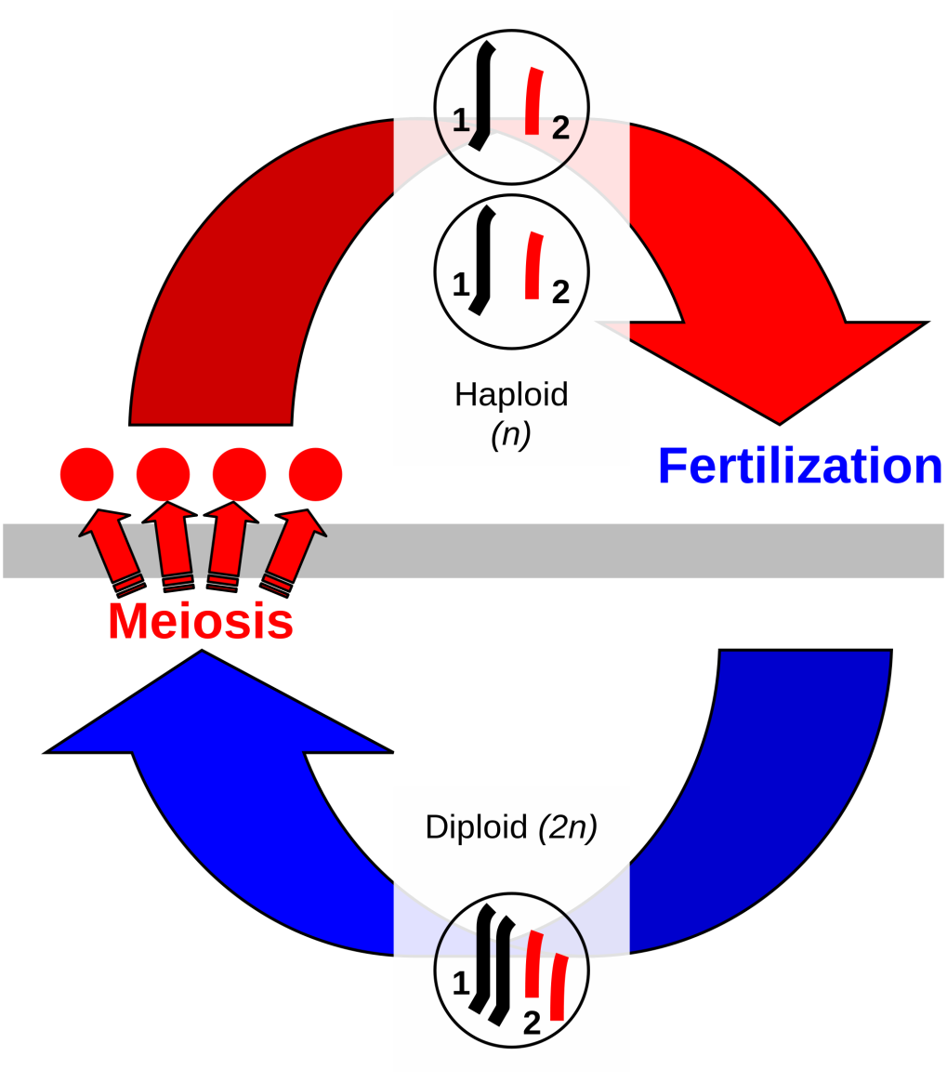
Meiosis, Sex, and Variation
The events of meiosis and the sexual life cycle generate a tremendous amount of variation.
Every organism that is produced through sexual selection is genetically unique.

Slide 22
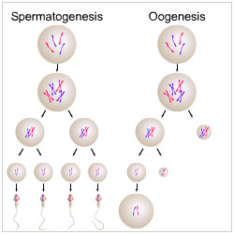
Meiosis in Humans -polar bodies

Slide 23
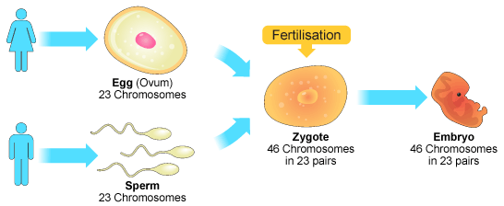
What comes next?

Slide 24
Nondisjunction
“Aneuploidy” = abnormal number of chromosomes
Due to either:
A homologous chromosome pair fails to separate during Anaphase I.
The sister chromatids within a single chromosome fail to split correctly during Anaphase II.

Slide 25
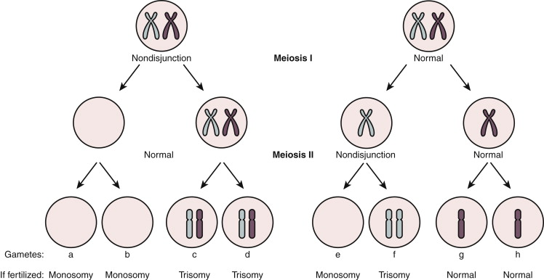

Slide 26
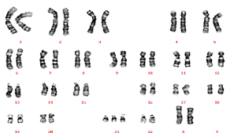
Karyotype – shows gender and nondisjunction

