Slide 1
Mendelian Genetics

Slide 2
Vocab
Phenotype vs. Genotype
Homologous chromosomes
Gene vs. Allele
Dominant vs. Recessive
Homozygous vs. Heterozygous
Genotype Letters | Genotype Descriptions | Phenotypes
BB | Homozygous Dominant | Dominant (Brown Eyes)
Bb | Heterozygous | Dominant (Brown Eyes)
bb | Homozygous Recessive | Recessive (Blue Eyes)

Slide 3
Meiosis Review
Because pairs of homologous chromosomes must divide during meiosis to create eggs and sperm (i.e., gametes) with half the chromosomes found in a normal body cell, each gamete only receives one allele (one of the two homologous chromosomes) for a particular trait.
Therefore, when fertilization occurs, a zygote (and later baby) will receive one allele from each parent.

Slide 4
Drawing of Meiosis Tracing Alleles

Slide 5
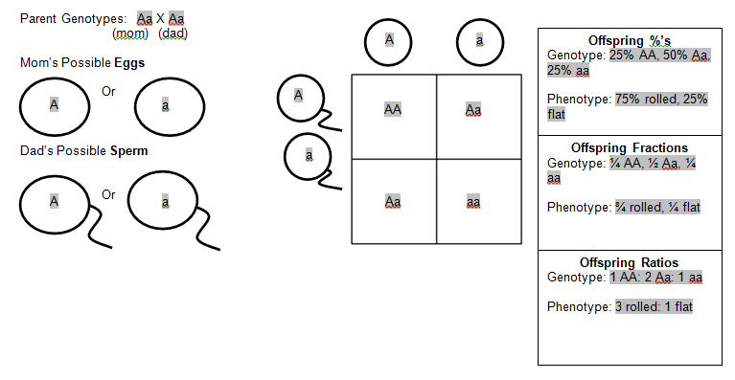

Slide 6
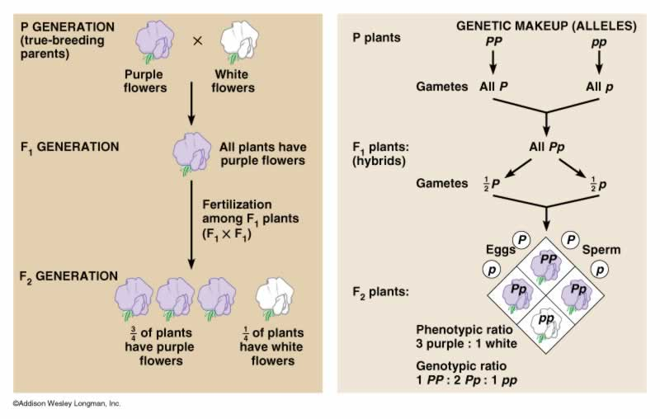
Mendel’s Experiments
Purebred vs. Hybrid
P – pure opposites
F1 – “children” – all heterozygotes
F2 – “grandchildren” –
1:2:1 ratio

Slide 7
Probability
Multiplication Rule = Having BOTH traits (this trait AND this trait)
Addition Rule = Having one trait OR another trait
**Note: For this to work, it has to be IMPOSSIBLE for the two events to occur at the same time. For example, we could not use the addition rule of probabilities to determine the probability of offspring having white flowers OR green leaves because these two events could occur at the same time.

Slide 8
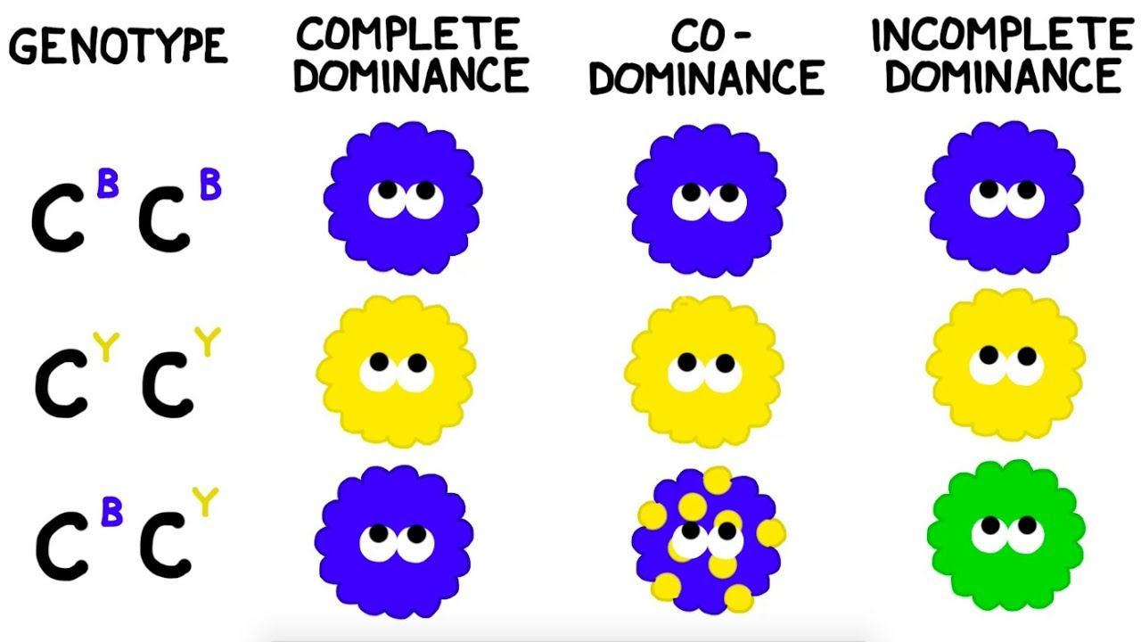
Incomplete vs. Codominance
Incomplete dominance occurs when a heterozygous individual has a “blend” of the two phenotypes.
Codominance occurs when heterozygous individual displays both traits in their pure form.
What does this look like in a Punnett square?

Slide 9
Sex-Linked
Sex-Linked traits occur when the gene is located on the sex chromosome (usually the X)
Can be X-linked Recessive or X-linked Dominant
Females can be carriers for a recessive X-linked trait, but not show it
X^{H}X^{h} (dominant phenotype, but carries the allele for the recessive trait)
Males cannot be carriers for X-linked traits (cannot be heterozygotes)
X^{H}Y or X^{h}Y
What does this look like in a Punnett square?

Slide 10
2 Traits at once – Dihybrid Crosses – what it looks like in terms of Meiosis
Parent 1: PpGg
Parent 2: PpGg

Slide 11
Trick to solve them…
Parent 1: PpGg
Parent 2: PpGg
Gamete 1 = F (the FIRST allele for each trait) = PG
Gamete 2 = O (the OUTER allele for each trait) = Pg
Gamete 3 = I (the INNER allele for each trait) = pG
Gamete 4 = L (the LAST allele for each trait) = pg

Slide 12
9 dominant / dominant : 3 dominant / recessive : 3 recessive / dominant : 1 recessive / recessive

Slide 13
Shortcut for dihybrids! Use probability rules!
Probability of having one trait and the probability of having the other, then MULTIPLY!

