Slide 1
Mitosis and the Cell Cycle

Slide 2
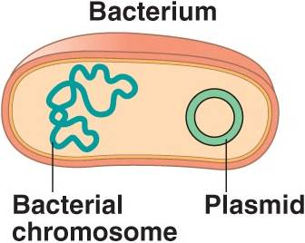
DNA Organization in Prokaryotes
Circular Chromosome
Plasmids
Genome
“Prokaryote”
No Nucleus
No membrane bound organelles

Slide 3
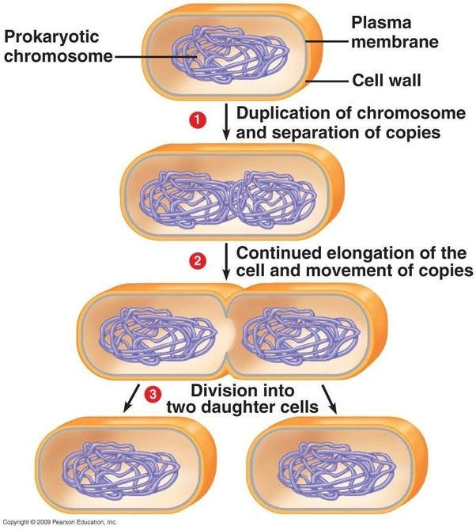
Prokaryote Reproduction
Asexual Reproduction
1 parent
Offspring identical to parent
100% of DNA comes from that parent
Binary Fission
Not mitosis because there is no nucleus

Slide 4
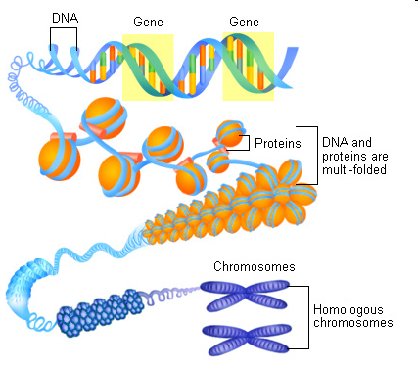
All eukaryotic organisms contain DNA that is loosely wrapped around proteins called histones. This loose arrangement of DNA and histone proteins is called chromatin.
Before cell division in eukaryotic cells, the parent cell copies its DNA. This is called DNA replication

Slide 5
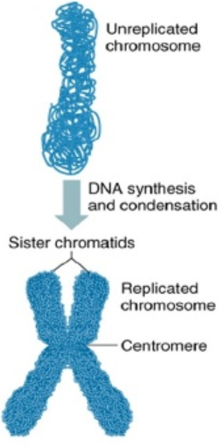
Before cell division in eukaryotic cells, the parent cell copies its DNA (DNA replication).
Later, the chromatin coils up tightly into X-shaped chromosomes (they are X-shaped because they are duplicated chromosomes). The two sides of each X-shaped chromosome are identical copies of DNA called chromatids or sister chromatids. (Remember, one copy of the DNA was created during DNA replication.)
The chromatids are connected by the centromere.

Slide 6
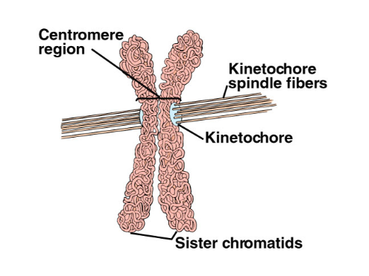
Centromere
Kinetochore
Spindle Fibers

Slide 7
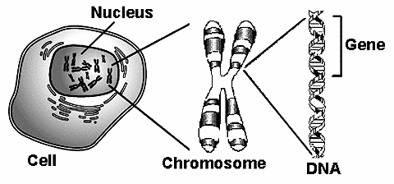
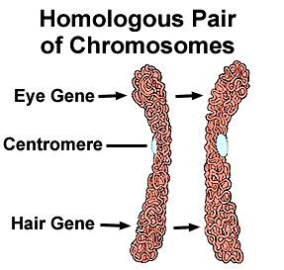
Homologous Chromosomes
46 chromosomes
23 “matching” pairs
Genes
One maternal/One paternal

Slide 8
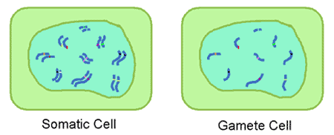
Somatic (diploid) vs. Gametes (haploid)

Slide 9
Why Divide???
Not enough DNA: “DNA overload”
Not enough membrane: divide to get a higher SA:V
Can’t get needed materials in fast enough or bad wastes out fast enough
**It’s a little more complicated than this, but we’ll learn more details in Unit 6 Part 3.

Slide 10
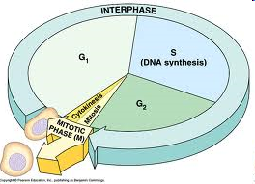
Cell Cycle vs. Mitosis vs. Cytokinesis

Slide 12
Interphase – normal cell activities (90% of time)
G1 (Growth through production of organelles)
S (Synthesis of DNA)
G2 (Makes items needed for division)
Sometimes G0 (Stage of non-division) → offshoot of G1

Slide 13
Mitosis – making identical diploid daughter cells
Unicellular Organisms | Multicellular Organisms
Reproduction only | Replacing cells that die from normal wear and tear Growth and development from a single fertilized egg (zygote) Reproduce asexually (ex: plants can grow by “grafting” / “cutting”)

Slide 14
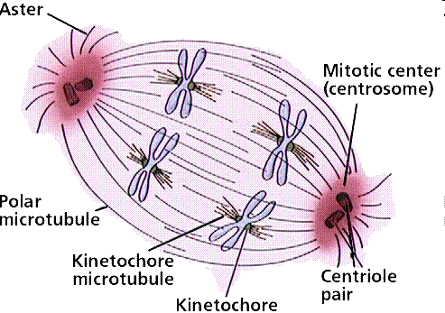
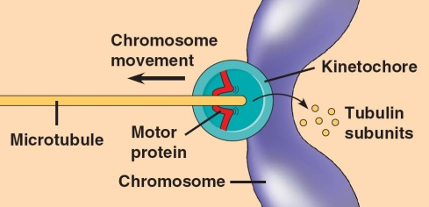
What does the cell need to divide?
Mitotic Spindle
Microtubules
Centrosome
Centriole
Motor Protein

Slide 15
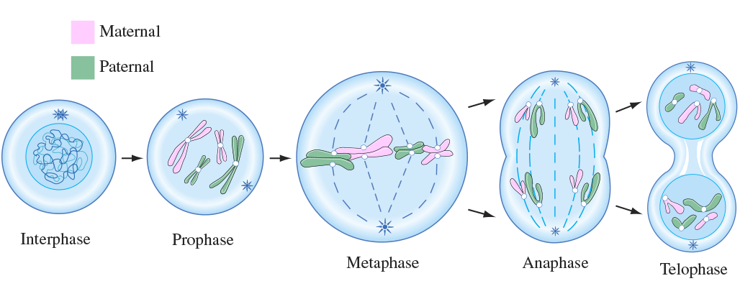

Slide 16
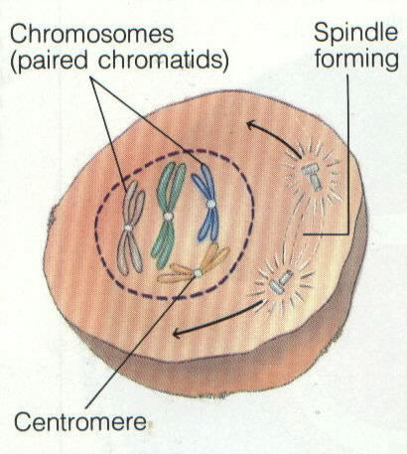
PROPHASE

Slide 17
Steps of MITOSIS
PROPHASE
Nuclear membrane and nucleolus is broken down
2. Chromatin coils into chromosomes
3. Centrioles migrate toward opposite poles (plants DON’T have centrioles)
4. Spindle forms

Slide 18
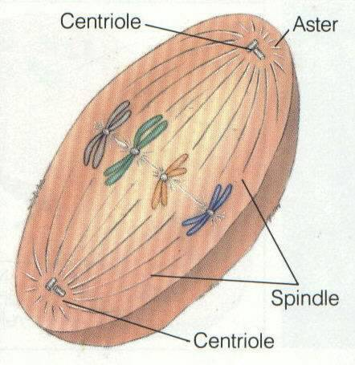
METAPHASE

Slide 19
Steps of MITOSIS
METAPHASE
Spindle fibers attach to chromosomes
Chromosomes align on the equatorial plane

Slide 20
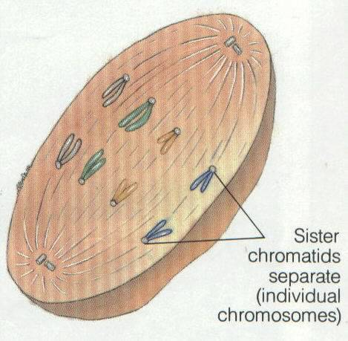
ANAPHASE

Slide 21
Steps of MITOSIS
ANAPHASE
Spindle fibers pull chromatids apart and move to opposite ends
Other spindle fibers lengthen the cell

Slide 22
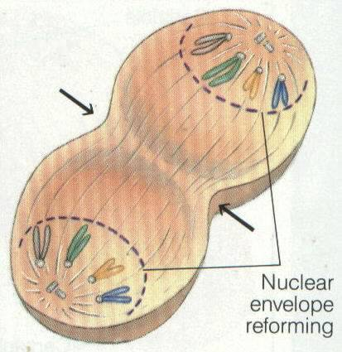
TELOPHASE

Slide 23
Steps of MITOSIS
TELOPHASE
chromosomes stop moving and uncoil into chromatin
Nuclear membrane and nucleolus reform
Mitotic spindle breaks down

Slide 24
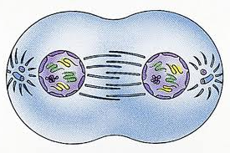
Which Stage?
Notes:
telophase

Slide 25
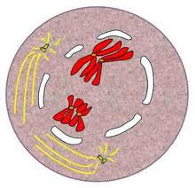
Which Stage?
Notes:
prophase

Slide 26
Which Stage?
Notes:
anaphase

Slide 27
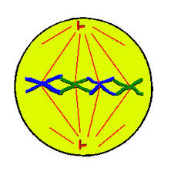
Which Stage?
Notes:
metaphase

Slide 28
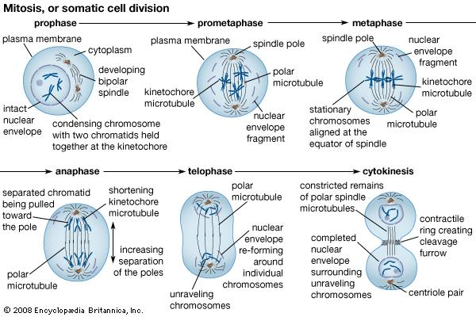
Phases of Mitosis
*CYTOKENISIS IS NOT A PART OF MITOSIS*

Slide 29
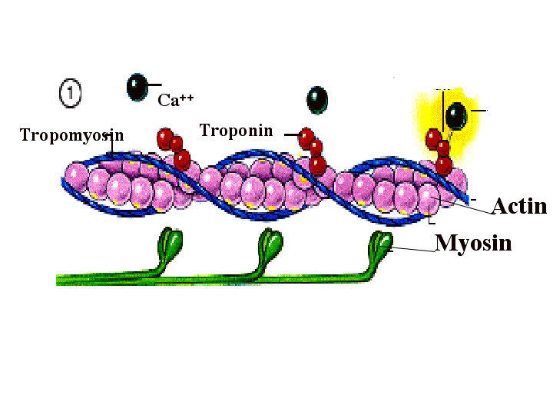
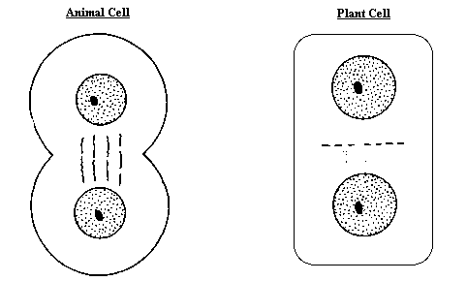
Plant vs. Animal Cytokinesis
Cleavage furrow
Cell plate

Slide 30
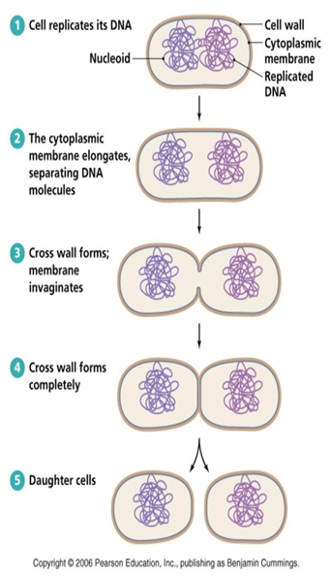
“Mitosis” in prokaryotes= Binary Fission

