Slide 1
Unit 5, Part 2 Notes – The Nervous System
AP Biology

Slide 2
Purpose of the Nervous System in Animals
To receive signals about environmental stimuli and coordinate a response to these stimuli
Two nerve cells (neurons) can communicate over a short distance called a synapse

Slide 3
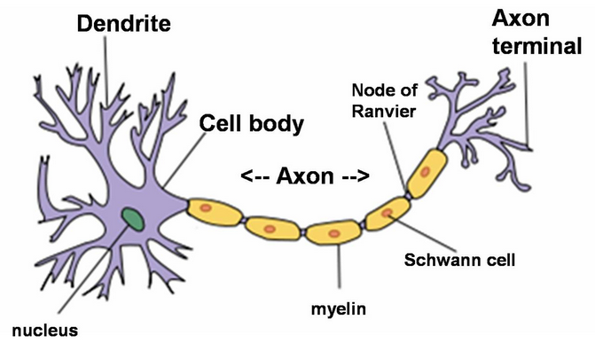
Neuron Structure
Dendrites
Cell body / soma
Axon and axon hillock → action potential
Axon terminals and neurotransmitters

Slide 4
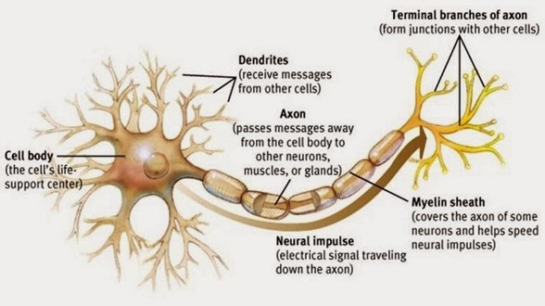
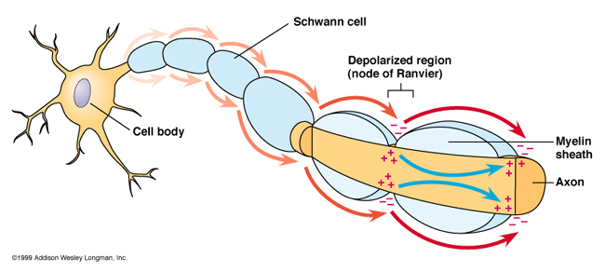
Schwann cells (myelin sheath) and Nodes of Ranvier → saltatory conduction

Slide 5
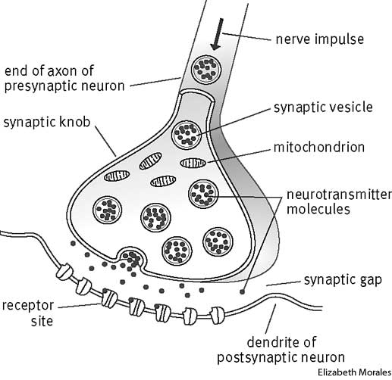
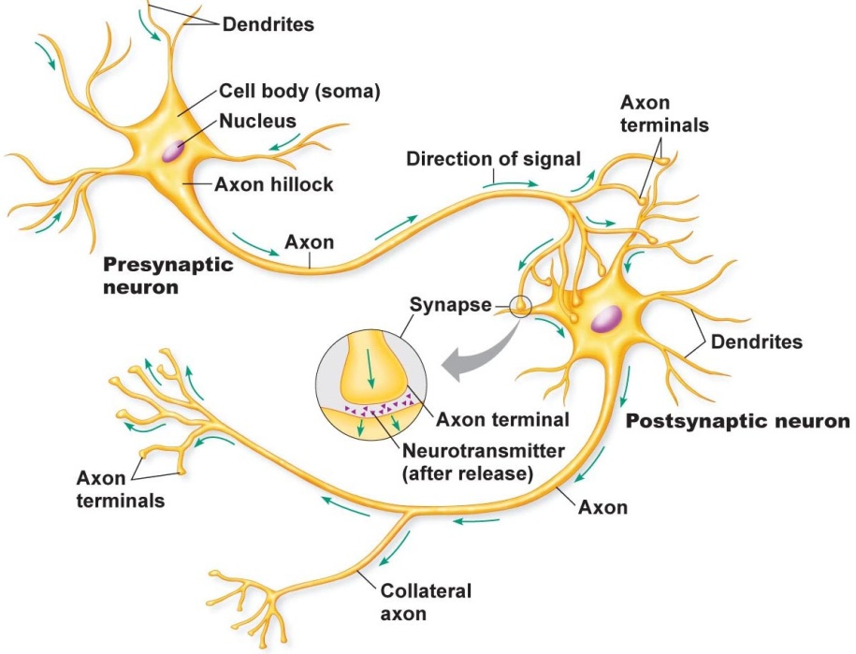
Sending a signal from one neuron to another
Pre-synaptic neuron
Post-synaptic neuron
Synapse / synaptic cleft

Slide 6
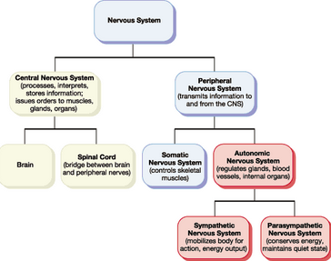
Major divisions of the nervous system in humans
Central nervous system (CNS) vs. peripheral nervous system (PNS)

Slide 7
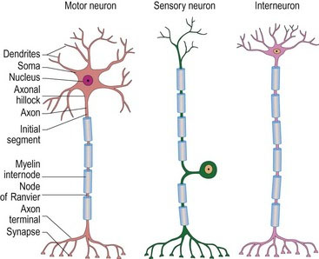
Types of Neurons
Sensory neurons
Interneurons
Motor neurons

Slide 8
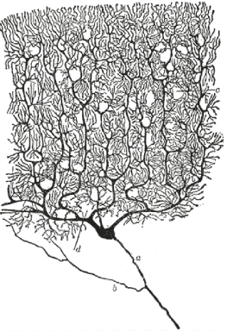
Many interneurons have highly branched dendrites

Slide 9
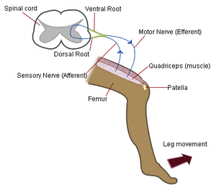
Reflex Arc
Bypasses the brain (faster)
Monosynaptic reflex arc (ex: knee jerk reflex)

Slide 10
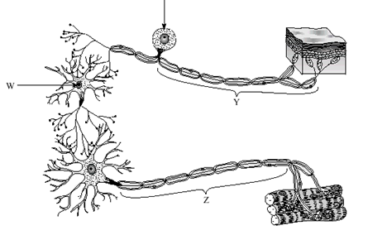
Polysynaptic reflex arc

Slide 11
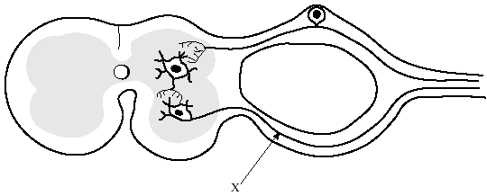
Polysynaptic reflex arc
Dorsal Root
Spinal Cord

Slide 12
Most sensation/response pathways are not reflex arcs…
Most pathways involve the use of interneurons in the brain
Sensory receptor cell → sensory neuron → interneuron in spinal cord → interneurons in brain → interneuron in spinal cord → motor neuron → muscle cell

Slide 13
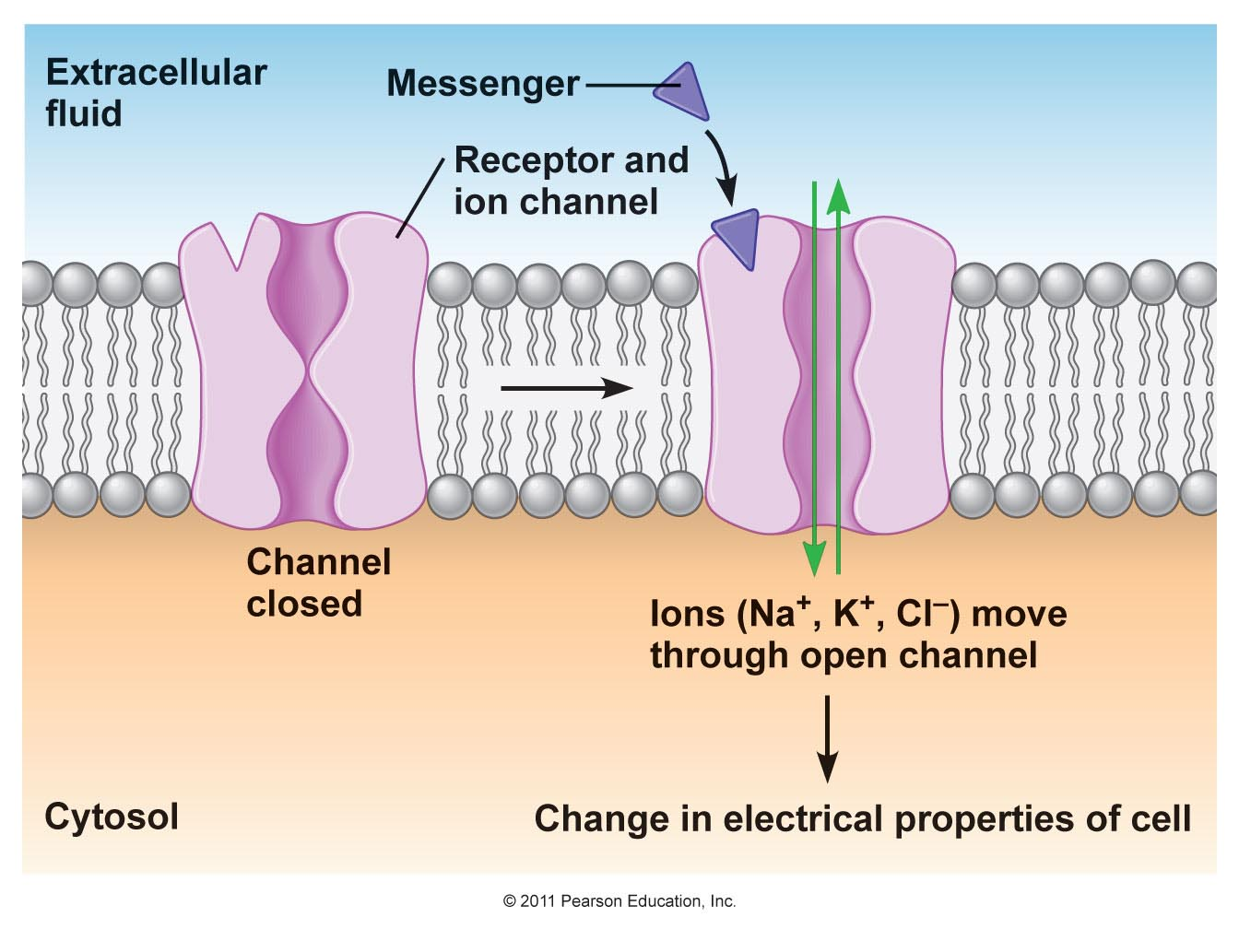
Types of ion channels involved in nerve signaling
Leaky ion channels
Ligand-gated ion channels (image)
Voltage-gated ion channels

Slide 14
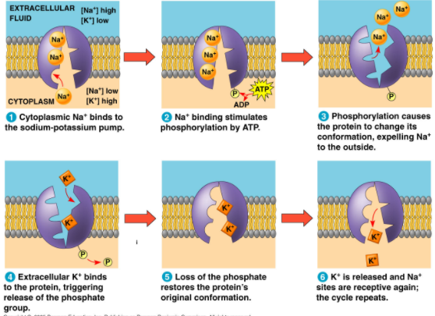
Nerve signals are the result of electrical currents sent down the length of a neuron
In a neuron at rest…
Na+/K+ pump ensures that there are more Na+ outside the cell and more K+ inside the cell

Slide 15
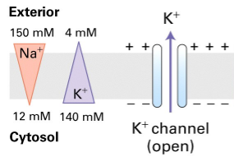
In a neuron at rest…
K+ tends to flow through leaky K+ channels from a high concentration inside the cell to a low concentration outside the cell

Slide 16
The cytoplasm has an overall negative charge compared to the extracellular solution for several reasons…
The sodium/potassium pump moves more Na+ out of the cell than it moves K+ into the cell
K+ exits the cell through the leaky K+ channels
There are large negatively-charged proteins inside the neuron’s cytoplasm.
-70 mV = resting potential of nerve cell

Slide 17
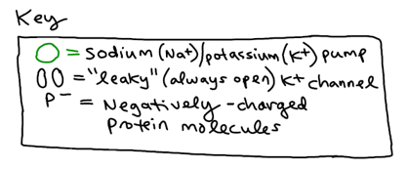
inside charge:
outside
axon (cytoplasm)
outside
charge:
outside

Slide 18
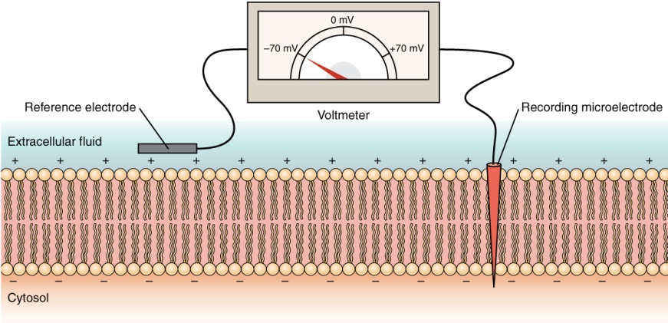
Measuring membrane potential

Slide 19
Action potential sent from axon hillock away from the cell body towards the axon terminals in response to a stimulus detected by the dendrites that causes positive charge to be brought into the cell (called depolarization because it moves the voltage closer to 0 mV from -70 mV)

Slide 20
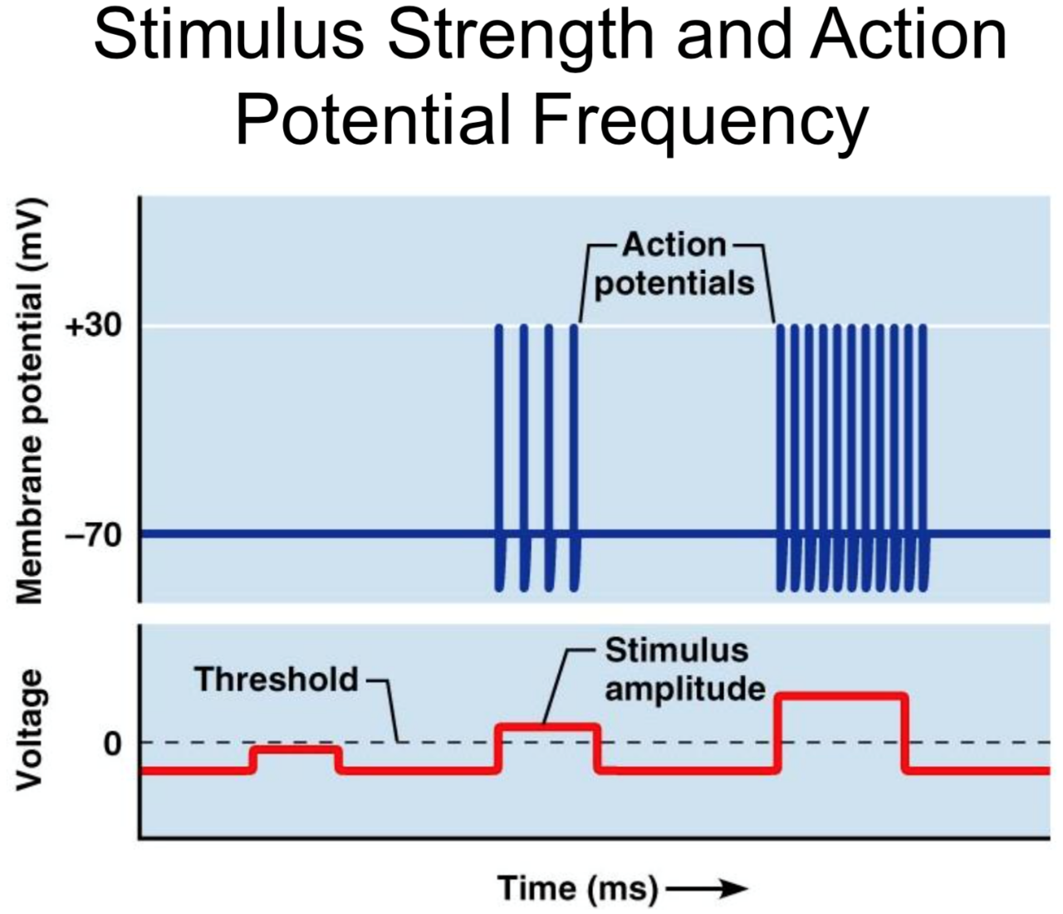
Stimulus → threshold potential = -55 mV (causes an action potential to begin)
All-or-None Principle
CAN increase frequency of action potential (but not amplitude)

Slide 21
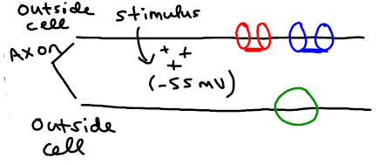
Threshold

Slide 22
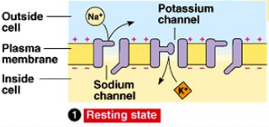
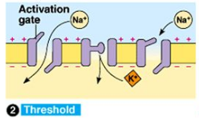
Threshold

Slide 23
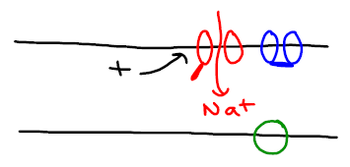
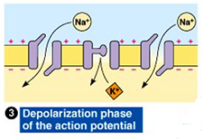
Depolarization

Slide 24
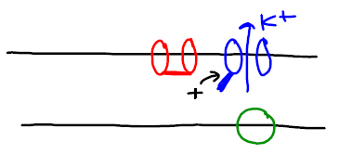
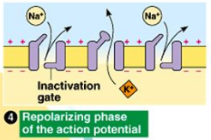
Repolarization

Slide 25
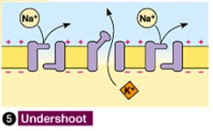
Hyperpolarization / Undershoot

Slide 26
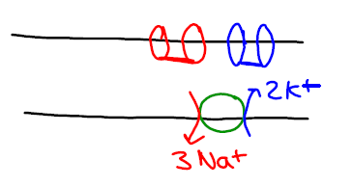
Back to Resting State

Slide 27
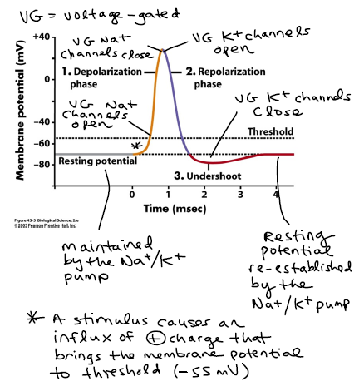

Slide 28
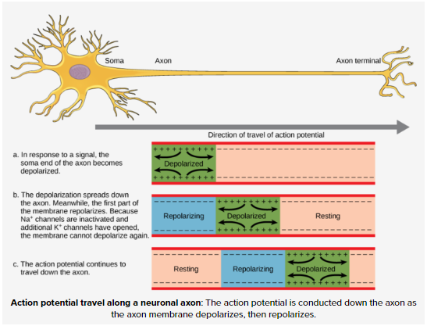
Movement of action potential down a neuron and the refractory period

Slide 29
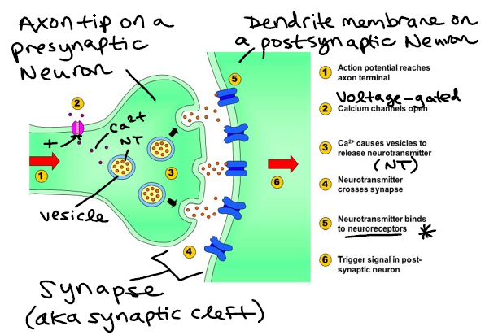
Signaling from one neuron to another

Slide 30
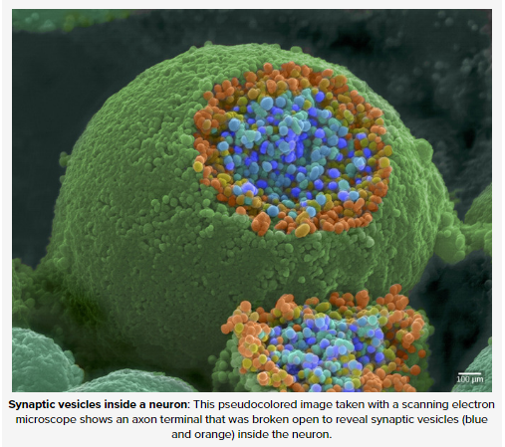
Synaptic Vesicle

Slide 31
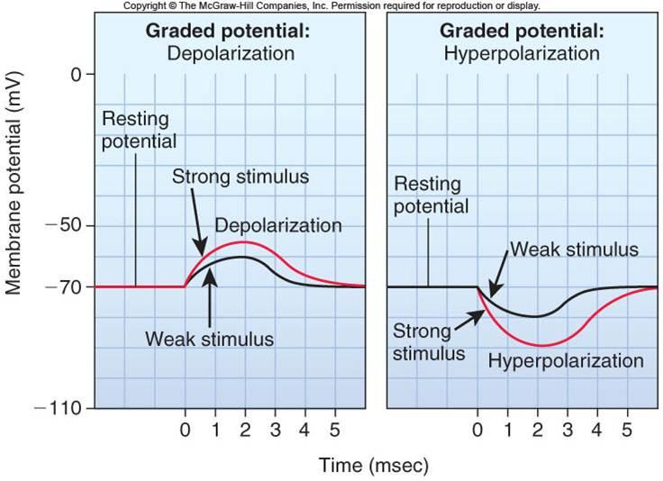
Excitatory post-synaptic potential (EPSP) –
example neurotransmitter: glutamate
Inhibitory post-synaptic potential (IPSP)
example neurotransmitter: GABA

Slide 32
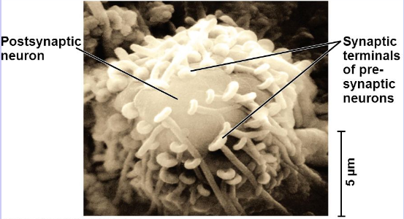
Multiple pre-synaptic inputs may be needed to bring the post-synaptic cell to threshold

Slide 33
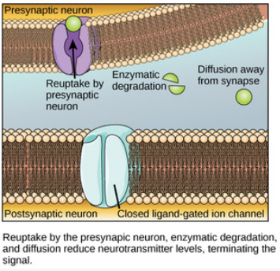
End of synaptic transmission

Slide 34
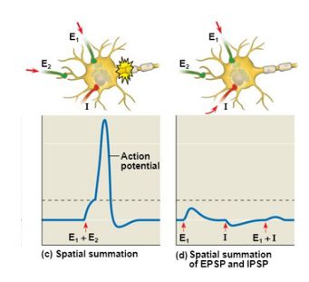
Spatial Summation of Pre-synaptic Inputs

Slide 35
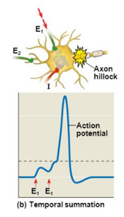
Temporal Summation of Pre-synaptic inputs

Slide 36
Neurotransmitters with Opposing Effects in the Body
Which division of the nervous system does this neurotransmitter act on? | Sympathetic (active during times of stress / emergencies) | Parasympathetic (active during times of relaxation / everyday life)
How does it affect the digestive system? | Slows it down | Speeds it up
How does it affect the pupils of the eye? | Dilates them | Constricts them
How does it affect the heart rate? | Speeds it up | Slows it down
How does it affect the breathing rate? | Speeds it up | Slows it down

Slide 37
Effect of caffeine on the nervous system
Video

Slide 38
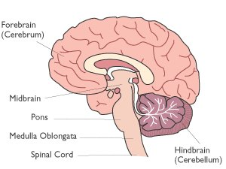
Different parts of the brain control different activities

Slide 39
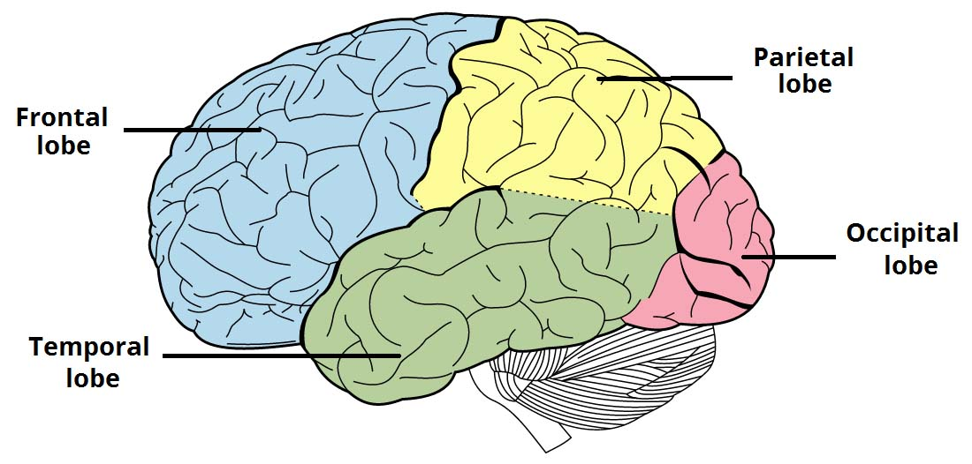
Different parts of the brain control different activities

Slide 40
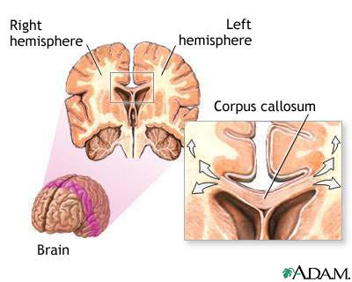
Communication between the right and left hemispheres of the brain

