Slide 1
Unit 1, Part 1 Notes - Populations
AP Biology

Slide 2
Definition of a population (write this down!)
-The group of individuals from one species living in a particular area
-Example: All of the red-cockaded woodpeckers living in a forest

Slide 3
Population Size vs. Population Density

Slide 4
Methods for Estimating Population Density
-Quadrat Technique (not quadrant, sorry!)
-Mark and Recapture Technique

Slide 5
Mark and Recapture Technique - A little fun math!
A limited number of individuals (e.g. 20) are captured at random and marked/tagged then released into the environment. Later a second group of animals is captured and the percentage of marked individuals determined.
If 10% of the animals in this second group have the tag (e.g., 4 out of 40 individuals in the recapture group have a tag), then the original 20 represented 10% of the population and the population then is 200.
We can represent this math with the following equation…
R = # of recaptured individuals that had a mark/tag (4) T = total # of recaptured individuals (40) M = # of individuals that were initially captured and marked (20) N = total # of individuals in the population (200)
R / T = M / N
4 / 40 = 20 / 200
0.1 = 0.1

Slide 6
Let’s answer Notes Question #1
Scientists are using the mark-recapture technique to estimate the population density of a population of turtles. (Yeah, this is totally made up). Initially, 30 turtles were captured and tagged (marked) with a line of orange paint on their shells and released back into the environment. The scientists later captured 20 more turtles and found that 5 of them had tags on their back. Using this information, estimate the size of the total turtle population.

Slide 7
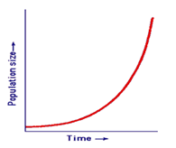
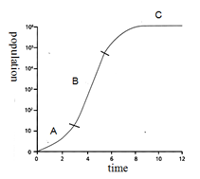
Exponential vs. Logistic Growth – what’s the big difference??

Slide 8
Question: for the logistic growth curve shown to the right, how does the birth rate compare to the death rate at points A, B, and C?
A:
B:
C:

Slide 9
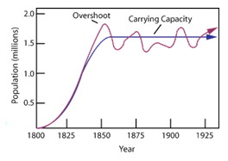
Most populations oscillate around the carrying capacity.

Slide 10
Notes Question #3

Slide 11
Demography
-In your notes: the study of factors that affect birth and death rate
-Alternate definition in our class textbook: the study of statistics that describe a population
-We will discuss the following factors that are part of demography: generation time, fecundity, survivorship, life history, age structure

Slide 12
Generation Time
-Average span of time between the birth of an organism and the birth of its offspring.
-Large organisms → longer generation times → slower population growth
-Small organisms → shorter generation times → faster population growth

Slide 13
Fecundity
-In your notes: Average number of offspring each individual produces at each life stage
(Ex: Humans have a higher fecundity in their mid-20’s and 30’s compared to their 50’s)
-Alternate definition from Openstax Biology online textbook: Potential reproductive capacity of an individual in a population (describes how many offspring could ideally be produced)

Slide 14
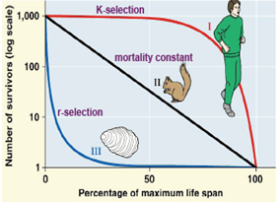
Survivorship
-The fraction of individuals that survive from birth to different life stages
-Types of survivorship curves:
Type I : low mortality rates until old age (ex: large mammals with few offspring but a high degree of parental care)
Type III: high mortality rates when young, mortality rates drop after the initial “die-off” (ex: fishes, marine invertebrates)
Type II : constant mortality rate at all ages (ex: Belding’s ground squirrels, other rodents, some invertebrates, some lizards)

Slide 15
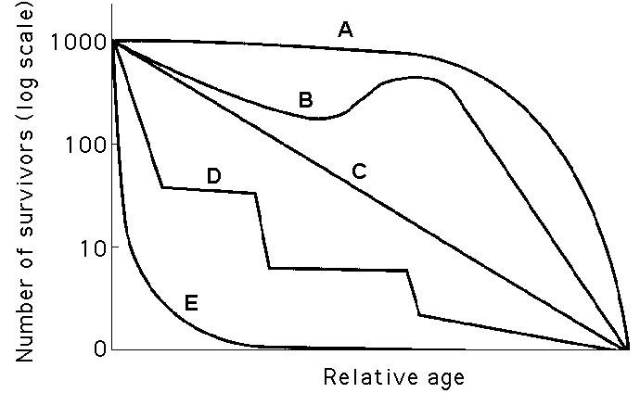
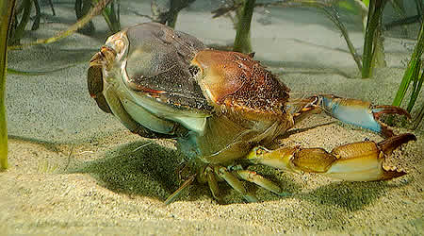
Do most populations show perfect Type I, Type II, or Type III curves?
-No!
-Example: Crabs (curve D)

Slide 16
Examples of notes annotations?

Slide 17
Life History
- An organism’s life history involves the traits that affect its schedule of reproduction and survival.
When reproduction begins (the age at first reproduction or age at maturity)
How often the organism reproduces
How many offspring are produced per reproduction

Slide 18
Two Life History Patterns
Semelparity = one reproduction with many offspring, small offspring, parent often dies shortly after reproduction, offspring mature at birth, little to no parental care, often occurs in unpredictable environments, r-selected species
Iteroparity = several reproductions with a few offspring each time, typically large offspring, parents have a long lifespan, offspring immature at birth, more parental care, often occurs in predictable environments with many adults competing for resources, K-selected species

Slide 19
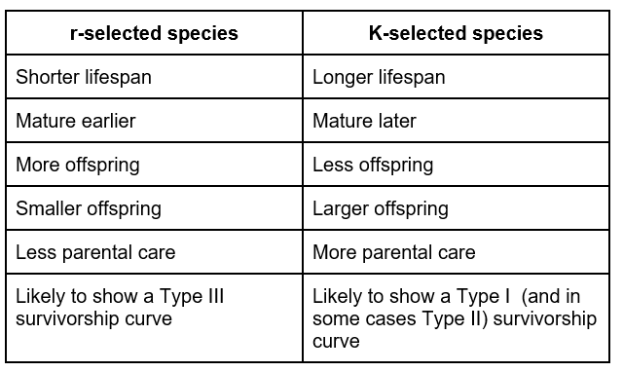
Differences between r-selected and K-selected species

Slide 20
Life History Trade-Off
-Trade-off between reproduction and survival
-Semeparity → many offspring (more reproduction), but they are less likely to survive (due to less parental care)... Also, the parent does not survive long after reproducing
-Iteroparity → few offspring (less reproduction), but they are more likely to survive (due to more parental care).... Also, the parent survives longer

Slide 21
Examples of notes annotations?

Slide 22
Age Structure
-Percentage of the population that falls into various age ranges (divided up by sex)
-More young people in the population → more rapid growth
-More old people (past reproductive age) in the population → slower growth, no growth, or negative growth

Slide 23
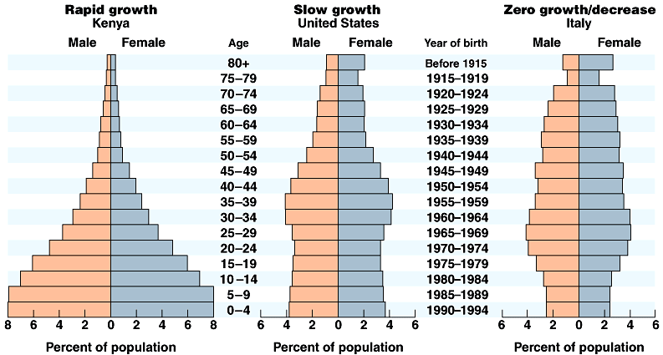
Age Structure Pyramids
Question: What can you conclude about the population growth rates in Kenya, the U.S., and Italy from their age structure pyramids? Explain your answer thoroughly.

Slide 24
Population Density
-Limiting Factors
Density-independent limiting factors
Density-dependent limiting factors

Slide 25
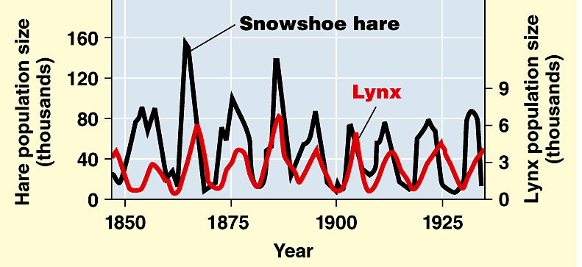
Question: What type of limiting factor is producing the population changes seen in the hare and lynx in the graph below. Explain your answer thoroughly.

Slide 26
Genetic diversity affects a population’s ability to respond to changes in the environment and prevent extinction
-Genetic diversity / genetic variation: amount of different types of genes within the population
Genes: segments of DNA that code for particular traits
Example: Cheetahs

Slide 27
Carrying capacity for the human population?
-Factors that may increase the carrying capacity: food production (agriculture), health care, etc.

Slide 28
Examples of notes annotations?

Slide 29
Behavior within populations
-Altruistic Behavior: behavior that makes an individual less likely to survive and/or reproduce but makes another individual more likely to survive and/or reproduce
-Example: Alarm calls in meerkats
-Some seemingly altruistic behaviors aren’t truly altruistic because there is reciprocity involved or they are helping relatives

Slide 30
Behaviors to increase personal survival and reproductive success (ex: territory marking, mating dances, etc.)

Slide 31
Signals sent between members of a population
Visual, audible, tactile, electrical, and chemical
Example: Bee Waggle Dance
Length of Waggle = distance from hive to flower patch
Amount of “vigor” in the dance = richness of nectar source
Angle of waggle relative to a vertical line representing the position of the sun = direction of the nectar source
How is this behavior cooperative?

Slide 32
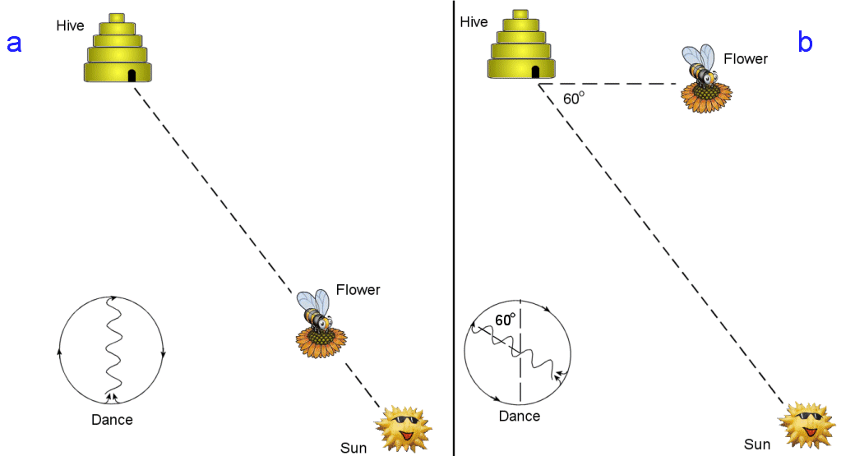

Slide 33
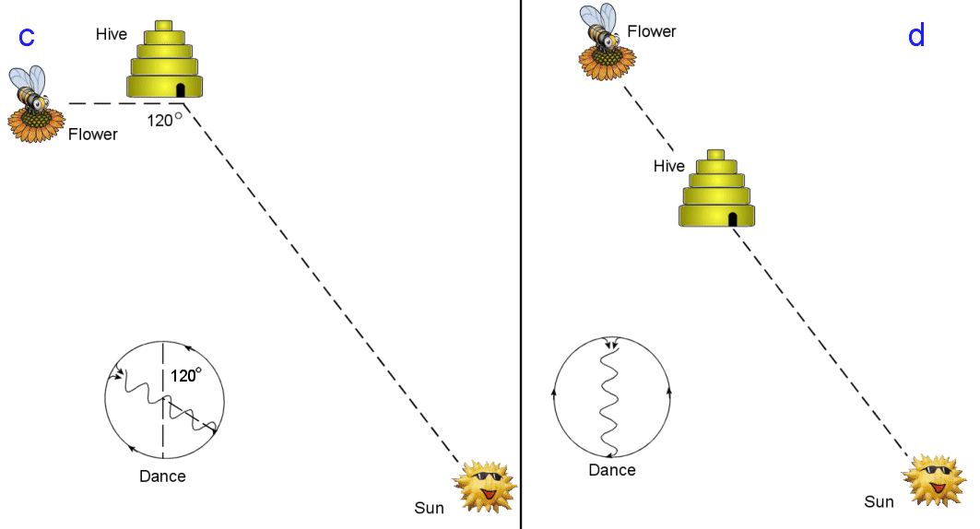

Slide 34
Examples of notes annotations?

