Slide 1
Science Course Selection
For 2019-2020 School Year

Slide 2
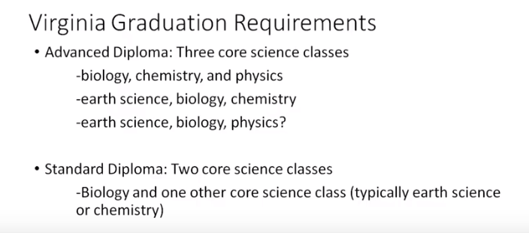

Slide 6
Chemistry II: Organic Chemistry
Microbiology

Slide 8
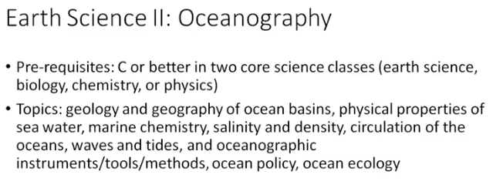

Slide 11
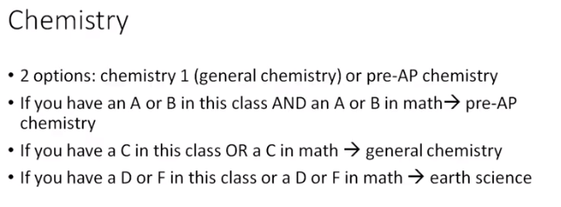

Slide 12
Chemistry II: Organic Chemistry
C or better in both Biology and Chemistry

Slide 13
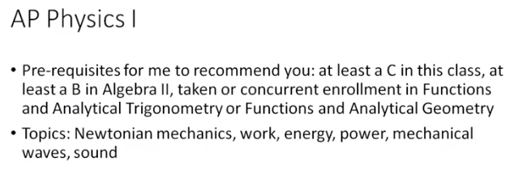

Slide 15
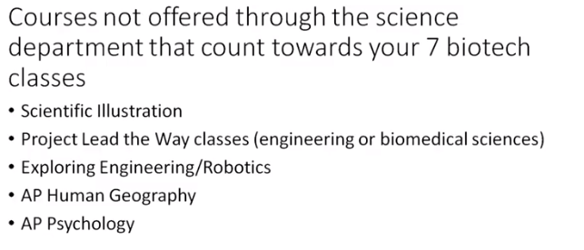

Slide 16
With that in mind, and with the chart in front of you, fill out the online survey:
https://goo.gl/forms/4p6QPpB0QFTbVkZs1
I’ve sent the link to your remind.
If you don’t have a phone with you today I can give you a paper form.

