Slide 1
Macroevolution and History of Life
Unit 1 Part 3 Notes

Slide 3
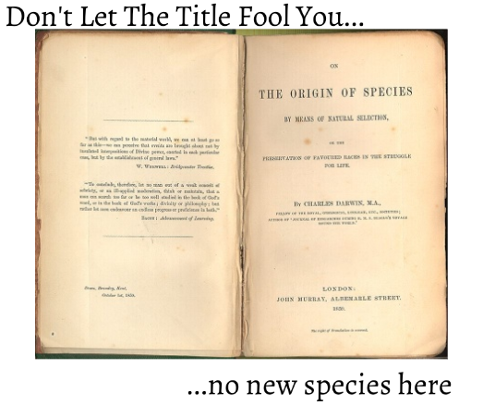

Slide 6
SPECIATION = REPRODUCTIVE ISOLATION

Slide 7
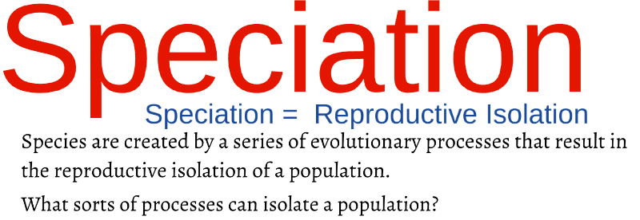
Allosteric speciation
Sympatric speciation

Slide 10
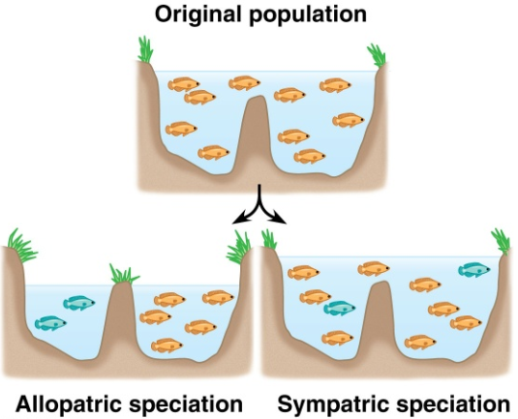

Slide 11
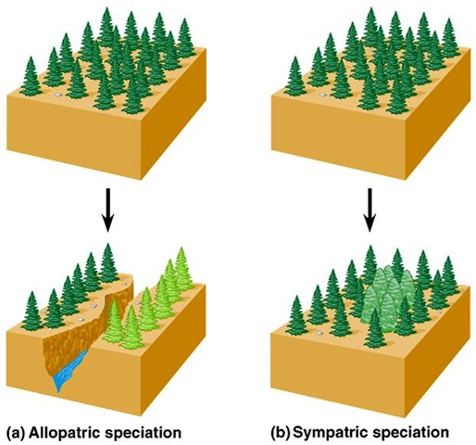

Slide 12
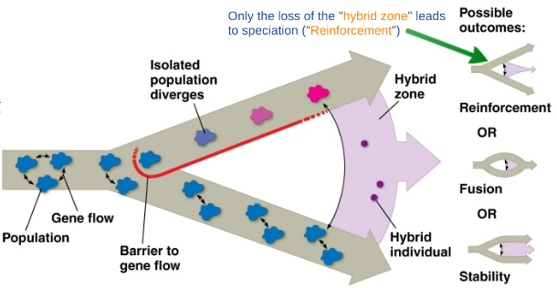
Isolation Doesn’t Always Mean Speciation

Slide 13
PRE = BEFORE
POST = AFTER
ZYGOTIC = ZYGOTE = FERTILIZED EGG (diploid cell when egg and sperm combine)

Slide 18
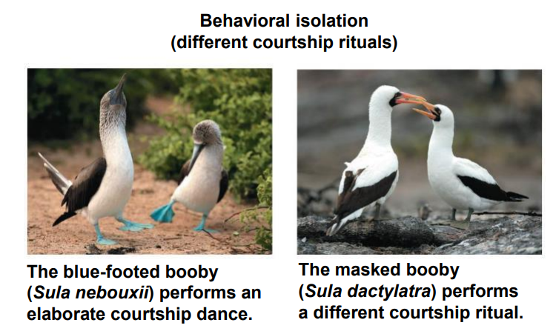

Slide 20
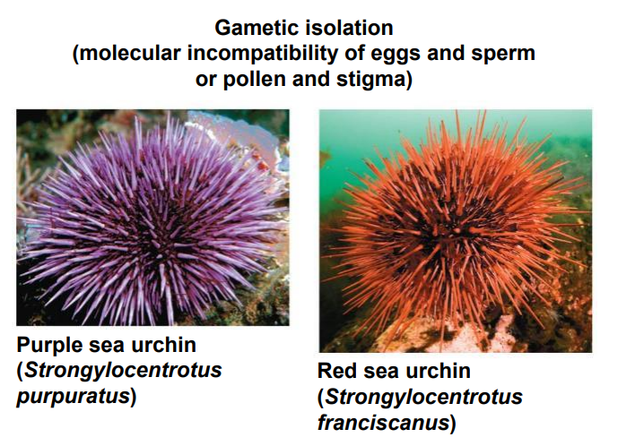
(proteins on the surface of gametes do not allow the fusion of sperm and egg)

Slide 21
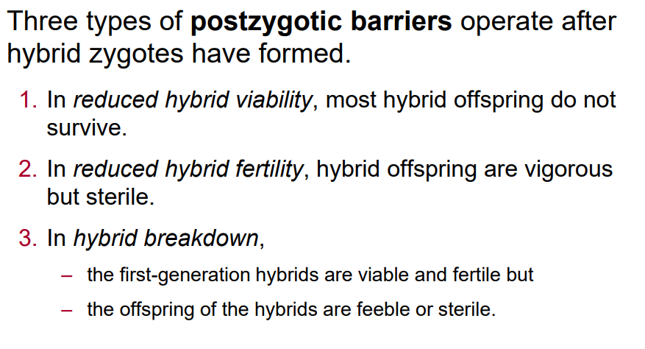

Slide 22
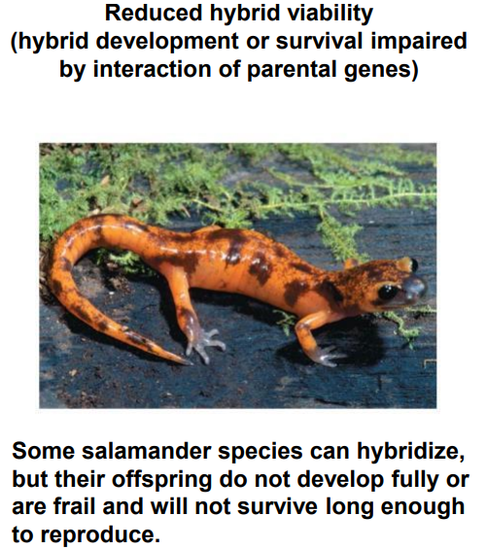
(zygote doesn’t develop properly, and if the hybrid is “born,” it doesn’t live long enough to reproduce)

Slide 23
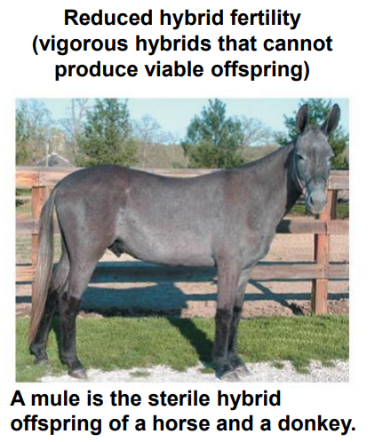

Slide 24
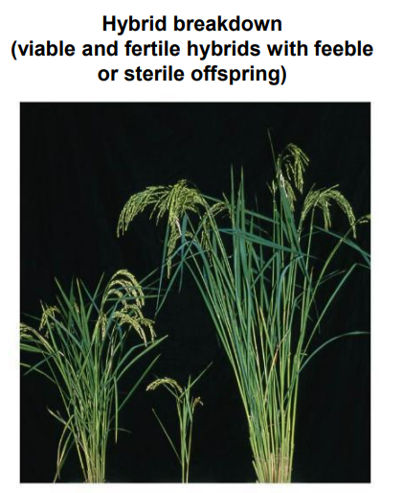

Slide 30
History of Life

Slide 32
Endosymbiosis: How Eukaryotes arose from Prokaryotes

