Slide 1
Standard Deviation & Standard Error
The effect of ttx Analysis

Slide 2
NULL HYPOTHESIS
The null hypothesis predicts that whatever we’re testing will have no effect on whatever we’re measuring.
In our statistical analysis, we hope to disprove our null hypothesis.
You can always start a null hypothesis with:
“There is no statistically significant difference between…”
So our null hypothesis would be “There is no statistically significant difference between the number of Na+ ions entering a cell with or without tetrodotoxin.”

Slide 3
Alternate Hypothesis
Two ways to write it:
Opposite of Null Hypothesis: instead of saying “there IS NO statistically significant difference”, we write that “there IS A statistically significant difference between….”
If, then: “If nerve cells are exposed to TTX, then…”

Slide 4
WHAT IS THE MEAN?
Mean is another term used for AVERAGE.
Mean Formula:
What it actually means:
(haha no pun intended!)
n = number of data points
x_{i} = an individual value
∑ = sum of all the individual values starting with the 1st one (i=1) and ending with the “n-th” on (so in a data set of 10, the 10th one)

Slide 5
Moral of the story?
Just because a formula looks complicated doesn’t mean that it actually is.
You can do it!

Slide 6
Why calculate the mean?
We calculate the mean from a set of data.
In experiments, we are trying to measure the effect of an independent variable.
Since the effect is measurable (quantitative), that means our data will have a range of numbers.
According to those numbers, we can figure out the most “normal” or common response to the variable.
It’s much easier to identify one number from a massive set as a reference point than to take every single number into account every time you discuss or analyze the data.

Slide 7
Calculate the mean
Your table already has added the “sum for each column.”
Since there are only 5 trials, you would divide the sum by 5 to find the average # of Na+ ions entering the different cells.
Write this mean in the table on the next page.

Slide 8
Standard Deviation
Why do we use this formula? – to determine the amount by which each data point typically differs from the mean (a measure of variation in the data set). “Simply put, it is a measure of how spread out the numbers are.”
What it actually means:
s = standard deviation
n = number of data points
x_{i} = an individual value
$$\overline{x}=the mean$$
∑ = sum of all the squared differences

Slide 9
Standard Deviation Step-by-Step
Find (x_{i} – x bar)² for each data point, write them down, and add them together
Divide that sum by (n-1)
Square root

Slide 10
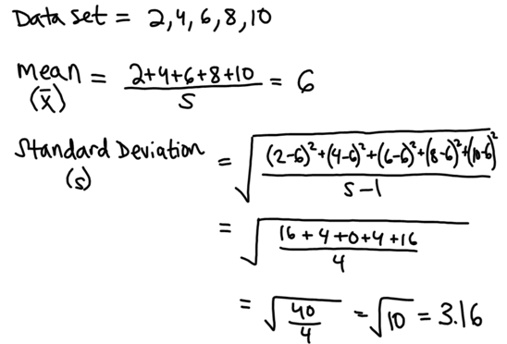
Standard Deviation Sample Calculation
What it actually means:
-In this data set, each value is typically 3.16 points away from 6 (the mean).
-The standard deviation would be much smaller in a sample of 4, 5, 6, 6, 7, 8 because the values are on average, closer to the mean (less spread out).

Slide 11
Standard Error
Why do we use this formula? - to determine the precision of the mean value based on standard deviation (s) and number of data points (n)

Slide 12
Standard Error Tips
Standard Error (SE$\overline{x}$) is also known as Standard Error of the Mean (SEM)
We are confident in the precision of our mean if the Standard Error is low… this is due to “s” (variation) being low and “n” (sample size) being high…
In other words, if most of our data points are clustered around the same value, AND we tested TONS of samples, we can be confident our mean is precise. (very low standard error)
If our data points are very scattered, and we only tested a few samples, we cannot be confident in our mean. (high standard error)

Slide 13
Standard Error Sample Calculation

Slide 14
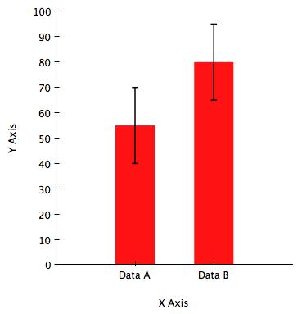
95% Confidence Limit
Definition: If we were to sample a larger amount of data, we are 95% confident that the real mean would fall within this range (i.e. the error bar when graphing the mean)
95% C.L. = Mean ± 2(SEM)

Slide 15
95% C.L. Sample Calculation
Mean + (2xSEM) = Error Bar Upper Limit
Mean – (2xSEM) = Error Bar Lower Limit

Slide 16
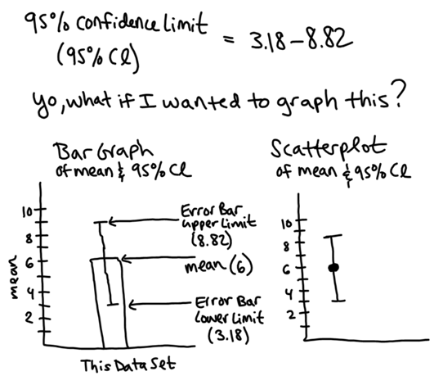
Graphing Means with Error Bars

Slide 17
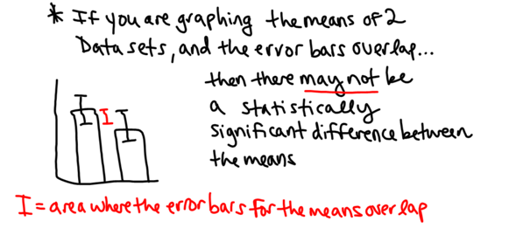
Interpreting Error Bars when Comparing Two Means

Slide 18
Interpreting Error Bars when Comparing Two Means (continued)

Slide 19
For your graph
Our independent variable is what we’re making different between the two groups (TTX or no TTX) – these are the two groups that are on the x-axis for which we will draw bars and error bars
The dependent variable is what we’re measuring (average number of Na+ entering the cell).

