Slide 1
Standard Deviation & Standard Error
Beak of the Finch Statistical Analysis

Slide 2
WHAT IS THE MEAN?
Mean is another term used for AVERAGE.
Mean Formula:
What it actually means:
(haha no pun intended!)
n = number of data points
x_{i} = an individual value
∑ = sum of all the individual values starting with the 1st one (i=1) and ending with the “n-th” on (so in a data set of 10, the 10th one)

Slide 3
Moral of the story?
Just because a formula looks complicated doesn’t mean that it actually is.
You can do it!

Slide 4
Why calculate the mean?
We calculate the mean from a set of data.
In experiments, we are trying to measure the effect of an independent variable.
Since the effect is measurable (quantitative), that means our data will have a range of numbers.
According to those numbers, we can figure out the most “normal” or common response to the variable.
It’s much easier to identify one number from a massive set as a reference point than to take every single number into account every time you discuss or analyze the data.

Slide 5
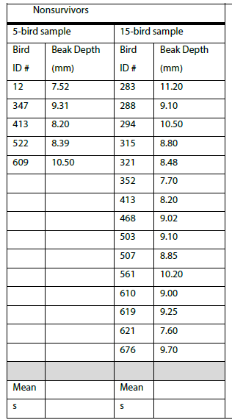
Part C: Nonsurvivors

Slide 6
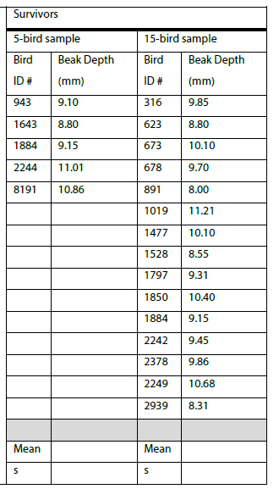
Part C: Survivors

Slide 7
Standard Deviation
Why do we use this formula? – to determine the amount by which each data point typically differs from the mean (a measure of variation in the data set). “Simply put, it is a measure of how spread out the numbers are.”
What it actually means:
s = standard deviation
n = number of data points
x_{i} = an individual value
$$\overline{x}=the mean$$
∑ = sum of all the squared differences

Slide 8
Standard Deviation Step-by-Step
Find (x_{i} – x bar)² for each data point, write them down, and add them together
Divide that sum by (n-1)
Square root

Slide 9
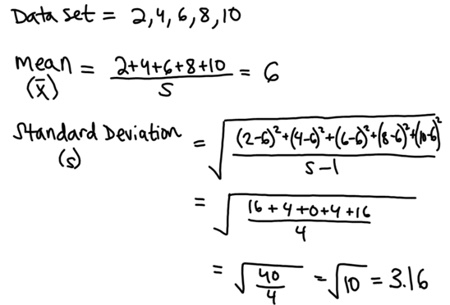
Standard Deviation Sample Calculation
What it actually means:
-In this data set, each value is typically 3.16 points away from 6 (the mean).
-The standard deviation would be much smaller in a sample of 4, 5, 6, 6, 7, 8 because the values are on average, closer to the mean (less spread out).

Slide 10
Nonsurvivor s

Slide 11
Survivors s

Slide 12
Standard Error
Why do we use this formula? - to determine the precision of the mean value based on standard deviation (s) and number of data points (n)

Slide 13
Standard Error Tips
Standard Error (SE$\overline{x}$) is also known as Standard Error of the Mean (SEM)
We are confident in the precision of our mean if the Standard Error is low… this is due to “s” (variation) being low and “n” (sample size) being high…
In other words, if most of our data points are clustered around the same value, AND we tested TONS of samples, we can be confident our mean is precise. (very low standard error)
If our data points are very scattered, and we only tested a few samples, we cannot be confident in our mean. (high standard error)

Slide 14
Standard Error Sample Calculation

Slide 15
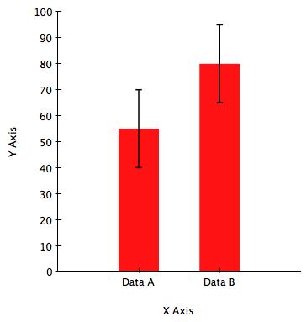
95% Confidence Limit
Definition: If we were to sample a larger amount of data, we are 95% confident that the real mean would fall within this range (i.e. the error bar when graphing the mean)
95% C.L. = Mean ± 2(SEM)

Slide 16
95% C.L. Sample Calculation
Mean + 2SEM = Error Bar Upper Limit
Mean – 2SEM = Error Bar Lower Limit

Slide 17
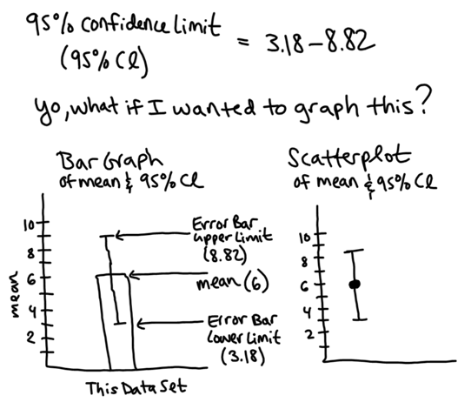
Graphing Means with Error Bars

Slide 18
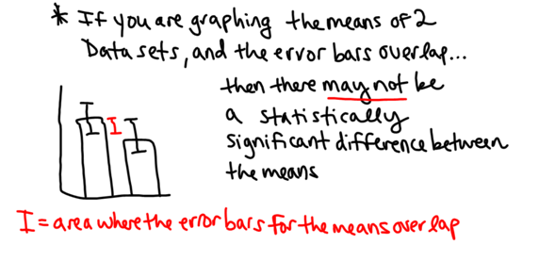
Interpreting Error Bars when Comparing Two Means

Slide 19
Interpreting Error Bars when Comparing Two Means (continued)

Slide 20
Further Statistical Testing = Chi Square Test
Why do we use this formula? To determine if we should reject or fail to reject (support) our null hypothesis

Slide 21
Steps of the Chi Square Test
1. State your null hypothesis
This is always a negative statement that begins with “There is no statistically significant difference between…”

Slide 22
Steps of the Chi Square Test (continued)
2. Determine your expected values
Typically, you will need to find your expected decimal frequencies and multiply by the total sample size to get whole numbers for your expected values.

Slide 23
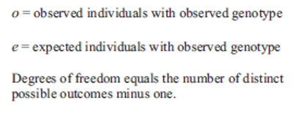
Steps of the Chi Square Test (continued)
3. Calculate your Chi square value
To calculate this value, you will need to know your observed and expected values and the following equation…

Slide 24
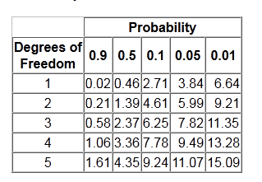
Steps of the Chi Square Test (continued)
4. Find your critical value using a critical values chart
To do this, you will need to know the number of degrees of freedom for your data (n-1) and use a p value of 0.05.

Slide 25
Steps of the Chi Square Test (continued)
5. Compare your Chi square value to your critical value and draw a conclusion
Remember, if your Chi square value is HIGHER than your critical value, you reject your null hypothesis. If your Chi square value is LOWER than your critical value, you support (fail to reject) your null hypothesis.

