Slide 1
Unit 10, Part 2 Notes – Timing and Coordination
AP Biology, Mrs. Jensen

Slide 2
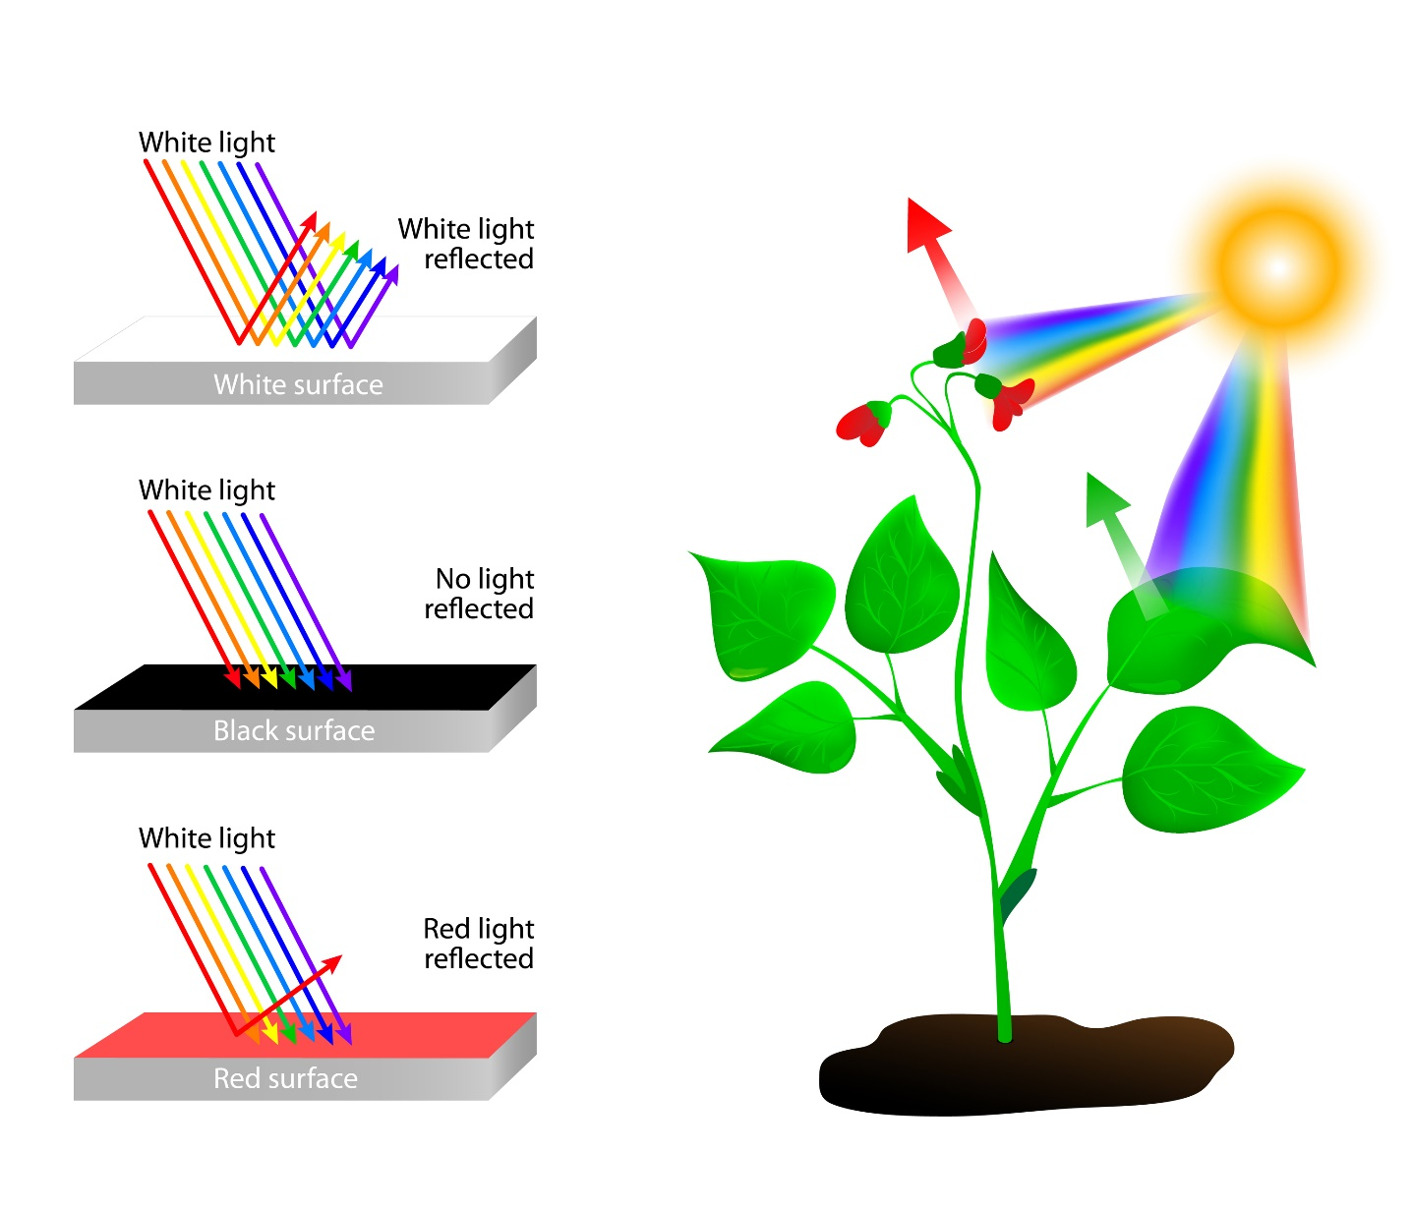
Plants need to be able to sense light levels…
Why?
How?
Photoreceptor molecules in plants sense light
Photoreceptors = a protein linked to a light-absorbing chromophore
Chromophore absorbs light → causes a shape change in the protein → signaling pathway within the plant that causes a reaction

Slide 3
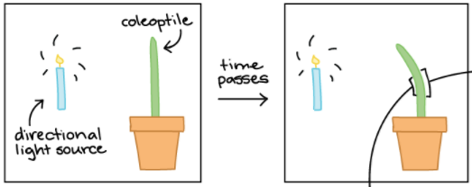
Phototropism
Observation: The “shoot” (above-ground portion) of a plant bends towards the light as it grows
Charles Darwin and his son Francis described this phenomenon in young grass seedlings that had just sprouted (leaves and shoots were still covered by a sheath called the coleoptile)

Slide 4
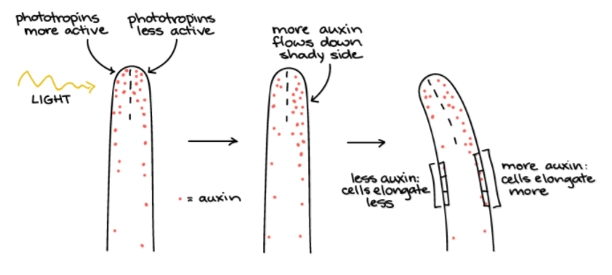
Phototropism
Why does this bending and growth towards the light happen?
Photoreceptors on the illuminated side of the shoot absorb more light than photoreceptors on the dark side of the shoot → more auxin hormone is transported down the dark side than the illuminated side → cells elongate more on the dark side → plant bends towards the light as it grows

Slide 5
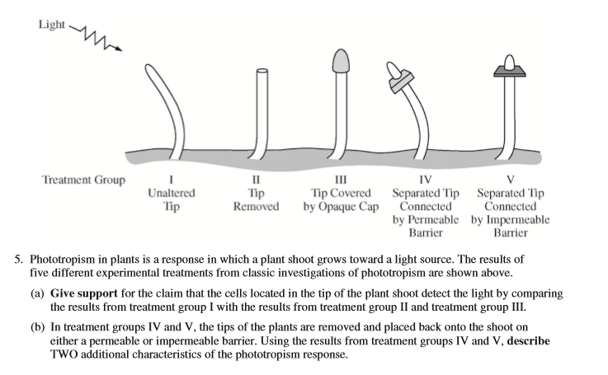
Phototropism Short Response Question from the 2015 AP Biology Exam

Slide 6
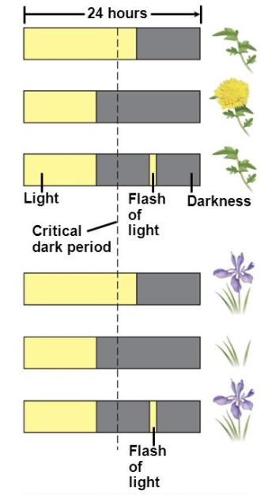
Photoperiodism
Plant flowering in response to changes in day/night length
What is happening in the two types of plants shown in the picture?

Slide 7
Photoperiodism
Short Day / Long Night Plants: flower late in the summer or fall when the day length decreases and the night length increases (ex: rice)
Long Day / Short Night Plants: flower in the late spring or early summer when the day length increases and the night length decreases (ex: spinach and sugar beets)

Slide 8
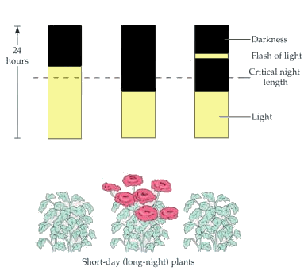
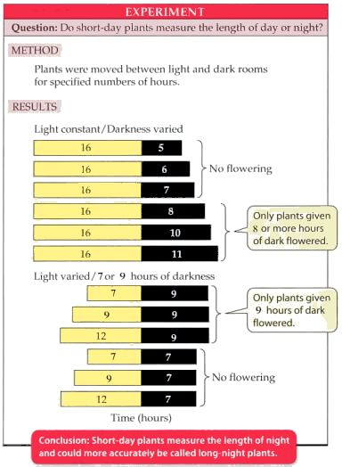
Surprise! It’s really the night that controls photoperiodism.

Slide 9
Circadian Rhythms
Bozeman Explanation
Arctic Squirrels case study
2015 AP Exam FRQ #1 (if time)

