Slide 1
Characteristics of Life
Pre-AP Biology: Unit 1 Topic 1
Objectives:
I can tell the difference between organisms and nonliving things
I can list and explain the characteristics all living things share
I can explain why some things are considered nonliving, even though they meet some characteristics of life

Slide 2
What is biology?
Biology is the study of life
Bio = life ; ology = study of
Biologists recognize that all living things share certain characteristics. They use these characteristics to classify things as living, nonliving, or once-living (dead).

Slide 3
What is an organism?
Organism= anything that has or once had all of the characteristics which define life

Slide 4
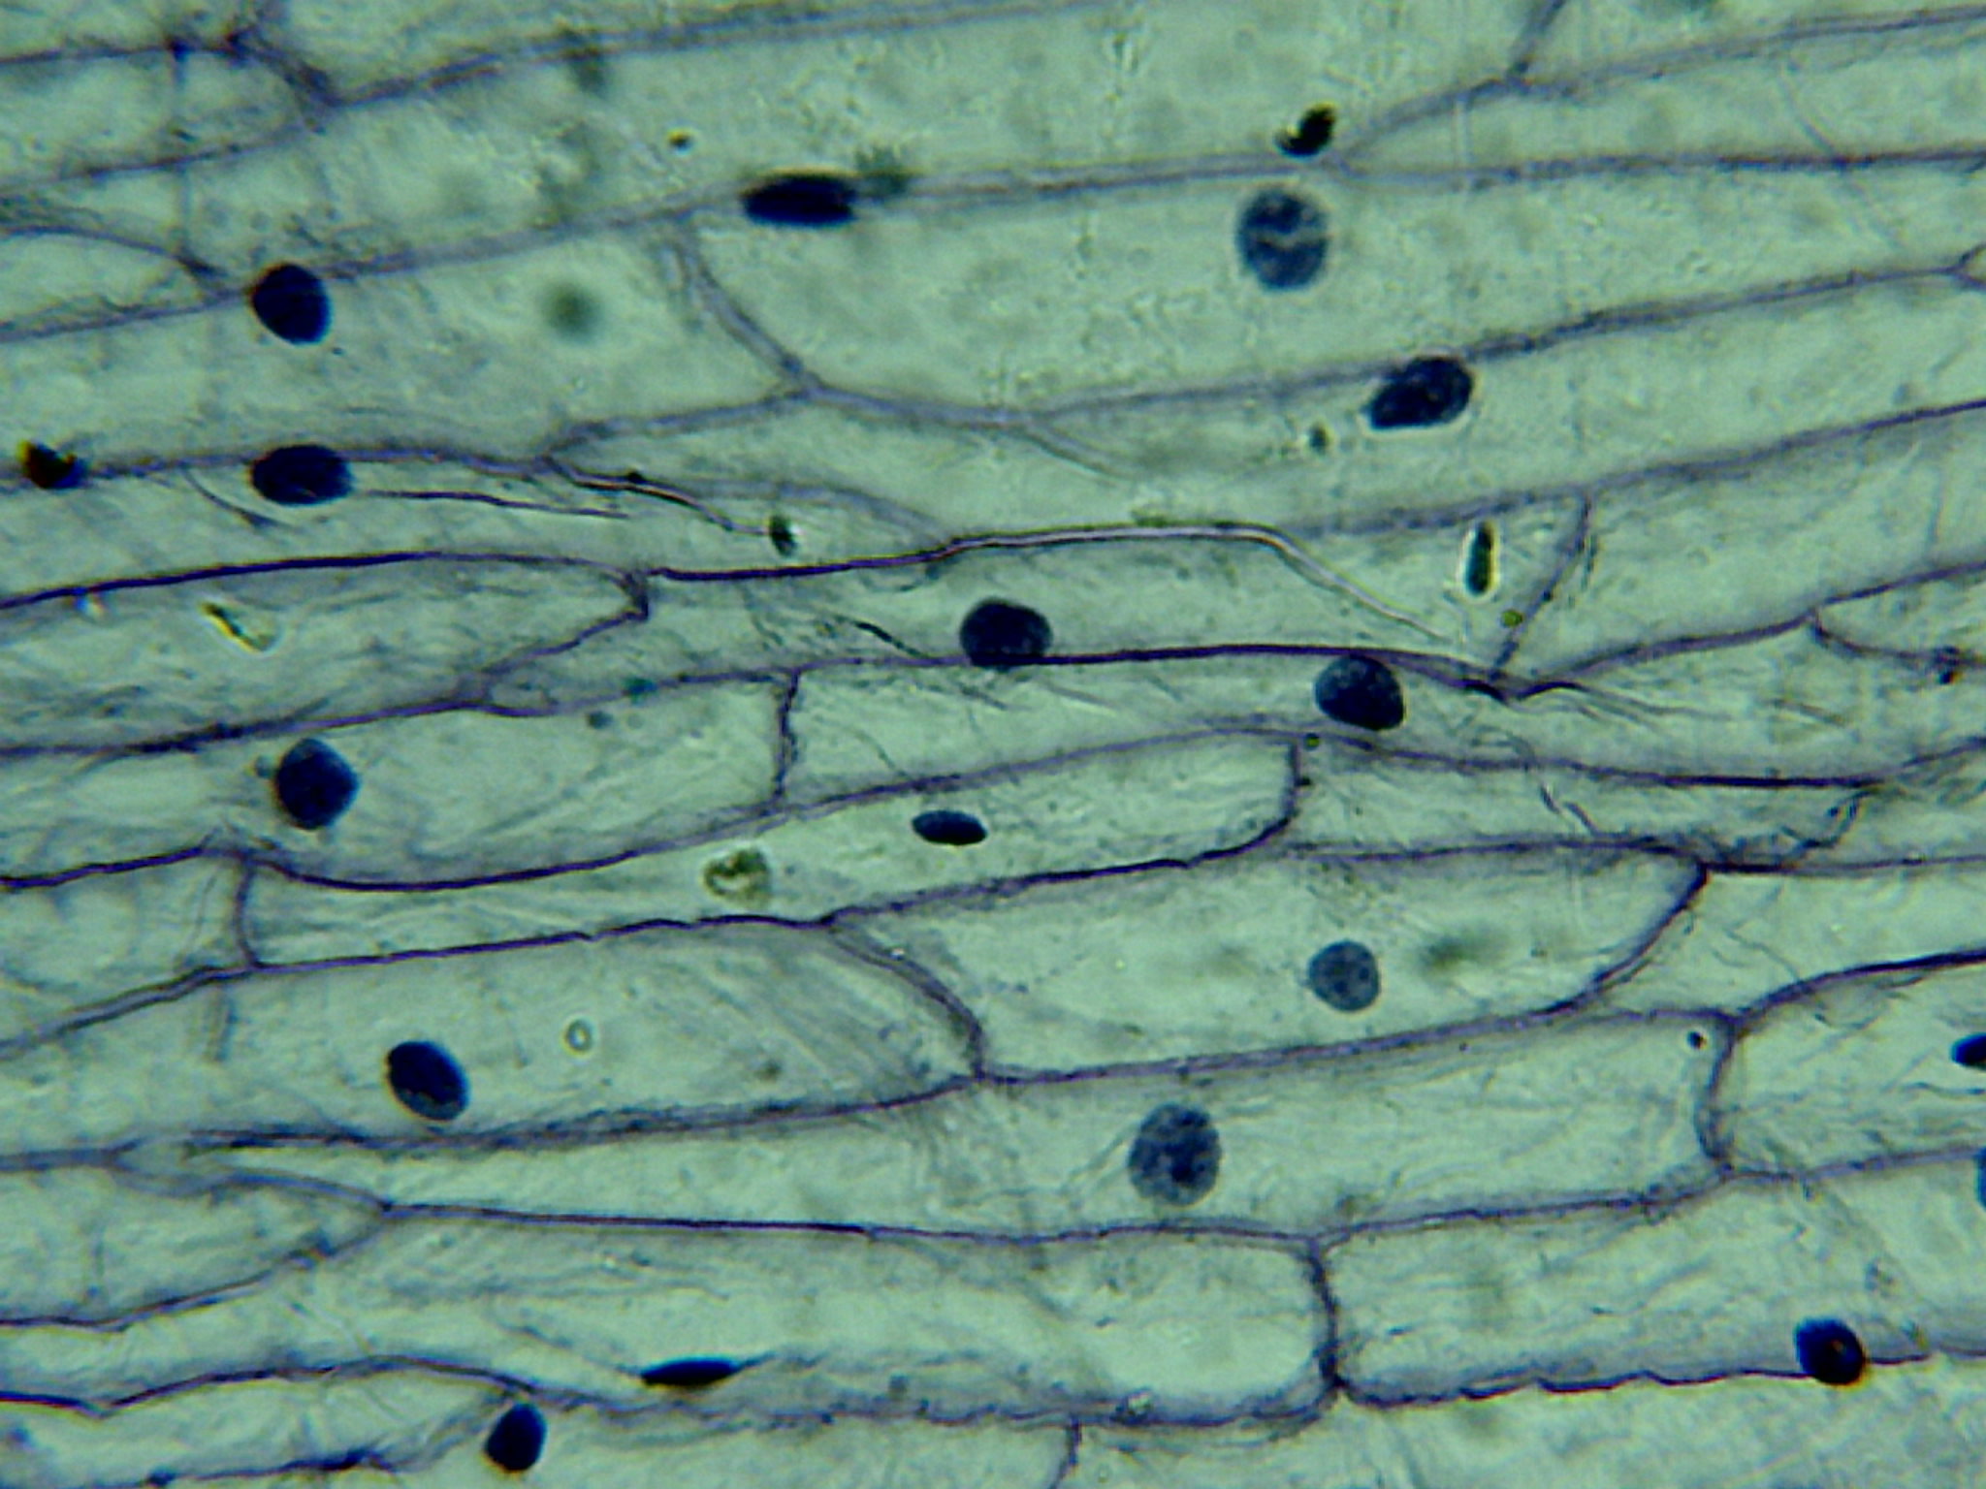
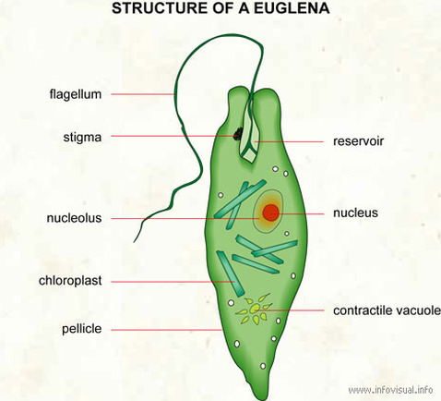
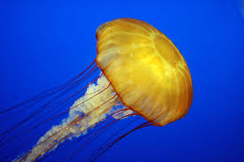
Characteristic of life #1: Made of One or more Cells
Cells are the smallest unit capable of all life functions. (a mitochondria, cell membrane, or an atom by themselves are not capable of all life functions)
Unicellular: organisms composed of one cell (ie bacteria, protists like amoeba, and certain fungi like yeast)
Multicellular: organisms composed of more than one cell (ie animals, plants, all fungi other than yeast)

Slide 5
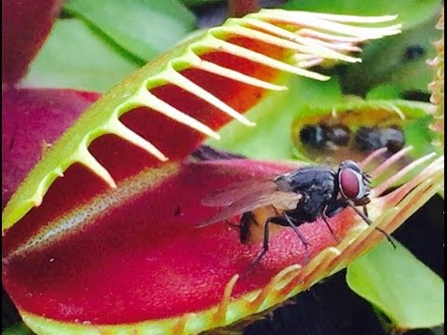
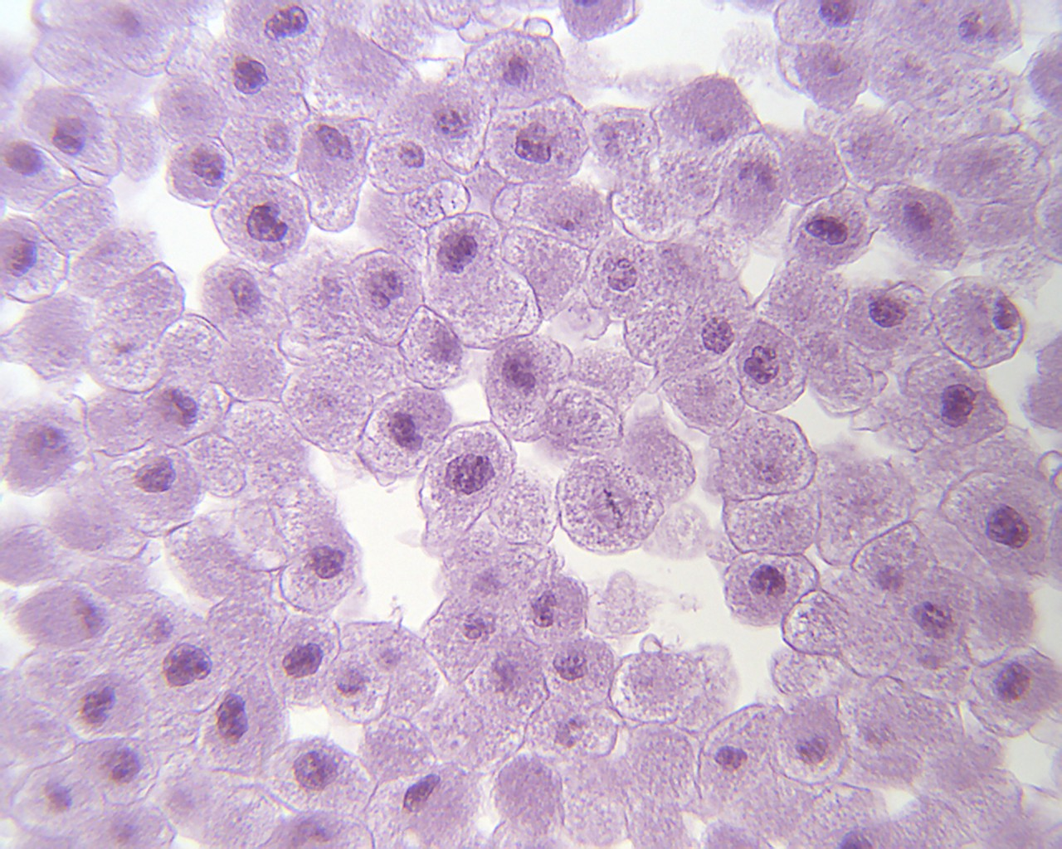
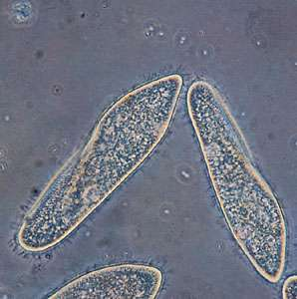
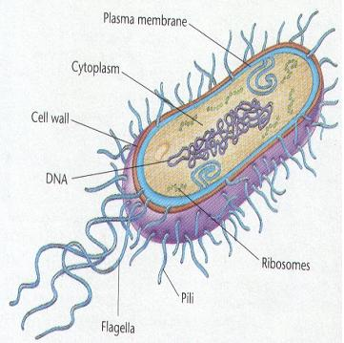
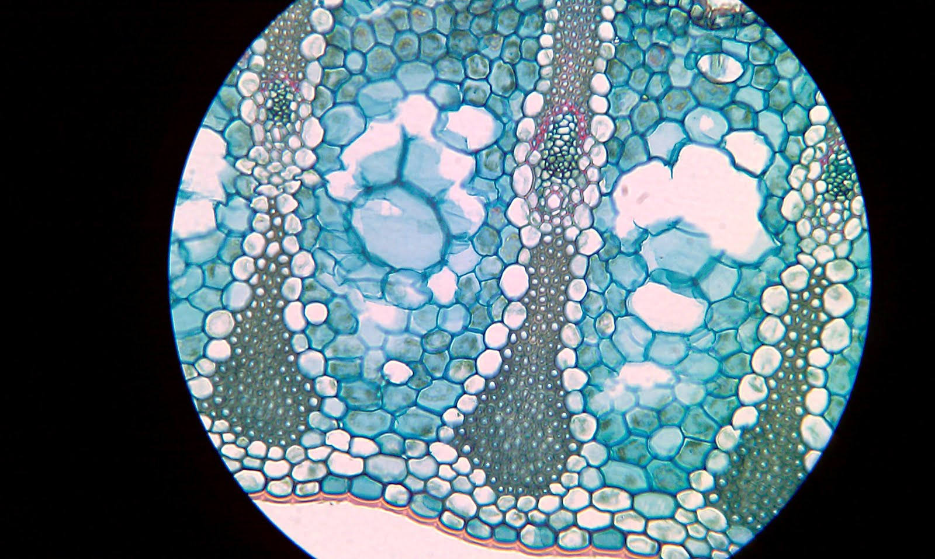
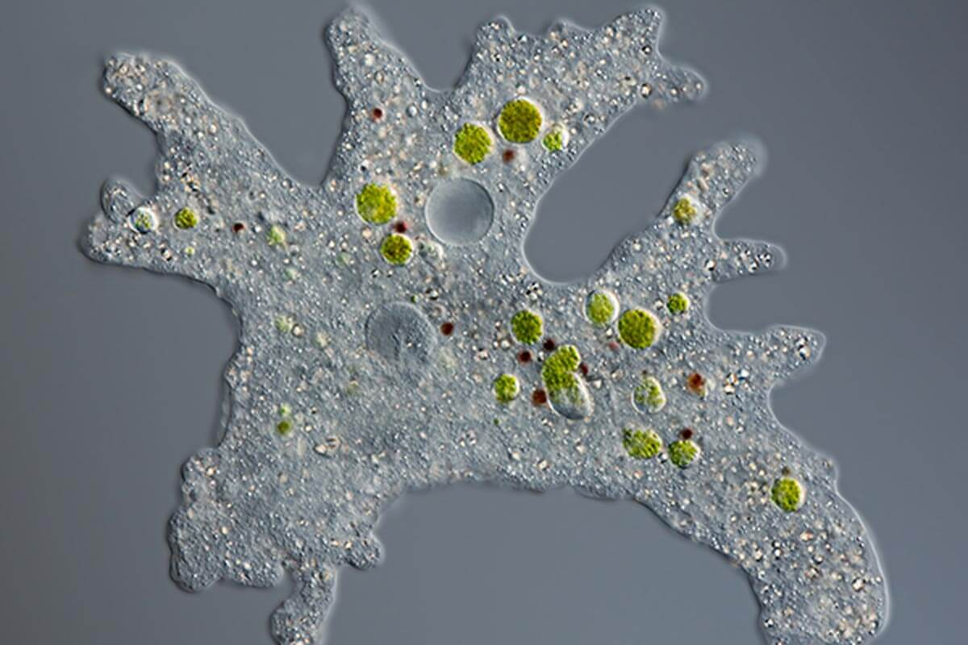
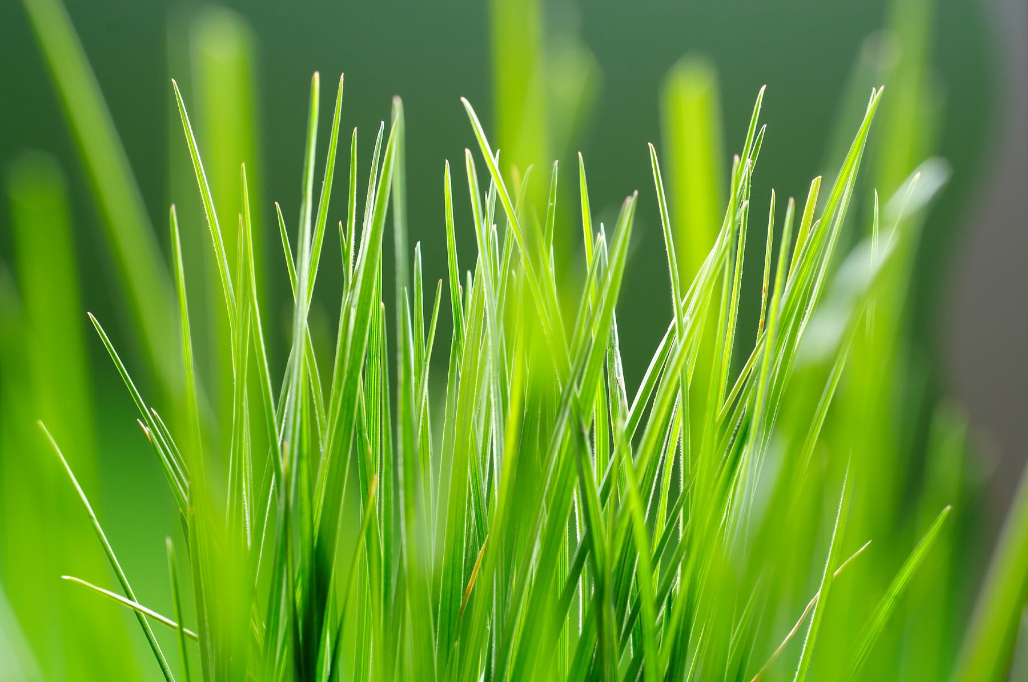
Uni or multi?
1
4
3
2
5
6
7

Slide 6
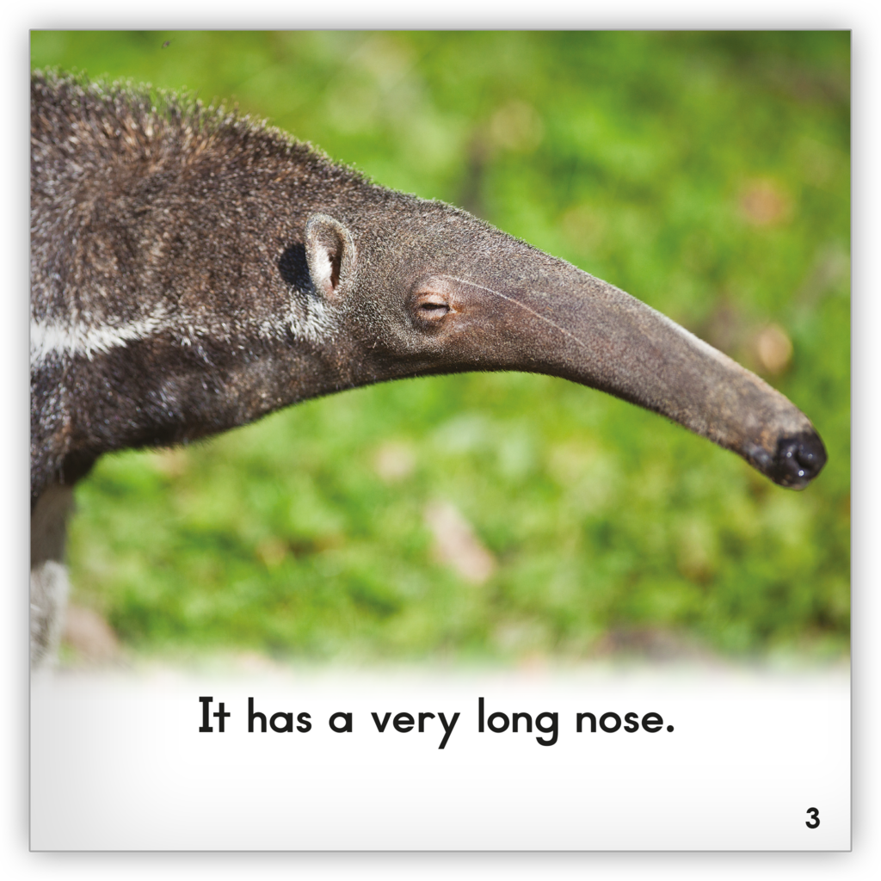
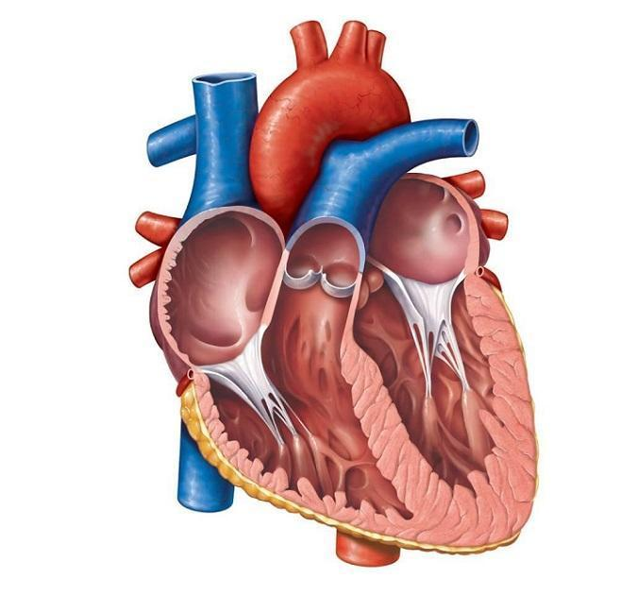
Characteristic of life #2: organization
Organization = living things are arranged in an orderly way
Each organized structure in an organism has a specific function
Ex – an anteater’s snout is made of different tissues specialized to hold its long tongue
Ex – a human heart is made of muscle tissue and has four chambers to keep blood with oxygen and blood without oxygen separated.

Slide 7
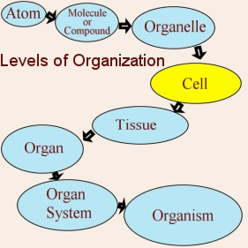
unicellular vs. multicellular organization
Unicellular organization = atoms like carbon, hydrogen, and oxygen are grouped into larger molecules like carbohydrates, proteins, and fats.
Large multicellular organisms like have additional levels of organization. These levels are given below.
Atom → Molecule → Cell →
Tissue → Organ → Organ System → Organism

Slide 8
Level | Definition | Example in Humans
Atom | The smallest unit of matter | Carbon
Molecule | Groups of atoms that are bonded together | Protein
Cell | The smallest unit of life (composed of atoms and molecules) | Muscle Cell
Tissue | Groups of cells that work together to perform a particular function | Muscle Tissue
Organ | Groups of cells and tissues that work together to perform a particular function | Heart
Organ System | Groups of cells, tissues, and organs that work together to perform a particular function | Circulatory System

Slide 9
The levels of biological organization from smallest to largest are:

Slide 10
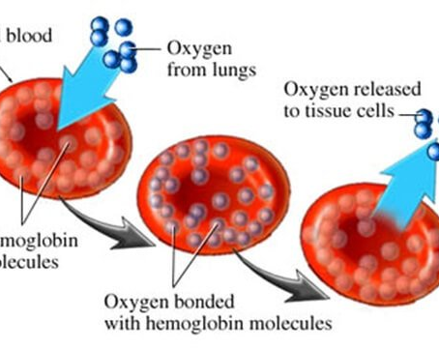
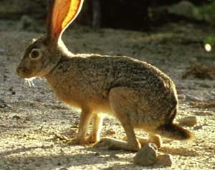
Characteristic of life #3: Regulation (Homeostasis)
Regulation: maintaining stable internal conditions despite changes in external conditions
Homeostasis is when internal conditions are stable.
Example – Whatever the air temperature is outside, a human’s internal temperature should remain stable at 98.6˚F. Your body can REGULATE internal temperature by sweating when you’re hot or shivering when you’re cold to reach stability again.
Other conditions that must be kept stable include water, oxygen, salt, sugar, and calcium levels in the blood.
Notes:
Homeostasis → homeo (self, same) / stasis (stay) → Homeostasis literally means to keep oneself the same (unchanging).

Slide 11
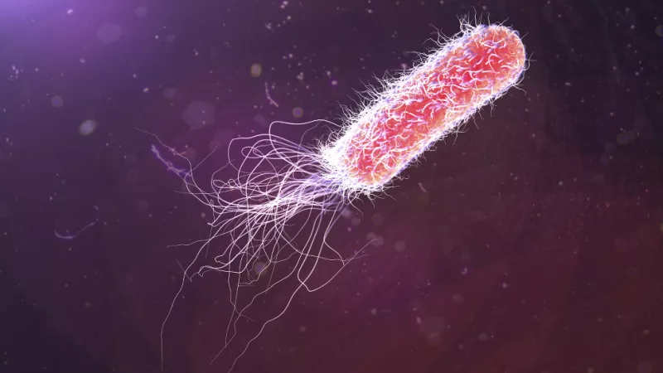
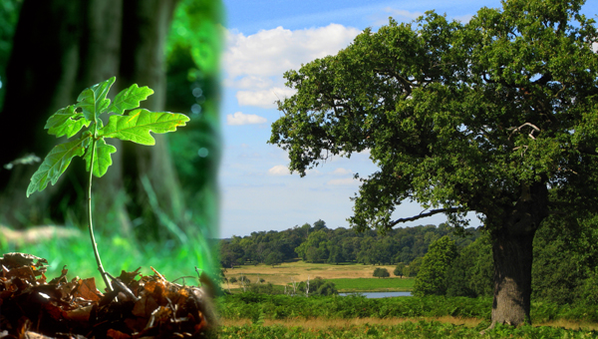
Characteristic of life #4: grow and develop
Most organisms begin as one cell!
Growth = results in the addition of mass and/or new cells
Notes:
Have them circle “addition of mass” and write unicellular above it – circle “new cells” and write multicellular

Slide 12
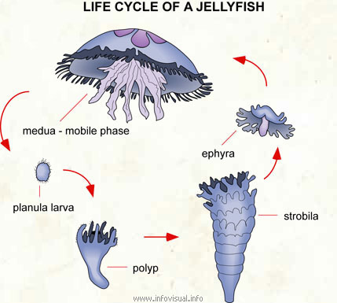
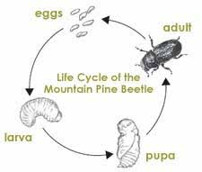
Characteristic of life #4: grow and develop
Development = changes that take place to bring an organism to maturity

Slide 13
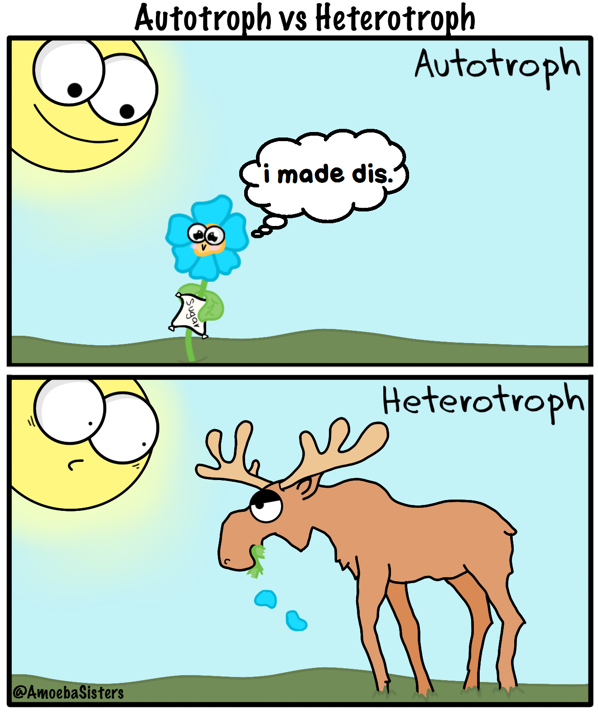
Characteristic of life #5: Requires ENERGY
All chemical reactions carried out within an organism require energy. There is energy stored in food, and that food is broken down when energy is needed.
Autotrophs = organisms that make their own food (using energy from sunlight during photosynthesis)
Heterotrophs = organisms that get their energy from consuming other organisms
All energy organisms use originally came from the SUN!

Slide 14
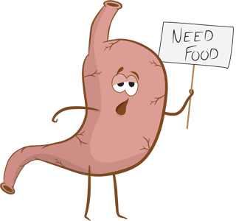
Characteristic of life #6: Responds to stimuli
Organism’s Internal Environment = all things inside of an organism
Organism’s External Environment = all things surrounding an organism

Slide 15
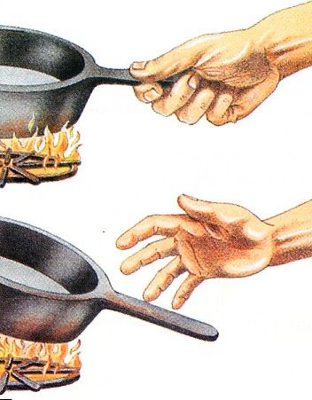
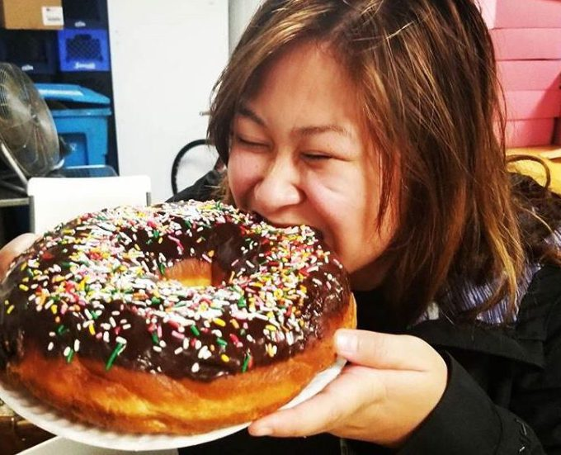
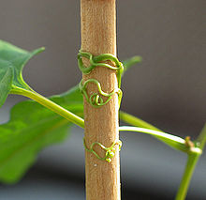
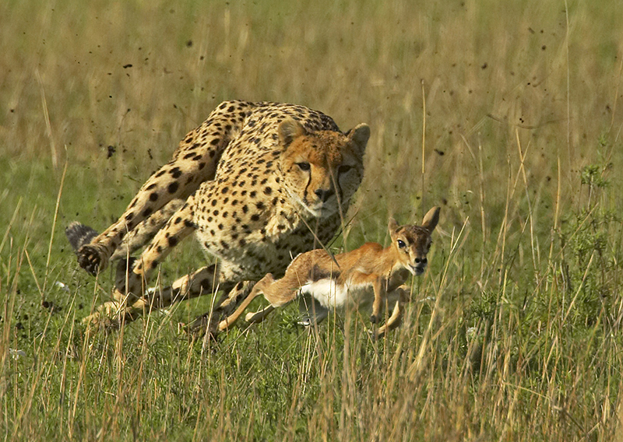
Characteristic of life #6: Responds to stimuli
Stimulus = anything that is part of either an organism’s external or an organism’s internal environment that causes a reaction
Response = an organism’s reaction to a stimulus

Slide 16
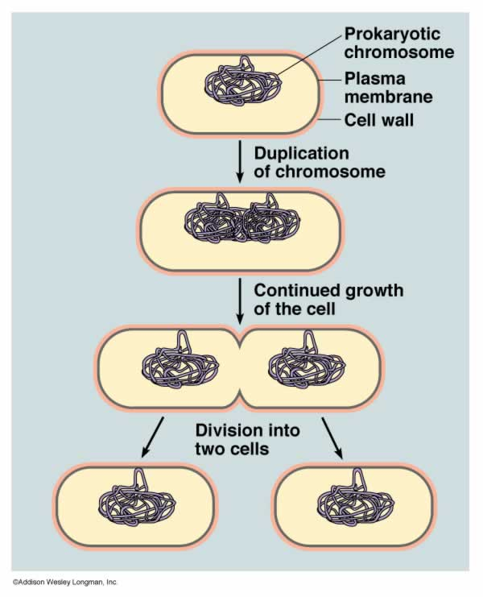
Characteristic of life #7: Reproduction
Reproduction = the production of offspring
No organism lives forever, so reproduction is how they ensure their genes “live on” after they die.
Two types: asexual vs. sexual
← What type is represented by the picture to the left?

Slide 17
Sexual vs. asexual reproduction
 | Sexual | Asexual
How many parent organisms are needed? | Two | One
Are the offspring genetically identical to the parent(s)? | No (remember, you have a mix of your parents’ DNA, so you are not identical to either one). | Yes

Slide 18
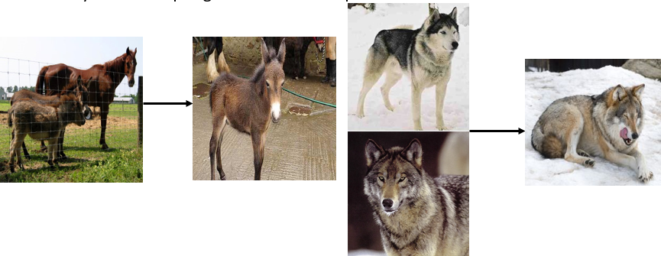
Characteristic of life #7: Reproduction
Species = a group of organisms that can breed with one another and produce fertile offspring
What happens when two different species mate with each other?
Hybrids = offspring of two different species which interbreed

Slide 19
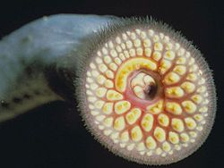
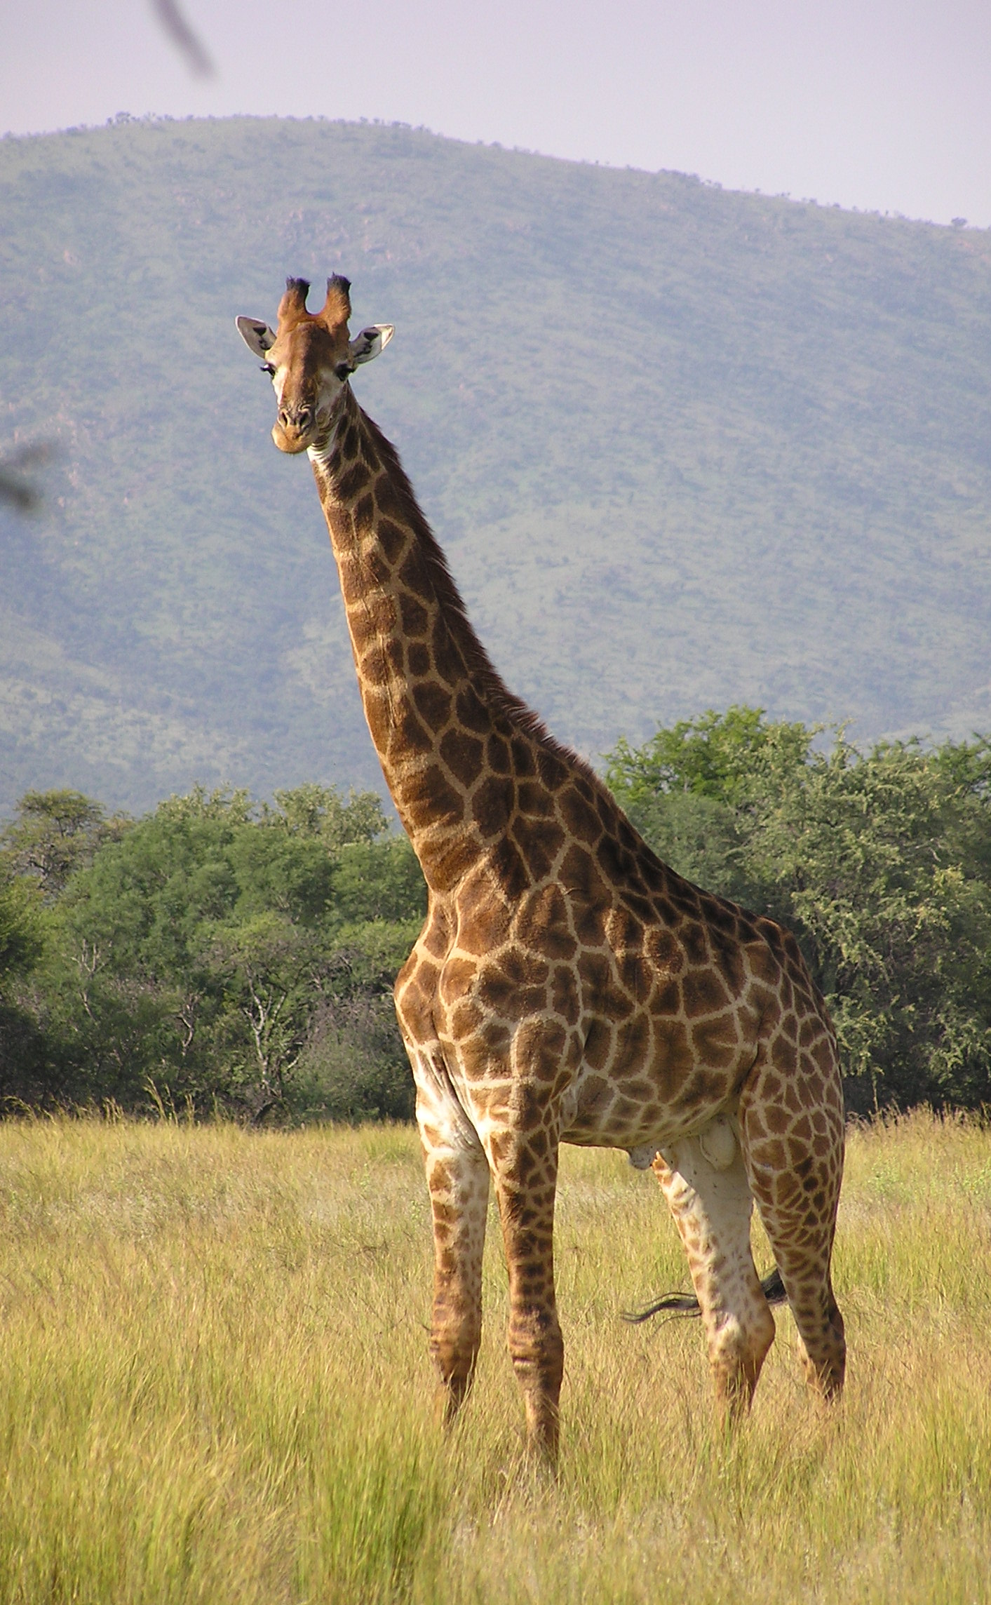
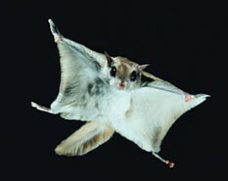
Characteristic of life #8: Groups of living things Evolve OVER TIME
Evolution is defined as change in a population of organisms over many generations.
A population is a group of organisms of the same species that live in a particular area.
Adaptation = any inherited characteristic that results from changes in a species over time
Example – giraffe necks

Slide 20
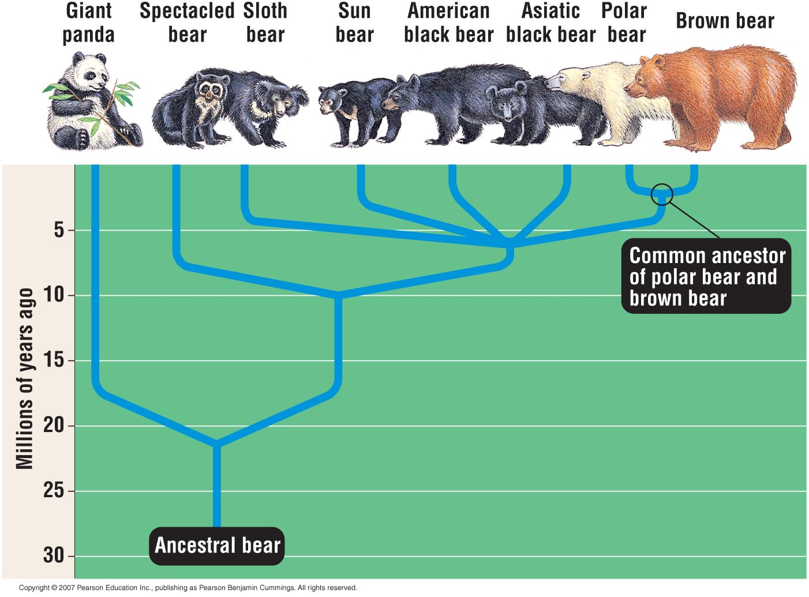

Slide 21
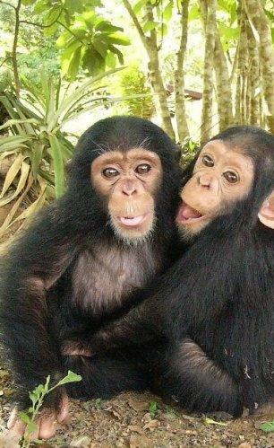
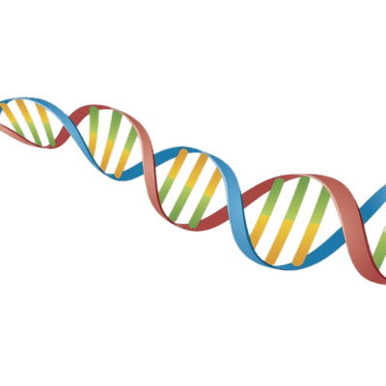
Characteristic of life #9: Has a genetic code (DNA)
All organisms store the complex information they need to live, grow, and reproduce in a genetic code written in a molecule called DNA.
What percentage of human DNA is shared with chimpanzees???

Slide 22
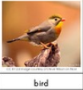
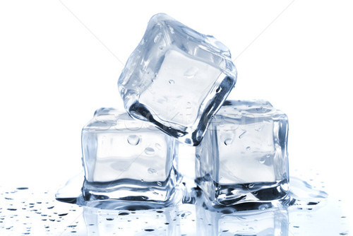
How do I tell: Living or not?
Living
Once-Living
Nonliving
Must have all 9 characteristics of life currently!
No exceptions!!
Does not currently have all 9 characteristics, but once did.
“Dead”
Usually still have DNA and cells.
Does not have all 9 characteristics of life.
Never did in the past.
Never will in the future.

