Slide 1
Lab Safety
Pre-AP Biology; Unit 1 Topic 2
Objectives:
I can distinguish between safe and unsafe practices in the lab
I can identify the location of safety equipment in the classroom
I can explain what the appropriate lab safety steps are in various scenarios (fire, cuts/burns, broken glass, etc)

Slide 2
Why do We Talk about Lab Safety?
Have any of you experienced what happens when you don’t follow lab safety?
http://www.msnbc.msn.com/id/42569811/ns/us_news-life/t/yale-student-dies-chemistry-lab-accident/

Slide 3
Article Analysis
What could have been done to prevent this accident?
What should the university do in response to the accident to improve their lab safety practices?

Slide 4
General Safety Rules
1. Listen to or read instructions carefully before attempting to do anything.
2. Wear proper protective gear and appropriate clothing.
3. Notify your teacher if any spills or accidents occur.

Slide 5
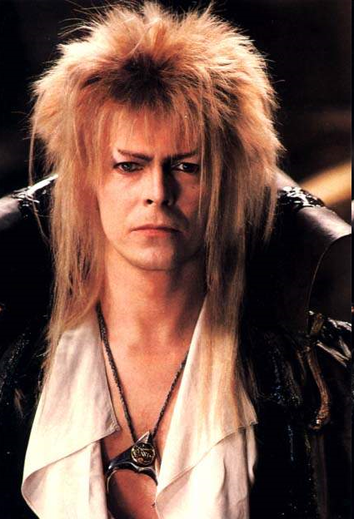
General Safety Rules
4. After handling chemicals, always wash your hands with soap and water.
5. During lab work, keep your hands away from your face and tie back your hair.

Slide 6
General Safety Rules
6. Know the location lab safety equipment.
7. Keep your work area uncluttered. Take to the lab station only what is necessary.

Slide 7
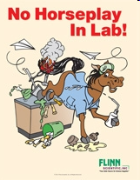
General Safety Rules
8. Never put anything into your mouth during a lab experiment.
9. Clean up your lab area at the conclusion of the laboratory period.
10. Never “horse around” or play practical jokes in the laboratory.

Slide 8
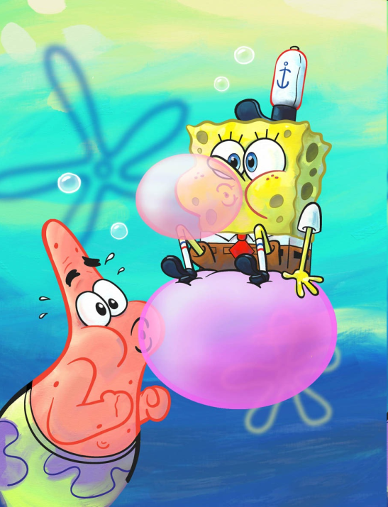
Behavior in the
Science Classroom
Students should not touch equipment unless given proper instructions and permission by the teacher
Always read your lab procedure!
Food, drink, and gum are a NO!
Minimize clutter

Slide 9

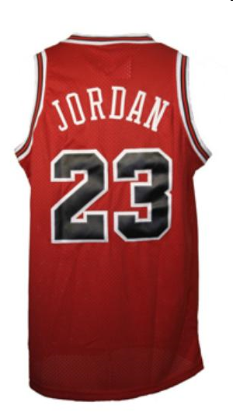
lab Appropriate Clothing
No open-toed shoes
Tie Hair Back
Roll up loose sleeves
Jersey Material: will melt!

Slide 10

Lab Safety Equipment
It is safer for your eyes if you wear glasses, rather than contact lenses.
Goggles with vents vs. goggles without vents
Sometimes if chemicals: Aprons and Gloves

Slide 11
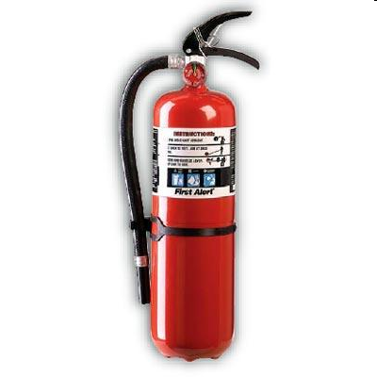
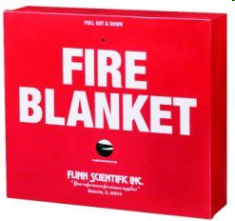
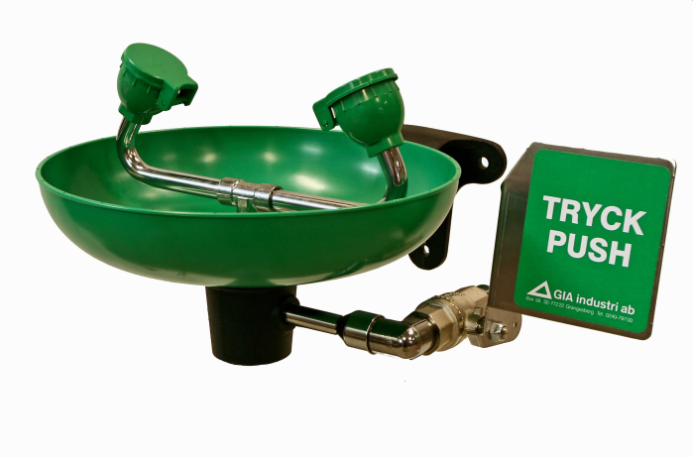
Lab Safety Equipment
Fire Extinguisher
Fire Blanket: used for fires on hair or clothing
Eye Wash

Slide 12
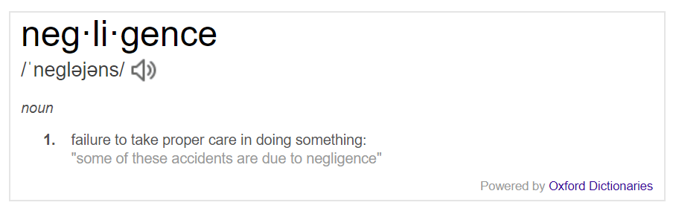
Equipment Usage
“The cost of replacing glassware or equipment caused by negligence could be the responsibility of the student”
What is negligence?

Slide 13

Glassware Safety
1. Chipped or cracked glassware should not be used. Show it to the teacher.
2. Broken glassware should not be disposed of in a classroom trashcan. There is a special glass disposal container for it.
3. If a piece of glassware gets broken, do not try to clean it up by yourself. Notify the teacher.

Slide 14
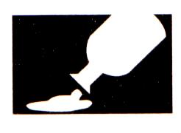
Chemical Safety
Wear protective goggles and a lab apron whenever heating or pouring hazardous chemicals.
Never mix chemicals together unless you are told to do so (and then only in the manner specified).
Never touch, smell, or taste any chemicals.

Slide 15
Chemical Safety
4. If you need to smell the odor of a chemical, waft the fumes toward your nose with one hand. Do not put your nose over the container and inhale the fumes.
5. Never pour water into a concentrated acid. Acid should be poured slowly into water.

Slide 16
Chemical Safety
6. Follow the instructions of your teacher when disposing of all chemicals. (Solid wastes should not be placed in the sink)
7. Wash your hands after handling hazardous chemicals.

Slide 17
Handling Biological Materials
With any live or preserved specimens, be RESPECTFUL!
Exercise caution when using sharp tools
Dispose of all biological materials as directed by the teacher

Slide 18
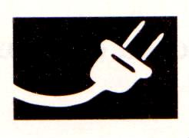
Electrical Safety
Lay electrical cords where no one can trip on them or get caught in them.
Be sure your hands and your lab area are dry before using electrical equipment.
Never poke anything into electrical outlets.

Slide 19
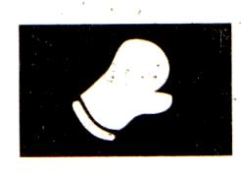
Heating Safety
Let burners and hotplates cool down before touching them. Test to see if they are cool enough by bringing the back of your hand close to them.
Use tongs and/or protective gloves to handle hot objects.
Never reach across an open flame or burner.
Tie back long hair and do not wear loose clothing

Slide 20
Heating Safety
5. Always point the top ends of test tubes that are being heated away from people.
6. When heating a test tube, move it around slowly over the flame to distribute the heat evenly.

Slide 21
First Aid
Injury: Burns
What To Do: Immediately flush with warm water until burning sensation is lessened.

Slide 22
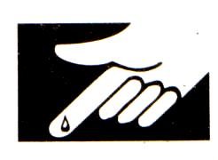
First Aid
Injury: Cuts and Bruises
What To Do: Do not touch an open wound without safety gloves. Pressing directly on minor cuts will stop bleeding in a few minutes.

Slide 23

First Aid
Injury: Eyes
What To Do: Flush eyes immediately with plenty of water for several minutes.

Slide 24

First Aid
Injury: Poisoning
What To Do: Find out what substance was responsible and alert the teacher immediately.

Slide 25
First Aid
Injury: Spills on the skin
What To Do: Flush with large quantities of water.

Slide 26
Lab Safety Comic or Poem
In the time given in class, create a comic strip or poem that meets the following guidelines. Whatever you do not finish will be homework.
Comic: create a comic strip about the consequences of breaking lab safety rules. You must include at least three safety rules and at least 6 frames.
Poem: create a poem that includes at least 3 lab safety rules. Your poem must be at least 10 lines long.

