Slide 1
The Scientific Method
Pre-AP Biology; Unit 1 Topic 3
Objectives:
I can collect quantitative and qualitative data
I can distinguish between observations and inferences
I can develop a well-written hypothesis based on observations and research
I can identify independent and dependent variables in an experiment
I can identify constants in an experiment
I can differentiate between a control group and experimental groups

Slide 2
Definition of Science
Science = an organized way of using evidence to learn about the natural world
AND
Science = the body of knowledge scientists have built up over the years using this process

Slide 3
Characteristics of Science
Relies on evidence
Expands scientific knowledge
Challenges accepted theories and claims
Questions results
Tests claims
Undergoes peer review
Peer review = a process by which the procedures used during an experiment and the results are evaluated by other scientists.
7. Uses the metric system (Meter, gram, liter, second)

Slide 4
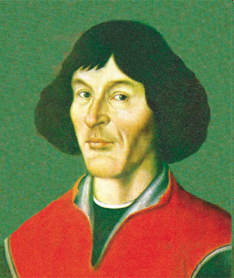
Science is Always Changing: An Example from Astronomy
Name that HOTTIE!

Slide 5
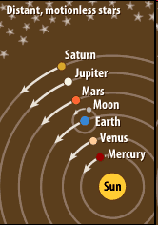
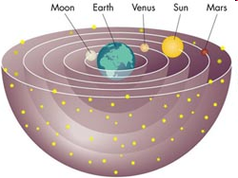
Copernicus and his heliocentric model
Old Geocentric Model
New Heliocentric Model

Slide 6
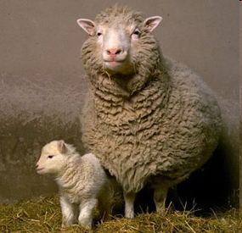
Science and Human Values
We use science to inform decisions about health care, environmental policy, etc.
Many of science’s major discoveries have been considered controversial because they call into question certain beliefs (ethics)
Example: Cloning, stem cell research,
evolution

Slide 7
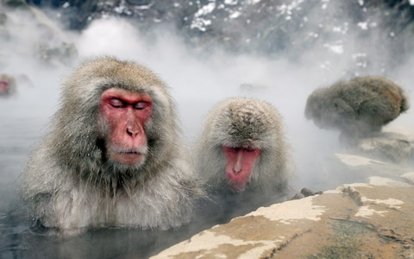
Scientists make Observations
What observations can you make about this image???

Slide 8
Observations vs. Inferences
Observation = a direct method of gathering information in an orderly way
Recording information using the five senses or tools
AH—Look at this!

Slide 9
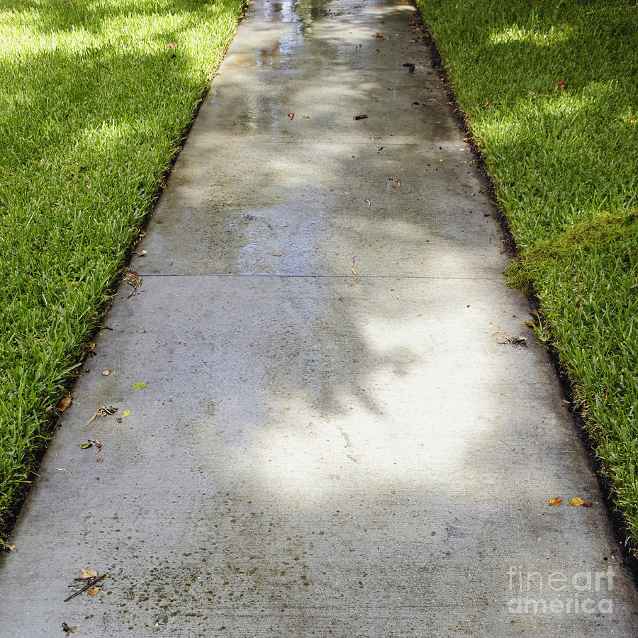
Observations vs. Inferences
Inference = a possible explanation or conclusion based on the observations you’ve made and the experiences you’ve had.
Example: You leave school and observe that the ground is wet. You infer that it rained.

Slide 10
Let’s practice making observations and inferences with some new images!!!

Slide 11
#1

Slide 12
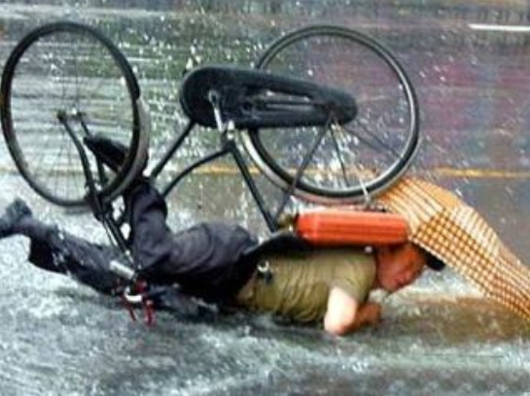
#2

Slide 13
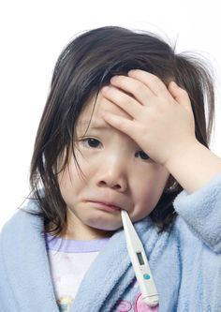
#3

Slide 14
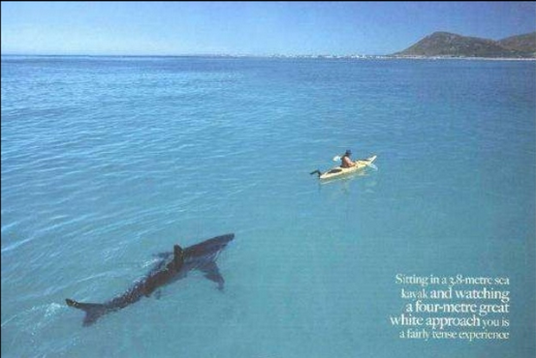
#4

Slide 15
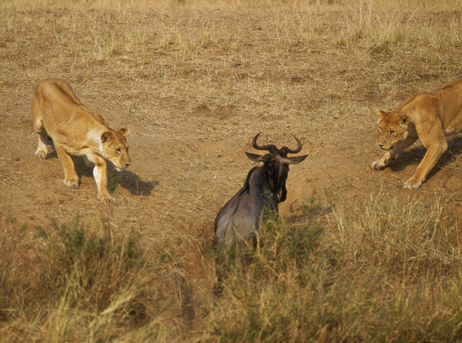
#5

Slide 16
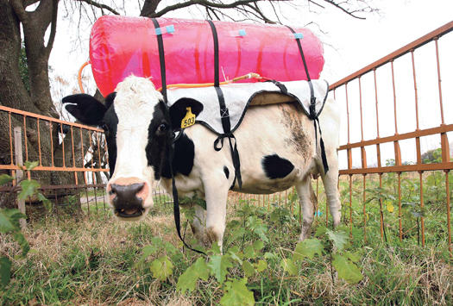
#6

Slide 17
The Scientific Method

Slide 18
Step #1: Ask a Question / State the Problem
A scientific question must be testable, meaning that you can perform an experiment to solve it.
Scientists base their questions upon:
Observations (after information has been collected)
Prior knowledge (experiences or things they’ve learned)
Related research (observations they or others have made)

Slide 19
Step #1: Ask A Question
What questions can we ask about the behavior that we observed with the Japanese Macaques?

Slide 20
Step #2: Form a Hypothesis
Hypothesis= a testable explanation of a situation
Written in an “If…then…” format.
“If [insert what you’re going to do to CAUSE a change], then [insert what change you predict will happen]”
Example: “If dogs receive three training sessions per day, then they will learn/recall tricks faster than dogs that receive one training session per day.”

Slide 21
Hypothesis is NOT…
NOT TO BE CONFUSED WITH:
Theory = a well-tested explanation that unifies a broad range of observations
Law = a statement of fact, deduced from observation, that a particular natural or scientific phenomenon always occurs if certain conditions are present.

Slide 22
Step #2: Form a Hypothesis
Let’s form a hypothesis about why our Japanese Macaques are exhibiting this behavior
Make sure that this is a testable hypothesis!

Slide 23
Step #3: Design an Experiment
Experiment = an investigation of a phenomenon in a controlled setting to test a hypothesis
Let’s look at a new experiment:
A scientist observes that grass grows taller in the part of his lawn right next to the sprinkler.
Hypothesis: If the grass is given extra water, then it will grow taller.

Slide 24
Step #3: Design an Experiment
Variable = any factor that can change or be changed and affect the outcome of an experiment (VARY = to change)
Water, sunlight, disease, height of grass, soil type, etc.
Independent Variable = the manipulated variable; what is changed by the experimenter.
Amount of water
Dependent Variable = the measured variable; the results we’re looking to find.
Change in height of grass

Slide 25
Memory tricks
I change the Independent Variable
In this experiment, I would change how much water the plants receive.
This is the CAUSE.
The dependent variable depends on the independent variable.
How tall the plant grows DEPENDS on how much water I give it.
This is the EFFECT we’re looking to measure.

Slide 26
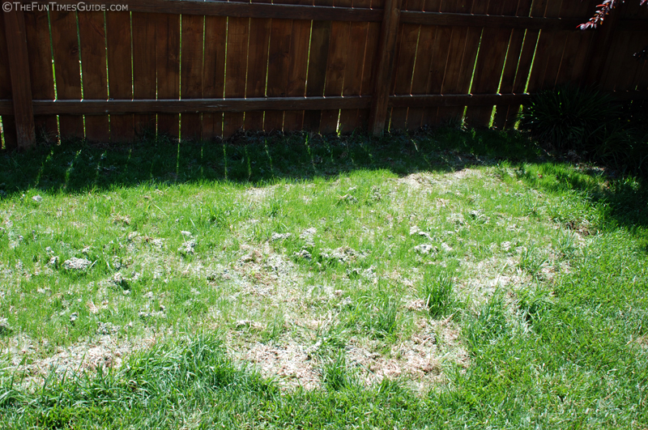
Step #3: Design an Experiment
Constant = a factor/variable that is kept the same during an experiment.
What are some constants in our grass experiment???

Slide 27
Step #3: Design an Experiment
Control Group = a group used for comparison that does not receive “the treatment.”
The plot of grass that was not given extra water.
Experimental Groups = the groups exposed to “the treatment” (the variable being tested).
The plots of grass that were given any amount of extra water.

Slide 28
Step #4: Perform an Experiment / Gather Data
Data = Information gained from observations
Quantitative Data: numerical data (measurements of quantities like time, temperature, length, mass, area, etc.)
Grass experiment = ?
Qualitative Data: descriptions of what our senses detect (qualities, not numerical)
Grass experiment =?

Slide 29
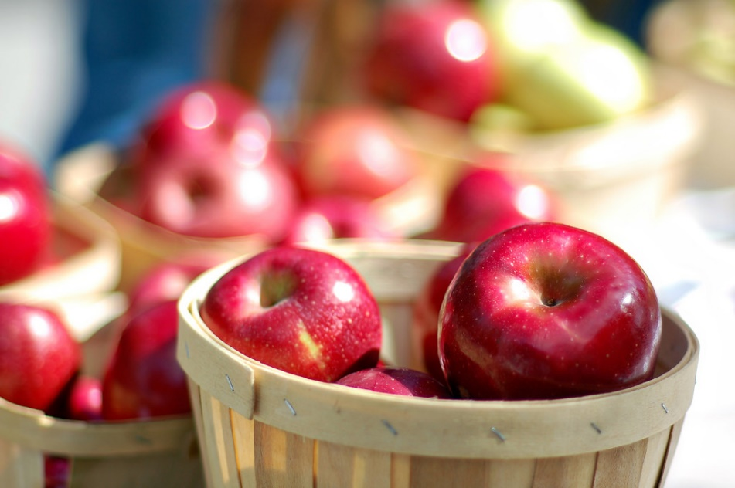
Quantitative vs. qualitative
Quantitative Example:
There are 10 apples in the basket.
The basket weighs 5.3 kilograms.
Qualitative Example:
The apples in the basket are a dark red.
The apples are smooth.

Slide 30
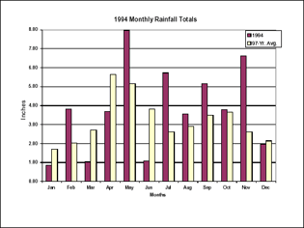
Step #5: Analyze the Data
Questions that scientists ask:
“Has my hypothesis been supported?”
“Is more data needed?
“Are different procedures needed?”
“What are the possible sources of errors?”
Work in groups to analyze data!
Tables and graphs
are good tools for
data analysis

Slide 31
Step #6: draw Conclusions
Conclusions may:
Support original hypothesis
Refute original hypothesis
Indicate that further research is needed

Slide 32
Your conclusions should include:
A conclusion statement that indicates whether your data supports or rejects your original hypothesis.
A summary of the data that supports your conclusion statement. You must discuss specific numerical values.
An explanation of HOW this specific data supports your conclusion statement. You should relate this to science you’re learning in class. Define vocabulary words, etc.
Often scientists will explore further research options at the end of their conclusion. “If I continued my study, I would next test…”

Slide 33
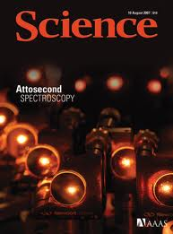
Step #7: Communicate results
Scientists report their conclusions and findings in scientific journals (peer-reviewed journals)
What examples can you think of?

Slide 34
The Culture of Science
Figure 1.22
Scientists build on what has been learned from earlier research.
They pay close attention to contemporary scientists working on the same problem.
Both cooperation and competition characterize the scientific culture.
Scientists check the conclusions of others by attempting to repeat experiments.

Slide 35
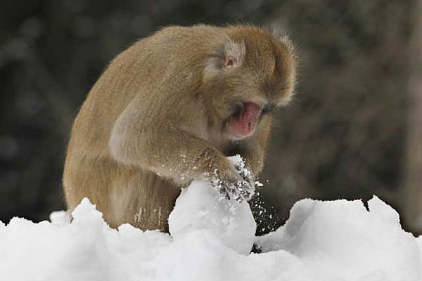
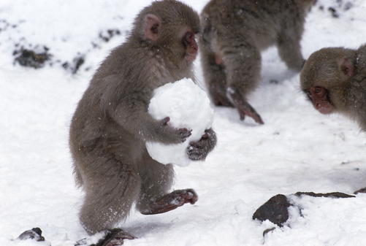
Fun Fact: Japanese Macaques build snowballs for fun!!!

Slide 36
Alka-seltzer investigation!

