Slide 1
DATA ANALYSIS
Pre-AP Biology; Unit 1 Topic 4
Objectives:
I can record (quantitative) data in tables and charts, using units
I can organize data to show the relationship between variables on appropriate graphs
I can identify and discuss trends using data

Slide 2
Organizing data collection
During an experiment, scientists use data tables (charts) to record their data.
Data tables include vertical columns and horizontal rows.
Each column and row should be labeled so you know what each number or description “means.”
Should have a title that fully communicates what information is displayed in the table (this could be the same as your graph title)

Slide 3
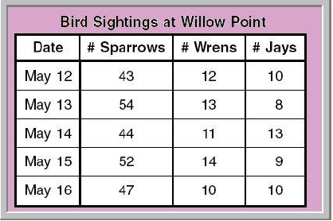
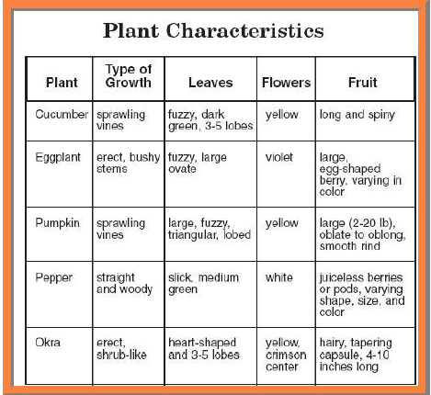
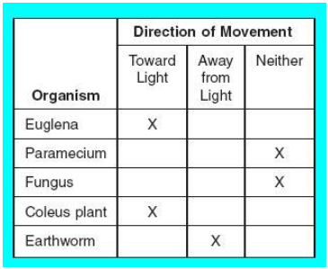

Slide 4
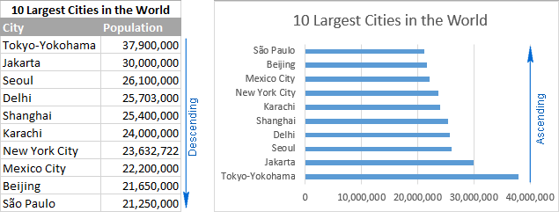
Why turn a chart into a graph?
Visualizes the data (most humans are visual learners)
Easily and quickly identify patterns or trends in the data

Slide 5
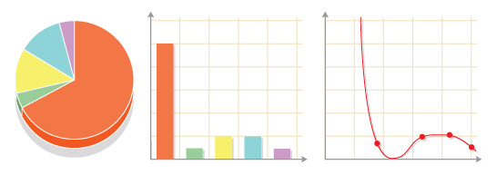
Types of graphs
Pie Bar/Histogram Line

Slide 6
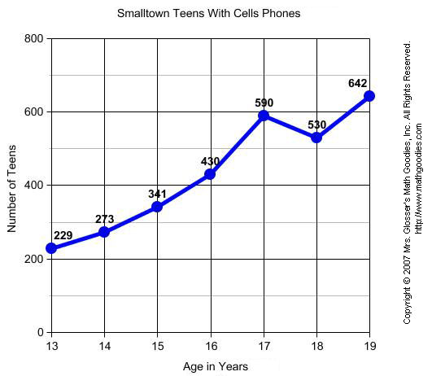
Line graph
Both variables on the x (horizontal) and y (vertical) axes are quantitative / numerical
Often (but not always), the variable on the x axis is time (measured in days, months, years, etc.).
Connected points allow us to see an overall trend in the data.
Extrapolation: when we estimate
values beyond our given data points on
the x axis.

Slide 7
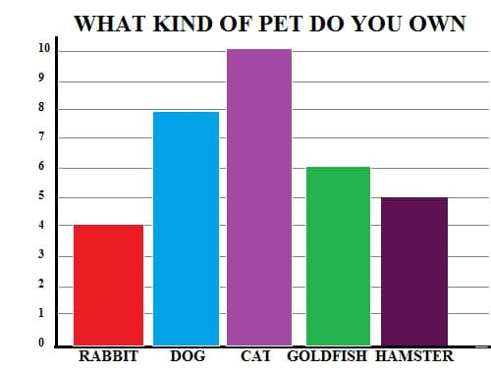
Bar graph
Used to compare values from different “categories”
One variable on the x axis that is typically QUALITATIVE
One variable on the y axis that IS QUANTITATIVE

Slide 8
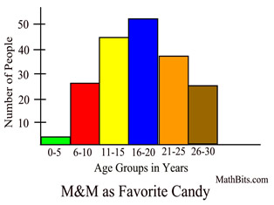
histogram
Similar to a bar graph.
Compares numerical ranges,
rather than “categories.”
‘
Example: the number of people within various age ranges who consider M&M’s to be their favorite candy at various age is depicted in the histogram shown below. Notice that the bars are not spaced apart like in a bar graph. Instead, they are connected.

Slide 9
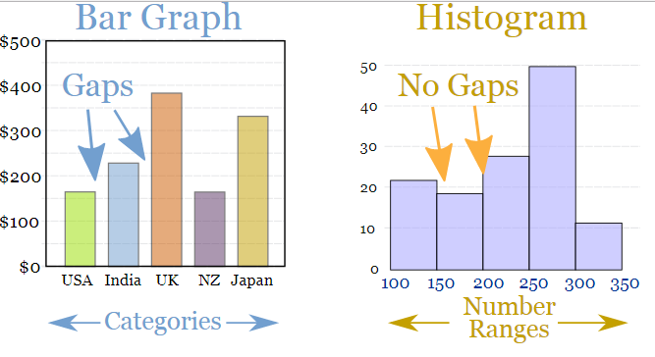

Slide 10
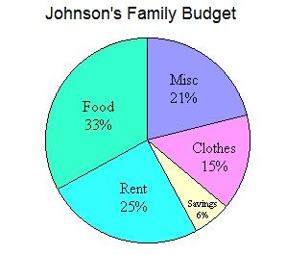
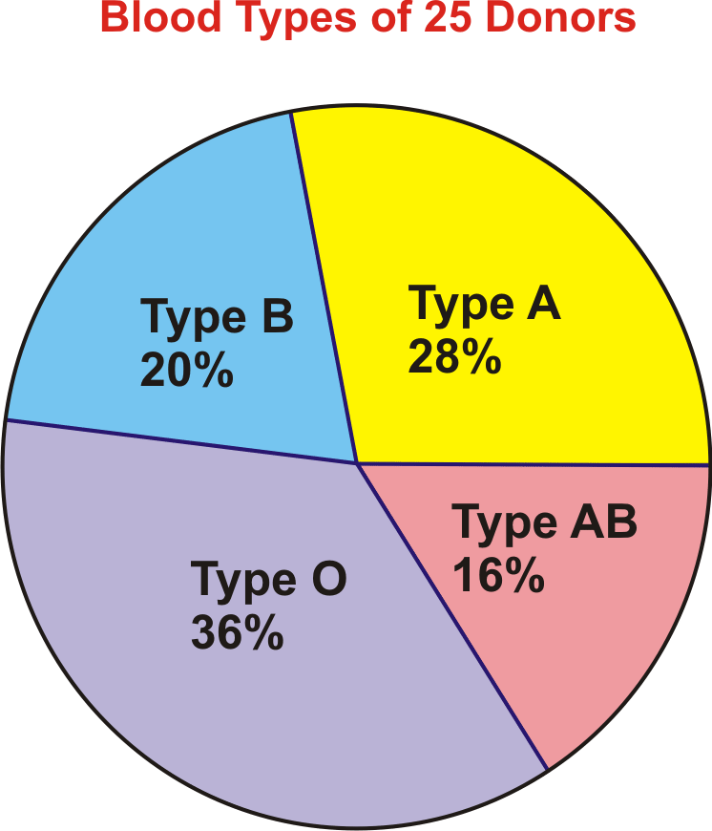
Pie graph (chart)
Used to compare the parts of a whole.
Percentages or fractions
We don’t make these in biology, but you should know how to read/analyze one.

Slide 11
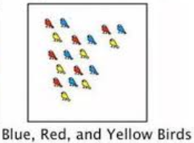
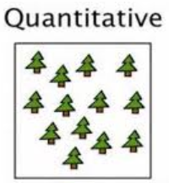
Review: qualitative vs. quantitative
Qualitative: descriptions or categories of something.
Example: types of candy or the characteristics of an apple
Quantitative: numerical or counted measurements
Example: number of students or how much an apple weighs

Slide 12
scientific graphs must include:
a descriptive title
variables placed on the correct axes
labeled axes with units in parentheses (if applicable)
properly scaled axes
properly plotted points or bars
a key/legend (if applicable)

Slide 13
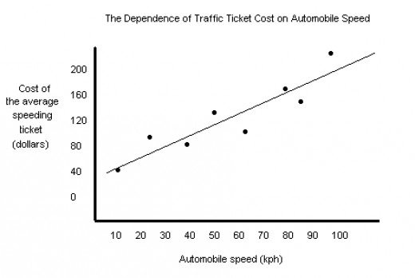
More detail: Title
“The effect of ________ on ________”
“How ______ effects ________”
first blank is independent variable
second blank is dependent variable
For example, the title for the scatter plot given below could be rewritten as “The effect of automobile speed on speeding ticket cost.”

Slide 14
More detail: Variables labeled on the correct axes
independent variable label goes on the x-axis
dependent variable label goes on the y-axis
You can remember this using the memory trick “DRY MIX”
DRY = Dependent Responding Y axis
MIX = Manipulated Independent X axis
For most labels, you should include units (in parentheses)
Example: Average Height of Grass (cm)

Slide 15
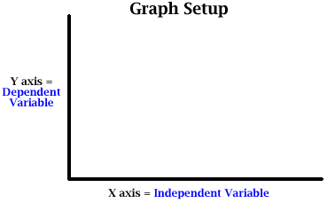

Slide 16
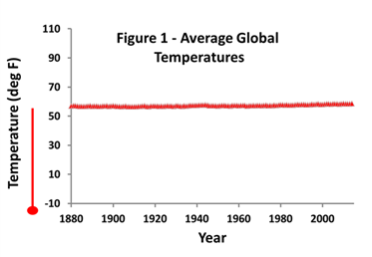
More detail: Appropriate Scales
Scale your axes so that the data is spread out across the whole grid
The graph given below has an badly scaled y axis
scale of the y-axis should only include values between 50-70*F
When creating your scale, you must write values along the entire axis!

Slide 17
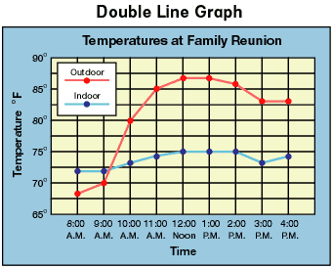
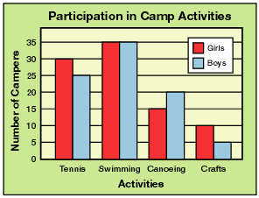
More detail: Key / legend
Two different sets of data can be plotted on the same graph to compare them to each other.
Must include a key/legend to distinguish between the different lines.

Slide 18
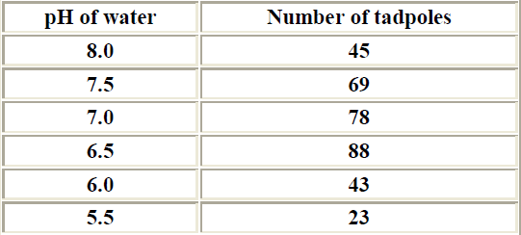
Practice graph #1:
Let’s say scientists were attempting to determine the effect of changing pH levels (a measure of acidity) in a pond on the number of surviving tadpoles. They counted the number of tadpoles found in ponds at various pH levels. Their data is given below. Please graph the data on the next page—making sure to include all the elements of a “proper scientific graph”—and answer the questions on your notes.

Slide 20
Graph analysis questions
What kind of graph did you use to plot the data and why?
What is the I.V.?
What is the D. V.?
What is the OPTIMUM water pH for tadpole survival?

Slide 21
How do I analyze a graph?
Read the title and axis labels for a graph or the title and all headings for a chart.
Try to identify the independent and dependent variables.
Some people choose to read the question before completing steps 1 and 2, and some people choose to complete steps 1 and 2 before reading the question.
Some terms you may want to know…
Maximum / optimum = the highest / best value
Minimum = the lowest value

Slide 22
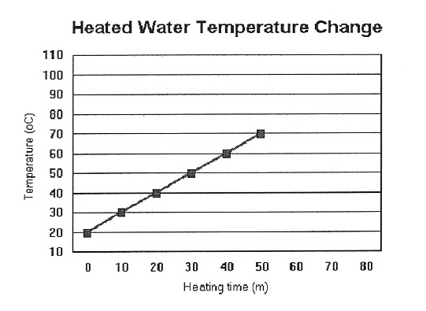
Practice problem #1
Based on the data in the graph to the right, the temperature of water at 25 minutes is
a) 15˚F
b) 15˚C
c) 45˚F
d) 45˚C

Slide 23
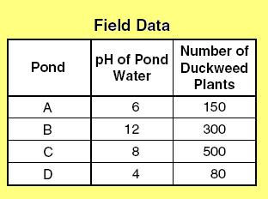
Practice problem #2
The information to the right was collected in the field while studying the effect of pH on the growth of the duckweed plant. The data shows that duckweed has optimum growth at a pH of:
a) 4
b) 6
c) 8
d) 12

