Slide 1
Unit 6 DNA, RNA, and Protein Synthesis

Slide 2
Topic 1: DNA History & Structure
By the end of this topic, you should be able to…
Identify the experiments and scientists involved in the discovery of DNA
Describe the structure of the DNA molecule

Slide 3
Review ☺
Define monomer
Define polymer
What is the monomer of nucleic acids?
Who discovered the structure of DNA and what is it’s structure?

Slide 4
Review ☺
Define monomer - Building block (single unit)
Define polymer - Chain of repeating units
What is the monomer of nucleic acids? - Nucleotide
Who discovered the structure of DNA and what is it’s structure? - “Watson & Crick” – double helix

Slide 5
History of DNA

Slide 6
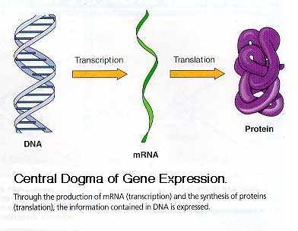
History of DNA
Early scientists thought protein was the cell’s hereditary material because it was more complex than DNA
Proteins were composed of 20 different amino acids in long polypeptide chains

Slide 7
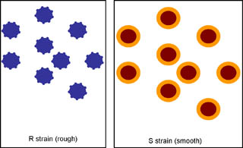
Transformation
Frederick Griffith worked with virulent S and nonvirulent R strain pneumonia bacteria
Bacteria can be considered:
virulent (disease causing) or
nonvirulent (harmless)

Slide 8
Griffith’s Experiment
Mice were injected with:
living virulent bacteria
living harmless bacteria
dead virulent bacteria
dead virulent + live harmless

Slide 9
Which ones killed the mice?
Mice were injected with:
living virulent bacteria
living harmless bacteria
dead virulent bacteria
dead virulent + live harmless

Slide 10
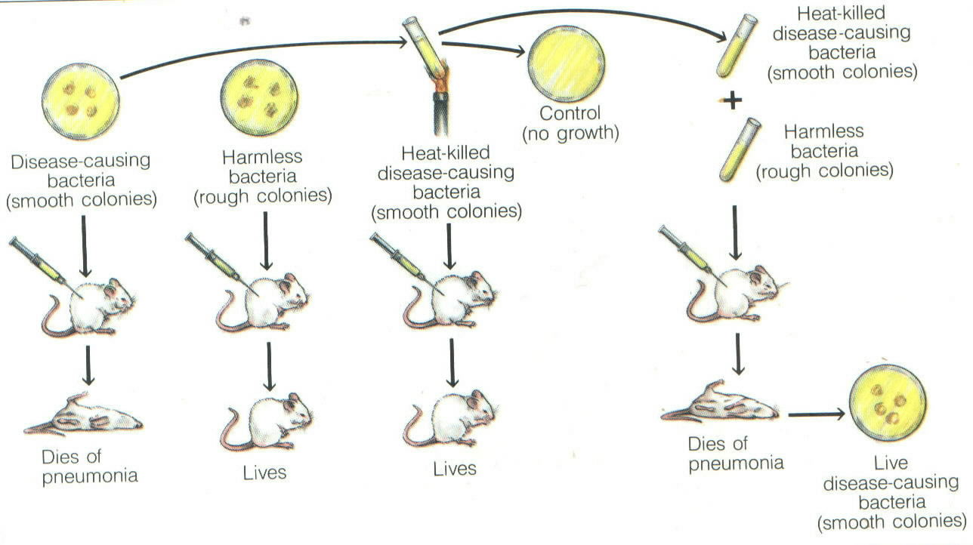

Slide 11
Experimental Results
living virulent bacteria
living harmless bacteria
dead virulent bacteria
dead virulent + live harmless

Slide 12
Results
Living bacteria used the virulent ability of the dead bacteria.
The bacteria picked up DNA from their surroundings and used the code to make toxins.
This is DNA transformation.
This suggested that DNA is the genetic material that determines traits of an organism

Slide 13
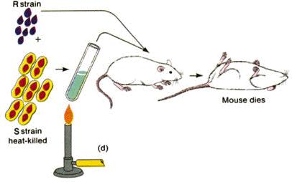
Griffith Experiment

Slide 14
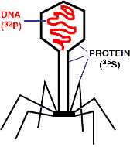
History of DNA
Viruses are made of DNA in a protein “coat”
Experiments on viruses by Hershey & Chase proved that DNA was the cell’s genetic material
Radioactive DNA was injected into bacteria!

Slide 15
Basically…
They used radioactive markers on protein and then DNA. The radioactive DNA was transferred to the bacteria, while the protein was not. They concluded DNA is the hereditary material of the cell.

Slide 16
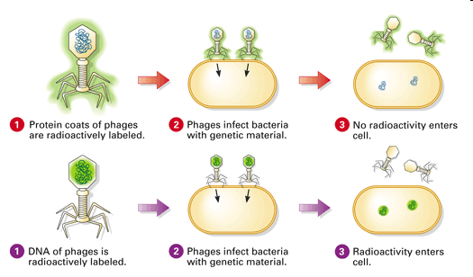

Slide 17
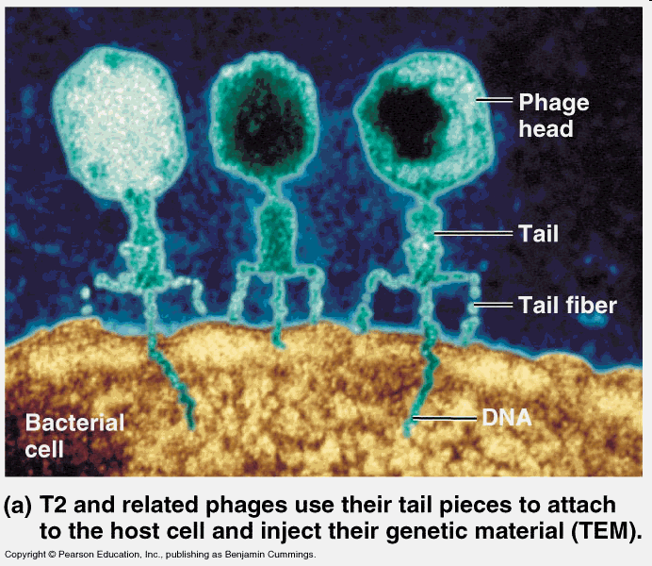

Slide 18
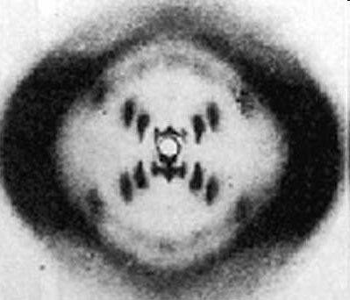
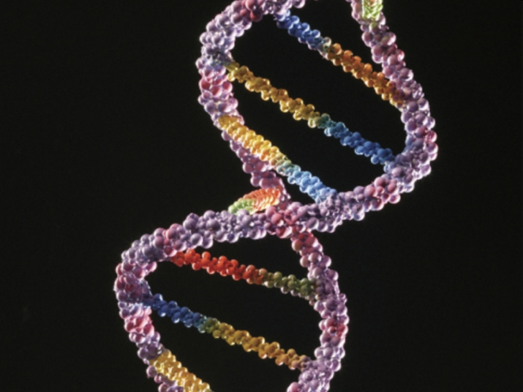
DNA Structure
Rosalind Franklin took diffraction x-ray photographs of DNA crystals
In the 1950’s, Watson & Crick built the first model (double helix) of DNA using Franklin’s x-rays

Slide 19
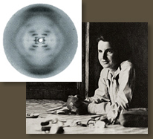
Rosalind Franklin

Slide 20
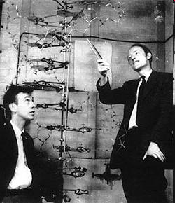
Watson and Crick
We’re big fat thieves!

Slide 21
Now it is your turn
You will be reading about several scientists that helped shape the discovery of DNA
There is much debate about who should be credited
It will be your job to pick out each scientist’s main contribution to the structure of DNA!

Slide 22
#4:
In 1869, Freidrich Meischer first identified “nuclein” which later became known as DNA.

Slide 23
#5
It had higher Phosphorus content than protein
The thing that normally digested protein, didn’t break it down

Slide 24
#6
He was the first to identify the molecule DNA.

Slide 25
#7
Structure of a nucleotide (order of parts)
Sugar in RNA (ribose)
Sugar in DNA (deoxyribose)
Identified ways DNA & RNA are put together

Slide 26
#8
That there are different forms of nucleotides (A, T/U, C, G)

Slide 27
#9
“Tetranucleotide structure” – the 4 nucleotides are always arranged in the same order (GTCAGTCA)

Slide 28
#10
Nucleotide composition varies among species (my neighbor doesn’t have the exact same nucleotide composition I do, even though we’re both humans)
A=T and C=G

Slide 29
#11
Total # of purines = Total # of pyrimidines
(A & G) (T & C)

Slide 30
#12
X-ray crystallography (diffraction) photos

Slide 31
#13
They used cardboard cutouts to represent individual pieces – moved them around on their desk like a puzzle.

Slide 32
#14
Double helix (Chargaff’s Rule)
Helix is right-handed (spirals up and to the right)
Strands are antiparallel
Outer edges of helix are able to H-bond with enzymes

Slide 33
#15
A-DNA
B-DNA
Z-DNA

Slide 34
DNA Structure

Slide 35
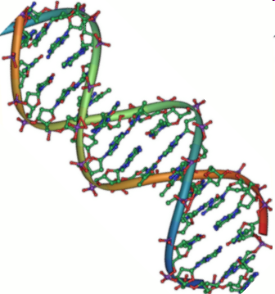
The Basics
DNA is a type of Nucleic Acid
DNA: Deoxyribonucleic Acid
Made of monomers called nucleotides
Function: to store genetic information

Slide 36
DNA
Double helix is formed by nucleotides linked to one another
A nucleotide is made of:
1. Phosphate group
2. 5-carbon sugar
3. Nitrogenous base

Slide 37
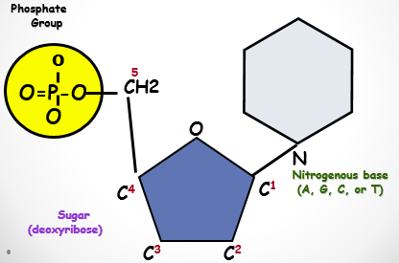
DNA Nucleotide

Slide 38
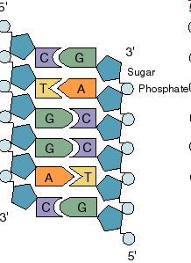
DNA
Two twisted strands called a double helix
Sides made of a sugar Deoxyribose bonded to phosphate (PO₄) groups
Center (or “steps”) made of nitrogen bases bonded together by weak hydrogen bonds

Slide 39
Hydrogen Bonding
The twisted helix is very stable.
But the hydrogen bonds are weak and the two strands can be pulled apart when the helix is untwisted by an enzyme.

Slide 40
DNA Double Helix
“Rungs of ladder”
Nitrogenous
Base (A,T,G or C)
“Legs/sides of ladder”
Phosphate &
Sugar Backbone

Slide 41
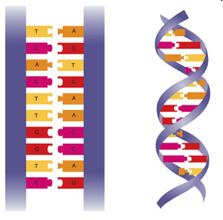

Slide 42
DNA Strands
The part of a strand that ends with a phosphate group is called the five prime (5’) end
The part of a strand that ends with a sugar is called the three prime (3’) end

Slide 43
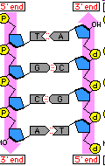
Antiparallel Strands
One strand of DNA goes from 5’ to 3’
The other strand is opposite in direction going 3’ to 5’
Strand 1:
5’ to 3’
Strand 2:
3’ to 5’

Slide 44
Antiparallel Strands
Explain in your own words what it means for the two DNA strands to be antiparallel to each other.

Slide 45
Nitrogenous Bases
Double ring PURINES
Adenine (A)
Guanine (G)
Single ring PYRIMIDINES
Thymine (T)
Cytosine (C)
A or G
T or C

Slide 46
Base-Pairings
Purines only pair with Pyrimidines
Hydrogen bonds connect the bases
3 H-bonds
G
C

Slide 47
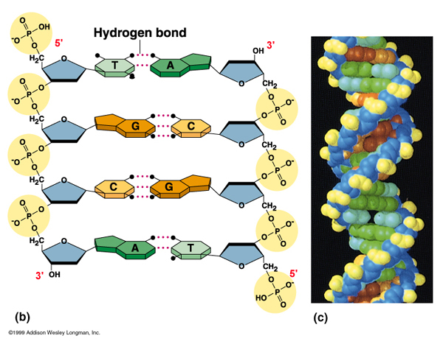
The process of specific bases bonding together to form the rungs of the ladder is called Complementary Base Pairing

Slide 48
Chargaff’s Rule
Adenine must pair with Thymine
Guanine must pair with Cytosine
T
A
C
G

Slide 49
Discovery of DNA Structure
Erwin Chargaff showed the amounts of the four bases on DNA ( A,T,C,G)
In a body or somatic cell:
A = 30.3%
T = 30.3%
G = 19.7%
C = 19.7%

Slide 50
Question:
If there is 30% Adenine, how much Cytosine is present?

Slide 51
Answer:
There would be 20% Cytosine
Adenine (30%) = Thymine (30%)
Guanine (20%) = Cytosine (20%)
Therefore, 60% A-T and 40% C-G

Slide 52
Question
Write out the sequence of a strand complementary to the following strand…
5’ - T T A G C A T G G – 3’

Slide 53
Answer
Original Strand: 5’ - T T A G C A T G G – 3’
Complementary 3’ - A A T C G T A C C – 5’
Strand:

