Slide 1
DNA Replication Unit 6 Topic 2

Slide 2
Topic 2: DNA REplication
By the end of this topic, you should be able to…
Identify the purpose of DNA replication
Identify and order the steps involved in DNA replication
Explain the purpose of molecules (enzymes) used in DNA replication

Slide 3
Replication Facts
DNA has to be copied before a cell divides
Each daughter cell needs a complete genome
DNA is copied during the S or synthesis phase of interphase
New cells will need identical DNA strands

Slide 4
Synthesis Phase (S phase)
S phase during interphase of the cell cycle
Nucleus of eukaryotes
S
phase
G₁
G₂
interphase
DNA replication takes
place in the S phase.
Mitosis
-prophase
-metaphase
-anaphase
-telophase

Slide 5
DNA Replication
Begins at Origins of Replication
Two strands open forming Replication Forks (Y-shaped region)
New strands grow at the forks
3’
Parental DNA Molecule
5’
Replication
Fork
3’
5’

Slide 6
DNA Replication
As the 2 DNA strands open at the origin, Replication Bubbles form
Prokaryotes (bacteria) have a single bubble
Eukaryotic chromosomes have MANY bubbles
Bubbles
Bubbles

Slide 7
DNA Replication is semi-conservative
each original strand is conserved
new double helix has one of the original two strands

Slide 8
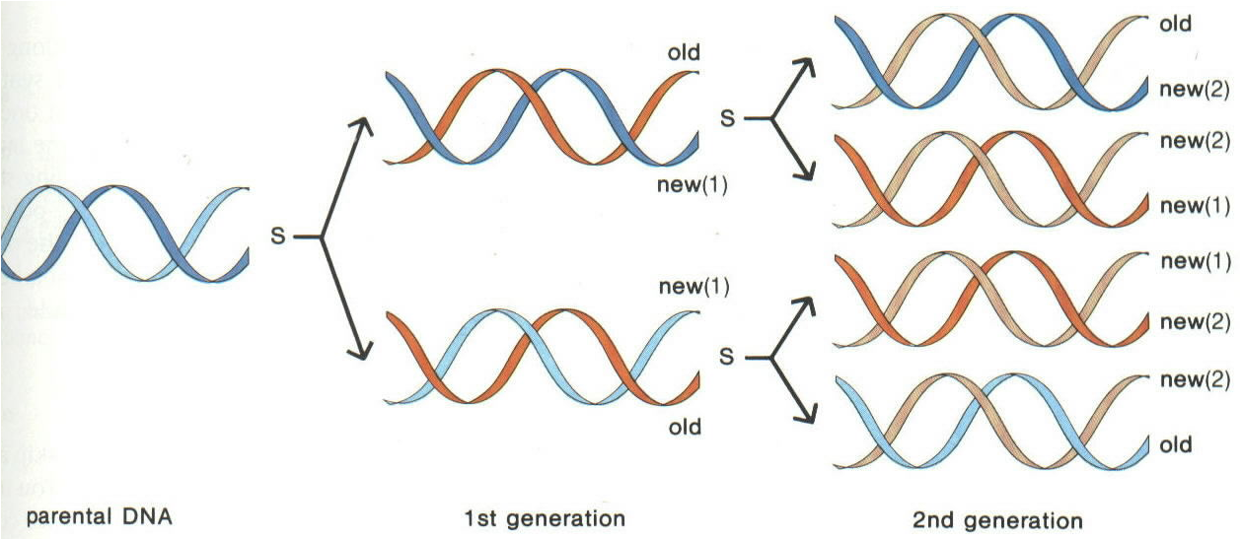
Semi-conservative Replication

Slide 9
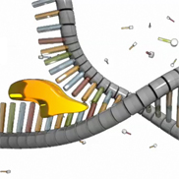
Steps of DNA Replication
1) Enzyme Helicase unwinds and separates the 2 DNA strands by breaking the weak hydrogen bonds

Slide 10
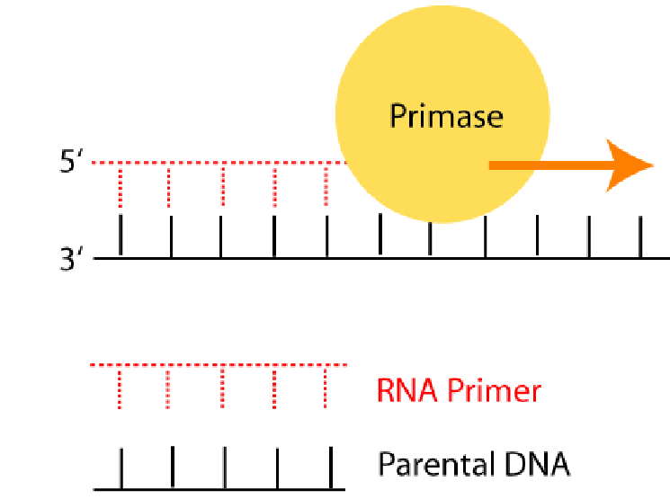
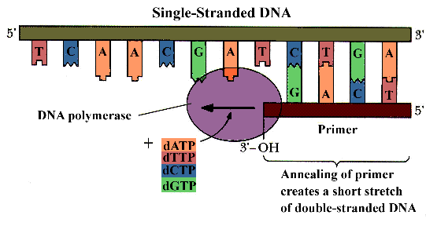
Steps of DNA Replication
2) Primase gathers nucleotides and brings them into the replication fork.
A “primer” is created to start the new strand.

Slide 11
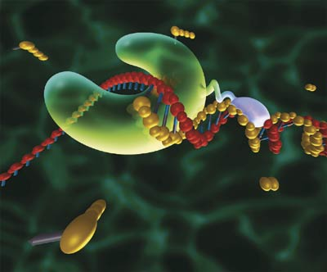
Steps of DNA Replication
3) The enzyme DNA Polymerase matches free nucleotides with the correct base pairs on the template (parent) strands.

Slide 13
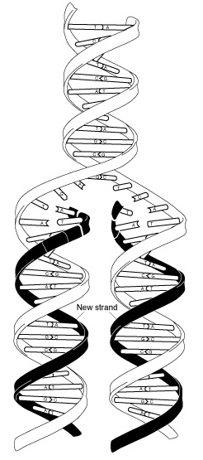

Slide 14
Steps of DNA Replication
4) The enzyme ligase connects any “breaks” in the new strands and the 2 new strands rewind back together.
The Big Question: Why are there “breaks” in the new strands at all?!

Slide 15
DNA polymerase can only add nucleotides to the 3’ end of the DNA
This causes the NEW strand to be built in a 5’ to 3’ direction
*Remember that DNA must be ANTI-PARALLEL
5’
3’
5’
RNA
Primer
DNA Polymerase
Nucleotide
Direction of Replication

Slide 16
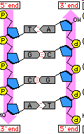
Remember the Strands are Antiparallel

Slide 17
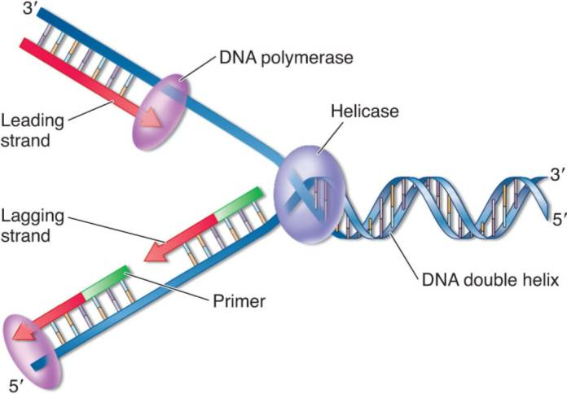
Making New DNA Strands
The Leading Strand is built into the replication fork, and can build continuously

Slide 18
The Lagging Strand is built in short sections called Okazaki Fragments in the opposite direction (out of the fork)
This causes the “breaks” in the strand because DNA polymerase must keep backtracking.

Slide 19
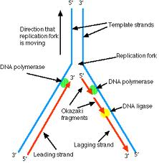

Slide 20
Joining of Fragments of DNA
The enzyme Ligase joins the sections together to make one strand
DNA ligase
5’
3’
3’
5’
Lagging Strand

Slide 21
A Quick Video to Help You Remember
http://sites.fas.harvard.edu/~biotext/animations/replication1.swf

Slide 22
Proofreading New DNA
DNA polymerase makes about 1 in 10,000 base pairing errors
Enzymes proofread and correct these mistakes
The new error rate for DNA that has been proofread is 1 in 1 billion base pairing errors

Slide 23
DNA Damage & Repair
Chemicals & ultraviolet (UV) radiation
damage the DNA in our body cells
Types of Repair:
1) Excision repair – when a repair enzyme removes damaged DNA
2) DNA polymerase and ligase work together to replace and bond the new nucleotides together

Slide 24
Drawing DNA Replication
Use the notes taken in class (the gray box) to illustrate the process of DNA replication. You need to show:
The enzymes involved (helicase, ligase, primase, polymerase
The original DNA molecule being unzipped (identify 5’ and 3’ on each)
The new DNA strands (lagging and leading) being built (be sure to build in the correct direction)
Nucleotides being dropped off at the replication fork (primase)
Label all bases shown! Color code them as well

Slide 25
