Slide 1
Unit 2
Biochemistry: Atomic Structure, Water Properties, Macromolecules, & Enzymes

Slide 2
Unit 2 Topic 1: Atomic and Molecular Structure
By the end of this topic, you should be able to…
Label an atom and it’s subatomic particles
Identify the charge of each subatomic particle
Differentiate between different types of bonds (covalent & ionic)
Explain the similarities and differences between the following terms: atom, ion, element, compound, molecule
List the six main elements in living things

Slide 3
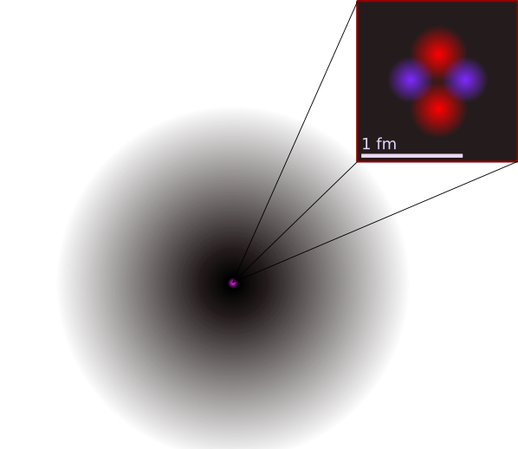
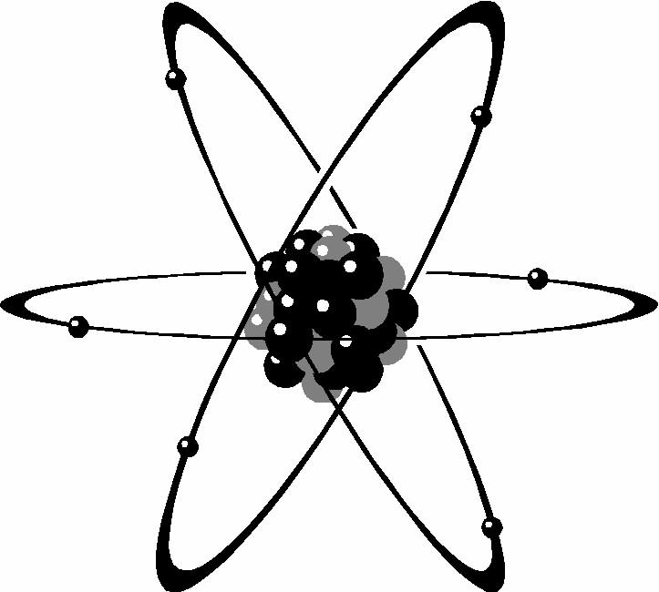
Atoms
What is an atom?
Basic unit of matter
Smallest particle of an element that contains all properties of that element (92 occur in nature)

Slide 4
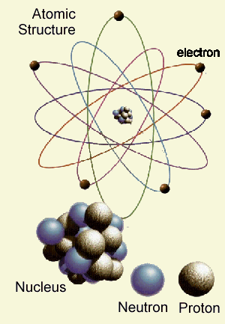
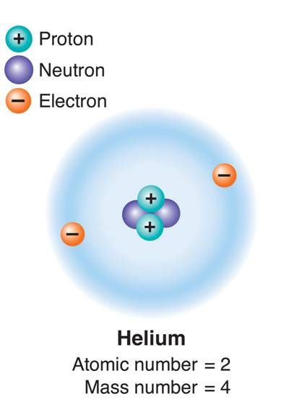
Subatomic Particles
While an atom is the smallest unit of matter, it is made of even smaller components (subatomic particles)
Proton: positive charge (+); located in the nucleus of atom
Neutron: neutral/no charge(0); in the nucleus of atom
Electron: negative charge(-); surrounds nucleus of atom (orbits the nucleus)

Slide 5
Label the Following Atom:
A:
B:
C:

Slide 6
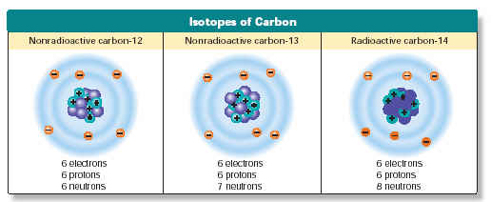
Neutrons
Atoms of the same element may have different numbers of neutrons
If this is the case, we are looking at isotopes of that element
Isotope: each of two or more forms of the same element that contain equal numbers of protons but different numbers of neutrons in their nuclei, and hence differ in relative atomic mass but not in chemical properties

Slide 8
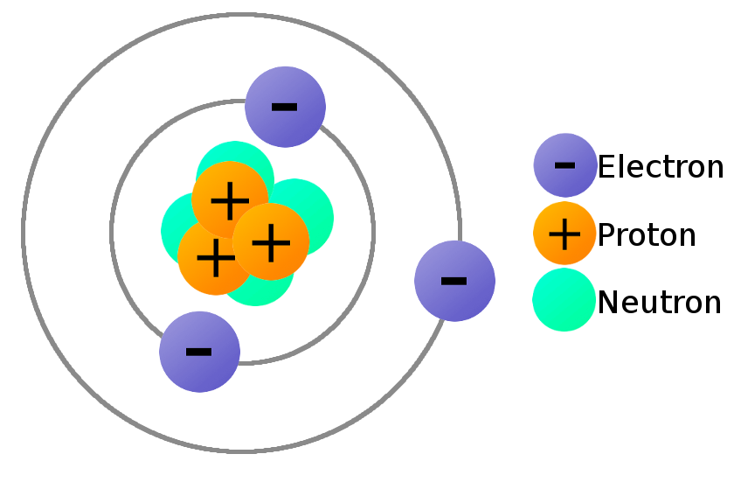
Protons
Atoms of the same element must all have the same number of protons in the nucleus of the element
The number of protons is also equal to the atomic number
The number of protons is balanced by the number of
electrons

Slide 9
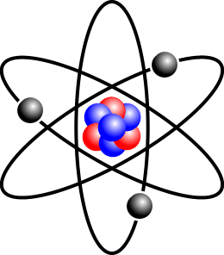
Electrons
Electrons have little to no mass (not included in atomic mass)
Travel at high speeds around the nucleus
Play a large role in chemical bonding!!

Slide 10
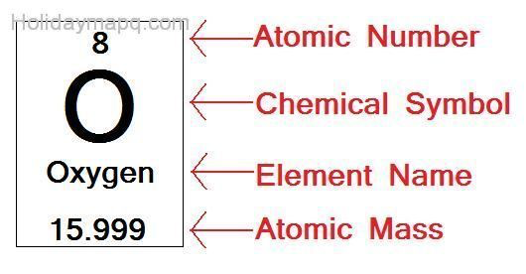
Periodic Table Information
Atomic number = number of protons
Atomic mass = number of protons + number of neutrons (essentially, add together everything found in the nucleus)
Protons & neutrons each have a mass of 1 amu (atomic mass unit)
Mass of electrons is negligible, so we do not add that in

Slide 12
Examining the Periodic Table

Slide 13
Elements
92 natural elements
An element is composed of only one type of atom
Six main elements in living things:

Slide 14
Chemical Compounds
Atoms are the basic unit of matter
Elements are made of atoms of one type
Compounds are formed by the chemical combination of two (or more) elements in definite proportions
Always formed from a specific combination of elements
Always formed in a set ratio
Example: CO or NH₃

Slide 15
Chemical Compounds
Compounds are chemically joined, so they differ from the elements that they are made of (H₂O is very different than hydrogen and oxygen on their own)
Chemical formulas are used to show the kind and proportion of atoms of each element in the compound

Slide 16
Molecules
Atom – smallest unit of matter
Element – made of one type of atom
Compound – two or more elements chemically bonded together
Molecule – two or more atoms joined together chemically
All compounds are molecules, but not all molecules are compounds

Slide 17
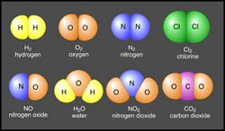
Draw an arrow to the row that contains molecules that are NOT compounds

Slide 18
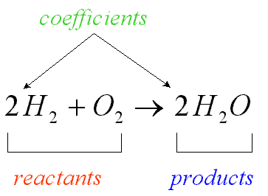
Understanding Chemical Formulas
Subscript after a symbol tells the number of atoms of that element
H₂O has 2 atoms of hydrogen & 1 atom of oxygen
Coefficients before a formula tell the number of molecules
3O₂ represents 3 molecules of oxygen or (3x2) or 6 atoms of oxygen

Slide 19
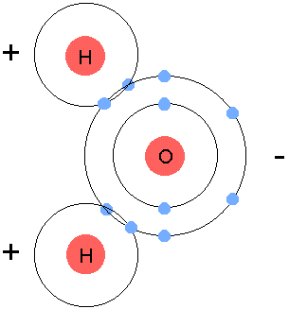
Chemical Bonds
Atoms in a compound are held together by chemical bonds
The electrons in the outermost shell that are used to form these bonds are called valence electrons
Types of bonds:
Ionic (electrons gained/lost, ions formed)
Covalent (electrons shared)

Slide 20
Ionic Bonds
Electrons are transferred (given / taken) from one atom to another
An ion forms as a result (atom that has gained or lost an electron)
Oppositely charged ions are attracted to one another
Positive ions have lost electrons (now there are more protons than electrons, giving this ion a positive charge)
Negative ions have gained electrons (now there are fewer protons than electrons, giving this ion a negative charge)

Slide 21
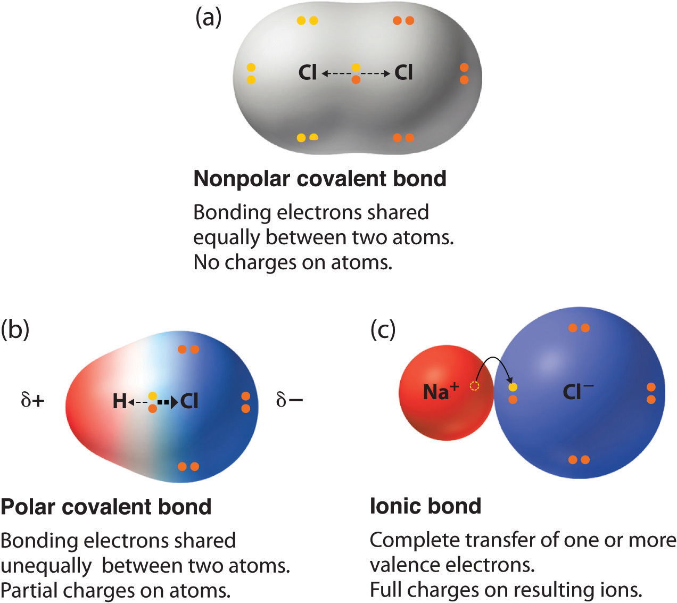
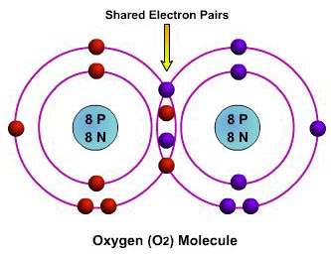
Covalent Bonds
Two atoms combine by sharing electrons
No change in charge for either atom
Strength of bond depends on the number of electrons shared

Slide 22
Unit 2 Topic 2: Water
By the end of this topic, I will be able to:
Explain what “water is polar” means
Explain the importance of hydrogen bonds in water
List the properties of water
Discuss the pH scale and identify substances as acids, bases, or neutral

Slide 23
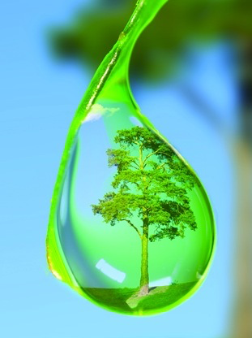
Properties of Water
Water is not alive, but understanding water is essential
~2/3 the mass of a cell is water
Most life-sustaining reactions take place in water solutions
Water, H₂O, is a molecule made of two hydrogen atoms covalently bonded to one oxygen atom

Slide 24
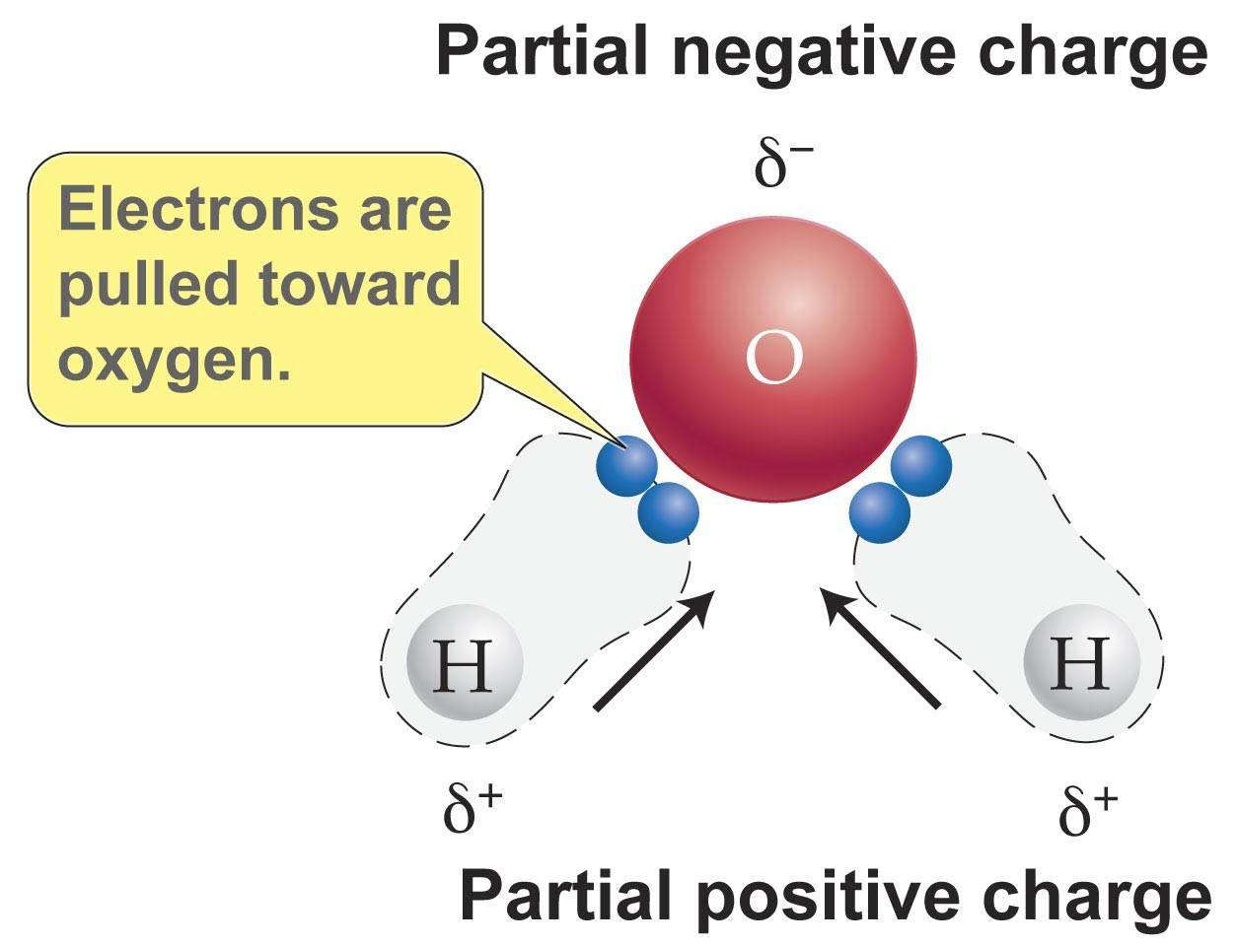
Polarity of Water
Electrons are unevenly distributed in a molecule of water
Leads to positive end and negative end
The atom with more protons, oxygen (8), pulls electrons closer to its nucleus
This makes oxygen slightly negative and hydrogen slightly positive

Slide 25
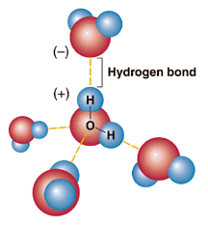
Water Molecules
Molecules of water are attracted to one another and form hydrogen bonds
Opposites attract
Each molecule of water can make up to four hydrogen bonds
Hydrogen bonds are VERY weak

Slide 26
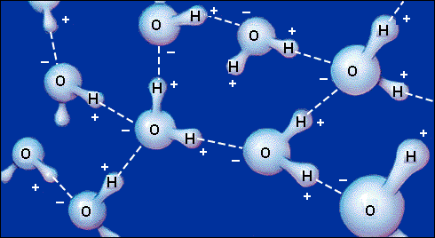
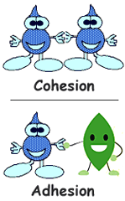
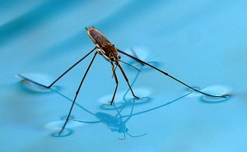
Properties of Water
Adhesion: attraction between unlike molecules (water to a paper towel)
Cohesion: attraction between like molecules (water to water)
Results in surface tension (measure of the strength of the surface of water)
Produces a surface film, allowing insects to walk on water

Slide 27
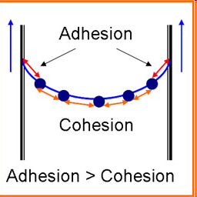
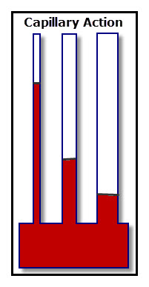
Capillary Action
Cohesion (water sticking to water) and adhesion (water sticking to other substances) work together to form capillary action
Water rises in a tube against gravity
Real life example: water is absorbed by the roots of plants
and travels upward!

Slide 28
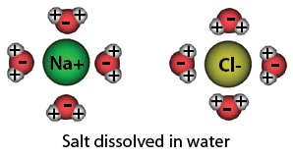
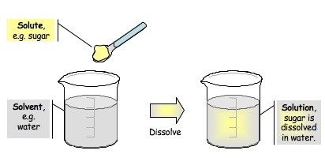
Properties of Water
Universal solvent: water dissolves more substances than any other liquid
Again, because water is polar and has hydrogen with positive ends and oxygen with negative ends, water attracts many other substances and is able to dissolve these substances it attracts
General rule: “like dissolves like,” so being polar, water dissolves other polar substances
It cannot dissolve nonpolar substances, like oils!

Slide 29
Vocab Relating to Solutions
Solute: substance that is dissolved (sugar)
Solvent: substance that does the dissolving (water)
Mixture: combination of substances in which individual substances retain their own properties (sand + sugar)
Solution: mixture of 2+ substances in which the molecules of these substances are evenly distributed (sugar water)
Suspension: no dissolving occurs, but one substance separates into small pieces and remains suspended

Slide 30
Solution/Suspension

Slide 31
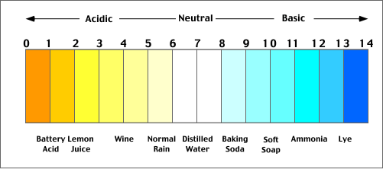
pH of Water
Pure water has a pH of 7
pH: measure of how acidic or basic a solution is
Scale ranges from 0 to 14
Acid: H+ (hydrogen ions) form in water; pH is less than 7
Base: OH- (hydroxide ions) form in water; pH is greater than 7
Neutral: pH is equal to 7
The lower the pH (when under 7), the stronger the acid
The higher the pH (when above 7), the stronger the base

Slide 32
Water Density
Water is less dense in its solid form (ice) than its liquid form
The orientation of hydrogen bonds pushes the molecules to push further apart, lowering the density
Because ice is less dense, it floats on liquid water
If water was most dense at the freezing point, then in winter the very cold water at the surface of lakes would sink, the lake could freeze from the bottom up, and all life in them would be killed. And, with water being such a good insulator (due to its heat capacity), some frozen lakes might not totally thaw in summer.

Slide 33
Density

Slide 34
Heat Capacity
Water absorbs a lot of heat from the air without having a large temperature change
Lakes and oceans often stabilize air temperatures
Water absorbs heat when it evaporates, which is why sweating helps us cool down
It takes a lot of heat to change the temperature of water because the hydrogen bonds between the water need to be broken!

Slide 35
Unit 2 Topic 3: Macromolecules
By the end of this topic, you will be able to…
Explain what the term “organic” means
Define monomer and polymer and explain how polymers are made/broken
Explain what happens to molecules during the processes of hydrolysis and dehydration synthesis
Identify the monomer for each class of organic compounds
Identify which class of organic compounds a compound falls into when given an image or function or elements used
Explain the function of each of the four classes of organic compounds

Slide 36
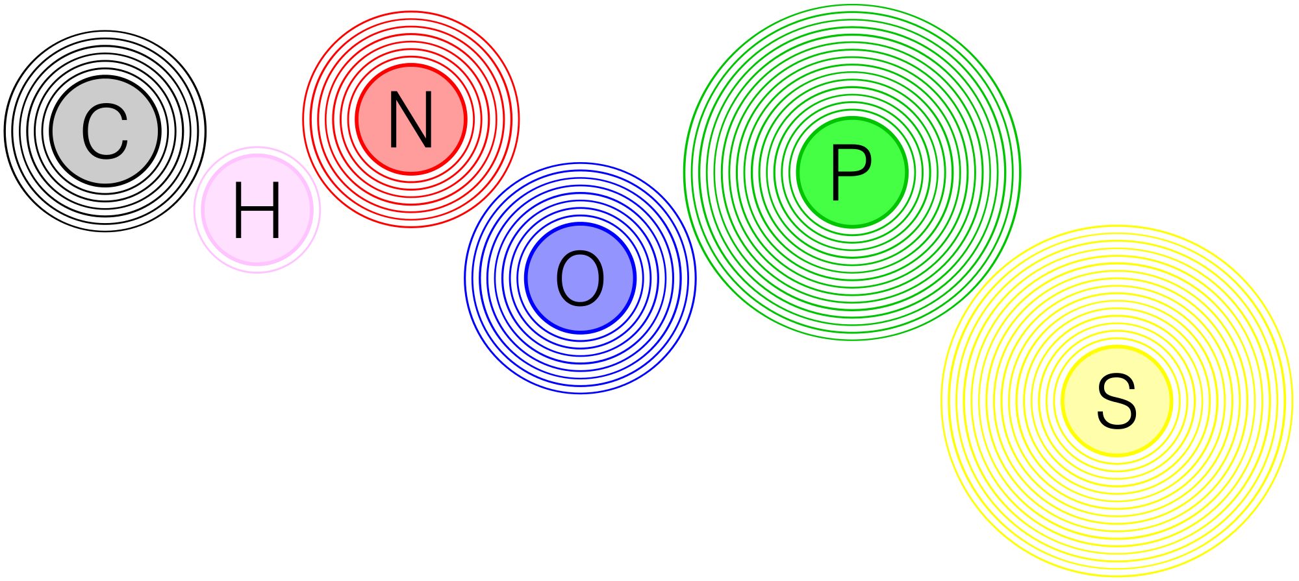
Elements in Living Things
Recap: what are the six main elements in living things?

Slide 37
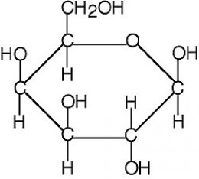
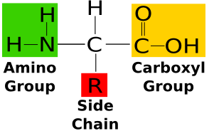
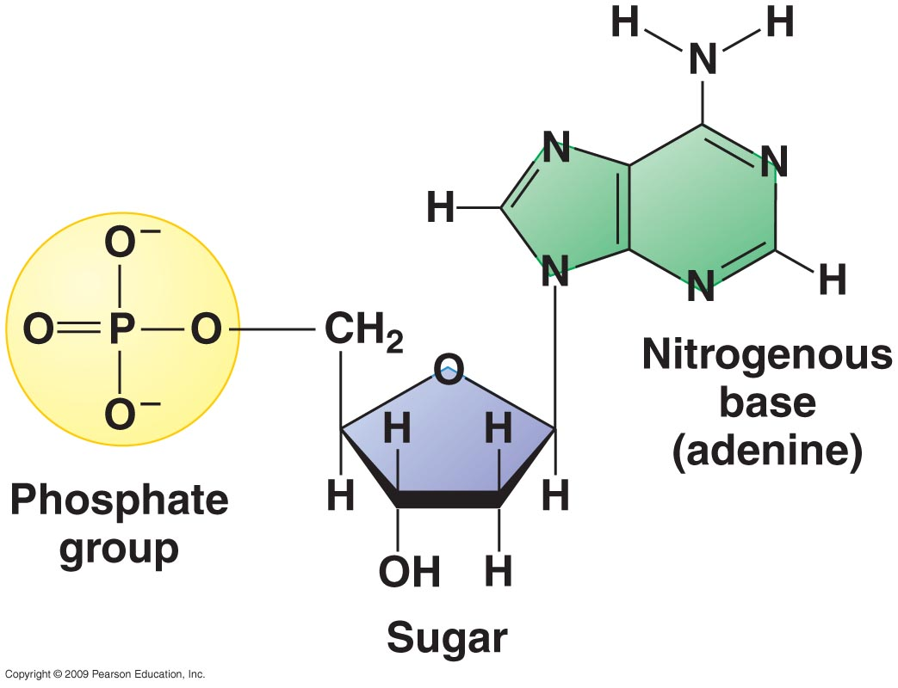
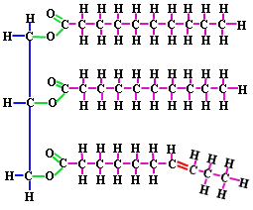
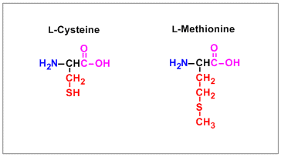
Macromolecules- Notice the Elements!
Proteins
Nucleic Acids
Lipids
Carbohydrates
Some of the amino acids (building blocks of proteins) contain sulfur, as shown in the image to the left

Slide 38
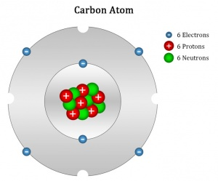
Carbon
Carbon is the backbone of organic compounds (macromolecules)
The term organic means contains carbon
Organic chemistry is an entire field dedicated to studying compounds containing bonds between carbon atoms
An atom of carbon contains FOUR valence electrons
So, it is able to make up to four covalent bonds with other atoms!

Slide 39
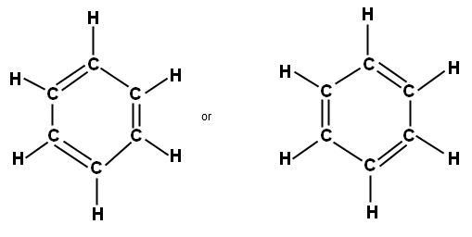
Organic Compounds
Look at the compounds to the right. Notice how the carbon are responsible for essentially holding the molecules together.

Slide 40
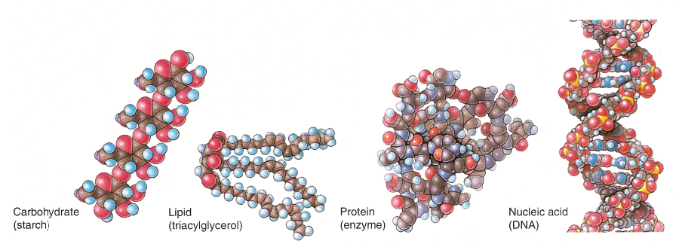
Macromolecules
Macro- large
Macromolecules are large molecules with a backbone made of carbon
Macromolecules are so large because they are made up of smaller units
Monomer: the building block of a polymer (repeating unit)
Polymer: long chain of repeating units (monomers)
Polymerization: process of linking monomers together to produce polymers

Slide 41
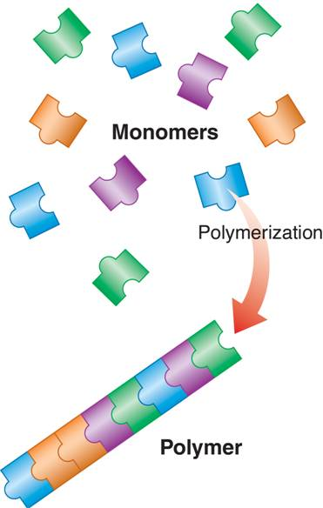

Slide 42
Making & Breaking Polymers
Dehydration Synthesis
Dehydrate – loss of water
Synthesis – to produce/make/combine
All together: this is the process by which monomers join together to make a polymer. In the process, water is lost. One water molecule is lost for every monomer joined to another.
Hydrolysis
Hydro – water
Lysis – to break or to burst
All together: this is the process where water is added to break the bonds holding monomers together.

Slide 43
Comparing the two:

Slide 44
One more time…

Slide 45
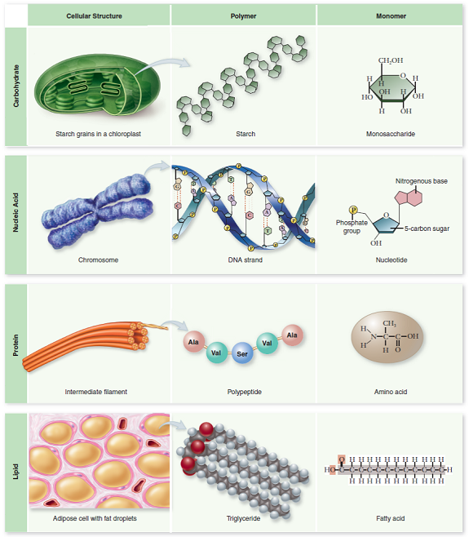
What are we building through dehydration synthesis?
Our macromolecules!
Four classes:
Carbohydrates
Lipids
Nucleic acids
Proteins

Slide 46
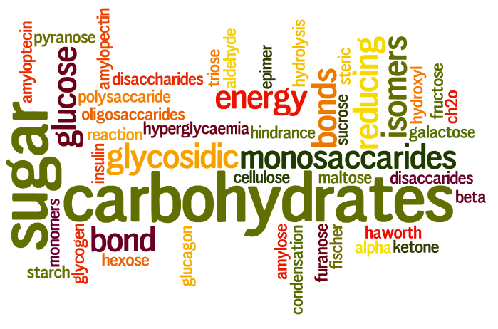
Carbohydrates
Carbohydrates are sugars
Carbo – carbon
Hydrate – water
So, carbohydrates are made of : carbon, hydrogen, and oxygen (1:2:1 ratio)
Function: short term energy storage; maintain plant structure (cellulose)
*General rule: anything that ends in –ose is a sugar
glucose… sucrose… galactose… lactose

Slide 47
Carbohydrates, cont.
Monosaccharide: monomer of carbohydrates; simple sugars (ie glucose)
Mono – 1
Saccharide - sugar
Disaccharide: two monosaccharides bonded together (ie sucrose)
Di – 2
Polysaccharide: carbohydrate polymer (many sugars joined together in a chain)

Slide 48
Hey, look! Sugars have a ringed structure! ☺

Slide 49
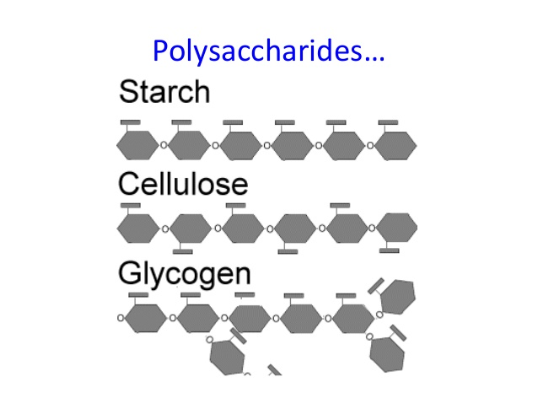
Importance of Polysaccharides
Store energy (short term)
Examples:
Starch: food storage in plants (think potatoes!)
Glycogen: food storage in animals (us!)
Cellulose: cell walls in plants

Slide 50
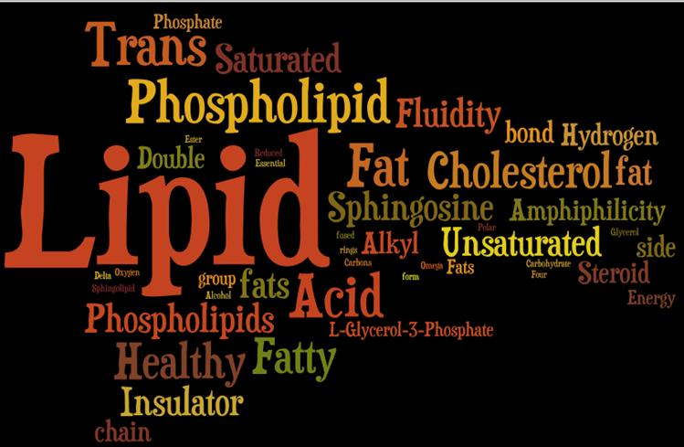
Lipids
Lipids include fats, oils, waxes, and steroids
Elements: like carbohydrates, these are composed of carbon, hydrogen, and oxygen
There are very few oxygen, and there is not a set ratio like in carbs
Functions: long-term energy storage, insulation, and protective coatings (think waxy layers of plants)
Lipids: Long term energy storage
*Steroids often carry chemical messages

Slide 51
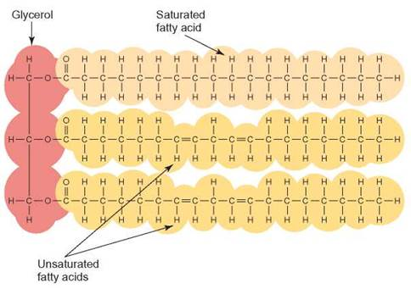
Lipids, cont.
Unlike the other classes of organic compounds, lipids do not have a “true” monomer. However, the structure between lipids is fairly consistent:
3 fatty acids + 1 glycerol
TRIGLYCERIDE!
Saturated v unsaturated:
Next slide!

Slide 52
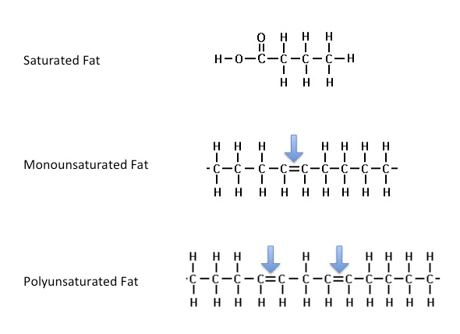
Saturated and Unsaturated Fats
Saturated: solid at room temperature (butter or coconut oil)
Only single bonds between the carbons on the fatty acid tails
“saturated” with hydrogen atoms
Unsaturated: liquid at room temperature (vegetable or canola oil)
At least one double bond in the fatty acid chain
Monounsaturated fat: only one double bond
Polyunsaturated fat: 2+ double bonds in structure

Slide 54
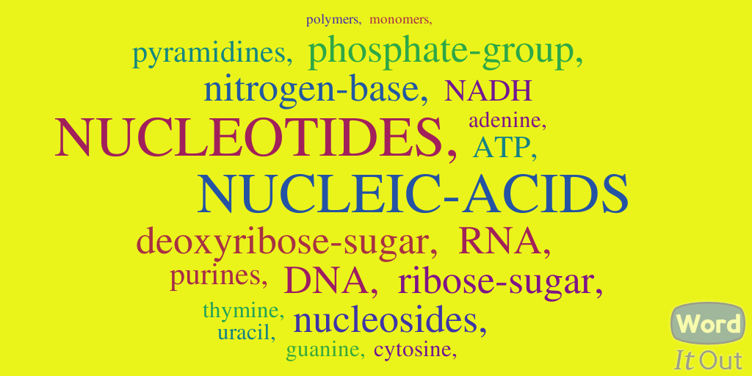
Nucleic Acid
DNA and RNA are both types of nucleic acids
Elements: CHNOP
Each nucleotide, or monomer, has a 5-C sugar, phosphate group, and nitrogenous base
Remember, sugars contain CHO… add in the N base and P-group, and there you have the elements CHNOP!
Functions: store and transmit genetic information (DNA- master code; RNA- carries code)

Slide 55
Nucleic Acid, cont.
Nucleotides are the building blocks, or monomers, of all nucleic acids
3 parts:
5-carbon sugar (deoxyribose in DNA, ribose in RNA)
Phosphate group (almost always represented using a sphere/circle)
Nitrogenous base (DNA – adenine, thymine, cytosine, guanine; RNA – uracil instead of thymine)

Slide 56
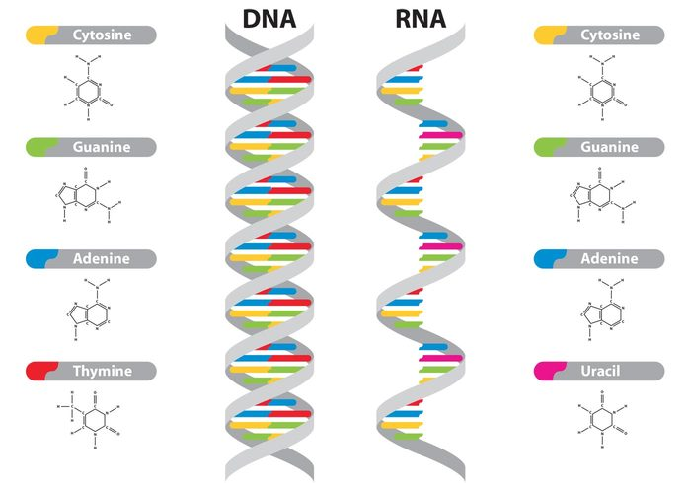
DNA & RNA
DNA
Deoxyribonucleic acid
Master copy of an organism’s genetic code
RNA
Ribonucleic acid
Copy of DNA (able to leave nucleus)
Plays major role in protein synthesis

Slide 57
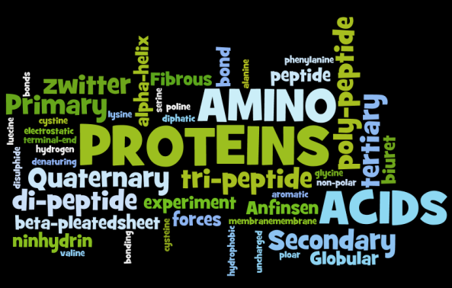
Protein
Elements found in proteins include:
CHNO and sometimes S
Functions:
Structure (hail, nails)
Transportation (hemoglobin in blood)
Movement (muscle fiber)
Defense (antibodies)
Regulation (hormones and enzymes)

Slide 58
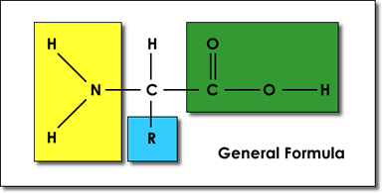
Protein, cont.
Amino acids are the building blocks, or monomers, of proteins
There are 20 different amino acids that can be bonded together in many different ways to make all of our proteins!
Amino acids…
Central Carbon
Hydrogen Atom
Amino Group
Carboxyl Group
R Group

Slide 59
Another View

Slide 60
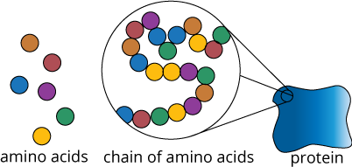
Protein
Polypeptide: a chain of amino acids linked together (polymer)
Amino acids are connected through peptide bonds
Proteins are made of polypeptides folded into complex structures

Slide 61
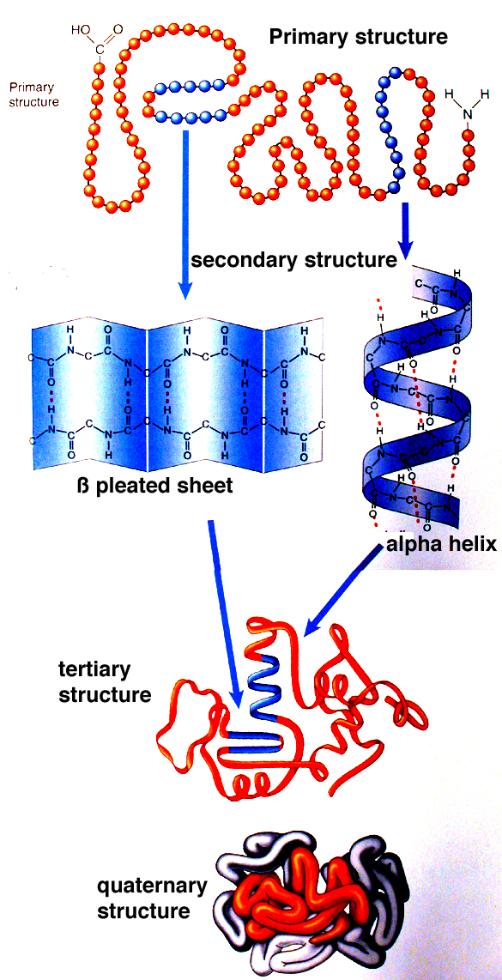
Protein Structure
Four levels of protein structure:
Primary
Secondary
Tertiary
Quaternary

Slide 62
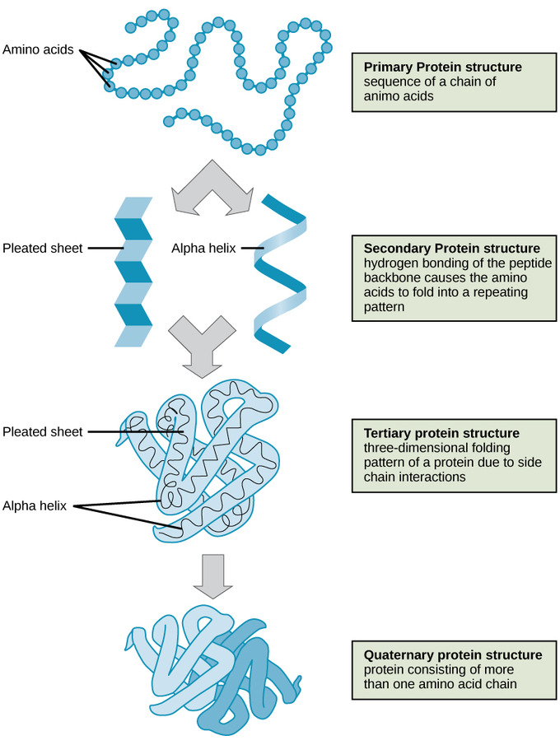
Structures, cont

Slide 63
Unit 2 Topic 4: Enzymes
By the end of this topic, students should be able to…
Identify the components of a chemical reaction (products and reactants/substrates)
Construct a graph detailing enzyme reaction data
Describe the function of an enzyme
Explain the importance of shapes in active sites on an enzyme
Explain how enzymes speed up chemical reactions (act as biological catalysts)

Slide 64
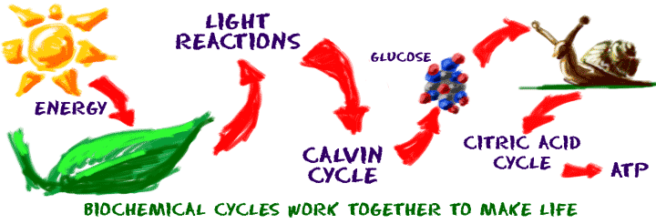
Why Study Chemistry in Biology?
In order to understand how an organism functions, we need to understand the reactions that take place in that organism.
Growth, response to stimuli, sensing, taking medicine to control regulation… all of this is chemistry!

Slide 65
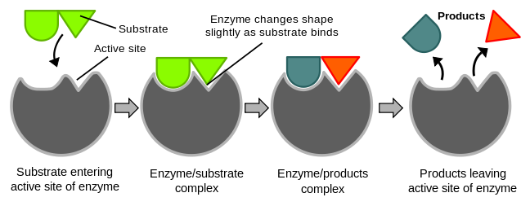
Enzymes
Enzymes are proteins that act as biological catalysts. (often end in –ase)
Living things produce enzymes to act as catalysts
Catalysts speed up chemical reactions
Catalysts do not change during a reaction… so they can be used over & over again unless their form/shape changes

Slide 66
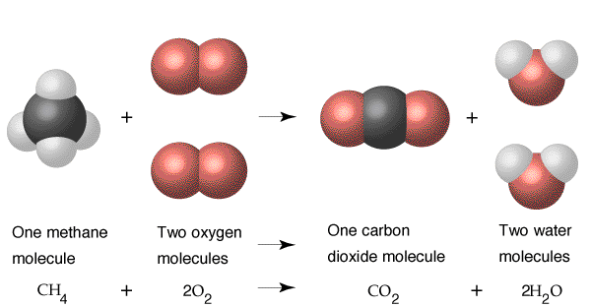
Chemical Reactions
To understand how enzymes speed up chemical reactions, we need to know what chemical reactions are.
Chemical reaction: process that changes reactants into products by breaking the bonds in the reactants and forming bonds in the products
Reactants: what you start with
Products: what you end with
*In chemical reactions, you can either put reactants together or break them apart. Your product can be one final product or many individual pieces.

Slide 67
Energy in Reactions
Metabolism is the sum of all chemical reactions that take place in a living thing
Metabolic pathways: product from one reaction is the substrate (reactant) for the next
Catabolism: chemical reactions where complex molecules are broken down into simpler molecules
Usually release energy to drive these reactions
Anabolism: chemical reactions where simpler molecules are combined to form more complex molecules
Usually require energy

Slide 68
We can see that breaking glucose down (during respiration) is a catabolic reaction. However, building our macromolecules is an anabolic reaction.

Slide 69
Releasing V. Requiring Energy
Exothermic: energy released (digestion)
Endothermic: energy absorbed (synthesis)

Slide 70
Role of Enzymes
The role of enzymes is to lower activation energy!
Activation energy: the amount of energy required to start a reaction

Slide 71
How do they do that?
In biology, we like to say “form fits function.”
So, the form (shape) of an enzyme impacts its role.
Enzymes are shape specific. They only work with certain substrates. These substrates must fit into the active site of the enzyme.

Slide 72
Form Fits Function

Slide 74
Form Fits Function

Slide 75
Enzyme Shape
Each enzyme has a place called the “active site.” This is where the substrate(s) (reactants) bind to the enzyme.
Once the substrate(s) has connected itself with the enzyme, the reaction takes place.
The substrate(s) must fit exactly into the active site of the enzyme (lock & key model or induced fit).
Enzyme-Substrate Complex! (know this term, be able to label this!)
Once the reaction is complete, the enzyme releases the product(s) of the reaction.

Slide 76
Again, enzymes can build or break

Slide 77
What Happens if the Enzyme Changes Shape?
We call this a “denatured” enzyme/protein.
When the shape changes, the substrate(s) will no longer fit in the active site, so the enzyme will no longer function. The organism needs to get rid of this enzyme.

Slide 78
How Can Enzymes Become Denatured?
Enzymes work best in certain pH or temperature ranges. The best pH or temperature is said to be “optimum.”
Changing this optimum environment too much leads to enzyme denaturing.

