Slide 1
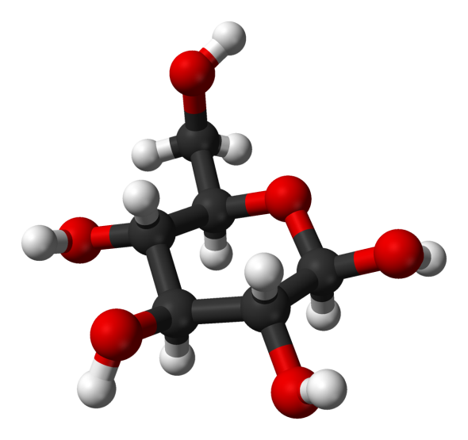
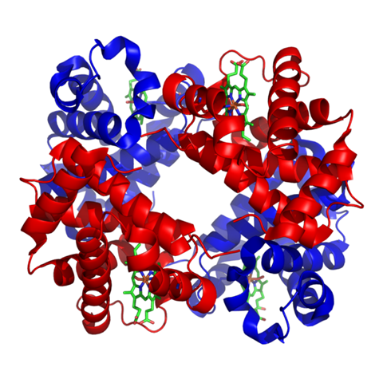
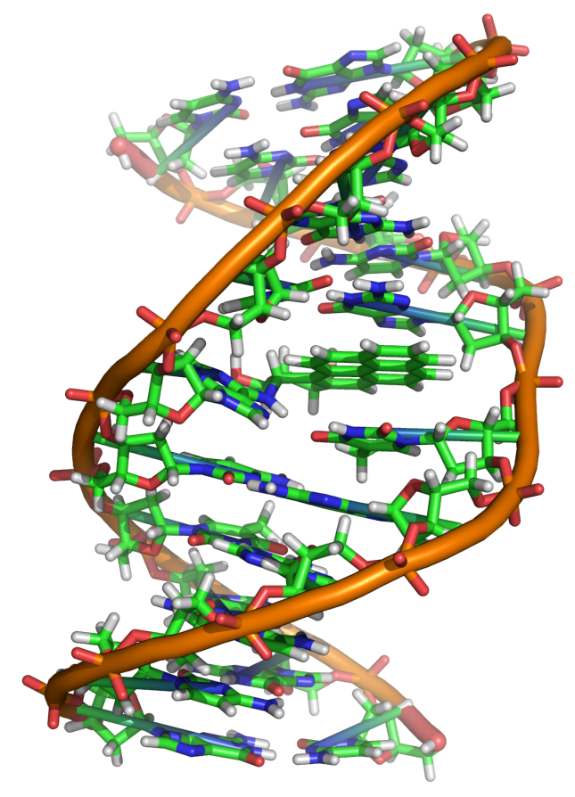
Macromolecules

Slide 2
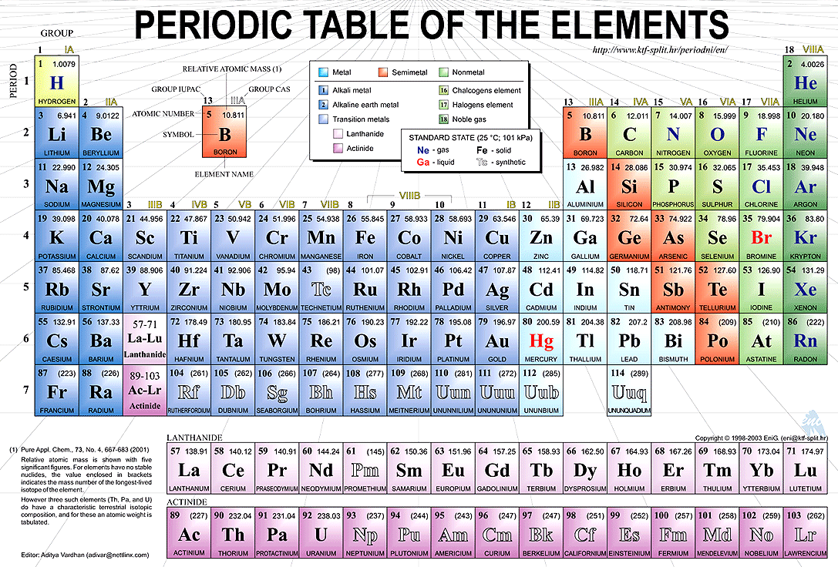
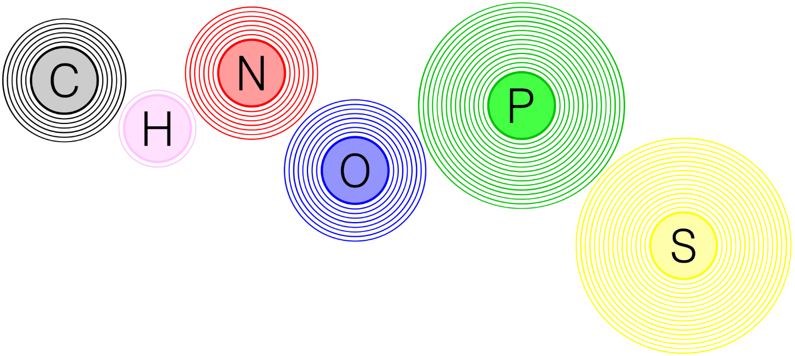
What elements are most common in our cells?
Carbon, Hydrogen, Nitrogen, Oxygen, Phosphorus, Sulfur.
Remember CHNOPS !

Slide 3
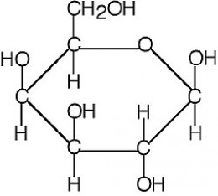
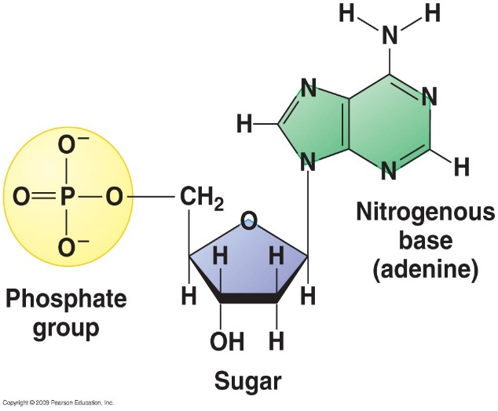
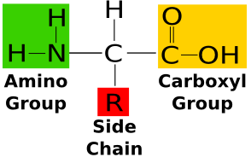
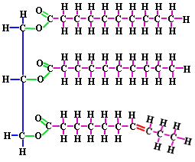
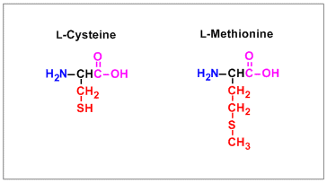
Macromolecules- Notice the Elements!
Carbohydrates
Proteins
Nucleic Acids
Some of the amino acids (building blocks of proteins) contain sulfur, as shown in the image to the left
Lipids

Slide 4
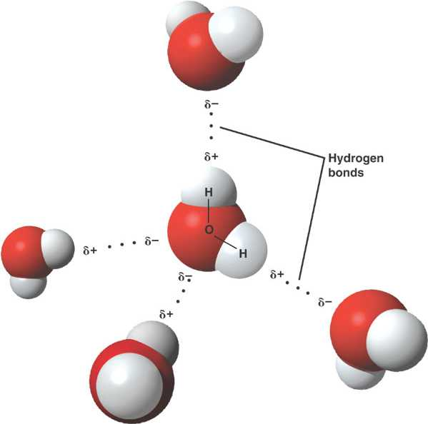
What have we already talked about?
Water…which elements are found in water?

Slide 5
Carbon
Carbon is the backbone of organic compounds (macromolecules)
The term organic means something contains carbon

Slide 6
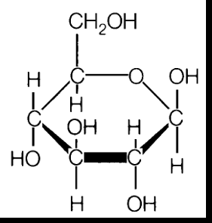
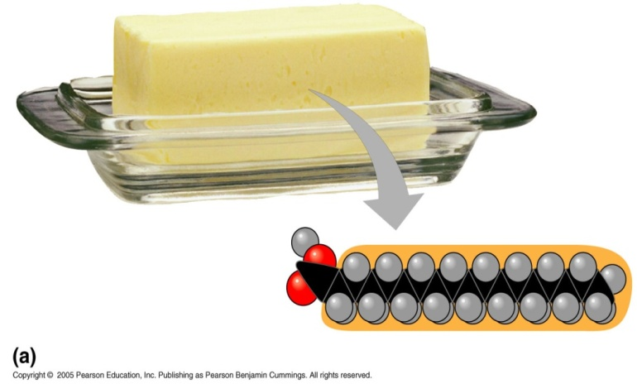
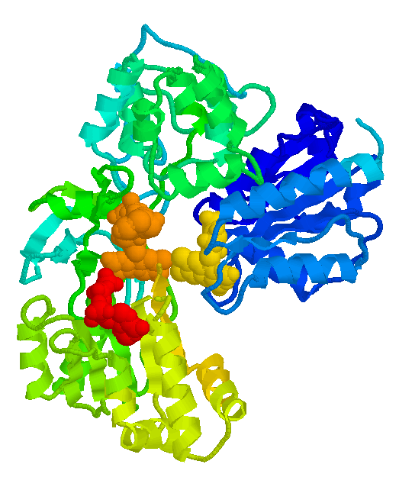
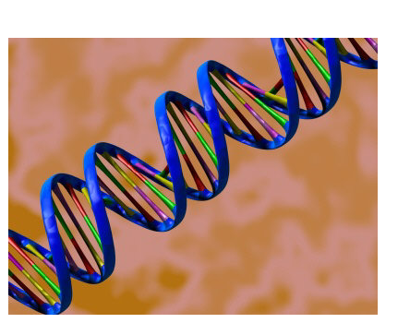
Carbon Compounds
Organic chemistry is the study of all compounds that contain bonds between carbon atoms.
Lipids (Fats)
Nucleic Acids (DNA)
Carbohydrates
Proteins

Slide 7
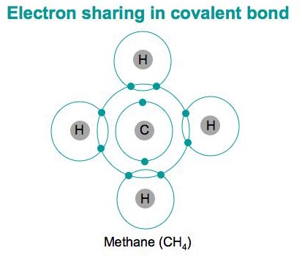
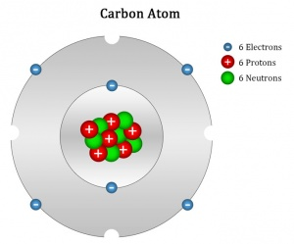
Carbon Compounds
A carbon atom contains FOUR valence electrons, which means it can form four covalent bonds with other atoms

Slide 8
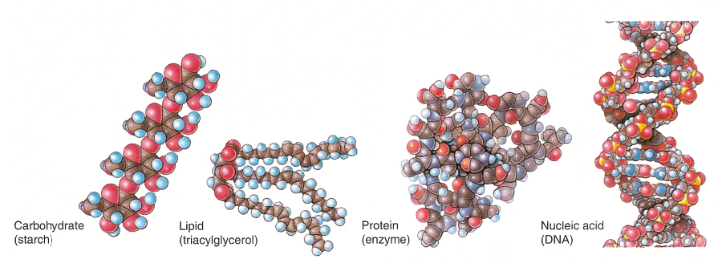
Carbon Compounds
MACRO = large
macromolecules: large carbon-based molecules formed by a process called polymerization
Macromolecules are so large because they are made up of smaller units
Monomer: the building block of a polymer (repeating unit)
Polymer: long chain of repeating units (monomers)
Polymerization: process of linking monomers together to produce polymers

Slide 9
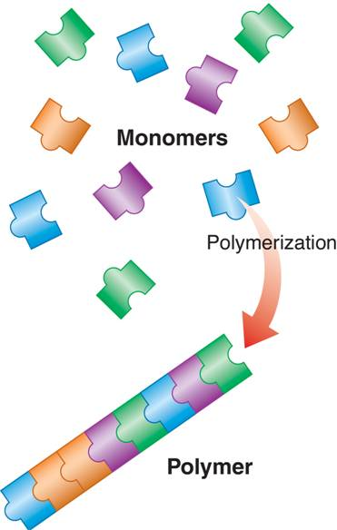

Slide 10
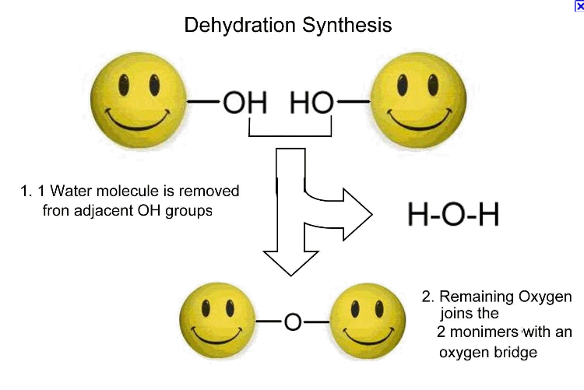
Building and Breaking Down Molecules
1) Dehydration/Condensation Synthesis: monomers are joined to form a polymer; molecules of water are released
Dehydrate – loss of water
Synthesis – to produce/make/combine

Slide 11
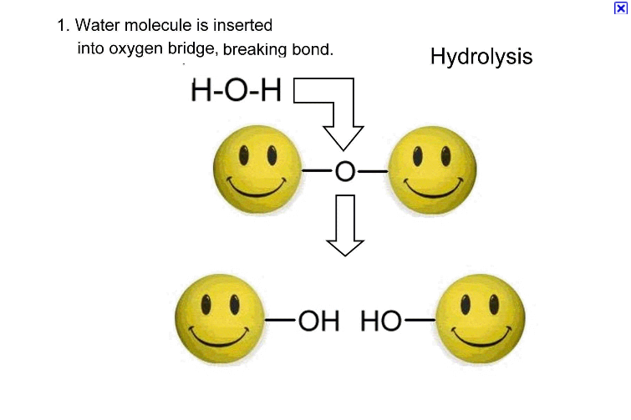
2) Hydrolysis: a polymer is broken into monomers when water molecules are added
Hydro – water
Lysis – to break or to burst

Slide 12
And again:

Slide 13
One last time:

Slide 14
Macromolecules in Living Things
4 Types
1) Carbohydrates
2) Lipids
3) Nucleic Acids
4) Proteins

Slide 15
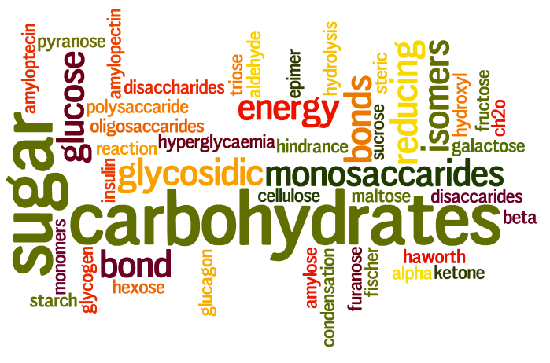
1. Carbohydrates
Carbohydrates are sugars
Carbo – carbon
Hydrate – water
So, carbohydrates are made of : carbon, hydrogen, and oxygen (1:2:1 ratio)
Function: short term energy storage; maintain plant structure (cellulose)
*General rule: anything that ends in –ose is a sugar
glucose… sucrose… galactose… lactose

Slide 16
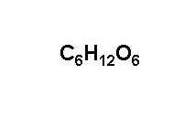
1. Carbohydrates (sugars)
Functions: short-term energy storage; also used to maintain plant structure
Sugars – Short term energy storage
Made of: Carbon, Hydrogen, Oxygen (1 Carbon: 2 Hydrogen: 1 Oxygen)
Glucose

Slide 17
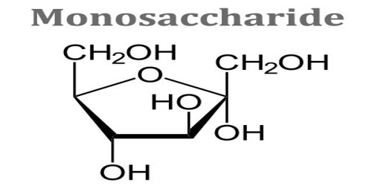
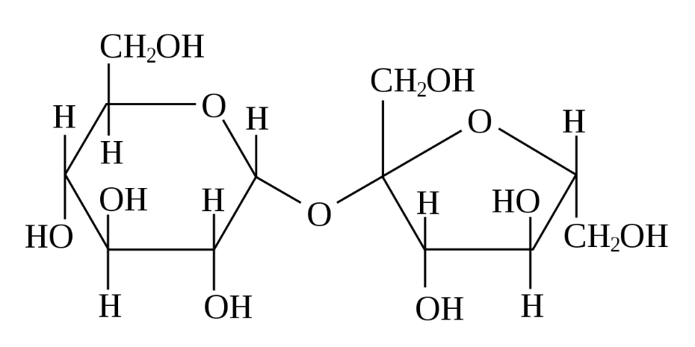
1. Carbohydrates (Sugars)
monosaccharide: carbohydrate monomer, simple sugars
Example: glucose and fructose
disaccharide: 2 monosaccharides form a 2-sugar carbohydrate
Example: sucrose

Slide 18
1. Carbohydrates
polysaccharide: carbohydrate polymer (forms when sugars join together in a long chain)
Examples:
1) starch: used as food storage by plants
2) glycogen: form in which animals store food
3) cellulose: structure in plants (cell walls!)
4) chitin: structure in some animals (insect exoskeleton!)

Slide 19
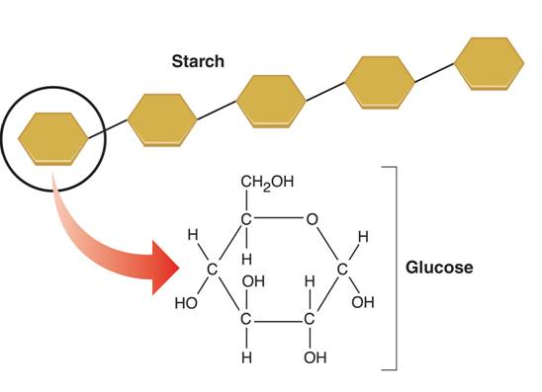

Slide 20
2. Lipids (Fats)
Functions: long-term energy storage, insulation, protective coatings, cell membrane
Lipids - Long term energy storage
Elements: Carbon and Hydrogen (with a few Oxygens) -- similar to Carbohydrates
Examples: fats, oils, and waxes - insoluble in water
Steroids are also lipids. Many steroids (like hormones) serve as chemical messengers.

Slide 21
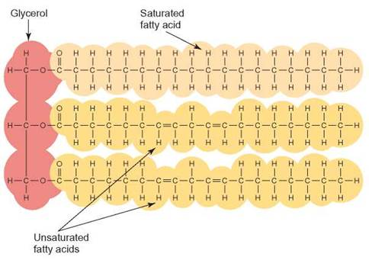
2. Lipids
Unlike the other classes of organic compounds, lipids do not have a “true” monomer. Their monomers have two parts. Even so, the structure between lipids is fairly consistent.
Structure: Usually 3 fatty acids (carbon-hydrogen chains) bonded to 1 glycerol molecule
This is called a “triglyceride”

Slide 22
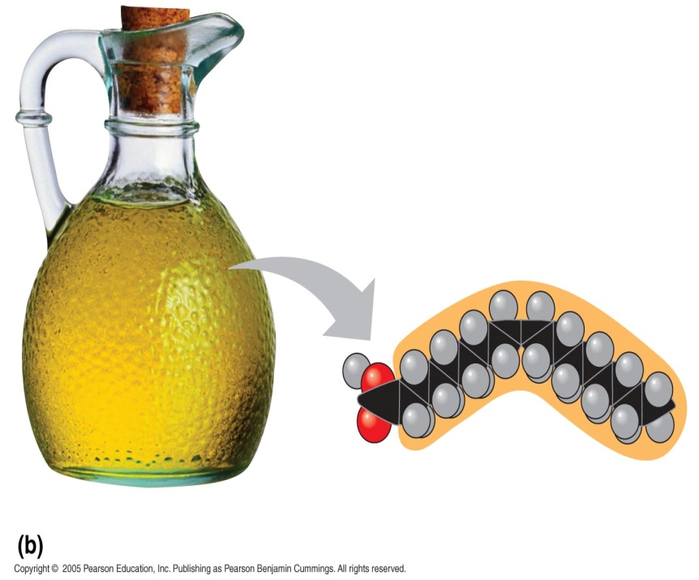
2. Lipids
Saturated vs. Unsaturated Fat…which is “worse” for you and why?
Saturated Fat (Butter)
Unsaturated Fat (Oil)

Slide 23
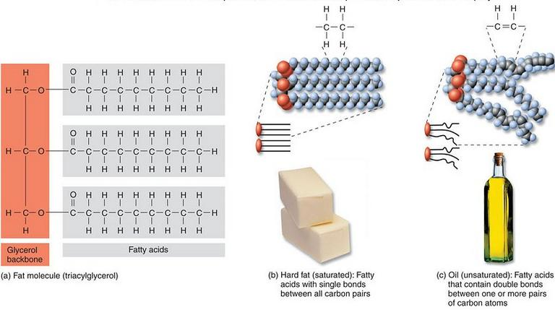

Slide 24
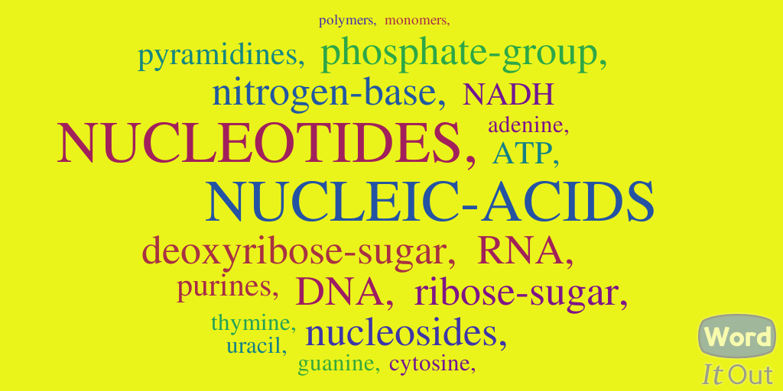
3. Nucleic Acids
Made of: C, H, O, N, and P
Functions: store & transmit genetic information in cells (DNA–master code; RNA–carries code)
Nucleotide: monomer of a nucleic acid ; 3 parts (5-carbon sugar, nitrogenous base and phosphate group)
Remember, sugars contain CHO…add the N base and the P-group and there you have the elements CHNOP!
DNA or RNA: polymers made by linking nucleotides in a chain

Slide 25
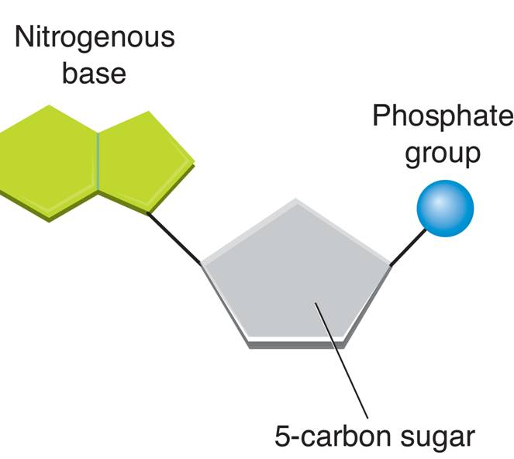
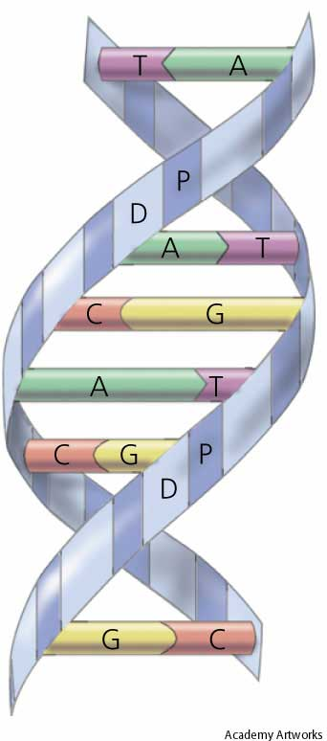
3. Nucleic Acids
Monomer: Nucleotide
Polymer: DNA

Slide 26
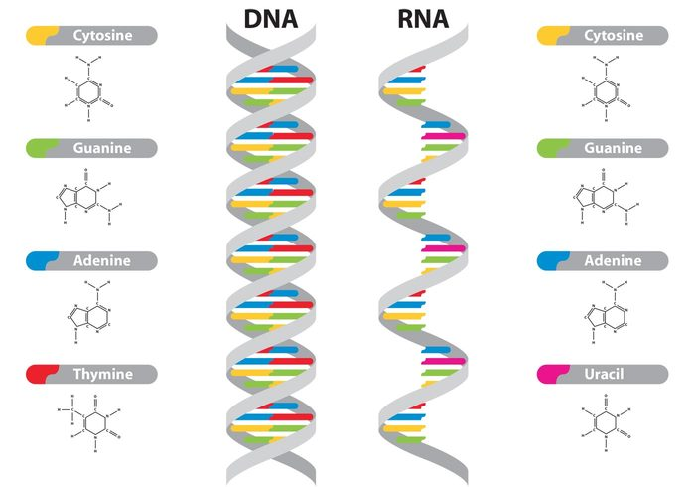
DNA & RNA
DNA
Deoxyribonucleic acid
Master copy of an organism’s genetic code
RNA
Ribonucleic acid
Copy of DNA (able to leave nucleus)
Plays major role in protein synthesis (making proteins)

Slide 27
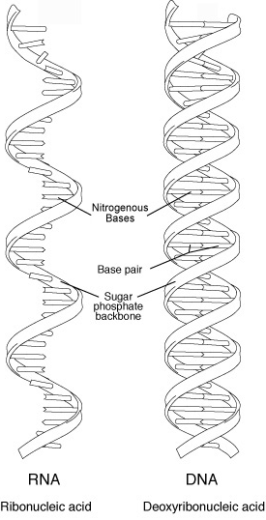
3. Nucleic Acids

Slide 28
4. Proteins
Made of: C,H,N,O and sometimes S
Functions:
1) Structure (hair, nails)
2) Transport (hemoglobin in blood)
3) Movement (muscle fibers)
4) Defense (antibodies)
5) Regulating Cell Functions (hormones and enzymes)

Slide 29
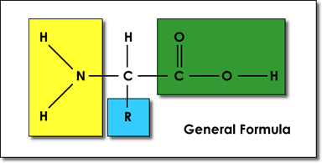
4. Proteins
Amino Acids : Monomers of proteins; Consists of a central Carbon atom bonded to 4 groups
20 common amino acids
4 Groups
1) Hydrogen Atom
2) Amino Group
3) Carboxyl Group
4) R group (changes in each Amino Acid!)

Slide 30
Another View

Slide 31
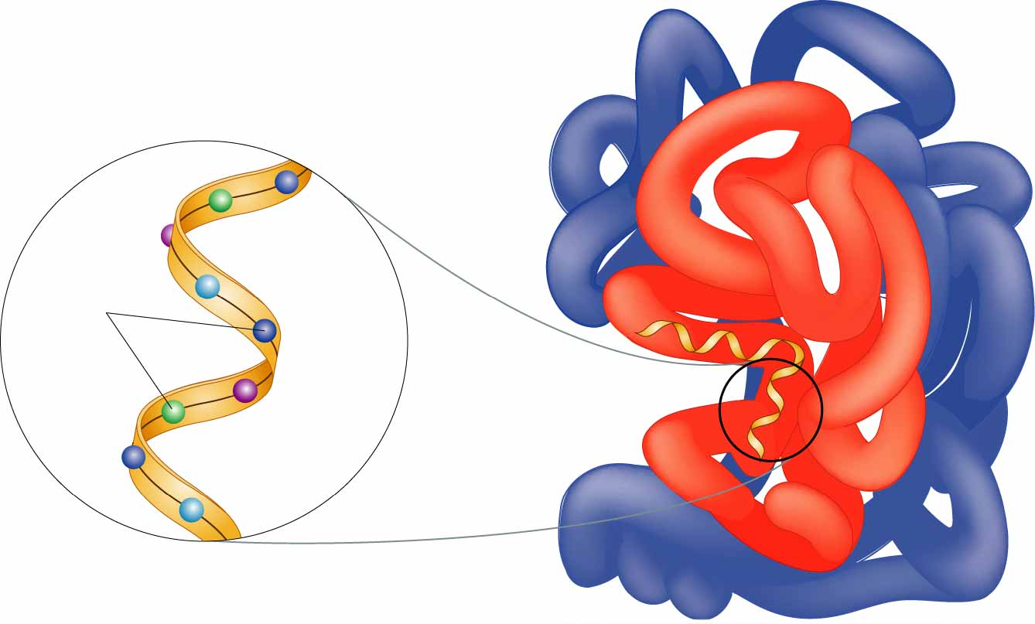
4. Proteins
Polypeptide: polymer; one chain of amino acids connected by “PEPTIDE BONDS”
Proteins: several polypeptides folded into complex structures.

Slide 32
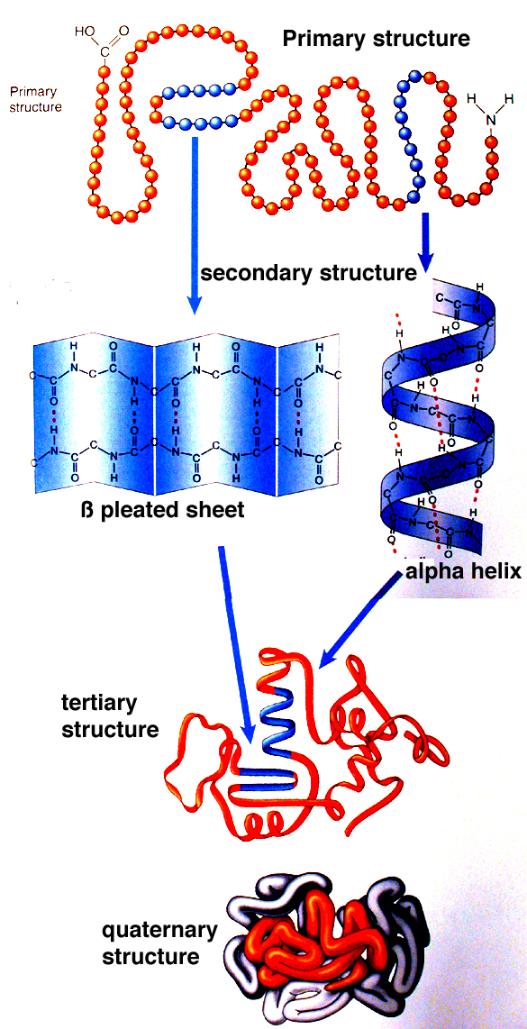
4. Proteins
Four Levels of Protein Structure
1) Primary
2) Secondary
3) Tertiary
4) Quaternary

Slide 33
