Slide 2
Why do we study chemical reactions in biology?
Chemistry isn’t just what life is made of, chemistry is also what life does
Everything that happens in an organism is based on chemical reactions (growth, response to environment, etc.)

Slide 3
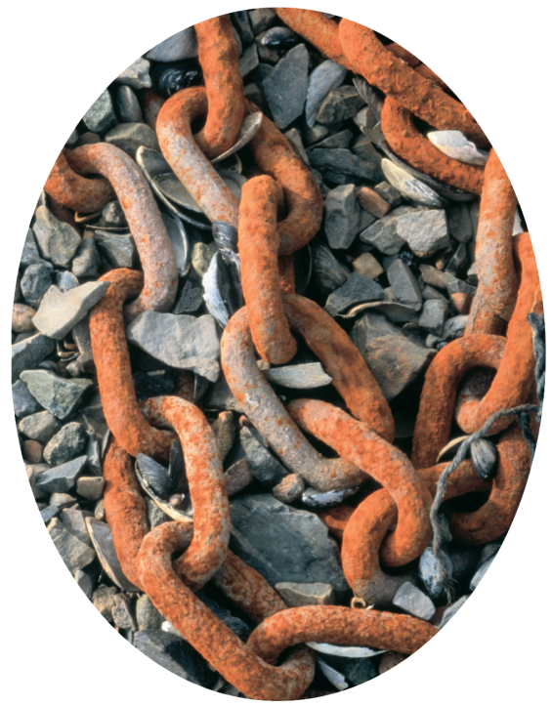
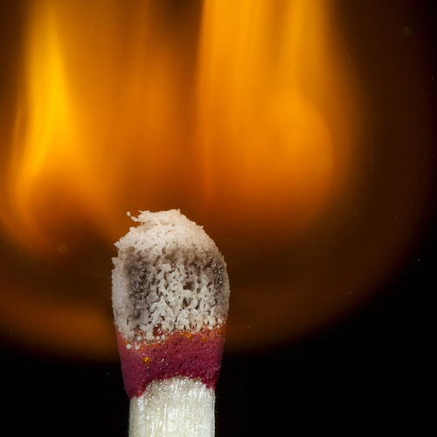
Chemical Reaction
A process that changes reactants into products.
Slow Reactions vs. Fast Reactions

Slide 4
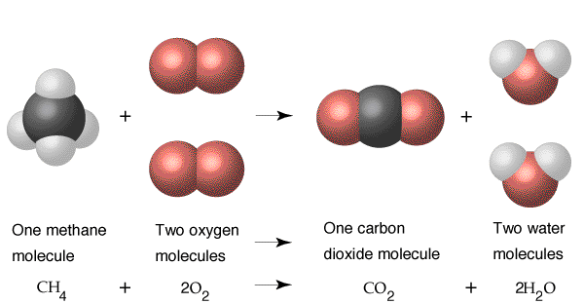
Chemical reactions → breaking bonds in reactants and forming bonds in products

Slide 5
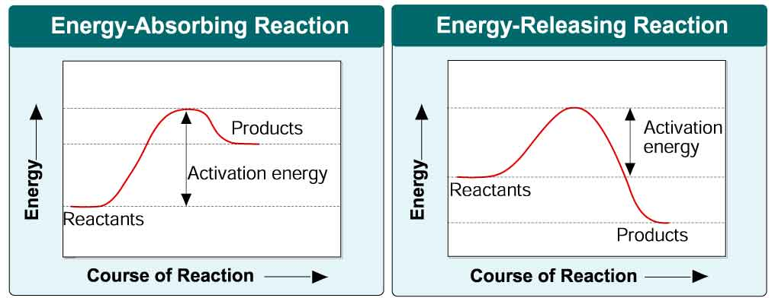
Energy Changes
Some reactions release energy and some absorb energy
Activation Energy: the energy required to start a reaction

Slide 6
Speeding up Reactions
Slow reactions or reactions with high activation energies need a catalyst
Catalyst = any substance that lowers the activation energy of a reaction to “speed it up”
Enzymes are catalysts that are protein molecules.

Slide 7
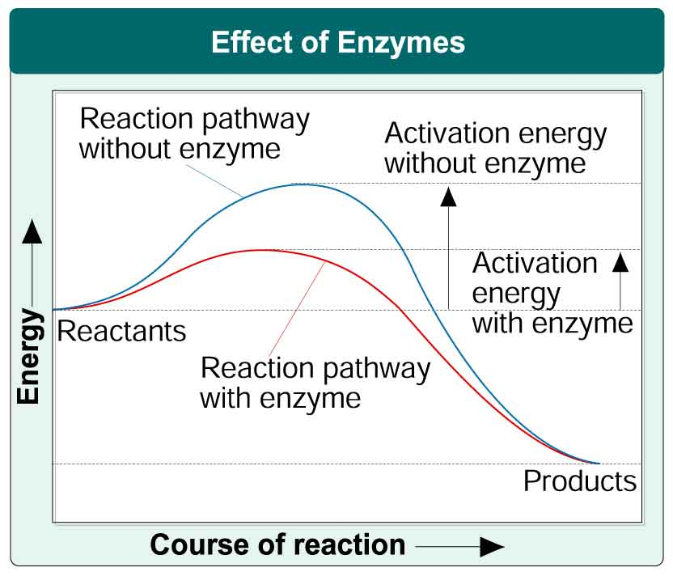

Slide 8
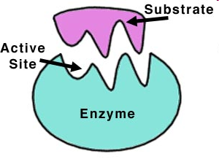
Enzymes
Enzymes provide a site where reactants can be brought together to react.
In an enzyme-catalyzed reaction, the reactants are called substrates.
Each enzyme has a specific shape and a specific portion called the active site, where substrates bind.

Slide 9
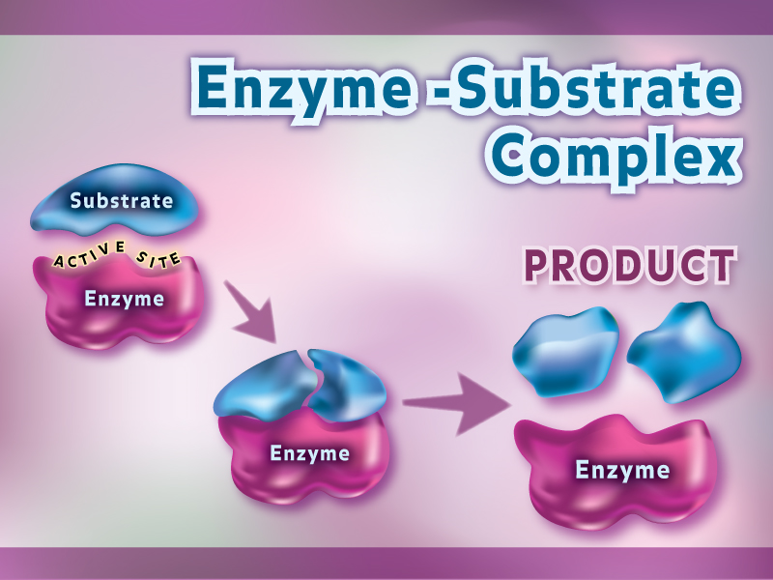
The substrates must fit exactly into the active site. This is called the lock and key model. When the substrates are locked in to the active site, the whole thing is called the enzyme-substrate complex.
Once the reaction is complete, the enzyme releases the products of the reaction.
Enzymes can join or break substrates into products.

Slide 10
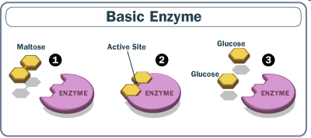
Breaking 1 Substrate into 2 Products
G:\Teacher Resources\Downloaded Videos\Enzyme Action.avi

Slide 11
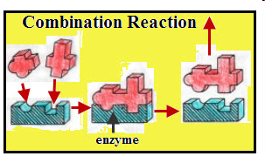
Joining 2 Substrates into 1 Product

Slide 12
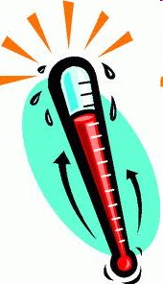
Enzymes can break or join substrates into products.
Enzymes work best at a certain pH and temperature.
Roles of Enzymes:
1) regulating chemical pathways
2) making materials
3) releasing energy
4) transferring info

Slide 13
Factors that affect Reaction Speed
Inhibitors – compete for space in the active site
Slow down reaction
Temperature – higher temp = faster reaction speed
Can get too hot and denature protein structure
pH – enzymes work best at a particular pH
Substrate concentration – higher substrate = faster reaction speed
There is a point where it levels off

Slide 14
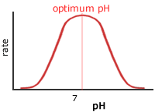
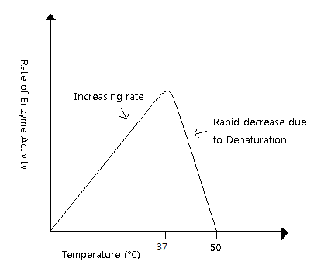
Graphs that show how factors affect reaction speed

Slide 15
Draw your own enzyme-catalyzed reaction!
LABEL:
Enzyme
Substrate
Enzyme-Substrate Complex
Active Site
Products

