Slide 1
Unit 3: cells
Theory, types, structures, movement

Slide 2
Unit 3 Topic 1: The cell theory
By the end of this topic, I will be able to…
List the three components of the cell theory
Describe the importance of each of the contributors to the cell theory
Virchow, Schleiden, Schwann, Leeuwenhoek, Hooke
Relate the invention of the microscope to the development of the cell theory

Slide 3
The cell theory
Three components:
All living things are composed of cells
Cells are the basic unit of structure and function in living things
All cells come from preexisting cells

Slide 4
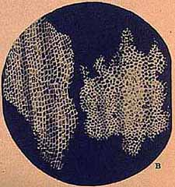
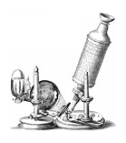
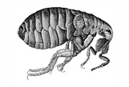
How did we get the cell theory?
What tool do we need to see most cells?
The microscope!
People you should know involved with this tool:
Anton van Leeuwenhoek – starting in 1678, he used to grind lenses and assemble them together to make compound microscopes
Robert Hooke – he observed fleas and cork; while looking at cork, he saw what he called cells. He discovered plant cells (he did not know this) AND coined the term cell.
Why did he call them “cells?”
When he looked at the cork (in 1665), he saw what looked like thousands of chambers, or little boxes, and called them cells (like a prison cell or monastery cell, where monks live)

Slide 5
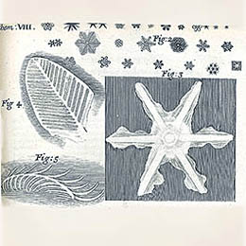
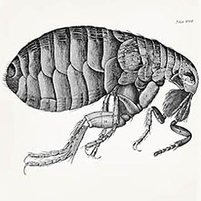
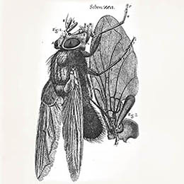
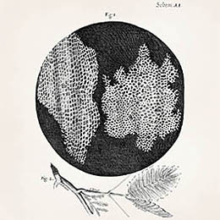
What hooke saw (his drawings)
Snowflakes
Fleas
Flies
Cells

Slide 6
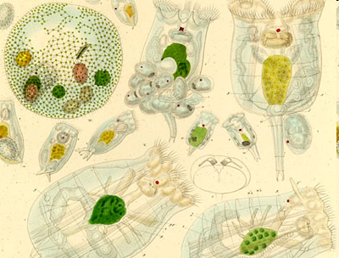
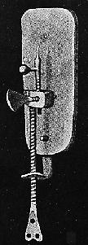
Leeuwenhoek (1678)
Worked on ways to make superior lenses (again, he would grind and reassemble lenses together)
Did NOT invent the microscope (it was invented nearly 40 years before he was born- in the 1590s)
Developed a lens tube with a magnifying power of 270x
He was the first to see and describe bacteria, yeast, and “animalcules” (little animals)
Observed the animalcules in pond water and on his own dental scrapings (plaque)
His observations are among the first observations ever recorded for bacteria

Slide 7
What leeuwenhoek saw

Slide 8
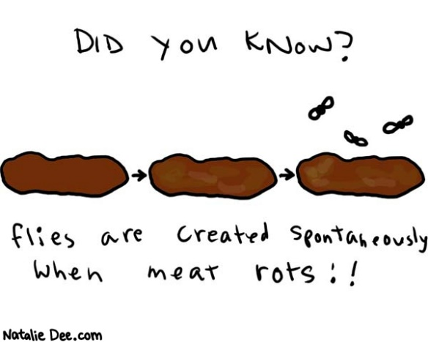
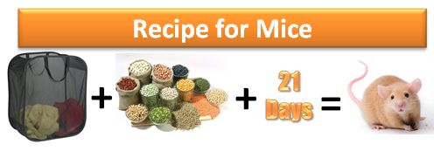
Years and years of no progress….
Nothing really drastic happens between the work of Hooke/Leeuwenhoek
and our next scientists for close to two centuries
Why?
Likely, because people believed in spontaneous generation and were unwilling to believe anyone telling them otherwise.
What’s that?
The belief that something living can come from something non-living. We will revisit this in evolution later this year!

Slide 9
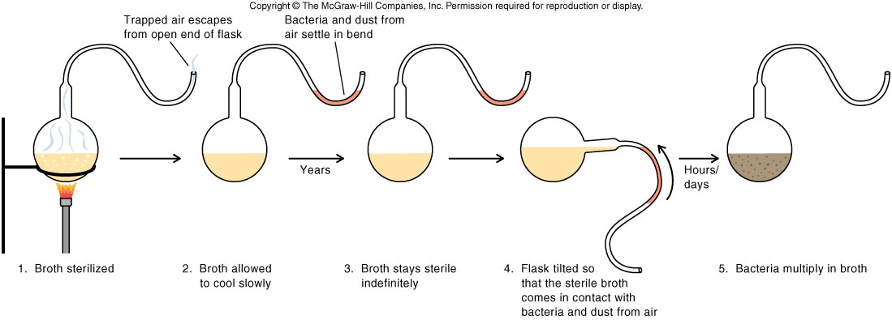
Louis pasteur
Finally put an end to the debate on where living things come from and disproved spontaneous generation with his famous experiment:
Living things only come from living things!

Slide 10
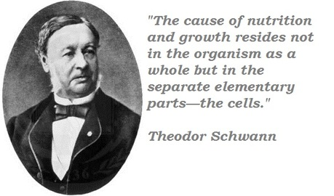
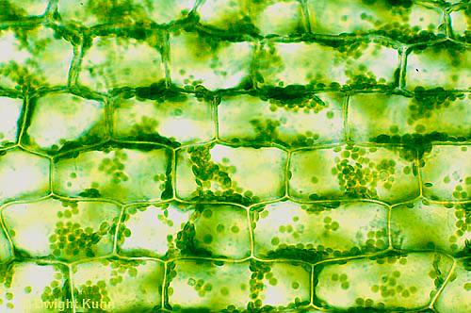
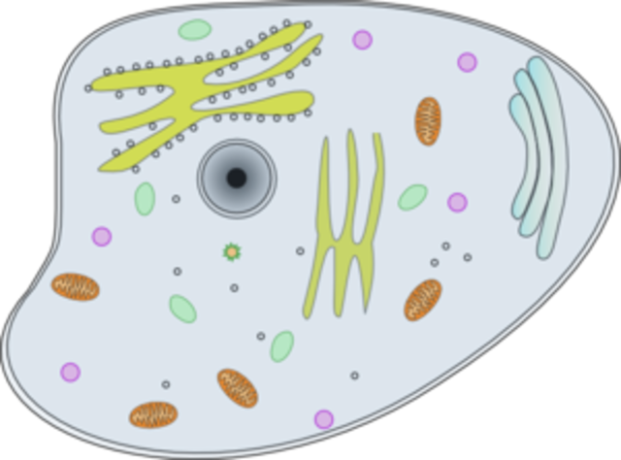
1838-1839
Two German scientists, Matthias Schleiden and Theodor Schwann, continue studying living things.
1838 – Matthias Schleiden (botanist, so studies plants) concluded that all plants are made of cells
1839 – Theodor Schwann (physiologist) concluded that all animals are made of cells

Slide 11
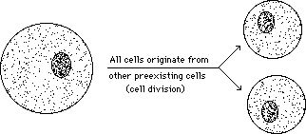
And finally, virchow
1855: Rudolph Virchow concluded that all cells come from preexisting cells (part 3 of the cell theory)

Slide 12
The cell theory
The 3 Basic Components of the Cell Theory were now complete:
1. All organisms are composed of one or more cells. (Schleiden & Schwann)(1838-39)
2. The cell is the basic unit of life in all living things. (Schleiden & Schwann)(1838-39)
3. All cells are produced by the division of preexisting cells. (Virchow)(1858)

Slide 13
Language target: 30-ish minutes
In the small space in your notes, sketch a timeline highlighting development of the cell theory
After you have the dates/people/events/images set out, create your timeline on the slip of paper available to you in the front
When done, work on microscope parts handout
Timeline Component | Value (points)
Date (Year) | 2.5 (.5 points per date)
Person with description of work | 5 (1 point per person with description)
Image (COLORED) relating to work | 2.5 (.5 points per image)

Slide 14
Language target: 30-ish minutes
A’s (90+) | B’s (80-89) | C’s (70-79) | D’s (60-69) | F’s (<59)
23% (7) | 39% (12) | 26% (8) | 9% (3) | 3% (1)
In the small space in your notes, sketch a timeline highlighting development of the cell theory
After you have the dates/people/events/images set out, create your timeline on the slip of paper available to you in the front
Timeline Component | Value (points)
Date (Year) | 2.5 (.5 points per date)
Person with description of work | 5 (1 point per person with description)
Image (COLORED) relating to work | 2.5 (.5 points per image)

Slide 15
Unit 3 topic 1 enrichment: the microscope
By the end of this topic, you should be able to…
Label a microscope and explain the function of each part
Bring a specimen into focus when using a compound light microscope
Write about the history of the microscope

Slide 16
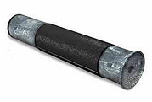
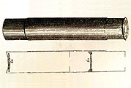
History of the microscope
The first microscope is believed to have been invented in/around the 1590s by Hans and Zacharias Jansen
Zacharias was a spectacle maker that is credited with inventing the first microscope. However, he was born ~1580, so he would have been very young in 1590.
It is believed his father, Hans, assisted him in the building of the first microscope.

Slide 17
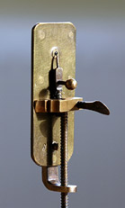
Hooke & leeuwenhoek
These two made improvements on the microscope by modifying the lenses.
Leeuwenhoek's instruments consisted of simple powerful magnifying glasses, rather than the compound microscopes (microscopes using more than one lens) of the type used today or in Zacharias Jansen's original microscope design.
Leeuwenhoek's design is extremely simple, using a single lens mounted in a tiny hole in a brass plate that makes up the body of the instrument. The specimen was then mounted on a sharp point that sticks up in front of the lens. Its position and focus could be adjusted by turning the two screws. The entire instrument was only 3-4 inches long, and had to be held up close to the eye, requiring good lighting and great patience to use.

Slide 18
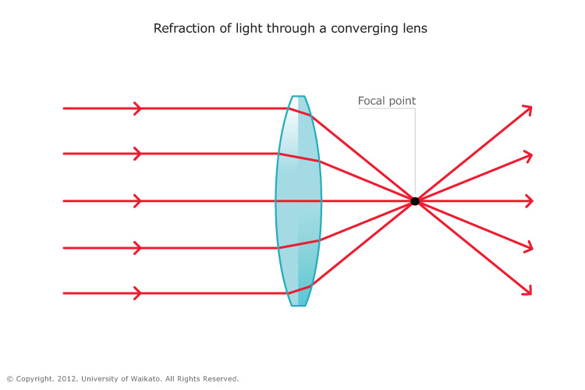
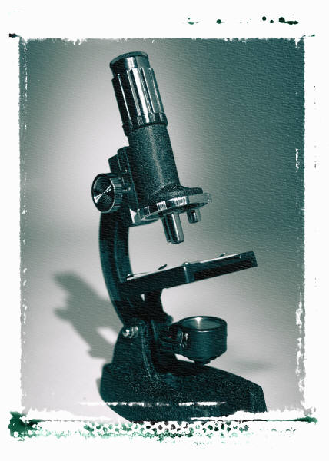
Today’s microscope please note… we will only be discussing the compound light microscope (we may address the SEM and TEM later in the course)
The scopes we use in class are compound microscopes
Have more than one lens
Convex lenses are used to build the microscopes (and glasses)
These lenses bend light and focus it in one spot
Bending Light: The objective (bottom) convex lens magnifies and focuses (bends) the image inside the body tube and the ocular convex (top) lens of a microscope magnifies it (again).
Ocular Lens
(Magnifies Image)
Objective Lens
(Gathers Light,
Magnifies
And Focuses Image
Inside Body Tube)
Body Tube
(Image Focuses)

Slide 19
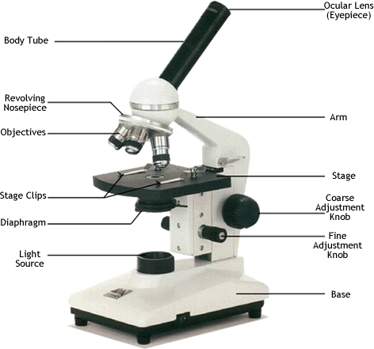
Parts of the microscope
Objective lenses
Body tube
Ocular lens
Nosepiece
Stage clips
Diaphragm
Light source
Arm
Stage
Adjustment knobs
Base

Slide 20
Top functions
Ocular Lens (eyepiece): magnifies the specimen (typically 10x) and what you look through to observe the specimen
Body Tube: holds the objective lens(es) the proper distance from the ocular lens
[Revolving] Nosepiece: holds the objective lens(es); turn this to switch objective/magnification
Arm: holds the body tube/nosepiece/objective lenses; used to support the microscope; always carry with one hand on the arm
Objective Lenses: increase/decrease magnification; change power; use the nosepiece to switch between objective lenses

Slide 21
Middle functions
Stage: flat surface used to hold the specimen/slide
Stage clips: two clips used to hold the slide/specimen in place; always use these!
Diaphragm: controls the amount of light coming through the specimen/slide
Coarse adjustment knob: moves the stage up and down (quickly) for focusing your image
This is the larger of the two adjustment knobs
Never use this on high power!

Slide 22
Bottom functions
Fine adjustment knob: this is the smaller of the two adjustment knobs and it is used to move the stage slightly to sharpen the image
Light source: projects light upwards through the slide/specimen, diaphragm, and lenses
Usually a light, though can be a mirror
Base: supports the microscope; always carry with one hand on the base

Slide 23
Magnification
To determine your magnification…you just multiply the ocular lens by the objective lens
Ocular 10x Objective 40x:10 x 40 = 400
So the object is 400 times “larger”
Objective Lens have
their magnification
written on them.
Ocular lenses usually magnifies by 10x

Slide 24
Caring for a Microscope
Clean only with a soft cloth/tissue
Make sure it’s on a flat surface
Don’t bang it
Carry it with 2 HANDS…one on the arm and the other on the base

Slide 25
Using a Microscope
Place slide on stage and lock clips
Start on the lowest magnification
Don’t use the coarse adjustment knob on high magnification… you’ll break the slide!!!
Adjust light source
Use fine adjustment to focus

Slide 26
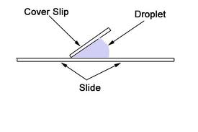
HOW to prepare a slide:
Put your specimen on the glass slide
Add 1-2 drops of water to your specimen
Place one edge of the coverslip on the slide.
Slowly lower it until the whole coverslip is flat.
Reduces air bubbles
Secure under stage clips on the stage.

