Slide 1
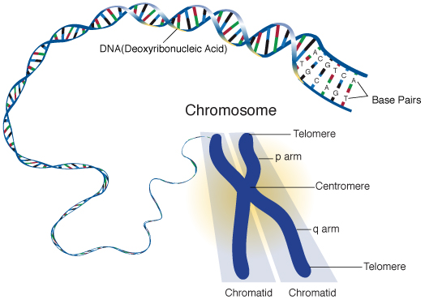
Unit 5: Cell Cycle & Division
Topic 1: DNA Organization
By the end of this topic, you should be able to…
Identify parts of a chromosome
Explain why DNA has to copy and coil before cell division
Explain why cells cannot continue to grow forever

Slide 2
1. DNA is a double helix made of nucleotides

Slide 3
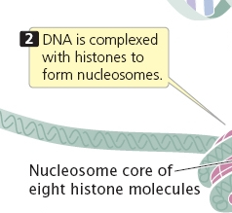
2. Histone proteins protect the DNA

Slide 4
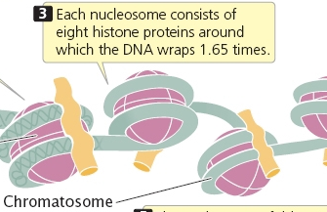
3. Nucleosomes are made of DNA and 8 histone proteins

Slide 5
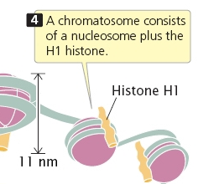
4. H1 Histone is added to make a chromatosome

Slide 6
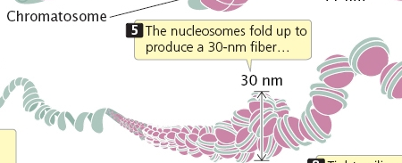
5. These fold into chromatin fibers

Slide 7
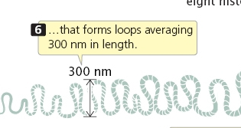
6. The fibers make loops

Slide 8
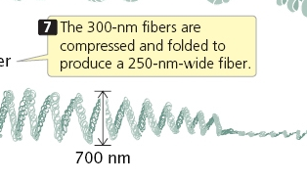
7. The loops make compressed chromatin

Slide 9
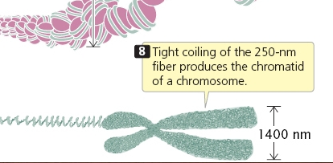
9. Chromosome: 2 sister chromatids connected by centromere
8. The chromatin is packed into a chromosome
9. Chromosome consists of 2 sister chromatids connected by a centromere

Slide 10
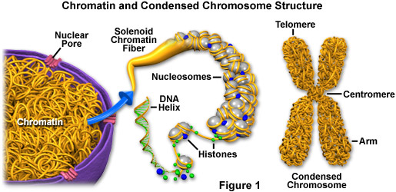
Organization of Genetic Material
All the DNA in a cell constitutes the cell’s genome
A genome can consist of a number of DNA molecules
DNA molecules in a cell are packaged into chromosomes

Slide 11
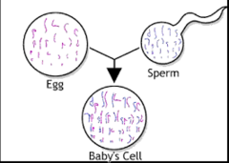
Organization Continued…
Eukaryotic chromosomes consist of chromatin, a complex of DNA and protein that condenses during cell division
Every eukaryotic species has a characteristic number of chromosomes in each cell nucleus
Non-reproductive cells have two sets of chromosomes

Slide 12
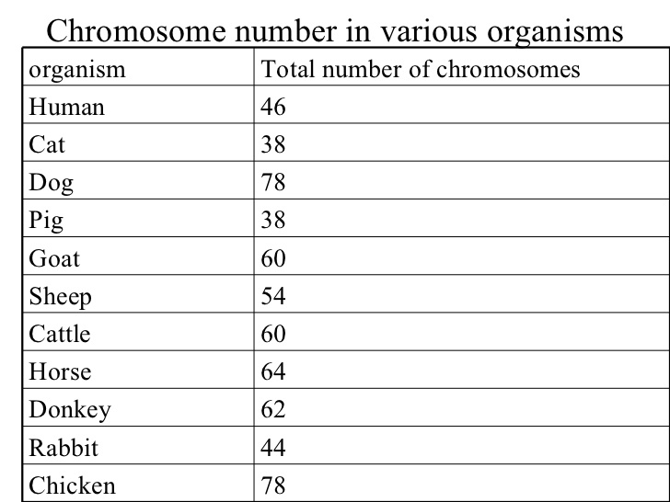

Slide 13
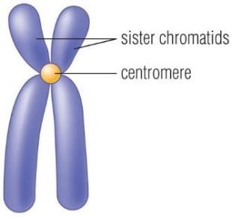
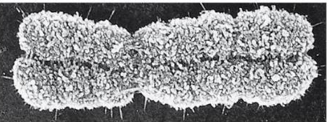
DNA Terms
In preparation for cell division, DNA is replicated and the chromosomes condense
Each duplicated chromosome has two sister chromatids which separate during cell division
The centromere is where the two chromatids are most closely attached

Slide 14
To reproduce or not to reproduce, that is the question.
-The Cell Cycle

Slide 15
Growth vs. Division
When an animal or plant grows, what happens to its cells?
Does an animal get larger because each cell increases in size (grows) or because it produces more of them?

Slide 16
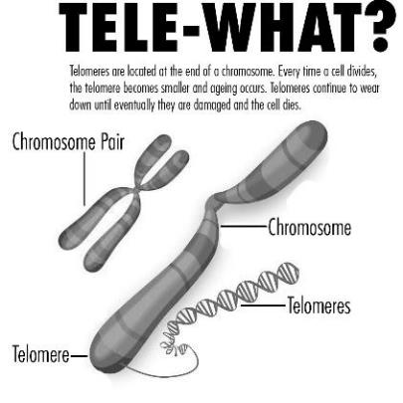
Why can’t cells grow forever?
REASON 1: Not enough DNA! ...as the cell increases in size, it keeps the same amount of DNA. Eventually the cell will grow too much for the DNA to control all its activities
DNA Overload: when the DNA of a cell has too many tasks to do (like making proteins), and not enough DNA to get the job(s) done, the cell has “DNA overload” [cell size must be limited]
Every time a cell divides, the telomeres (ends of chromosomes) become smaller, so organisms age!

Slide 17
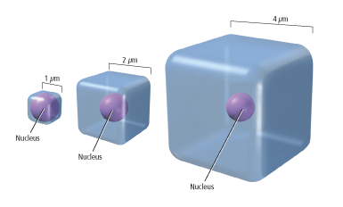
Why Can’t Cells Grow Forever?
REASON #2: SURFACE AREA TO VOLUME RATIO:
Surface area of membrane doesn’t increase as quickly as cell volume
Too little membrane → not enough exchange of materials in and out of the cell

Slide 18
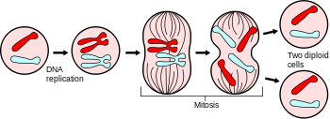
The Solution?
Before a cell becomes too large, it divides to form 2 “daughter cells”.
This process is called cell division
Cell division can only happen once a cell has made a copy of its DNA so that each daughter cell can have a full genetic library

Slide 19
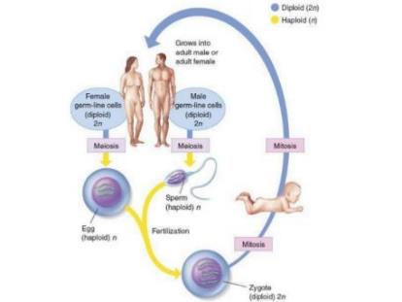
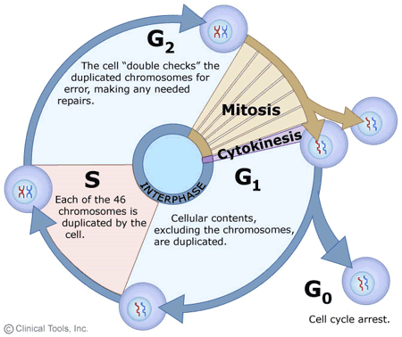
Why Divide?
Multicellular organisms depend on cell division for
Development from a fertilized cell
Growth
Repair
Cell division is an integral part of the cell cycle, the life of a cell from formation to its own division

Slide 20
Topic 2: Mitosis
By the end of this topic, you should be able to…
Explain why cells must divide
Draw and label the stages of mitosis
Compare and contrast cell division (cytokinesis) in plant and animal cells
Compare and contrast prokaryotic and eukaryotic division

Slide 21
Purpose of Mitosis
To create two identical daughter cells from one parent cell
Cells begin diploid (2 sets of chromosomes) and end diploid
Used for somatic cell division and asexual reproduction

Slide 22
Types of Asexual Reproduction
Binary fission
Sporulation
Regeneration
Vegetative propagation

Slide 23
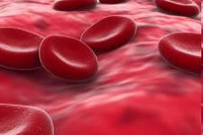
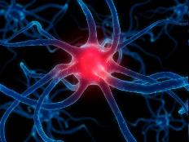
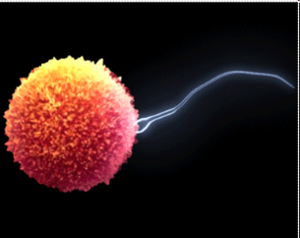
Vocab
Diploid Cells (2n) = 2 sets of chromosomes…one from each parent (Example: human body cell) --- SOMATIC CELLS
Haploid Cells (n)= only have 1 set of chromosomes (Example: Sperm or Egg Cell) --- SEX CELLS
Notes:
Make sure to talk about sex chromosomes
Sometimes the most complex organism does not have the most chromosomes!

Slide 24
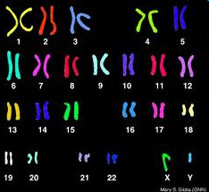
Types of Chromosomes
Sex chromosomes = determine the sex of an organism; either X or Y, referred to as “23rd pair”
Autosomes = all the other chromosomes in an organism (“1st – 22nd pair”)
Notes:
Ear hair
Female: XX
Male: XY

Slide 25
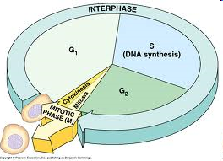
Cell Cycle
The series of events that cells go through as the grow and divide
During the cycle, a cell grows, prepares for division, and divides to form 2 daughter cells, each of which then begins the cycle again
2 Main Parts
1) Interphase
2) Cell Division (mitosis + cytokinesis)

Slide 26
Stages of the Cell Cycle
G1
S
G2
Mitosis
Cytokinesis
Interphase

Slide 27
The Steps Prior to Cell Division
the cell doubles in size (G1 Phase)
chromosomes replicate (S Phase)
the number of organelles doubles (G2 Phase)
most doubling is directed by the nucleus

Slide 28
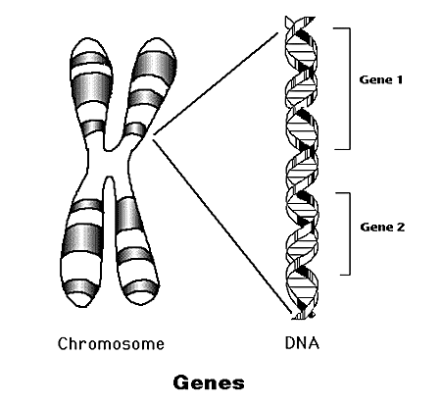
Replicated Chromosome
Sister chromatids
centromere

Slide 29
What is DNA Replication?
A chromosome is unzipped and thus starts as one strand of DNA
Each daughter cell needs its own copy of the DNA strand.
The DNA strand is duplicated and the two parts are “tied” together.

Slide 30
Important Details
DNA replication occurs during
S phase, NOT mitosis
(S stands for Synthesis or making more DNA)
Mitosis and cytokinesis overlap

Slide 31
Important Details
Cells can also enter a G₀ phase
in which they no longer divide
Cells move to the next stage when enough “trigger protein” has built up

Slide 32
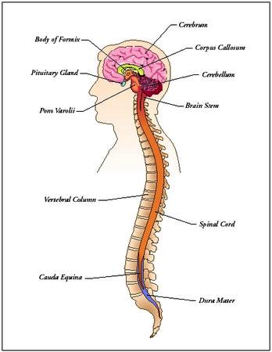
Cells of the adult central nervous system (brain and spinal cord) do NOT divide.

Slide 33
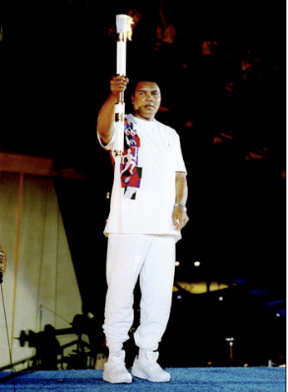
PARKINSON'S
Cassius Clay
Muhammad Ali
Progressive nervous system disorder - nerve cells break down and die and cannot be replaced

Slide 34
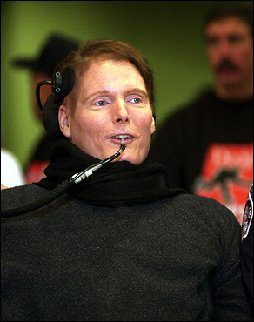
Christopher Reeve
Horseback injury left him paralyzed

Slide 35
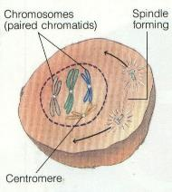
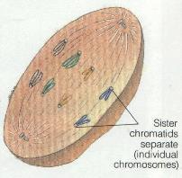
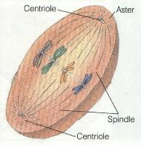
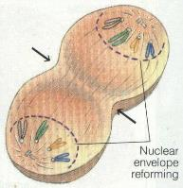
Mitosis is the process of dividing just the nucleus (not the whole cell.)
Prophase
Metaphase
Anaphase
Telophase

Slide 36
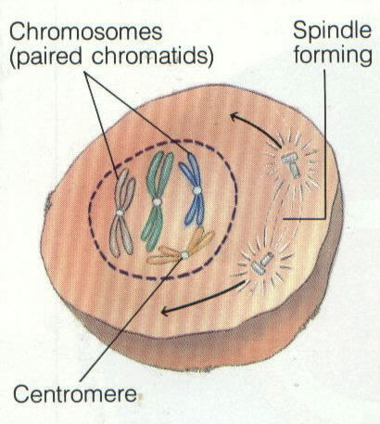
PROPHASE

Slide 37
Steps of MITOSIS
PROPHASE
Nuclear membrane is broken down
2. Chromosomes appear
3. Centrioles migrate
(plants DON’T have centrioles)
4. Spindles form

Slide 38
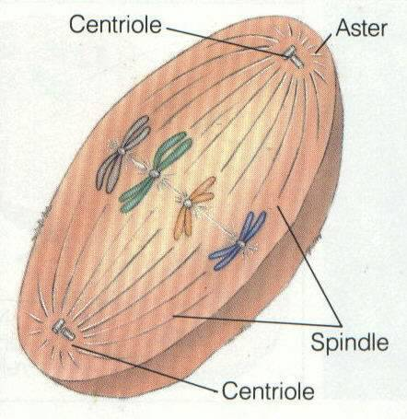
METAPHASE

Slide 39
Steps of MITOSIS
METAPHASE
Chromosomes align on the equatorial plane
Spindle fibers attach to chromosomes

Slide 40
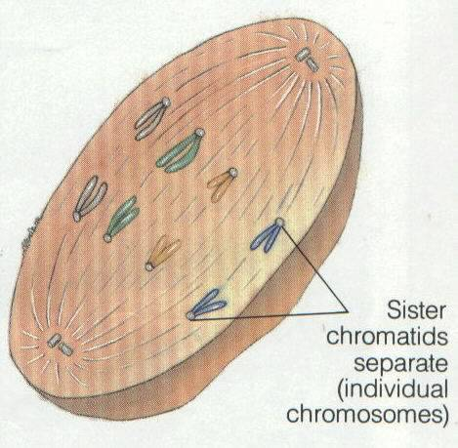
ANAPHASE

Slide 41
Steps of MITOSIS
ANAPHASE
Chromatids move to opposite ends of the cell with the help of spindle fibers

Slide 42
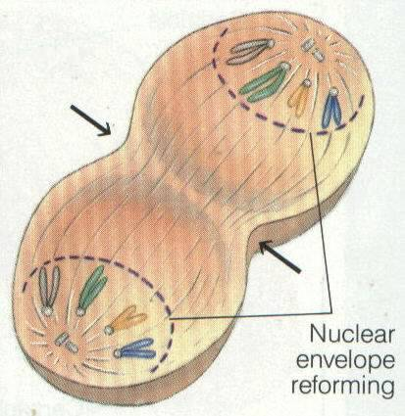
TELOPHASE

Slide 43
Steps of MITOSIS
TELOPHASE
chromosomes stop moving and the nuclear membrane reforms

Slide 44
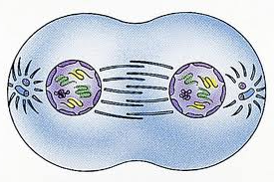
Which Stage?
Notes:
telophase

Slide 45
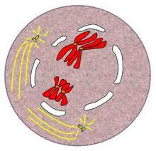
Which Stage?
Notes:
prophase

Slide 46
Which Stage?
Notes:
anaphase

Slide 47
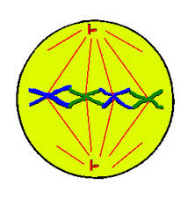
Which Stage?
Notes:
metaphase

Slide 48
CYTOKINESIS
Division of the entire
cell after the nucleus divides
Differs for plants and
animals because plant cells
have cell walls

Slide 49
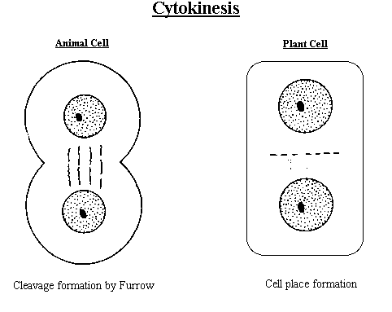

Slide 50
Animal Cell Division
The cell membrane constricts to make a groove and divide
This groove is referred to as the cleavage furrow

Slide 51
Plant Cell Division
Vesicles produced by golgi bodies form a midline in the cell
Vesicles fuse to make a cell plate which attaches to cell wall

Slide 52
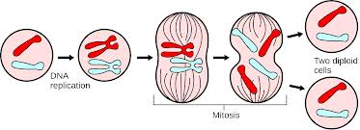
How does the beginning cell differ from the ending cells?

Slide 53
Mitosis Rap
http://www.youtube.com/watch?v=pOsAbTi9tHw

Slide 54
Binary Fission in Bacteria
Prokaryotes (bacteria and archaea) reproduce by a type of cell division called binary fission

Slide 55
Reproduction in Prokaryotes
Binary Fission (ASEXUAL): cell parts reproduce and cell divides in half
-The most common form of reproduction for bacteria and archae
-In binary fission, the DNA replicates, and the two daughter chromosomes actively move apart
-The plasma membrane pinches inward, dividing the cell into two
-Produces genetically identical daughter cells

Slide 56
binary fission = bacteria divide

Slide 57
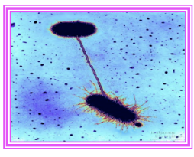
Conjugation (SEXUAL): exchange of genetic material (plasmid) between two bacterium
Reproduction in Prokaryotes
-One bacterium transfers the plasmid to the other bacterium through the conjugation bridge.
-This produces genetic diversity in bacteria that may ensure their survival. Can pick up resistance to antibiotics this way!
Bacterial conjugation
with a conjugation bridge.

Slide 59
Topic 3: Meiosis
By the end of this topic, you should be able to…
Compare and contrast sexual and asexual reproduction
Illustrate meiosis I and meiosis II
Explain fertilization of eukaryotic cells
Explain production of egg and sperm cells
Explain nondisjunction and read a karyotype

Slide 60
Warm-Up
Are somatic (body) cells haploid or diploid and what does this mean?
Haploid = one set of chromosomes (egg, sperm… gametes)
Diploid = two sets of chromosomes (body cells)
How many chromosomes are found in human body cells?
46 chromosomes (23 pairs – 1 set from mom, 1 set from dad)
Why is mitosis necessary and important?
Grow; repair; development
How do daughter cells differ from parent cells in mitosis?
Genetically identical (don’t differ)
How does mitosis differ from meiosis?

Slide 61
Chromosome Structure, revisited

Slide 62
Diploid Cell- where DNA comes from

Slide 63
Meiosis does two things -
1) Meiosis takes a cell with two copies of every chromosome (diploid - 2n) and makes cells with a single copy of every chromosome (haploid – 1n).
In meiosis, one diploid cells produces four haploid cells.

Slide 64
2) Meiosis scrambles the specific forms of each gene that each sex cell (egg or sperm) receives.
This makes for a lot of genetic diversity. This trick is accomplished through independent assortment and crossing-over.
Genetic diversity is important for the evolution of populations and species.

Slide 65
Why do we need meiosis?
Meiosis is necessary to halve the number of chromosomes going into the sex cells
Why halve the chromosomes in gametes?
At fertilization the male and female sex cells will provide ½ of the chromosomes each – so the offspring has genes from both parents that together total 100% of the genes the offspring should have

Slide 66
Purpose
Meiosis is used to make special cells - sperm cells and egg cells - that have half the normal number of chromosomes. It reduces the number from 23 pairs of chromosomes to 23 single chromosomes. The cell copies its chromosomes, but then separates the 23 pairs to ensure that each daughter cell has only one copy of each chromosome. A second division that divides each daughter cell again to produce four daughter cells.

Slide 67
Meiosis
Parent cell – chromosome pair
Chromosomes copied
1st division - pairs split
2nd division – produces 4 gamete cells with ½ the original no. of chromosomes

Slide 68
Meiosis I : Separates Homologous (Matching) Chromosomes
Interphase
DNA is replicated
The result is two genetically identical sister chromatids which remain attached at their centromeres
(just like in Mitosis)

Slide 69
Prophase I
During this phase each pair of chromatids don’t move to the equator alone, they match up with their homologous pair and fasten together (synapsis) in a group of four called a tetrad.
Extremely IMPORTANT!!! It is during this phase that crossing over can occur.
Crossing Over is the exchange of segments during synapsis.

Slide 70
Metaphase I
The chromosomes line up at the equator attached by their centromeres to spindle fibers from centrioles.
Still in homologous pairs

Slide 71
Anaphase I
The spindle guides the movement of the chromosomes toward the poles
Sister chromatids remain attached
Move as a unit towards the same pole
The homologous chromosome moves toward the opposite pole

Slide 72
Telophase I
This is the end of the first meiotic cell division.
The cytoplasm divides, forming two new daughter cells.
Each of the newly formed cells has half the number of the parent cell’s chromosomes, but each chromosome is already replicated ready for the second meiotic cell division

Slide 73
Cytokinesis
Occurs simultaneously with Telophase I
Forms 2 daughter cells
Plant cells – cell plate
Animal cells – cleavage furrows
NO FURTHER REPLICATION OF GENETIC MATERIAL PRIOR TO THE SECOND DIVISION OF MEIOSIS

Slide 74
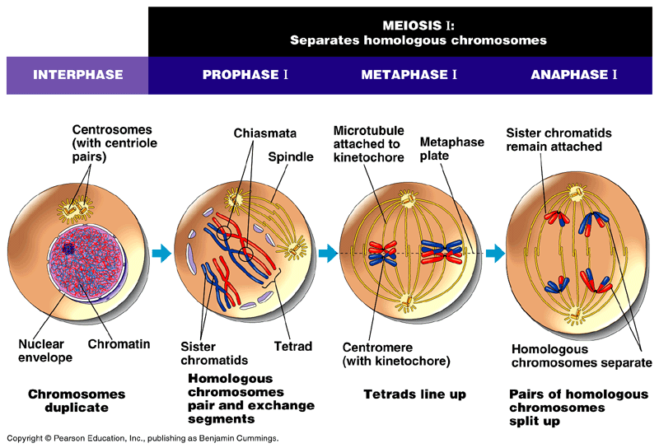

Slide 75
Meiosis II : Separates sister chromatids
Proceeds similar to mitosis
THERE IS NO INTERPHASE II !
(no replication of DNA this time)

Slide 76
Prophase II
Each of the daughter cells forms a spindle, and the double stranded chromosomes move toward the equator

Slide 77
Metaphase II
The chromosomes are positioned on the metaphase plate in a mitosis-like fashion

Slide 78
Anaphase II
The centromeres of sister chromatids finally separate
The sister chromatids of each pair move toward opposite poles
Now individual chromosomes

Slide 79
Telophase II and Cytokinesis
Nuclei form at opposite poles of the cell and cytokinesis occurs
After completion of cytokinesis there are four daughter cells
All are haploid (n)

Slide 81
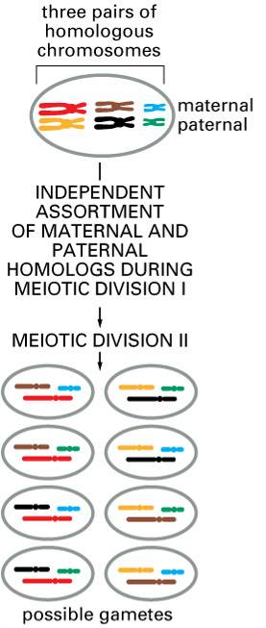
One Way Meiosis Makes Lots of Different Sex Cells (Gametes) – Independent Assortment
Independent assortment produces 2^{n} distinct gametes, where n = the number of unique chromosomes.
In humans, n = 23 and 2²³ = 6,000,0000.

Slide 82
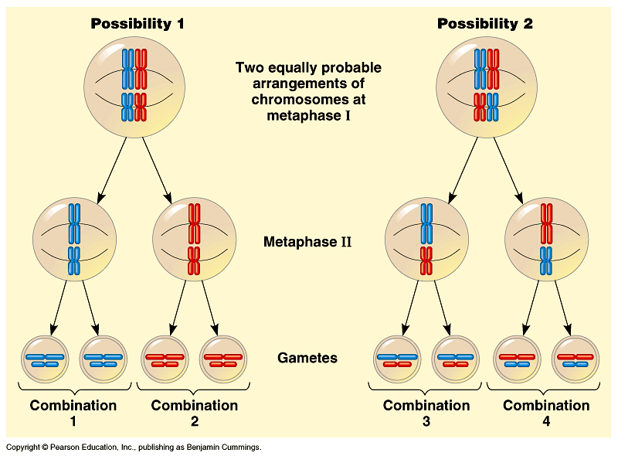

Slide 83
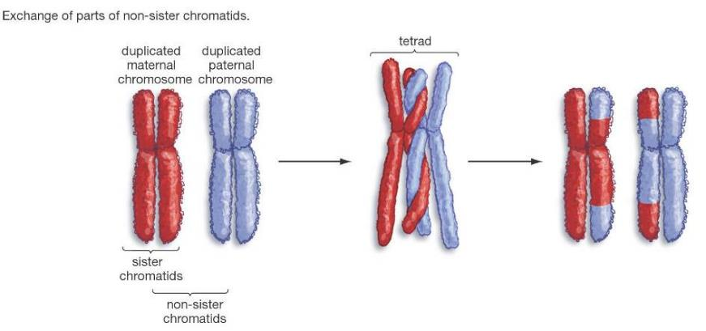
Another Way Meiosis Makes Lots of Different Sex Cells: Crossing-Over
Crossing-over multiplies the already huge number of different gamete types produced by independent assortment.

Slide 84
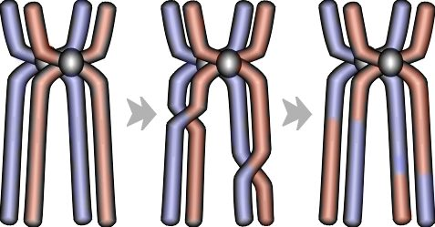
Swapping genes is known as a crossing over

Slide 85
Crossovers occur while the homologous chromosomes are paired in Prophase I.

Slide 86
Meiosis
Sex cells divide to produce gametes (sperm or egg).
Gametes have half the # of chromosomes.
Occurs only in gonads (testes or ovaries).
Male: spermatogenesis
Female: oogenesis
Meiosis is similar to mitosis with some chromosomal differences.

Slide 87
Fertilization
The fusion of a sperm and egg to form a zygote.
A zygote is a fertilized egg
sperm
n=23
n=23
2n=46
zygote
egg

Slide 88
Nondisjunction
Occurs when chromosomes fail to separate.

Slide 89
Nondisjunction
Can occur during Anaphase I or Anaphase II of Meiosis
Result: eggs or sperm with incorrect number of chromosomes
If the mutated egg or sperm is fertilized, the child will have abnormalities.
Note: It may also occur in anaphase of Mitosis, but usually the abnormal cells die and the whole organism is not affected.

Slide 90
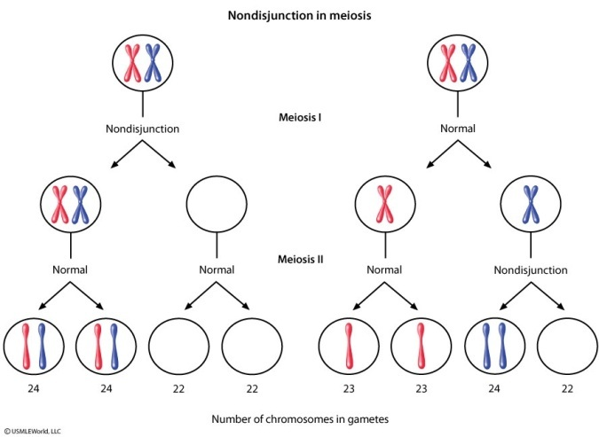

Slide 91
Nondisjunction results in chromosomal abnormalities
Trisomy: Each cell has an extra chromosome
Monosomy: Each cell has one less chromosome

Slide 92
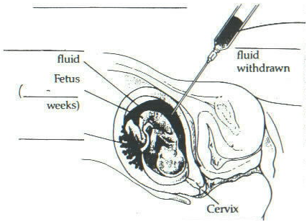
Amniocentesis
amniotic fluid
fetus
14-16
weeks

Slide 93
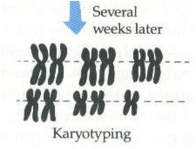

Slide 94
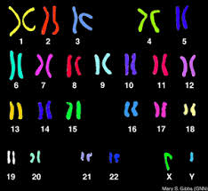
Karyotypes can detect chromosomal abnormalities
Chromosomes are photographed, cut, and matched based on size

Slide 95
Examples:
In humans, nondisjunction results in a person having more or less than 46 chromosomes.
Trisomy 21 → Down Syndrome- 1 in 691 babies born in US are born with DS (alters course of development, low muscle tone)
Trisomy 13 → Patau Syndrome (~1 in 9,500 births); many with this diagnosis will not make it to birth or will survive on average 10 days (clefts, improper brain formation, extra digits)
Monosomy –Turner Syndrome→ only has an X in pair 23 (missing another sex chromosome); 1 in 2,000 female births; delayed puberty, hearing/ear issues; infertility
Trisomy- Klinefelter Syndrome → has XXY (an extra sex chromosome); 1 in 500 to 1 in 1,000 male births; small testes (less testosterone)

Slide 96
Trisomy 21: Down Syndrome
Three copies of chromosome 21
Occurrence: 1 in 700 births, increased chances when mother is over 40.
Shorter average life span (35 yrs)
Common facial characteristics
Notes:
http://www.youtube.com/watch?v=EA0qxhR2oOk -- Nondisjunction

Slide 97
Trisomy 13: Patau Syndrome
Extra copy of Chromosome 13
Occurrence: 1 in 10,000 births
Characteristics:
Cleft lip and palate
Mental disabilities
Polydactyl
Usually on live about 3 months, 80% die within the first year

Slide 98
Monosomy: Turner Syndrome
Missing a sex chromosome
1 in 2,000 births
Usually cannot tell before puberty
Sex organs do not fully develop
Webbed neck

Slide 99
Trisomy: Klinefelter Syndrome (XXY)
Caused by an extra X chromosome
1 in 1,000 males
Underdeveloped testes, taller, may have breast development, sterile

Slide 100
Stages of Meiosis
Meiosis I
chromosome reduction occurs

Slide 101
Prophase I
tetrad
homologous
chromosomes

Slide 102
equator
(midline)
spindle
fibers
centromeres
Metaphase I

Slide 103
homologous chromosomes
Anaphase I

Slide 104
daughter cells
haploid
Telophase I
n = 23

Slide 105
crossing over helps to shuffle the genes
crossing over
homologous chromosomes

Slide 106
Stages of Meiosis
Meiosis II
chromosomes separate
as they do in mitosis

Slide 107
spindle
nuclear membrane
Prophase II

Slide 108
centromere
equator
Metaphase II

Slide 109
sister
chromatids
Anaphase II

Slide 110
haploid
n = 23
Telophase II

Slide 111
Topic 4: Cell Cycle Regulation
By the end of this topic, you should be able to…
Explain the role of cell regulation checkpoints
Explain what happens when the cell cycle control fails

Slide 112
Regulation of Cell Cycle
G1/S checkpoint
G2/M checkpoint
Tumor suppressor genes can control these checkpoints
Tumor suppressor genes turn off or decrease rate of cell division

Slide 113
Figure 12.15
G₁ checkpoint
Control system
S
G₁
M
G₂
M checkpoint
G₂ checkpoint

Slide 114
For many cells, the G₁ checkpoint seems to be the most important
If a cell receives a go-ahead signal at the G₁ checkpoint, it will usually divide
If the cell does not receive the go-ahead signal, it will exit the cycle, switching into a non-dividing state called the G₀ phase
G₁ checkpoint
M checkpoint
G₂ checkpoint

Slide 115
Neighboring cells communicate with dividing cells to regulate their growth also.

Slide 116
Some of the genes that control cell division are called Proto-oncogenes.
Proto-oncogenes encode proteins that function to stimulate cell division
Important for normal human development and for the maintenance of tissues and organs.

Slide 117
Oncogenes and Cancer Cells
When mutated, an oncogene may produce a large amount of these growth proteins, resulting in excessive cell division.
When a cell can no longer regulate its rate of cell division it becomes a Cancer Cell.

Slide 118
Sometimes a proto-oncogene undergoes a mutation and becomes an oncogene.

Slide 119
Because there are several genes that act as proto-oncogenes it may take 3-4 mutations to cause harm.
Anything that can damage genes can cause these harmful mutations.
These are called
carcinogens or
mutagens.

Slide 120
Cancer is a disease of the cell cycle. Some of the body cells divide uncontrollably and tumors form.
Tumors in Liver
Tumor in Colon

Slide 121
DNA mutations disrupt the cell cycle.
Mutations may be caused by:
1. radiation
2. smoking
3. Pollutants
4. chemicals
5. viruses

Slide 122
Due to DNA mutations, cancer cells ignore the chemical signals that start and stop the cell cycle.

Slide 123
Due to DNA mutations, cancer cells cannot communicate with neighboring cells. Cells continue to grow and form tumors.
Skin cancer

Slide 124
SUMMARY
Normal Cell Division
DNA is replicated properly.
Chemical signals start and stop the cell cycle.
Cells communicate with each other to avoid becoming overcrowded.
Cancer Cells
Mutations occur in the DNA when it is replicated.
Chemical signals that start and stop the cell cycle are ignored.
Cells do not communicate with each other and tumors form.

Slide 125
Cancer Vocabulary
Tumor = loss of cell cycle control = abnormal growth of cells
Benign = non-spreading
Malignant = spreading
Metastasis = spread rate of a malignant cancer to locations other than their origin
(tumor cells enter blood vessels and travel to other parts of the body)

Slide 126
Environment and Cancer
Solid relationship exists between environmental factors and cancer
Cancer cluster: Large number of cases in restricted area
Epidemiologists examine environment for link
Cancer cluster in Woburn, Massachusetts,
Environmental trigger, industrial solvents from contaminated well water

Slide 127
Skin Cancer
~1 million new cases in U.S. per year
Almost all cases related to UV light exposure from sun or tanning lamps
Lightly pigmented people higher risk
genetic characteristics can affect the susceptibility

Slide 128
Skin Cancer
Ozone depletion also contributes to increased UV exposure and risk
In spite of risk, some choose low SPF suntan lotions and only 25% of Americans consistently use sunscreen

Slide 129
Smoking
Related to cancers of oral cavity, larynx, esophagus, and lungs
Accounts for 30% of all cancer deaths
Most have very low survival rate (e.g. 13% lung cancer sufferers survive beyond 5 yrs)

Slide 130
Case Study Response
Hypothesis: If _______________________, then ___________
Cite all pieces of evidence used by Tina’s doctor in her diagnosis
Tie in information from page 1 (background info)
Use information written in the brainstorming section to put Tina’s case all together

