Slide 1
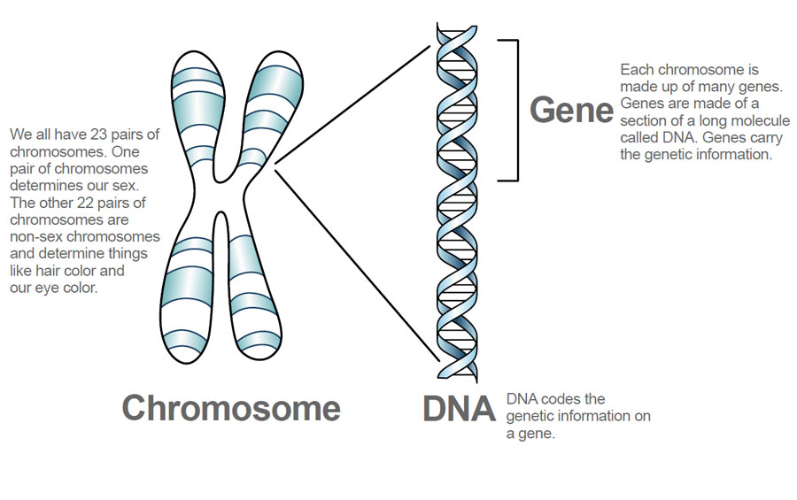
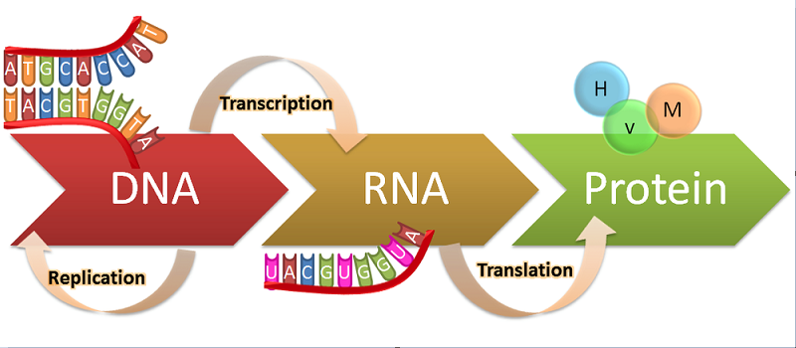
Unit 7
Genetics

Slide 2
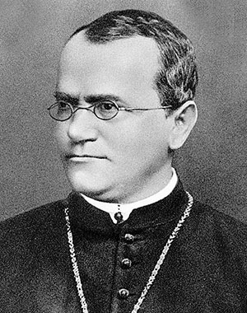
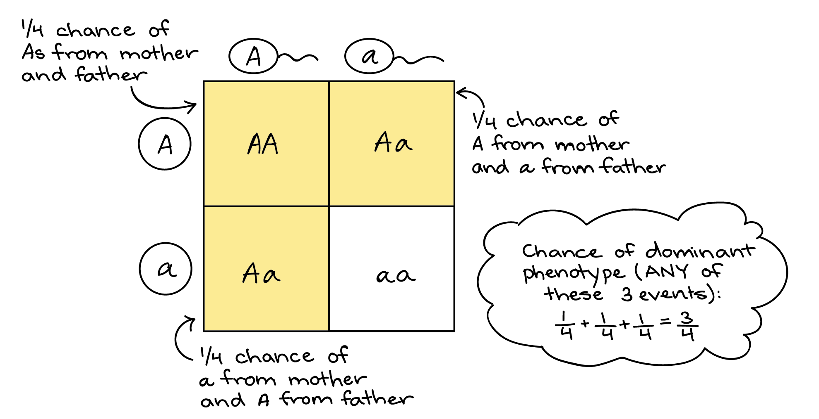
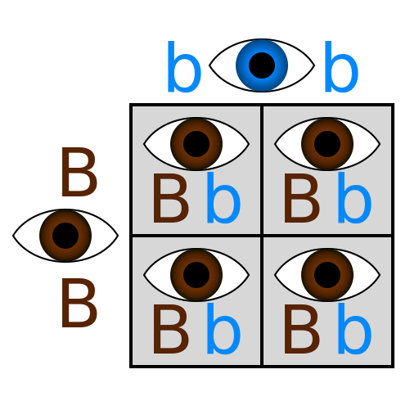
Topic 1: Mendel & Basic Crosses
By the end of this topic, I should be able to:
Use basic genetic vocabulary (genotype, phenotype, homozygous, heterozygous, dominant, recessive)
Describe the experiments of Gregor Mendel and the laws he established
Produce and analyze Punnett squares for basic monohybrid crosses

Slide 3
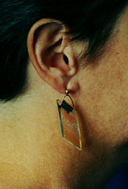
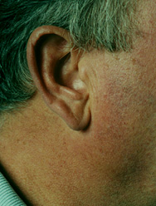
Attached Lobe | Unattached Lobe
Unattached Earlobe—dominant—chromosome 21

Slide 4
Hitchhiker's Thumb | Regular Thumb
Straight Thumb is dominant---chromosome 17

Slide 5
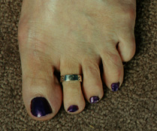
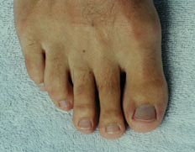
Short Second Toe | Long Second Toe
Long Second Toe Dominant---Chromosome 20 TT or Tt

Slide 6
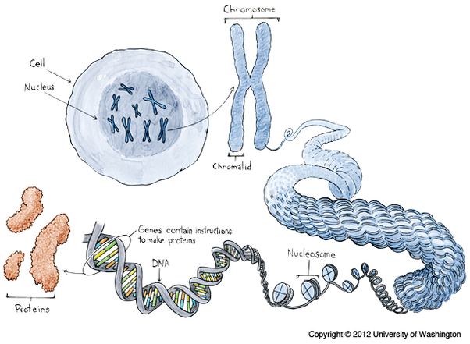
IMPORTANT GENETIC VOCABULARY:
Genetics – the study of heredity
Heredity - characteristics inherited from parents to offspring through genes (passing of traits from parent to offspring)
Trait - specific characteristic that can be passed from parent to offspring (hair color, flower color, seed pod)
Gene – protein code found on the DNA that determines a trait (section of DNA that codes for a protein/trait)
Allele – a different form of the same gene that specifically designates what that trait will look like (variation of a gene/trait)

Slide 7
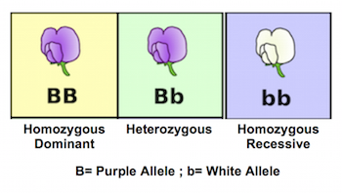
IMPORTANT GENETIC VOCABULARY:
Dominant – the trait that is visible (seen), always expressed (BB)
Recessive – the trait that is sometimes hidden. Hidden (not seen) when paired with a dominant trait. Only visible (seen) when there are 2 recessive alleles being expressed (bb)
Homozygous: organisms that have 2 identical alleles for a particular trait and are called true-breeds (purebred – BB)
Heterozygous: organisms have 2 different alleles for the same trait and are called hybrids (Bb).
Genotype: Refers to the genetic make up of an organism. (Tt, Ss)
Phenotype: Refers to the physical appearance of an organism. (Tall or short, yellow or green, short tail or long tail)

Slide 8
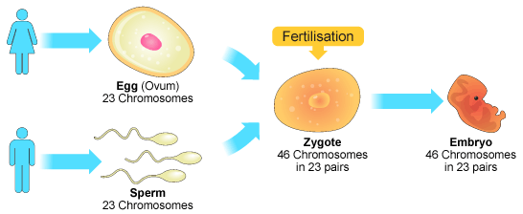
How are genes inherited?
Humans have 23 pairs (2 sets) of homologous chromosomes for a total of 46 chromosomes. Each parent contributes only 1 set of chromosomes to their child.
When a sperm cell (23 chromosomes) and an egg cell (23 chromosomes) join during fertilization, it results in a zygote (46 chromosomes).
We have homologous chromosomes (1 from each parent)… we inherit 2 copies of each gene

Slide 9
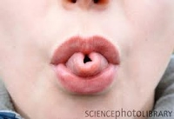
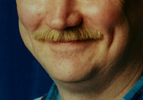
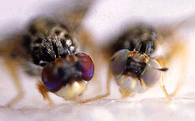
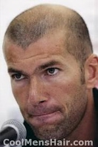
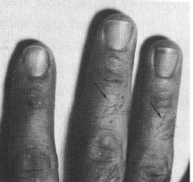
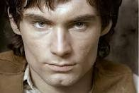
EXAMPLES OF DOMINANT TRAITS
Tongue Rolling
Cheek Dimples
Red Eye Color in Flies
Widow’s Peak
Mid-Digit Hair
Cleft Chin
Notes:
Dimples: chromosome 5 Widow’s peak: chromosome 4 mid-digit hair: chromosome 10 tongue rolling: chromosome 22 cleft chin: chromosome 16

Slide 10
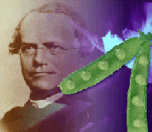
MENDELIAN GENETICS
Known as “The Father of Genetics”
Studied English Pea Plants (1800s) to determine inheritance of traits.
Used Cross Pollination in plants to determine the process of inheritance.
P: tall x short
Determined Generations:
(1). Parental Generation (purebreds – homozygous)
PP or pp Genotypes
(2). F1 Generation (hybrids – heterozygous Pp)
(3). F2 Generation (3:1 ratio of traits PP, Pp, pp)
F1: 100% tall
F2: 75% tall; 25% short

Slide 12
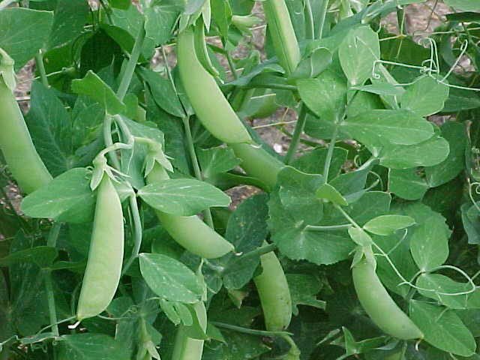
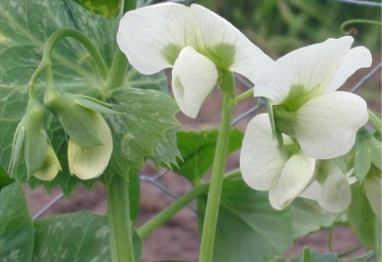
Why Use Pea Plants?
Rapid reproduction.
Male and female parts on same plant.
Distinctive traits.
Ability to control pollination and fertilization.

Slide 13
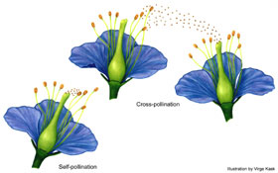
Some terms to know:
Anthers
Self-pollinating--sperm cells in pollen fertilize egg cells in the same plant
Fertilization--during sexual reproduction, male and female reproductive cells join and produce a new cell.
Stigma

Slide 14
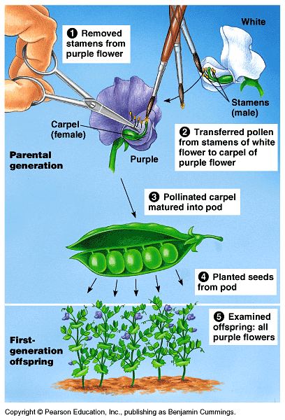
Some terms to know:
True-breeding peas--when they self-pollinated, they would produce offspring identical to themselves.
Cross-pollination- two different plants pollinating to produce seeds.
He wanted to produce seeds from two different plants.
He took off the pollen-bearing male parts
he dusted pollen from another plant

Slide 15
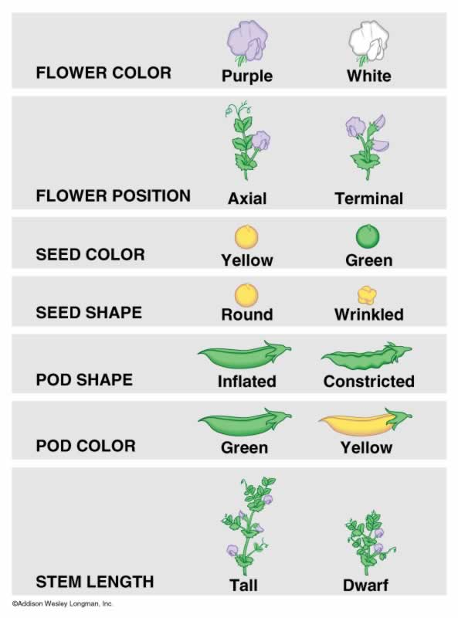
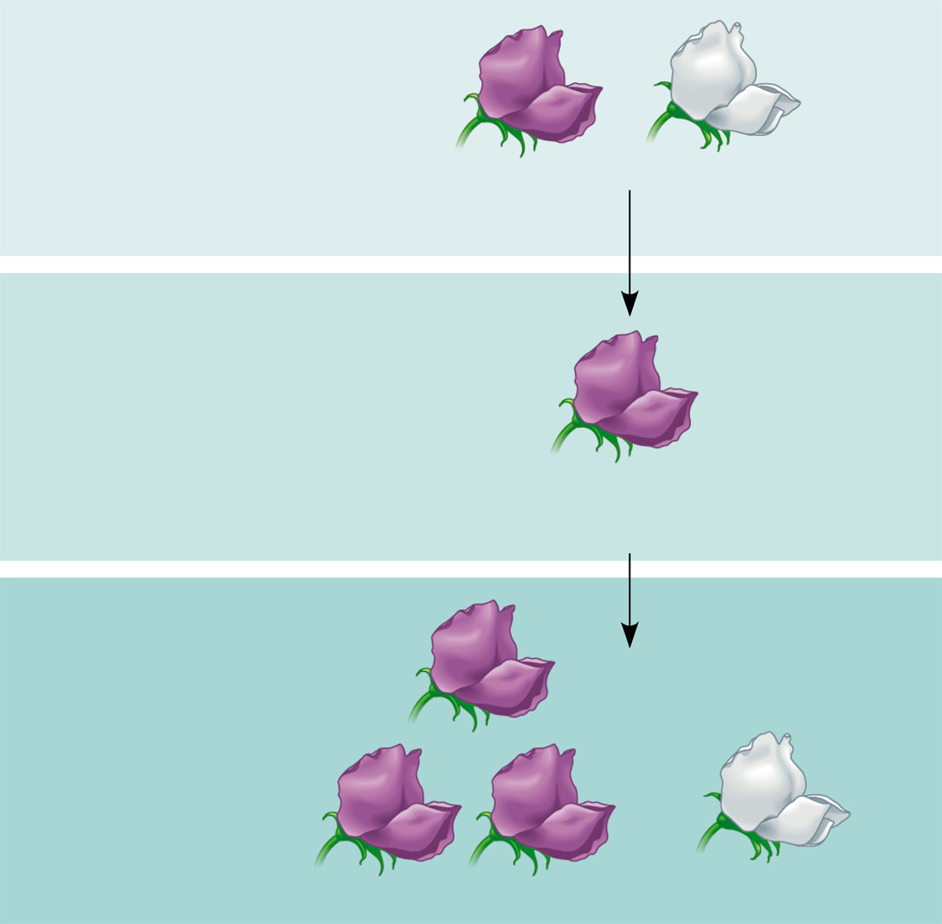
P Generation
(true-breeding
parents)

Purple
flowers
White
flowers
F₁ Generation
(hybrids)
All plants had
purple flowers
F₂ Generation

Slide 16
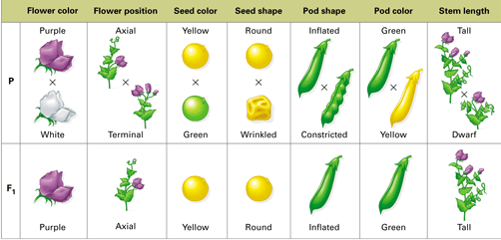
1st set of experiments
Single factor cross (looking at one trait: monohybrid)
Cross pollinated plants with opposite characteristics to see which trait would appear in the F1 hybrid
Concluded individual factors called genes (that have different forms called alleles) control each trait of a living thing (and one may be dominant over another)
Notes:
all traits studied were controlled by a single gene
all genes were either dominant or recessive (no co-dominance)
only a limited # of traits were studied
This made it easy for Mendel to interpret results

Slide 17
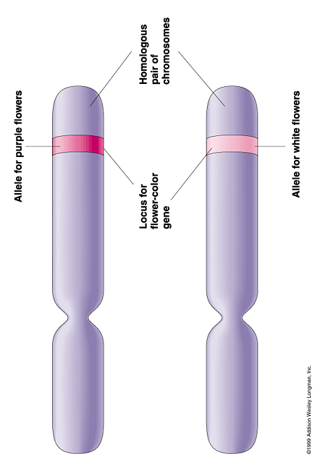
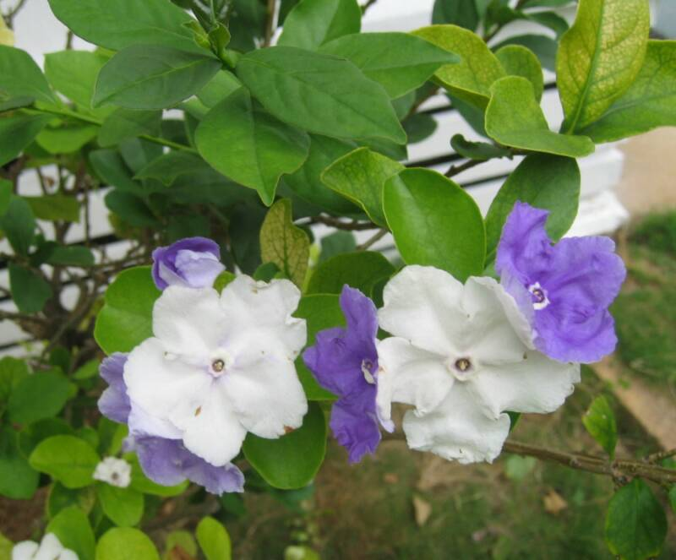
The Law of Dominance (LAW 1)
Alleles can be either dominant or recessive (strong or weak)
Dominant alleles are observable
Recessive alleles are not usually observable, when the dominant allele is present (can still be in genotype)
A CAPITAL LETTER = DOMINANT allele (Ex. A = Purple allele)
A lower case letter = recessive allele (Ex. a= White allele)
Each trait requires TWO alleles
AA = Purple = homozygous dominant
Aa = Purple = heterozygous
aa = White = homozygous recessive
Genotypes Phenotypes Description of genotype

Slide 18
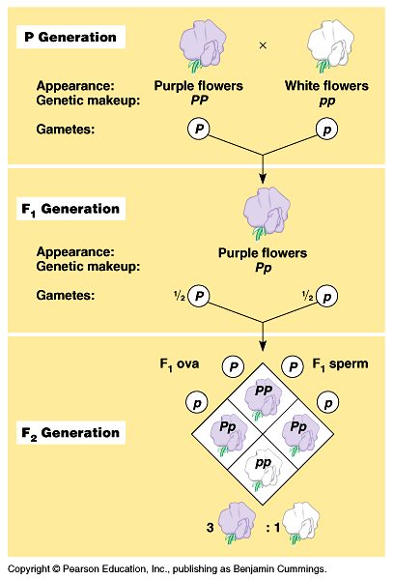
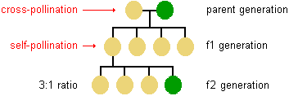
2nd set of experiments
Wanted to know what happened to recessive factors so let F1 hybrids self pollinate
Concluded that a dominant allele had covered up (masked) the recessive allele in the F1 generation
Observed that a recessive allele had segregated from dominant allele in the F2 generation

Slide 19
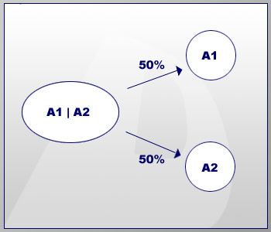
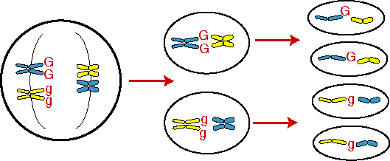
The Law of Segregation (LAW 2)
Alleles for a gene separate when forming a sperm and egg (meiosis)
There are TWO alleles for each trait (1 in each of the chromosome pairs)
When eggs and sperm are made, the two alleles are separated from each other (on their respective homologous chromosomes)

Slide 20
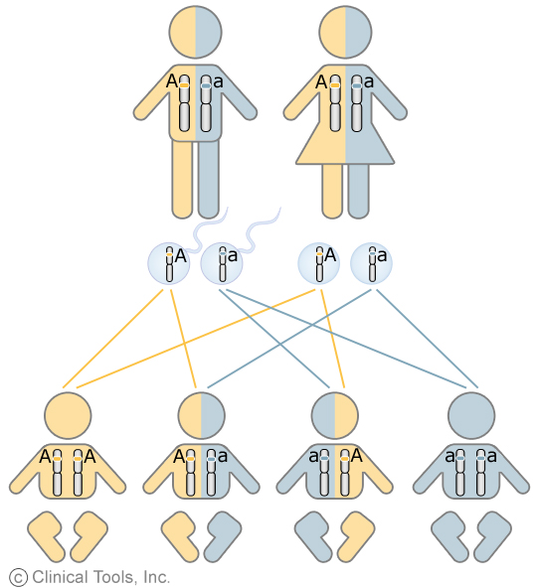

Slide 21
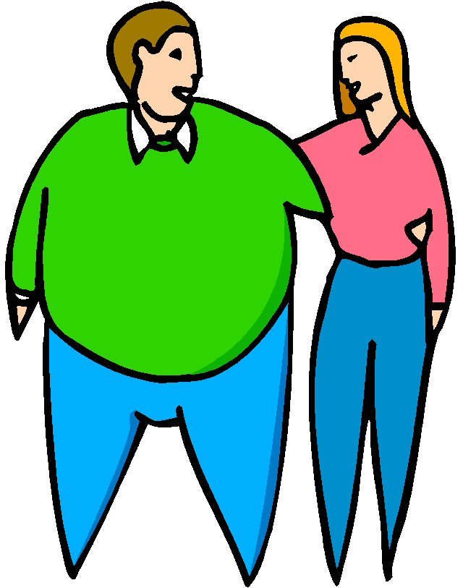
Law of Independent Assortment (LAW 3)
Alleles for different genes are distributed to sperm and egg independently
Could be
tall and fat
Short and thin
Tall and thin
Short and fat
Why all siblings do not look exactly alike
Each pair of alleles sorts out independently during gamete formation
Ex. Brown hair and brown eyes aren’t connected

Slide 22
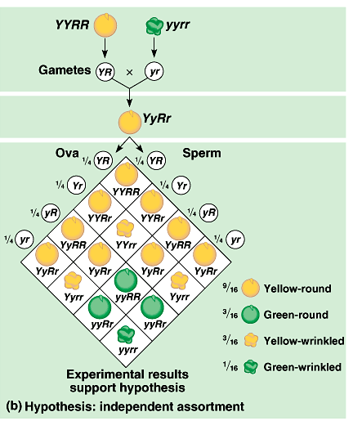
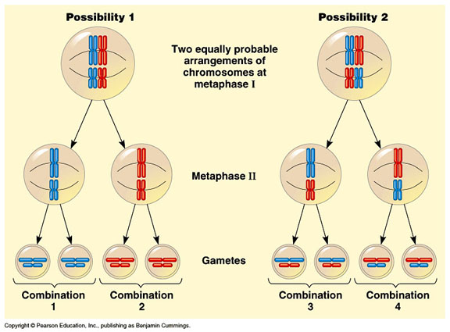
INDEPENDENT ASSORTMENT “the random alignment of homologous chromosomes at metaphase plate (Metaphase I)”
http://fig.cox.miami.edu/~cmallery/150/mitosis/c13x9independent-assortment.jpg

Slide 23
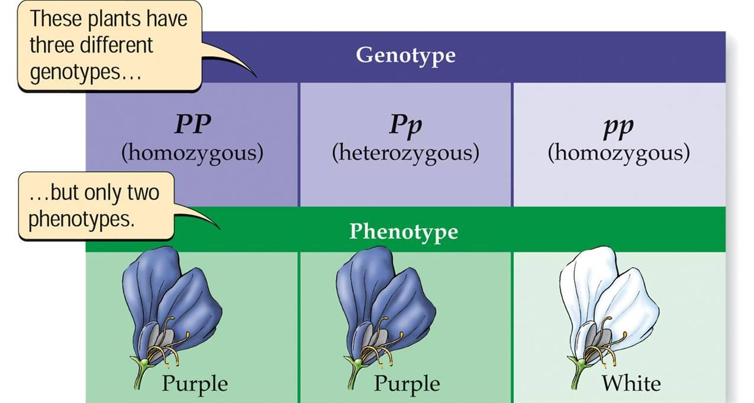
Tools for determining likelihood of an organism inheriting a specific trait
Punnett squares; probability

Slide 24
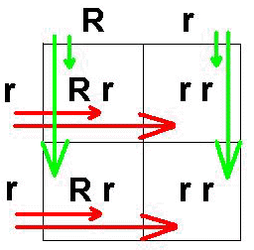
What is a Punnett Square ?
A tool or grid used to predict and compare the genetic variations that will result in a cross of two organisms traits.

Slide 25
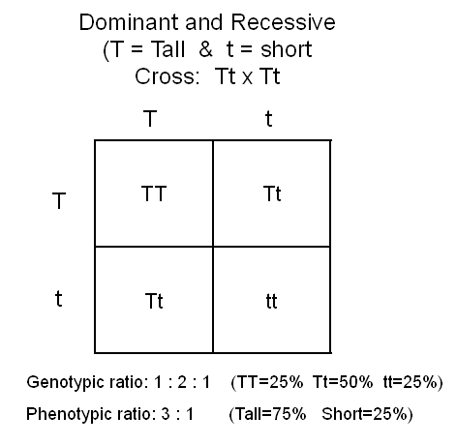
Probability:
Likelihood that event will occur
Probability predicts average outcome from a LARGE # of events
Small # of events not always “accurate”
Punnett squares are used to predict and compare the genetic variations that result from a cross using the principles of probability
Ratios:
¼ : fractions
3:1 (dominant phenotype to recessive phenotype)
1:2:1 (DD: Dd: dd)
Percentages:
½ = 50%

Slide 26
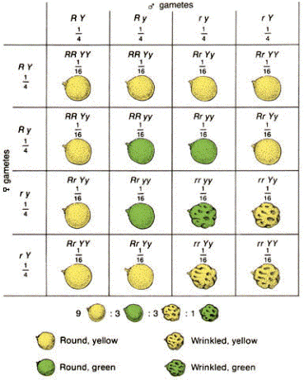
Two Types of Punnett Squares
Monohybrid: A Punnett Square that tests for the inheritance of one trait (example: long necks)
Dihybrid: A Punnett Square that tests for the inheritance of two traits (example: long necks and fur color).

Slide 27
Punnett Squares
Rolled Tongue (R) vs. Non-rolled tongue ( r )
heterozygous
Genotypes
Rr - 50%
rr - 50%
Phenotypes
Rolled - 50%
Non-rolled - 50%
homozygous recessive

Slide 28
Example 1: Homozygous x Homozygous
Situation: One parent is homozygous dominant for green pods(GG) and the other parent is homozygous recessive for yellow pods(gg).
Parent Genotypes: GG X gg
Offspring Ratios
-Genotype: 100% Gg
-Phenotype: 100% green
G
G
g
Gg
Gg
g
Gg
Gg

Slide 29
Example 2: Homozygous X Heterozygous
Situation: One parent is homozygous for green pods, and the other parent is heterozygous.
Parent Genotypes: GG x Gg
Offspring Ratios
-Genotype: 50% GG, 50% Gg
-Phenotype: 100% green

Slide 30
Example 3: Heterozygous X Heterozygous
Situation: Both parents are heterozygous for pod color
Parent Genotypes: Gg x Gg
Offspring Ratios
-Genotype: 25% GG
50% Gg
25% gg
-Phenotype: 75% green, 25% yellow

Slide 31
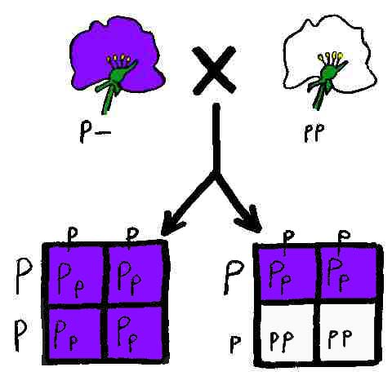
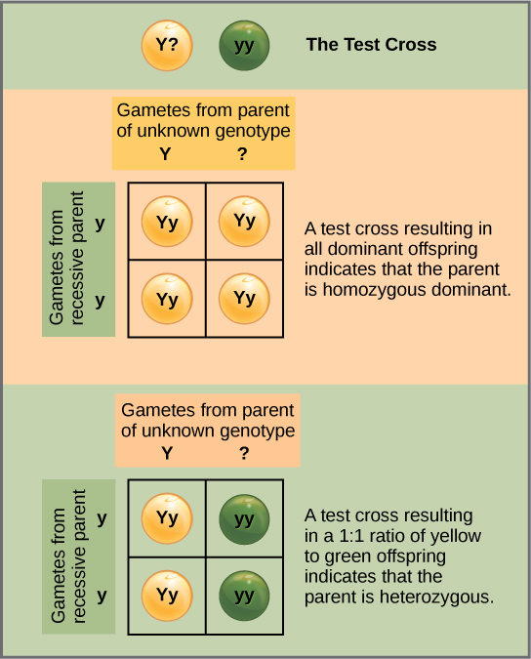
Test Cross
Process of crossing an unknown genotype individual to a homozygous recessive individual to determine what the unknown genotype is.

Slide 32
Example 4: Testcross
Situation: a green-podded plant with an unknown genotype is crossed with a yellow-podded plant. The offspring genotype ratios are given below.
Genotype Ratio: 50% Gg, 50% gg
Question: What was the genotype of the parent green-podded plant? Gg
?
?
g
Gg
gg
g
Gg
gg
Notes:
Could be given genotype or phenotype ratio.

Slide 33
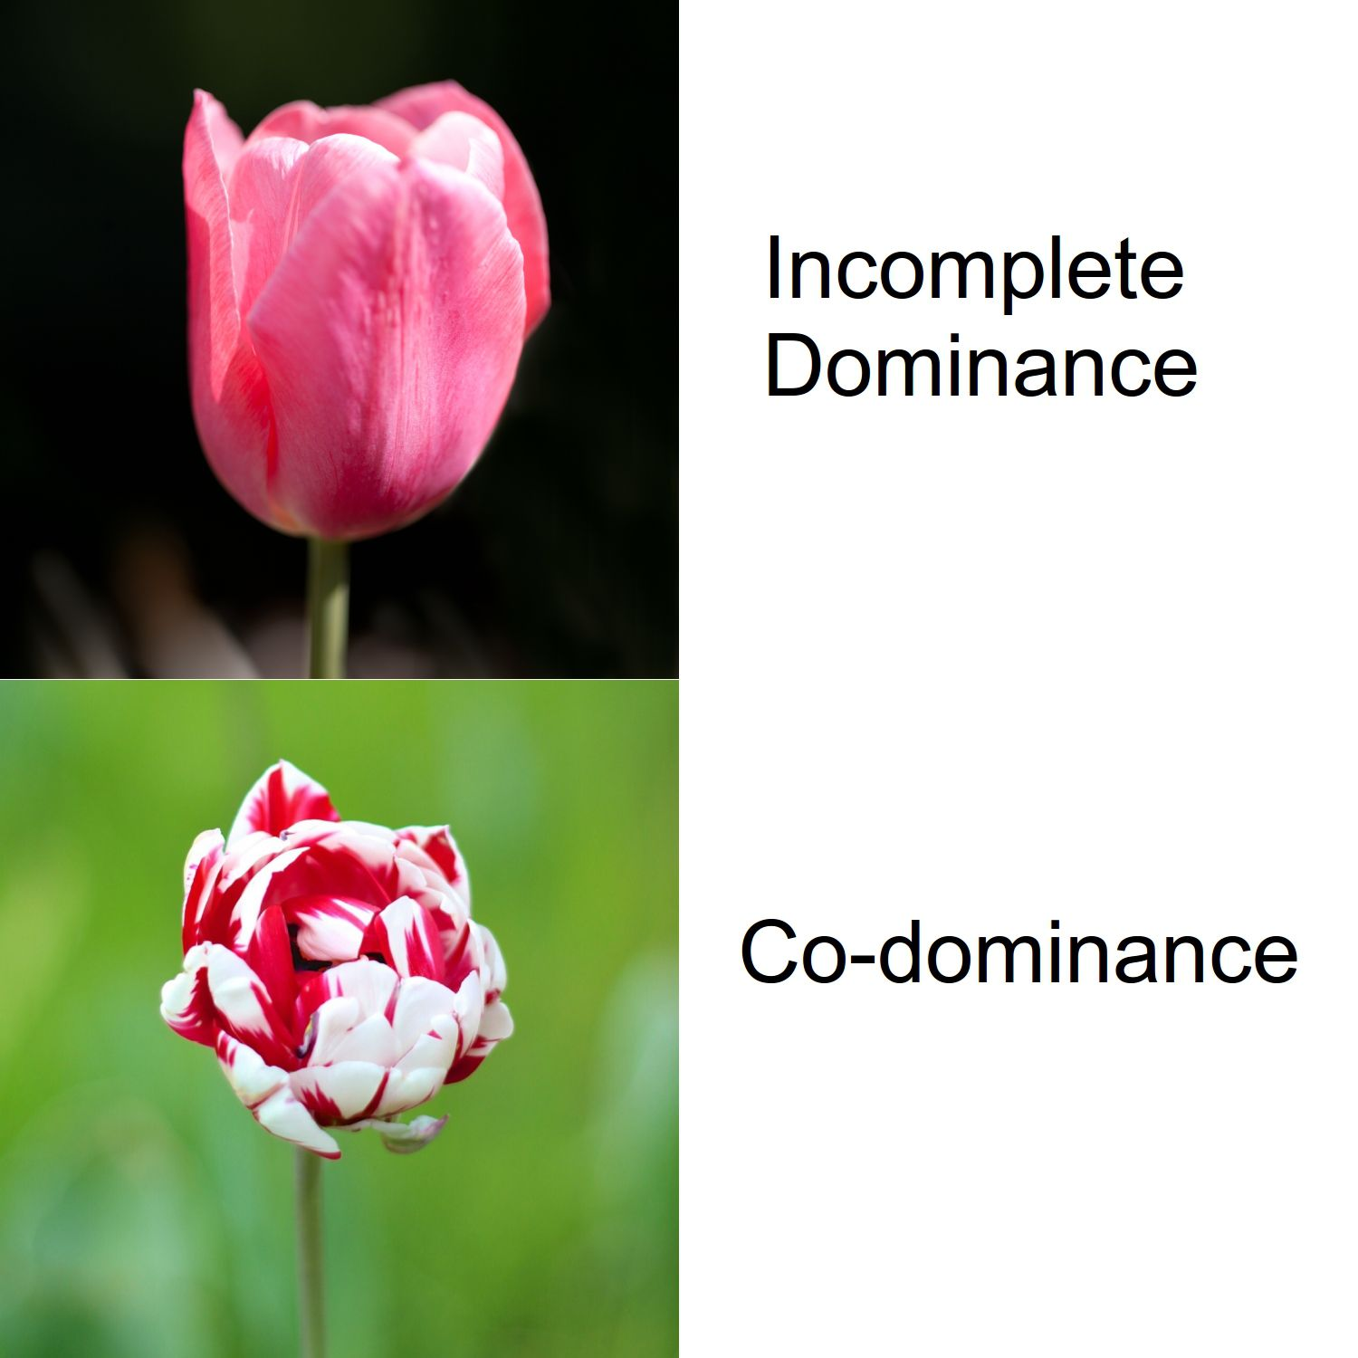
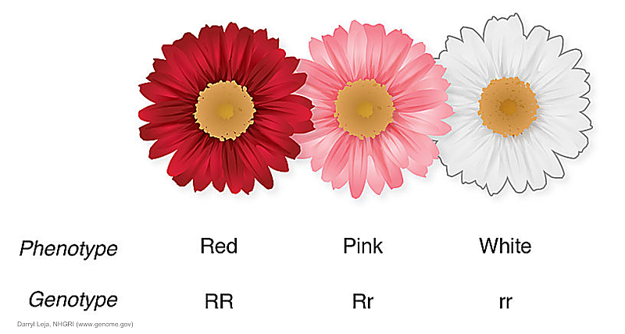
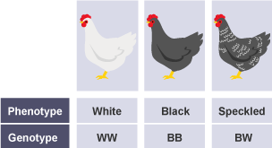
Topic 2: Variations of Dominance
By the end of this topic, I should be able to:
Use Punnett squares for exceptions to Mendelian Genetics (incomplete dominance, codominance, blood types, and sex-linkage)
Use Punnett squares for dihybrid crosses

Slide 34
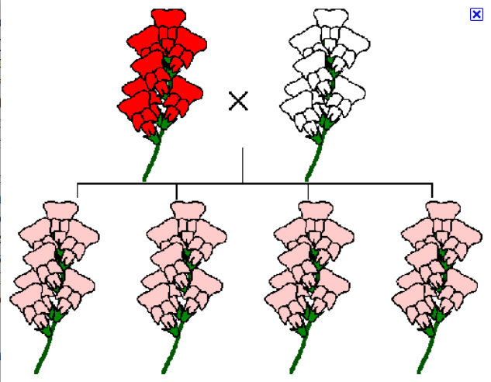
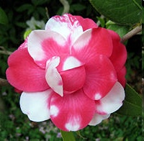
Exceptions to Simple Dominance
Incomplete Dominance: alleles “blend” (ex: pink flowers)
Codominance: both alleles show up in their “pure form” (ex: red and white splotchy flowers)
Notes:
Incomplete dominance is also called blending inheritance

Slide 35
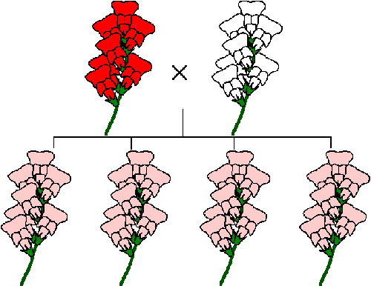
Incomplete Dominance
There is no dominant allele or recessive allele
Blending: Red and White flowers
R=Red
W=White
RW=Pink
Situation: If red and white flower alleles show incomplete
dominance, what offspring ratios will you see if you cross a
Red-flowered plant with a white-flowered plant?
Parent Genotypes: _________________________
Offspring Ratios:
Genotype: _____________
Phenotype: ____________

Slide 36
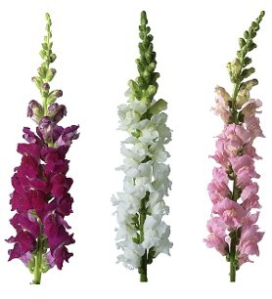

Slide 37
Codominance
There is no dominant or recessive allele but both are expressed
Ex: a chicken with white
& black feathers
Situation: If black and white chicken alleles show codominance, what offspring ratios will you see if you cross a black chicken with a white chicken? Hybrids display speckled coloration.
Parent Genotypes: _________________________
Offspring Ratios:
Genotype: _____________
Phenotype: ____________

Slide 38
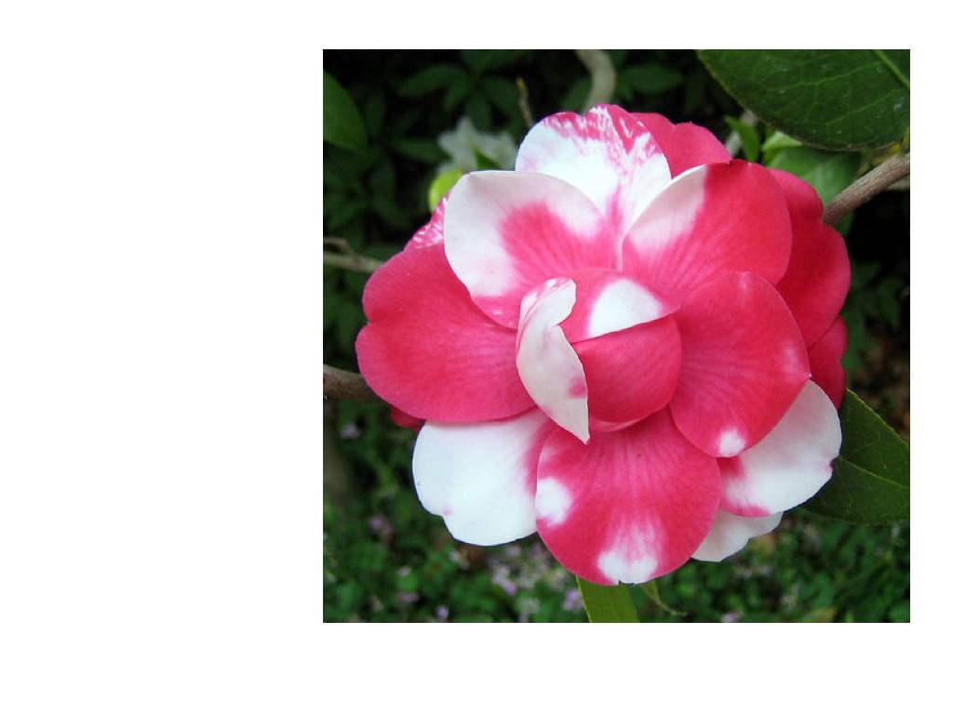

Slide 39
Contrasting Incomplete Dominance & Codominance

Slide 40
Multiple Alleles
Sometimes there are more than two alleles for a particular gene → “multiple alleles”.
For example, there are three alleles controlling human blood type—A, B, and O. A and B are both dominant (express codominance) over O.
Blood Type:
Type A=AA, AO
Type B=BB, BO
Type O=OO
Type AB = AB
Type AB=AB

Slide 41
Situation: If two parents with blood type AB have children, what offspring ratios will you see?
Parent Genotypes:
Offspring Ratios
-Genotype:
-Phenotype

Slide 42
Each blood group is represented by a substance on the surface of red blood cells (RBCs). These substances are important because they contain specific sequences of amino acid and carbohydrate which are antigenic.

Slide 43
More Info…
Allele from Parent 1 | Allele from Parent 2 | Geno-type | Blood Type
A | A | AA | A
A | B | AB | AB
A | O | AO | A
B | A | AB | AB
B | B | BB | B
B | O | BO | B
O | O | OO | O
Since there are three different alleles, there are a total of six different genotypes at the human ABO genetic locus.

Slide 44
Blood Types A & B
Blood Types | Possible Genotypes
A | AA AO
B | BB BO
If someone has blood type A, they must have at least one copy of the A allele, but they could have two copies. Their genotype is either AA or AO. Similarly, someone who is blood type B could have a genotype of either BB or BO.

Slide 45
Blood Type AB & O
Blood Type | Genotype
AB | AB
O | OO
A blood test of either type AB or type O is more informative. Someone with blood type AB must have both the A and B alleles. The genotype must be AB. Someone with blood type O has neither the A nor the B allele. The genotype must be OO.

Slide 46
Sex -linked inheritance
Sex linkage = the presence of genes on a sex chromosome (X or Y)
X-linked Genes = genes found on the X chromosome
Y-linked Genes = genes found on the Y chromosome
Sex linkage was discovered by Thomas Morgan while working with fruit flies…tiny and easy to mate!
Fruit flies can have red or white eyes
Morgan noticed that there were a few white eyed males, but almost no white-eyed females…

Slide 47
Thomas’s Conclusion
The gene for fruit fly eye color is on the X chromosome
Compare the size of the X and Y chromosomes!
Remember, males have only 1 X chromosome, while females have 2
Red Eye Allele: X^{R}
White Eye Allele: X^{r}

Slide 48
https://www.youtube.com/watch?v=qYHJq47iZPE

Slide 49
Example 1: X^{R}X^{R} x X^{r}Y
Red eyed female x white-eyed male
X^{R}
X^{R}
X^{r}
X^{R}X^{r}
X^{R}X^{r}
Phenotype Ratio:
50% red-eyed females
50% red-eyed males
Y
X^{R}Y
X^{R}Y

Slide 50
Example 2: X^{R}X^{r} x X^{R}Y
Red-Eyed Female (HETEROZYGOTE) x Red-Eyed Male
Phenotype Ratio:
50% Red-eyed females
25% Red-eyed males
25% White-eyed males
X^{R}
X^{r}
X^{R}
X^{R}X^{R}
X^{R}X^{r}
Y
X^{R}Y
X^{r}Y

Slide 51
A Human Example of Sex Linkage
Hemophilia is a human X-linked disorder that causes blood to clot incorrectly → patient “bleeds out” after a minor cut
Normal Allele: X^{H}
Hemophilia Allele: X^{h}
recessive
Common in Anastasia’s Family…just the men!

Slide 52
Hemophilia
Situation: Carrier Mother X Normal Father
Parent Genotypes:
X^{H}X^{h} x X^{H}Y
Phenotype Ratio:
50% normal females
25% normal males
25% hemophilic males
X^{H}
X^{h}
X^{H}
X^{H}X^{H}
X^{H}X^{h}
Y
X^{H}Y
X^{h}Y

Slide 53
Polygenic
Produced by interaction of several genes
Show wide ranges of phenotypes
Example: human skin and hair color and other complex traits

Slide 54
Dihybrid Cross
Involves two characteristics (two pairs of contrasting traits) for each individual.
Predicting the results of a dihybrid cross is more complicated than predicting the results of a monohybrid cross.
All possible combinations of the four alleles from each parent must be considered.

Slide 55
Dihybrid Cross (2 factors): a 16 square grid that is used to predict and compare the genetic variations that will result when crossing 2 traits of two organisms.
RrYy x RrYy
RY Ry rY ry
R = Tall
r = short
Y = Green
y = Yellow
RRYY
RRYy
RrYY
RrYy
RY
Ry
rY
ry
RRYy
RRyy
RrYy
Rryy
RrYY
RrYy
rrYY
rrYy
RrYy
Rryy
rrYy
rryy

Slide 56
How to’s of Dihybrid Crosses
1. Figure out the alleles:
Identify what trait/letter is Dominant (B – Black fur)
Identify what trait/letter is Recessive (b – Brown fur)
2. Draw your box (16 squares for dihybrids!)
3. Determine the Possible gametes (sex cells) that could be made from the parents.
You should have 4 combinations (For AaBb: AB, Ab, aB, & ab)
The letters should be all different for each combination! (Yr or Ab)
4. Label each side of Box, Plug & Chug!
Put the same letters together again (AABb)
Make sure to put dominant alleles First! (AaBb)
5. Determine your possible Genotypes! (1/16 bbrr, etc)
Double check your work, all the possible genotypes should add up to 16!
6. Determine your possible Phenotypes! (1/16 brown wrinkled, etc)
Double check your work, all the possible phenotypes should add up to 16!

Slide 57
Expressing probabilities for genotypes & phenotypes (2 factor cross)
Ratios:
4/16 - fractions (parts of the total – don’t reduce)
Genotype ratios are typically not used in 2 factor crosses
Phenotype ratios use the DD:DR:RD:RR pattern
Example- 9:3:3:1 (DD: DR: RD: RR)
Percentages:
Need to label with trait

Slide 58
Finding the Gametes for Dihybrid Crosses
Remember, each gamete must have ONE COPY of the two genes
To find possible gametes for each parent, use the FOIL method
(x + 3)(x + 4) =
x² + 4x + 3x +12

Slide 59
Homozygous X Homozygous
Possible Gametes:
HG
HG
HG
HG
Parent 1: H H G G
Parent 2: h h g g
Possible Gametes:
hg
hg
hg
hg

Slide 60
Homozygous x Homozygous
Parent Genotypes: HHGG x hhgg
HG
HG
HG
HG
Offspring Ratios
-Genotype:
100% HhGg
-Phenotype:
100% Tall +
Green
hg
HhGg
HhGg
HhGg
HhGg
hg
HhGg
HhGg
HhGg
HhGg
hg
HhGg
HhGg
HhGg
HhGg
hg
HhGg
HhGg
HhGg
HhGg

Slide 61
Another Example: Heterozygous x Heterozygous
Possible Gametes:
HG
Hg
hG
hg
Parent 1: H h G g
Parent 2: H h G g
Possible Gametes:
HG
Hg
hG
hg

Slide 62
Heterozygous x Heterozygous
Parent Genotypes: HhGg x HhGg
Hg
hG
hg
HG
Offspring Ratios
-Genotype: too complicated!
-Phenotype:
Next Slide!
HG
HHGG
HHGg
HhGG
HhGg
Hg
HHGg
HHgg
HhGg
Hhgg
hG
HhGG
HhGg
hhGG
hhGg
hg
HhGg
Hhgg
hhGg
hhgg

Slide 63
Another Example: Heterozygous x Heterozygous
Parent Genotypes: HhGg x HhGg
Phenotype:
9: 3: 3: 1
9 Tall, Green
3 Tall, Yellow
3 Short, Green
1 Short, Yellow
Hg
hG
hg
HG
HG
HHGG
HHGg
HhGG
HhGg
Hg
HHGg
HHgg
HhGg
Hhgg
hG
HhGG
HhGg
hhGG
hhGg
hg
HhGg
Hhgg
hhGg
hhgg

Slide 64
Demonstrates Principle of Dominance
Demonstrates Principle of Independent Assortment

Slide 65
Topic 3: Pedigrees
By the end of this topic, I should be able to:
Analyze pedigrees
Create a pedigree

Slide 66
Pedigree
A diagram representing a family tree that shows how a trait is passed from generation to generation
The alleles that each person in the family has

Slide 67
Example 1: Pedigree!
Notes:
*

Slide 68
Squares indicate MALES
There are 7 males in this pedigree!
Notes:
*

Slide 69
Circles indicate FeMALES
There are 7 females in this pedigree!
Notes:
*

Slide 70
Shaded Shapes Represent Individuals that have the trait
There are 2 individuals in this pedigree that are affected!
Notes:
*

Slide 71
Matings Between Individuals = Horizontal lines
Notes:
*

Slide 72
Pedigrees!
How many generations are shown here?
3!
Notes:
*

Slide 73
Vertical line from relationship line = children
Notes:
*

Slide 74
How many children do parents in generation 1 have?
3 children!
Notes:
*

Slide 75
How many of the children in generation 3 have the trait?
One!

Slide 76
We label each individual by their generation and number
I - 2
II - 4
III - 5

Slide 77
Which individual can be labeled as “III.4”?
Notes:
*

Slide 78
Which individual can be labeled as “III.4”?
Notes:
*

Slide 79
Which individuals are the kids of II.3 and II.4?
Notes:
*

Slide 80
How are individuals II.1 and II.2 related?
Marriage!
Notes:
*

Slide 81
Pedigree 2
How many people in the family have the trait?
7 people

Slide 82
Pedigree 2
2. What is the sex of individual I – 1?
3. Does individual I-1 have the trait?
Male
YES

Slide 83
Pedigree 2
4. List the individuals in generation III that have the trait.
III-1 , III-6, III-8

Slide 84
Pedigree 2
5. How many children did the couple from generation 1 have?
5 children

Slide 85
Pedigree 2
6. What is the relationship between individual II-8 and III-9?
Mother-Daughter

Slide 86
Pedigrees and Traits
Pedigrees are most useful when analyzing a family’s history of genetic diseases and traits.
We can also predict if future family members will inherit a disease or trait using a pedigree.
Let’s look at some examples

Slide 87
Example 1: The pedigree below shows the inheritance of handedness in humans over three generations. The allele for right-handedness (R) is dominant over left-handedness (r). The shaded individuals below are recessive for handedness
R = right- handed
r = left handed

Slide 88
3
How many generations are there?
2. How many individuals are left handed?
3. Which individuals in the third generation are right handed?
4
III-1 and III-3

Slide 89
4. . What is the genotype and phenotype of individual I-2
Genotype Phenotype
5. the father (I-1) is heterozygous, what is the genotype of his two children?
II -1 ____________ II – 3 ___________
rr
Left-hand
rr
Rr

Slide 90
Example 2: Huntington’s Disease (H) is a dominant disorder.
1. What is the relationship between individual III-1 and III-2
Brother and sister

Slide 91
Example 2
2. What is the relationship between individual II-3 and III-4
Aunt-nephew

Slide 92
How many individuals in generation II do not have Huntington’s disease?
3 people (not shaded)

Slide 93
4. Based on the traits of IV-5, IV-6, and IV-7, what MUST the genotype of III-8 be?
Hh (Heterozygous)

Slide 94
If individual IV-7 mated with a heterozygous individual, what is the percentage their offspring has Huntington’s?
Genotype of IV-7:
Heterozygous genotype:
hh
Hh

Slide 95
H h
h
h
Hh hh
Hh hh
50% have the disease

Slide 96
**Note on sex-linked pedigrees
For sex-linked traits, female carriers are always represented as a half-way shaded circle, even though they do not express the recessive trait.
A female carrier looks like:

Slide 97
Which generation has female carriers in it?
Generation 1
Generation 2
Generation 3

