Slide 1
Evolution and classification
Unit 8

Slide 2
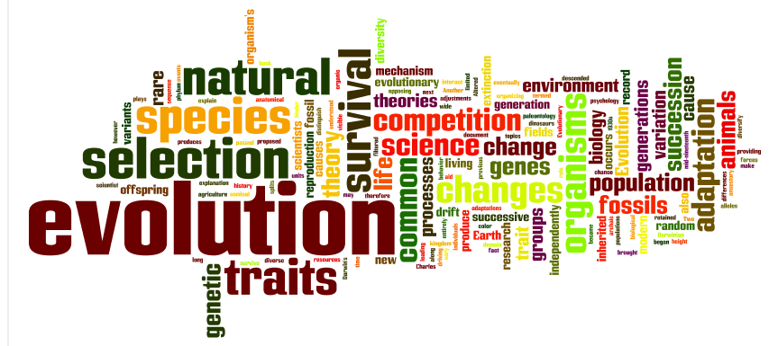
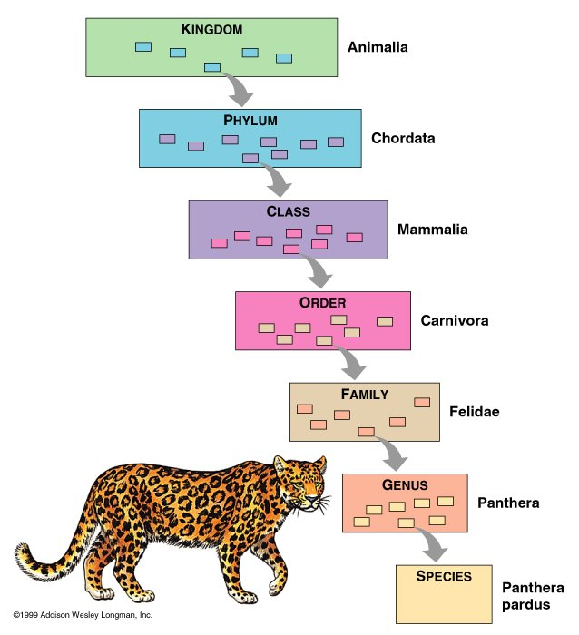
Topics
Topic 1: History of Life
Spontaneous generation v. biogenesis
Age of earth
Order of life on earth
Topic 2: Evolution
Theories and the people they came from (Lamarck, Darwin)
Evidence for evolution (fossils, structures, molecular)
Speciation
Topic 3: Classification
Domains & kingdoms
Characteristics
Dichotomous keys, cladograms

Slide 3
Topic 1
History of life

Slide 5
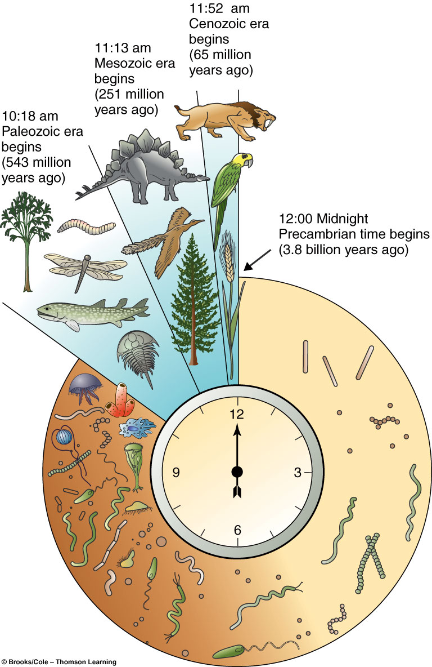
Topic 1: History of Life
Earth + solar system formed about 4.6 billion years ago
Bombardment of Earth by rocks and ice likely vaporized water and prevented seas from forming before 4.2 to 3.9 BYA
Earth’s early atmosphere likely contained:
water vapor and chemicals released by volcanic eruptions like nitrogen, nitrogen oxides, carbon dioxide, methane, ammonia, hydrogen, hydrogen sulfide.
- NO free oxygen in atmosphere!

Slide 6
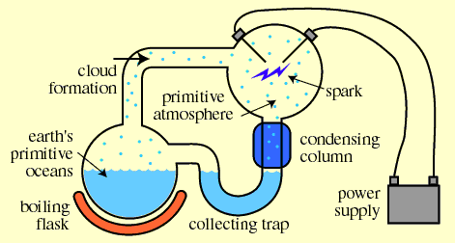
Formation of Life on Earth
Chemical evolution occurred prior to biotic (living) evolution
Energy from sun, volcanoes and lightning combined w/ gases to form chemical substances (Sugars, nucleotides, amino acids) which then combine to form all life on Earth
In the 1950s, Miller & Urey set out to demonstrate that it was possible for macromolecules to appear on earth, given the early atmospheric conditions, without organisms actually present yet
They recreated earth’s early atmosphere (H, CH₄, NH₃, H₂)
Add electric sparks (simulate lightning)
Gasses cooled, leaving water droplets
Water droplets contained amino acids and adenine (a nucleotide found in DNA & RNA)!
Yes, amino acids and nucleotides
could have formed under early conditions
on earth!

Slide 7
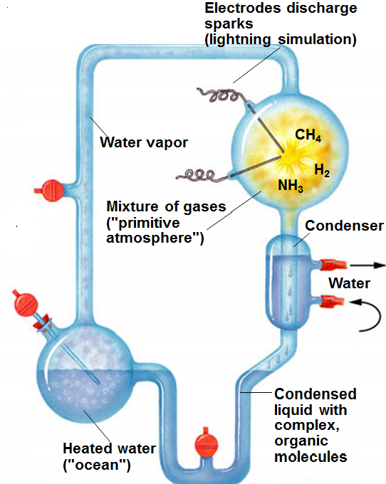
Miller-Urey Cont’d
Bottom line: Organic molecules (macromolecules) CAN form from inorganic molecules
RNA evolved before DNA. Why does this make sense?
RNA codes information (makes inheritance possible)
Self-replicates
First step of evolution in the Central Dogma
DNA→RNA→Protein

Slide 8
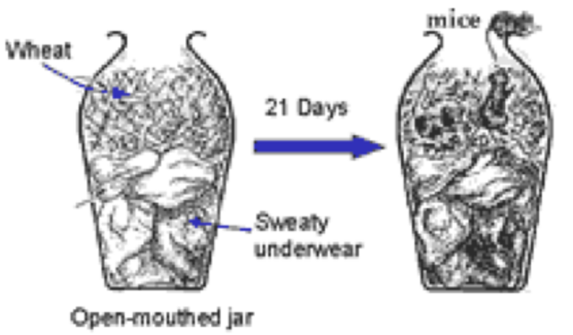
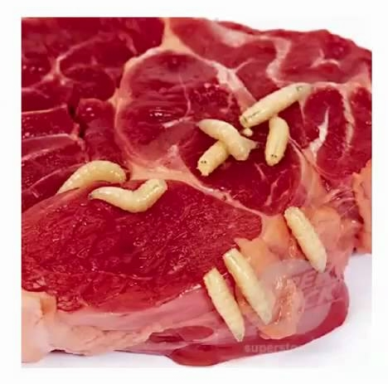
How Life Came to Be (Origin of Life Scientists)
Spontaneous Generation v. Biogenesis: for a very long time (until ~200 years ago), many people believed life could arise from nonliving matter.

Slide 9
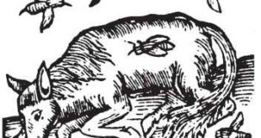
Spontaneous generation
The belief that life can arise from nonliving things
Frogs arise from mud
Flies arise from rotting meat
Mice arise from dirty underwear
Church approved this belief – people trust the church, this must be right
Francesco Redi is the first big name to say something different (biogenesis)
Battle of experiments to determine how life actually comes to be

Slide 10
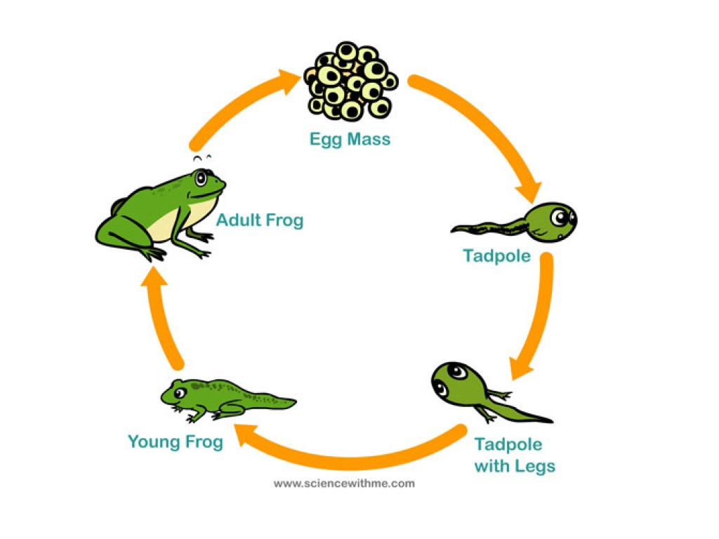
Biogenesis
The belief that life can only come from living matter
All life is from life
Now widely accepted, but was not until about 1860
In the life cycle of a frog, tadpoles hatch from eggs, eventually are frogs
Flies were previously larvae, which hatched from eggs (deposited on the meat)
Mice are born from other mice

Slide 11
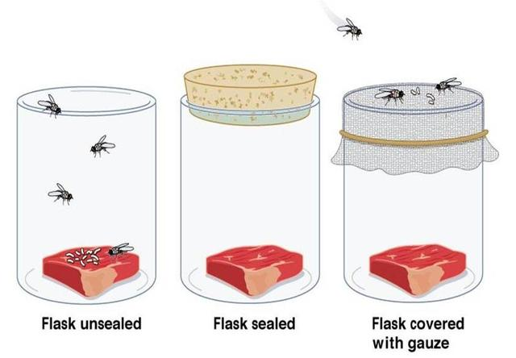
The people involved
**Francesco Redi (1668): designed an experiment to test spontaneous generation
In support of: BIOGENESIS
Setup: three jars, each holding meat
Control: no lid
Flies and air have access to meat
Experimental setup 1: closed lid
Neither flies nor air can access meat
Experimental setup 2: mesh lid (cheesecloth)
Flies cannot access meat, air can
Findings: the only jar with flies was the control!

Slide 12
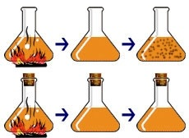
Needham (1748) Spallanzani (1770)
John Needham, an Englishman, wanted to prove Redi wrong
In support of: SPON. GENERATION
Experiment: heat broth to remove microbes; seal and let sit… check for life
Findings: there is bacteria in the broth! Spontaneous generation must be right.
Problem: did not heat broth long enough to remove all microbes
Lazzaro Spallanzani, an Italian doctor, was sure Needham made a mistake when attempting to remove all microbes and repeated his experiment
In support of: BIOGENESIS!
Experiment: pour broth in two flasks; heat broth (kill microbes); seal one flask and leave the other open
Findings: only the open flask contained microbes

Slide 13
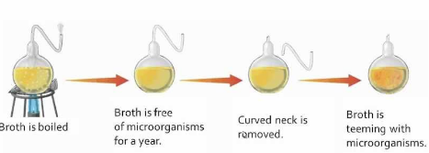
Pasteur (1862-1864)
French scientist that ended the debate
In support of: BIOGENESIS!
Setup: built upon the work of Needham and Spallanzani, but with a twist
Control: flask with broth that had been heated to kill microbes
Experimental setup: swan-neck flask with broth heated to kill microbes
Air has access to the broth!
Findings: swan-neck flask remained microbe-free until tilting the flask, allowing the broth to pick up microbes from the bend… spontaneous generation is not real!

Slide 14
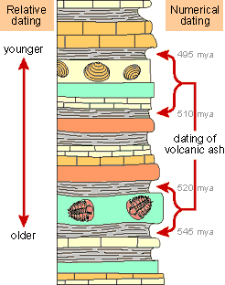
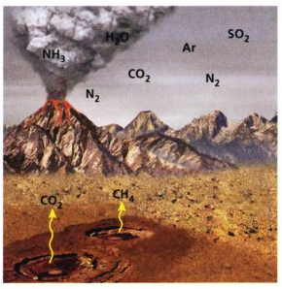
Life on Earth
Earth: 4.6 billion years old
Method of aging: radioactive/absolute dating v. relative dating
Early atmosphere: CO2, SO2, Methane, ammonia… no free O2
RNA, amino acids form and lead to first cells

Slide 15
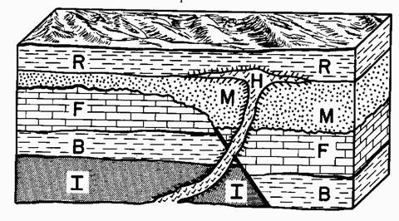
Determining the Age of Fossils
Relative Dating
Approximate age based on the position in the layers of the sedimentary rock
Fossils form when fine sediment buries organisms, but if they are not buried, it is possible to decay before fossilizing
Areas with wet lowlands or slow moving water are excellent for fossil formation
Absolute Dating
Exact age based on half-life of remaining fossil using radioactive dating (carbon-14)
Half-life: amount of time it takes for ½ of the radioisotope to decay
Remember: isotopes are the same atom with different numbers of neutrons
Carbon Dating: You want to determine how long it is taking for half of the sample of the isotope to decay.
Notes:
I, B, F, M, H, R
45’ line = tilt – faulting
If there were no letters, how could you tell B and B were the same age? Same key/picture/legend.
Sedimentary: all but H
H: igneous

Slide 16
Breakdown of Time (Eras)

Slide 17
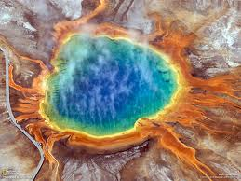
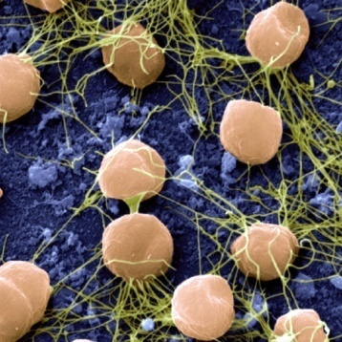
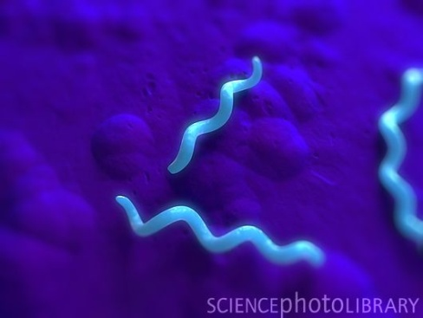
Oldest Life: 3.5 billion years ago (Precambrian Time)
Atmosphere lacked free oxygen
Organisms had to be anaerobic
First cells were archaebacteria (prokaryotes)
Cell walls lack peptidoglycan
Methanogens, halophiles, thermophiles
First cells were heterotrophic
There were autotrophic archaebacteria (chemosynthesis, not photosynthesis)
As autotrophs began living, they put oxygen into the environment (produce ozone layer)
Oxygen began accumulating 2.7BYA (banded iron/rust in rocks)

Slide 18
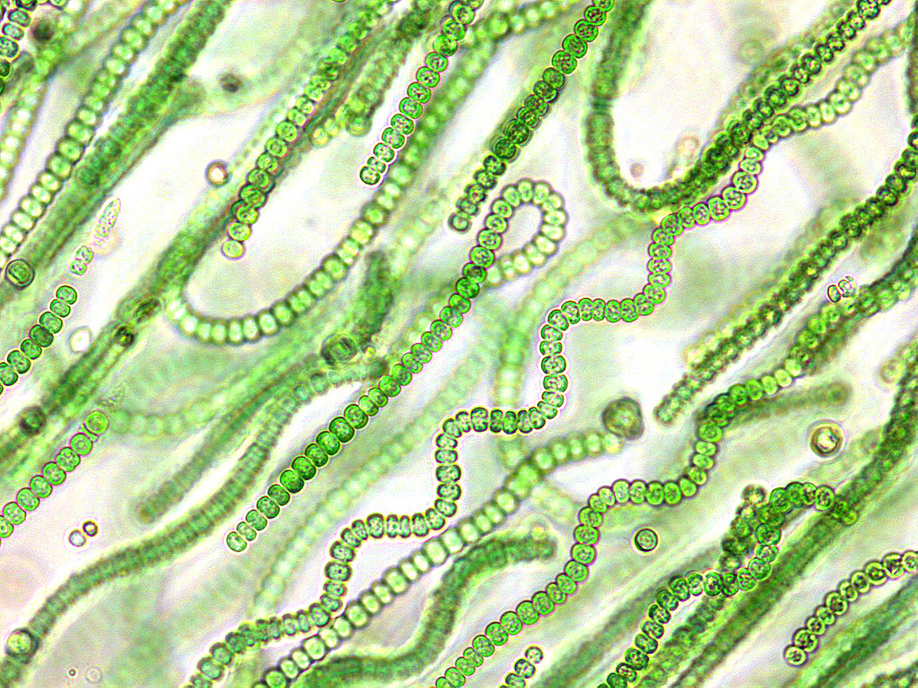
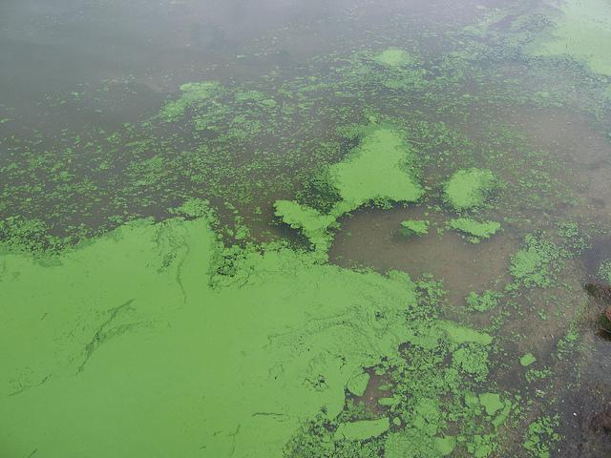
Photosynthetic Prokaryotes (Precambrian Time)
Blue green algae, cyanobacteria, were the first photosynthetic organisms
Produce: glucose, a carbohydrate (and oxygen)
Require: carbon dioxide (and water)
Significant oxygen in the atmosphere 2 billion years ago

Slide 19
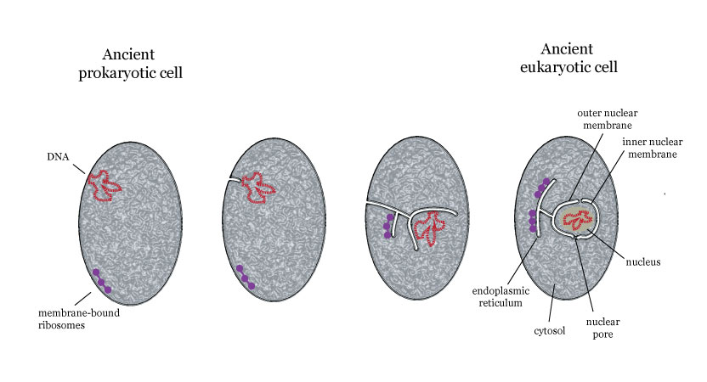
Eukaryotes Evolve 2.7 BYA (Precambrian Time)
Larger, more complex than prokaryotes
Can reproduce sexually, increasing genetic variation
Contain a nucleus and other membrane-bound organelles (golgi, lysosomes) for specific jobs in the cell
Internal membranes increase efficiency
How Eukaryotes evolved: Endosymbiosis

Slide 20
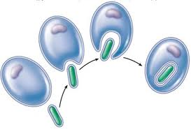
Endosymbiotic Theory
Ancestral cell engulfed smaller cell (aerobic bacteria or photosynthetic bacteria), but did not digest it
Origin of the mitochondria and chloroplast
Mitochondria and chloroplast contain their own (circular) DNA; have bacterial shape/structure
Formed a mutually beneficial relationship

Slide 21
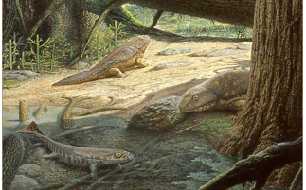
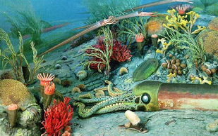
Paleozoic Era (245-542 MYA)
The first complex multicellular organisms evolve: FISH!
Fish are vertebrate (have a backbone)
First plants evolve from seaweed and move to land
Traces of complex burrows have been found- worms very active
Dominant animal life: amphibians
Vertebrate that spends half its life in the water, the other half on land
Certain fish evolved limbs and lungs for land life around 380 MYA
Conifer, a type of plant, evolves
Better adapted to drier climates
No flowering plants yet (all other major plant groups are)
Mass extinction to close this period ended 95% of life on earth

Slide 22
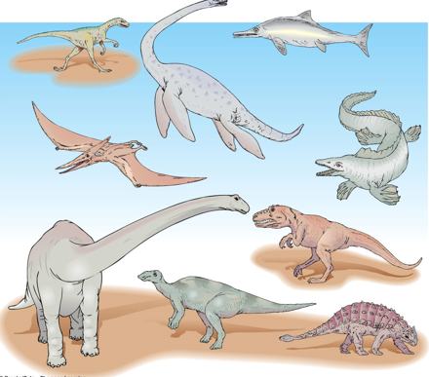
Mesozoic Era (65-245 MYA)
Pangea breaks and continents begin forming
Reptiles begin to dominate
Dinosaurs roamed in this period
First 150 MY of period is ruled by dinosaurs
Birds evolve from dinosaurs about 155 MYA
Mammals evolve at the same time as dinosaurs, but do not dominate
Many were very small, nocturnal insect eaters
Nocturnal: active at night (warm-blooded)
Flowering plants and insects co-evolve
When two organisms evolve at the same rate, same time
Leafy trees and shrubs also evolve

Slide 23
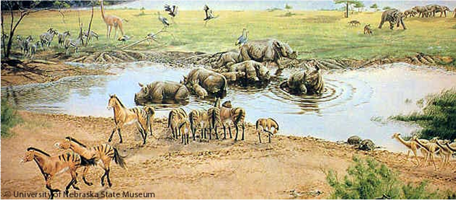
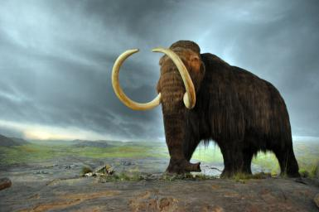
Cenozoic Era (Present)
Comparatively short when compared to other eras, but full of fossils! (deep record)
Mammals replace reptiles as the dominating group
Mammals: fur, fat, mammary glands, vertebrates
Angiosperm dominance (flowering plant) influenced faster evolution of birds and mammals
~35 MYA– climate became cooler/drier
Remember, mammals are warm-blooded
~2 MYA, humans evolved
Use of fire
Society and culture
Tools to control world

Slide 24
What you are doing now…
Theories of life/origin of life/sequencing life
Answer questions
Order events
Make timeline on computer paper
NEED DATES, IMAGES, DESCRIPTIONS

Slide 25
Topic 2
Evolution

Slide 26
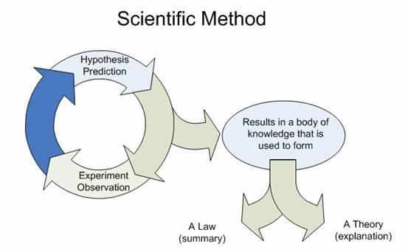
Revisiting Vocabulary
Inference: interpretation based on prior knowledge/experience
Hypothesis: a scientific explanation that can be tested (research based, written if-then)
Theory: a well-tested explanation that unifies a broad range of observations and hypotheses
About the natural world
Lots of evidence in support
Examples: Germ Theory, Theory of
Relativity, Theory of Evolution, Cell
Theory
Law: a statement based on repeated experimental observations
Always applies under the same conditions, describes how nature will behave under certain conditions.

Slide 27
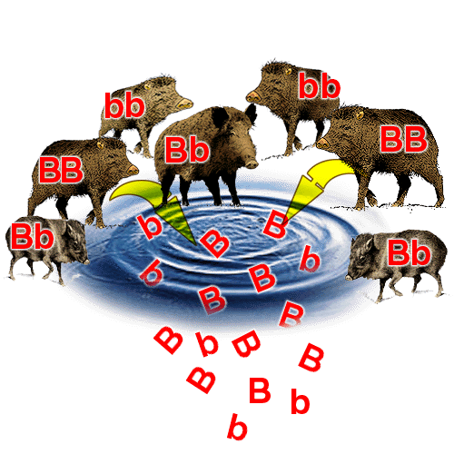
Evolution is a change in the genetics/traits of a species over a period of time
Genotypic v. phenotypic changes
Evolution acts on populations, not individuals
A population is a group of individuals of the same species in an area (can interbreed)
Populations share a gene pool
Gene pool: all of the genes (alleles) for all of the traits in a given population at any time
If all members of a population are homozygous for a particular allele, then the allele is “fixed” in the gene pool
Microevolution: small scale (molecular/DNA itself)
Seen in living populations
Macroevolution: large scale (speciation-many years)
Seen in the fossil record

Slide 28
Scientists of Evolution
Jean Baptiste Lamarck (1744-1829)
Acquired Traits
Theory of use and disuse
If an organ is used, it becomes stronger and better developed
If an organ is not used, it becomes weaker and withers away
Believed an organism acquires traits based on need/experience, not from genes
Charles Darwin (1809-1882)
Natural Selection
Descent by Modification
Nature will select the organisms that have variation that allow them to better survive (survival of the fittest)
Found that species vary locally/globally/over time
Studied finches and other animals in the Galapagos while on board the HMS Beagle (naturalist on voyage)

Slide 29
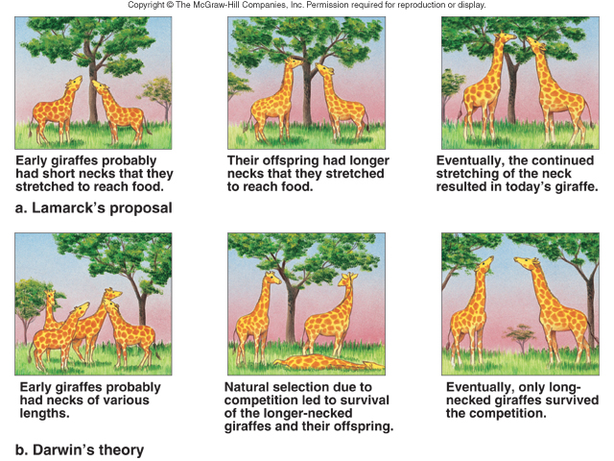
Giraffe Necks

Slide 30
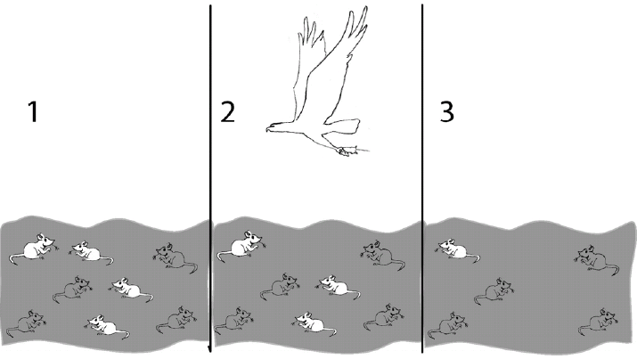
Darwin’s Theory
There is variation in every population
Some variations are favorable
(these organisms live and can reproduce, the others die)
More young are produced in each generation than can survive
(overproduction)
There is competition for resources (food, water, shelter, space)
(struggle for existence)
Those that are successful go on to reproduce
Overtime, small changes accumulate in a population because the best traits continue to be passed on

Slide 31
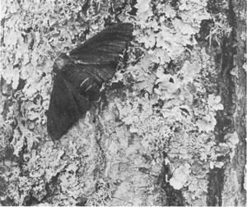
Natural Selection?
What leads to these changes?
Random mutations
Organisms w/ shorter generation times have higher mutation rates & so evolve quicker than animals w/ longer generation times
Examples:
Industrial Revolution vs. Peppered Moth
Darwin’s Finches

Slide 32
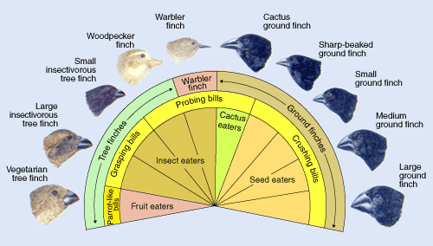
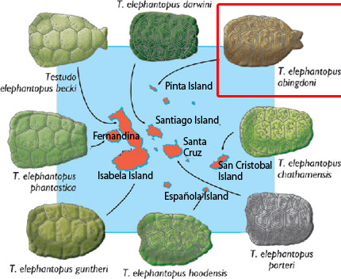
Darwin’s Studies
Turtle shells and finch beaks
Beak shape is related to food type

Slide 33
Evidence of Evolution – Overview
Fossils
Trace of long-dead organism found in layers of sedimentary rock; minerals replace tissue
Comparative anatomy
Compare structures in modern organisms with ancient organisms (homologous, analogous, and vestigial structures)
Comparative embryology
Finding similarities in embryos; organisms with a recent ancestor have more similar embryos
Comparative biochemistry
Finding similarities in protein and DNA sequences (the fewer differences, the more closely related two organisms are)

Slide 34
Memory trick

Slide 35
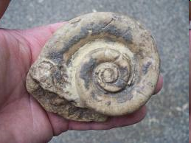
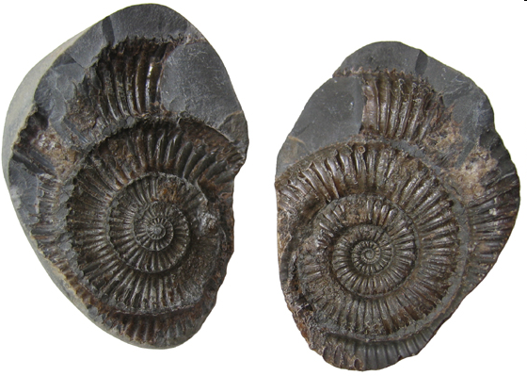
Fossils
(tell us age, diet, habitat, lifestyle, and how things have changed over thousands/millions of years)
Types of Fossils
Mold = imprint in rock
Cast = a mold filled with hard minerals

Slide 36
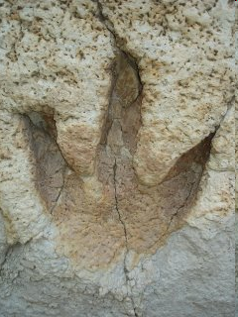
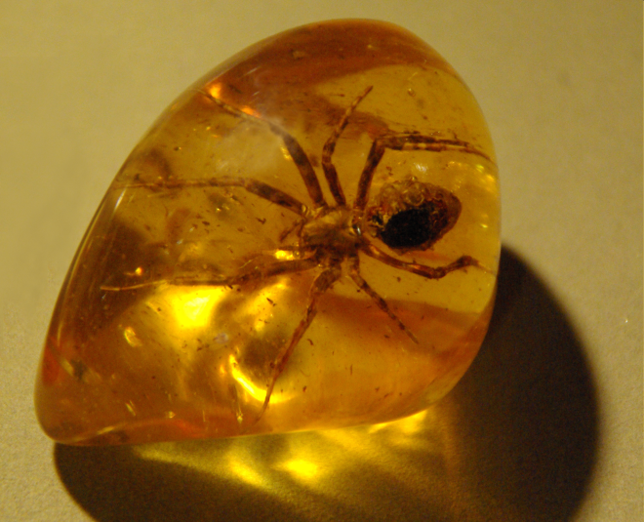
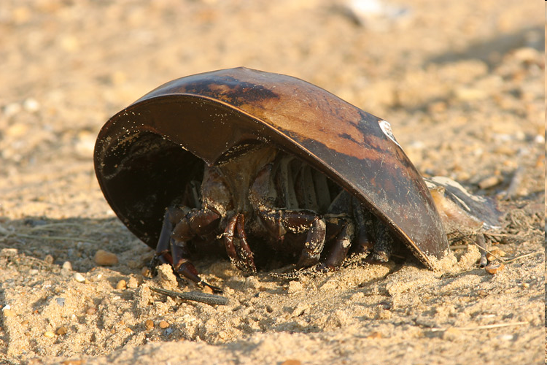
Trace Fossils = signs of life (footprints, burrowing, etc.)
Resin Fossils = organisms that have been preserved nearly perfectly in plant resin (amber)
“Living Fossils” = any living species that is nearly identical to species previously known only from fossils

Slide 37
II: Anatomy: Homologous Structures (divergent evolution)
Darwin proposed that animals with similar structures evolved from a common ancestor with a basic version of that structure.
Structures that are shared by related species and that have been inherited from a common ancestor are called homologous structures.
Homologous structures are similar in structure because they develop from same tissues early in development
may or may not have different functions.

Slide 38
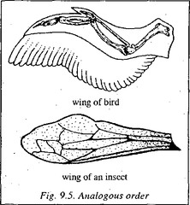
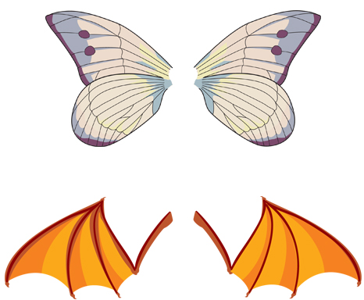
II: Anatomy: Analogous Structures (convergent evolution)
The clue to common descent is common structure, not common function.
A bird’s wing and a horse’s front limb have different functions but very similar structures (homologous structures).
Body parts that share a common function, but not structure, are called analogous structures. Analogous structures are used for the same purpose but are not due to a common ancestor.
The wing of a bee and the wing of a bird are analogous structures.

Slide 39
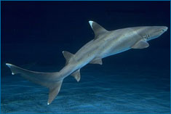
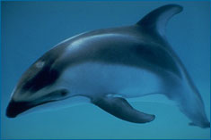
Homology or Analogy?
Shark
Dolphin
skeleton made of cartilage
use gills to get oxygen from the water in which they swim
don't nurse their young
don't have hair
skeleton made of bone
go to the surface and breathe atmospheric air in through their blowholes
do nurse their young
they are born with hair around their "noses"

Slide 40
Analogy- convergent evolution! Sharks and dolphins evolved their adaptations separately!

Slide 41
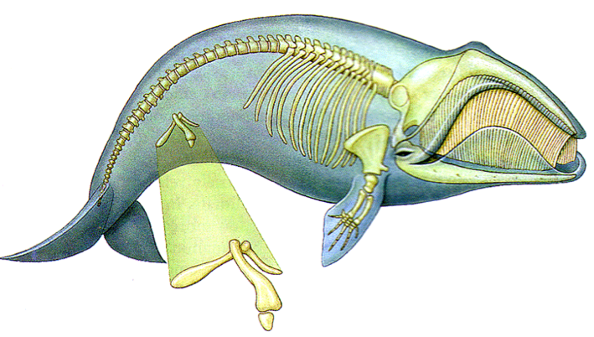
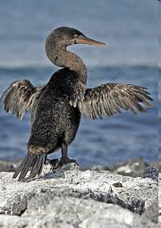
II: Anatomy: Vestigial Structures
Not all homologous structures have important functions.
Vestigial structures - inherited from ancestors, but have lost much of their original function due to different selection pressures.
The hipbones of bottlenose dolphins are vestigial structures. In their ancestors, hipbones played a role in terrestrial locomotion. However, as the dolphin lineage adapted to life at sea, this function was lost.
The human tailbone and appendix are vestigial structures.

Slide 42
III: Embryology

Slide 43
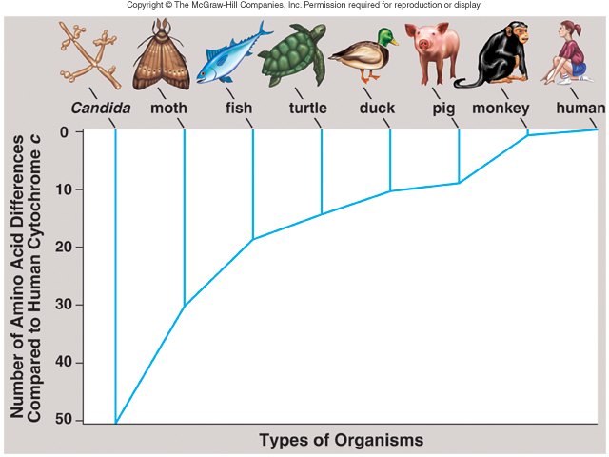
IV: Biochemistry
Universal genetic code – organisms use the same triplet code and the same 20 amino acids in proteins
All organisms have certain organic molecules in common.
Hemoglobin - carries oxygen in blood
Cytochrome c - protein for cell respiration found in almost all living cells
HOX genes – control development

Slide 44
Types of Natural Selection
Stabilizing
Directional
Disruptive
AKA diversifying
Sexual

Slide 45
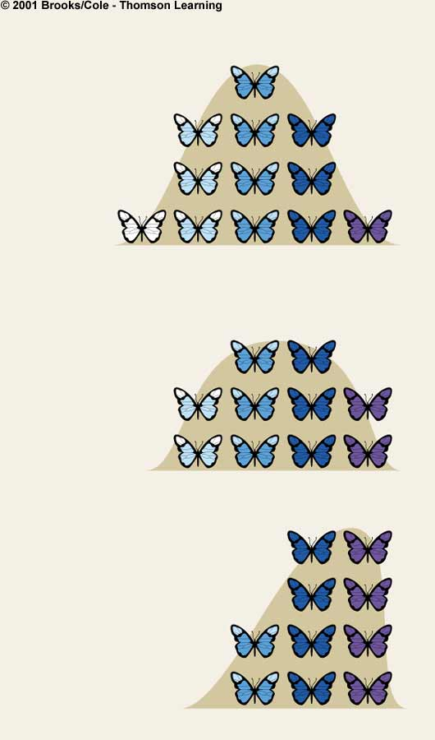
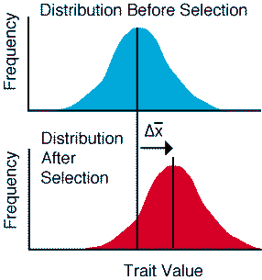
1. Directional Selection
Individuals at one end of the curve have higher fitness than those in the middle or at the other end.
Over many generations, the variation of the population’s trait will shift in the direction of the favorable trait!
(Example: Large beak size in finches.)
Number of individuals
in the population
Range of values for the trait at time 1
Number of individuals
in the population
Range of values for the trait at time 2
Number of individuals
in the population
Range of values for the trait at time 3

Slide 46
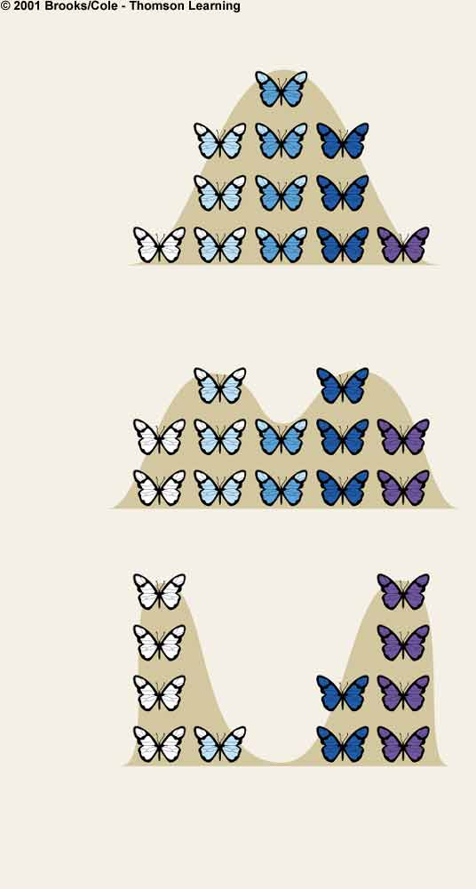
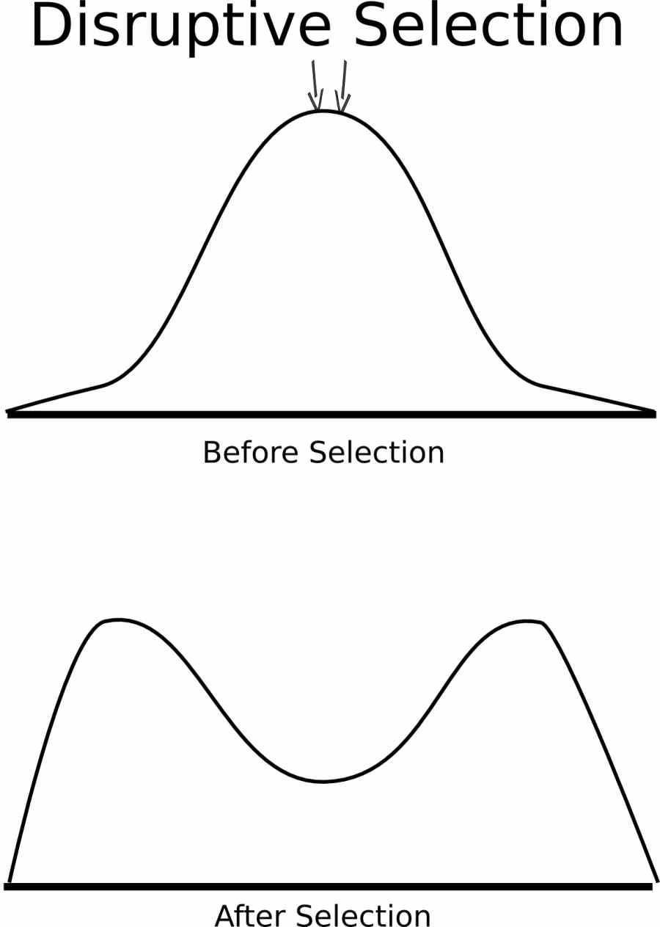
2. Disruptive Selection
Individuals at the upper and lower ends of the curve have higher fitness than those near the middle.
Creates two different phenotypes.
Example: In mice that are brown, tan, and white, the brown and white mice are more often chosen by mates because they stand out in coloration. The tan color is not chosen as often, and as thus is not favored by the environment.
Number of individuals
in the population
Range of values for the trait at time 1
Number of individuals
in the population
Range of values for the trait at time 2
Number of individuals
in the population
Range of values for the trait at time 3

Slide 47
3. Stabilizing Selection
Individuals near the center of the curve have higher fitness than those at either end of the curve.
This usually occurs in a very stable environment
Example: In a desert environment, out of black, white, and tan mice, the tan (intermediate) trait would be favored because they would blend in to the sand and be harder for predators to see.
Number of individuals
in the population
Range of values for the trait at time 1
Range of values for the trait at time 2
Range of values for the trait at time 3

Slide 48
Three Types of Natural Selection
Which type of selection could lead to one species splitting up into 2 separate species? Why?

Slide 49
Sexual Selection
Females choose males based on certain traits
Males with these traits have higher fitness
Reproductive success
Examples: Gorillas chosen
based on size and peacocks
chosen based on their tail
feathers.
Notes:
http://www.youtube.com/watch?v=gqsMTZQ-pmE&feature=fvwrel

Slide 50
Artificial Selection
To find an explanation for change in nature, Darwin studied change produced by plant and animal breeders.
Breeders knew that individual organisms vary, and that some of this variation could be passed from parents to offspring and used to improve crops and livestock – selective breeding.
For example, farmers would select for breeding only trees that produced the largest fruit or cows that produced the most milk.
Over time, this selective breeding would produce trees with even bigger fruit and cows that gave even more milk.
Artificial Selection = humans “select” certain characteristics in plants, dogs, etc., that they find favorable

Slide 51
When does evolution create new species? - Speciation
First off, how do we define a species?
Morphological Species Concept – internal and external structures are used to group organisms into species
Biological Species Concept– defines a species as a population of organisms that can successfully interbreed

Slide 52
Speciation
Speciation = formation of a new species
Reasons for Speciation
1) Geographic Isolation
2) Reproductive Isolation
-prezygotic (before fertilization)
-postzygotic (after fertilization)
Notes:
Wood frog and leopard frog – different mating calls

Slide 53
Speciation
There are two models of speciation, or how populations change over time
Model #1: Gradualism (change happens slowly, and new species are made at a constant rate)

Slide 54
Model #2: Punctuated Equilibrium (there are times of little or no change followed by times of rapid change – often due to major changes in the environment)
Stephen Jay Gould came up with this model!

Slide 55
Gradualism Punctuated Equilibrium

Slide 56
Another Way of Looking at It!

Slide 57
And yet another way of looking at it!

Slide 58
Patterns of Evolution
A) Coevolution = change of two or more species in response to one another
(Ex: predator/prey relationships)
Orchid Fly
Snails + Crabs
Notes:
Also mention evolutionary arms race between humans and bacteria

Slide 59
Patterns of Evolution
B) Convergent Evolution = organisms with different ancestors become very similar due to environment (Ex: sharks and dolphins)
C) Divergent Evolution = two or more related populations/species become different (Ex: Darwin’s finches)

Slide 60
Divergent
Evolution
Convergent Evolution

Slide 61
Patterns of Evolution
D) Adaptive Radiation = an extreme form of divergent evolution where many related species evolve from a single ancestor species

Slide 63
Mechanisms of Change
Mutation
A change in the DNA sequence.
(1 in 100,000) leads to new traits.
Some traits will be advantageous to the species.
Migration
Movement of individuals form
one population into another.
Can alter the genetic
characteristics of a population.

Slide 64
Mechanisms of Change
Nonrandom Mating- controls the genes
When individuals mate with one another more or less frequently: example inbreeding.
Selection
Artificial Selection – individuals
breed organisms for specific traits.
Natural Selection - environment
dictates which traits are needed to survive.

Slide 65
Mechanisms of Change
Genetic Drift
Random loss of alleles. Small population a person does not reproduce.
Founder effect – one or a few individuals migrate and become an isolated population with distinct genotypes.
The population splits due to migration events
Bottle neck – restrictions in genetic variability due to flooding or natural disasters.
The population splits due to natural disasters

Slide 66
Mechanisms of Change
Genetic Drift
Founder Effect Bottleneck Effect

Slide 67
Speciation (How do we get a new species?)
Usually involves successive change
Local populations of a species become isolated and more specialized (adapted)
Natural selection acts to keep them specialized (different from the larger population)
Convergent Evolution v. Divergent Evolution
Populations of a species must become reproductively isolated in order to develop into new species.

Slide 68
Variations vs. Adaptations
0
Variations – differences that exist within a population that may have no effect on fitness
Ex: length of your thumb
Adaptations – a variation that all members of a population have inherited because that trait improves fitness
Ex: an opposable thumbs

Slide 69
Sources of Variation
0
Sources of variation:
Mutations – individual genes change
Ex: ATC → AGC
Events during meiosis – during meiosis, chromosomes get mixed up (crossing over) in making eggs & sperm
Random fusion of gametes – which sperm fertilizes which egg – determined by chance

