Slide 1
Viral and Bacterial Genetics
AP Bio, Unit 7 Part 3

Slide 2
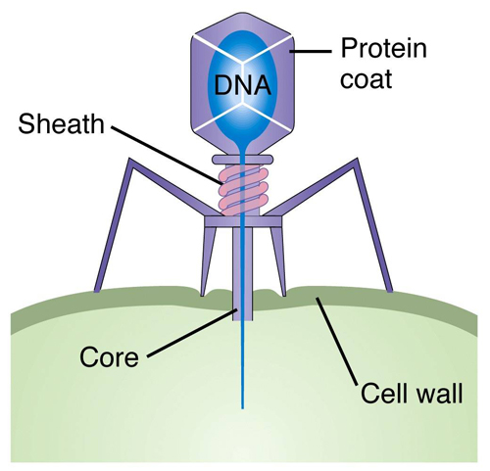
Virus Anatomy
Genetic Material
Capsid
Lipid Envelope
Obligate Parasites
“-phage”
“Bacteriophage”

Slide 3
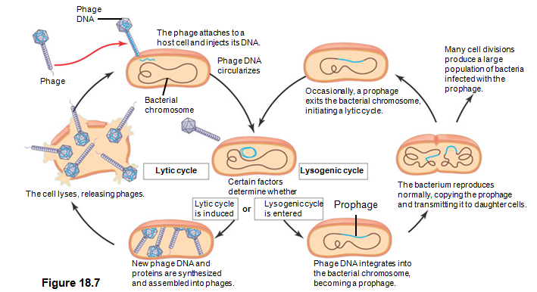
Viral Reproductive Cycles

Slide 4
Lytic vs. Lysogenic
Lytic = what we usually think of with viruses
Use the host cell to make more viruses, and then those new viruses burst out of the cell which kills the host.
Lysogenic = “undercover”…for now.
Viral DNA is incorporated into the host cell’s own genome. This viral DNA portion of the genome is now called a “prophage” literally translated to mean “Before the virus.” Now as the host replicates and divides, all of its offspring will have the prophage DNA sequence. Then, under certain conditions, the prophage will go into the lytic cycle and be transcribed like normal to make new viruses.

Slide 5
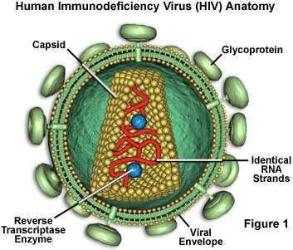
Retroviruses
RNA genome
Reverse Transcriptase
Does transcription, but backwards (RNA → DNA)
RNA → cDNA → full double helix
NO PROOFREADING which means increased genetic variation in viruses.
FREQUENT MUTATIONS make treatment difficult!

Slide 6
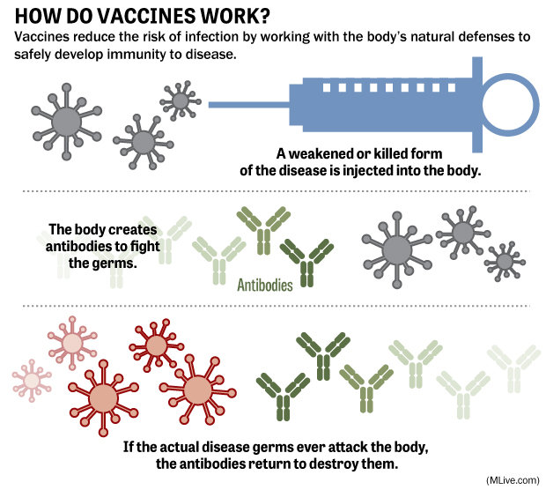
Vaccines

Slide 7
Bacterial DNA
Single circular chromosome vs. plasmid

Slide 8
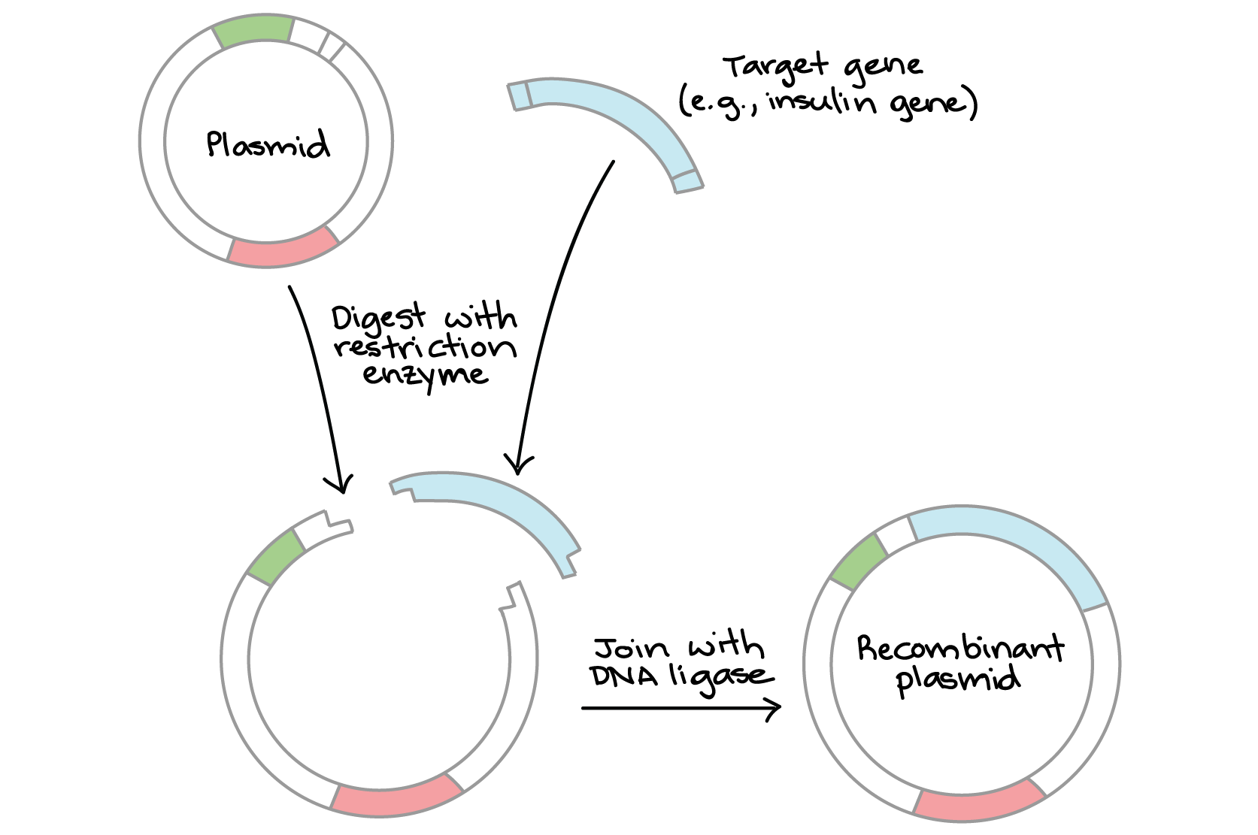
Plasmid DNA
2-30 nonessential genes (bacteria without plasmids can function normally).
Often carry antibiotic resistance genes or fertility genes (ability to make a sex pilus).
Used for biotechnology / medical purposes (can insert human genes).

Slide 9
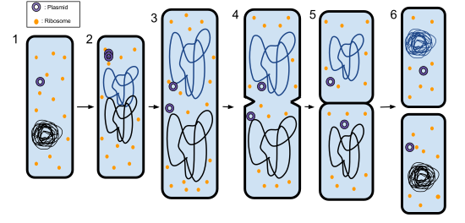
Bacterial Reproduction
Asexual = binary fission
Reproduce Quickly = mutations arise → genetic diversity even though asexually reproducing

Slide 10
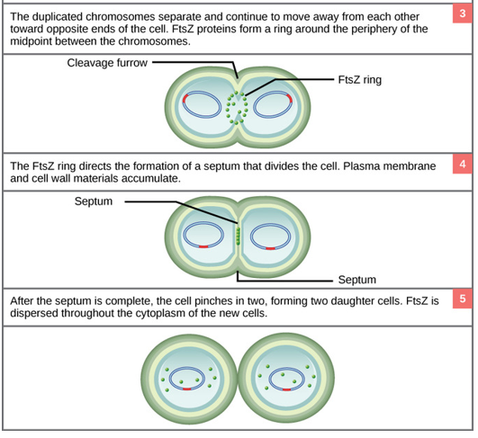
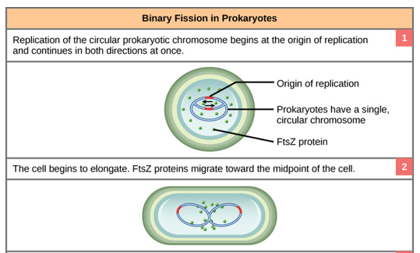
Binary Fission

Slide 11
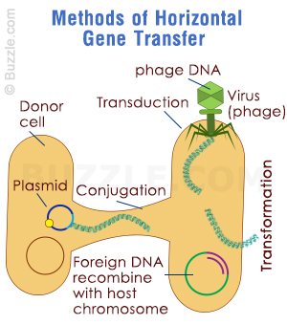
Increasing Genetic Variety in Bacteria (NOT Involving Reproduction)
Horizontal Gene Transfer: genetic transfer from one currently living organism to another currently living organism (not reproducing)

Slide 12
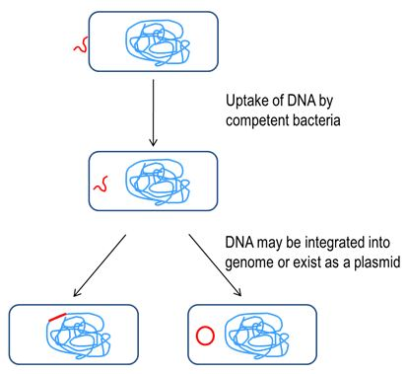
Transformation
A living bacteria takes in naked, foreign DNA from its environment and incorporates it into its own genetic material.
“Naked DNA” most likely from another bacteria that has been lysed/killed, and so its genetic information is no longer contained within the cell

Slide 13
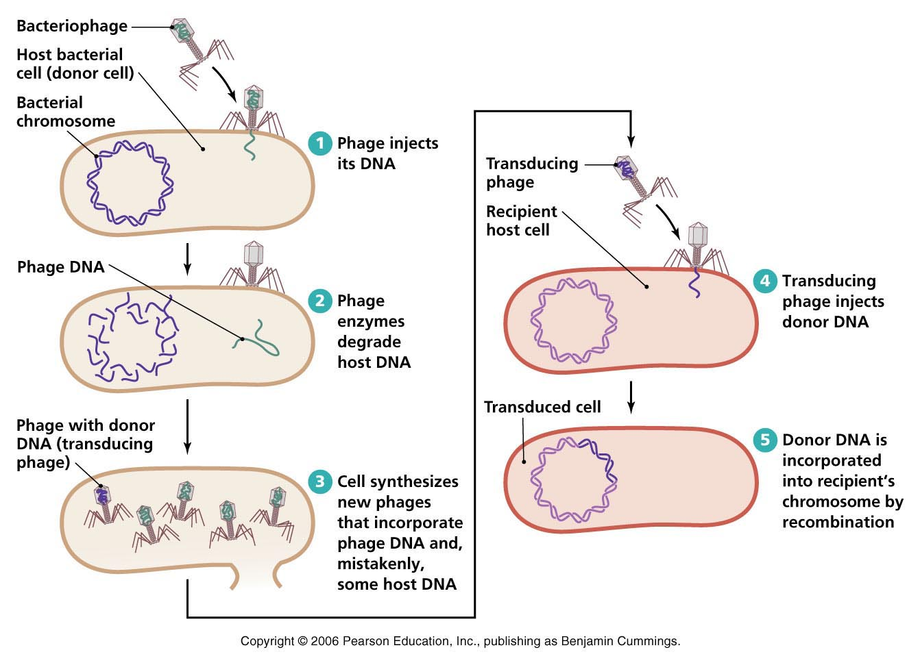
Transduction
When new viruses are formed in one host bacterial cell, the bacteria’s DNA can accidentally be enclosed in a viral protein coat rather than the viral DNA
When this new virus goes and “infects” another bacteria, it is simply giving it new DNA from the previous host bacteria.

Slide 14
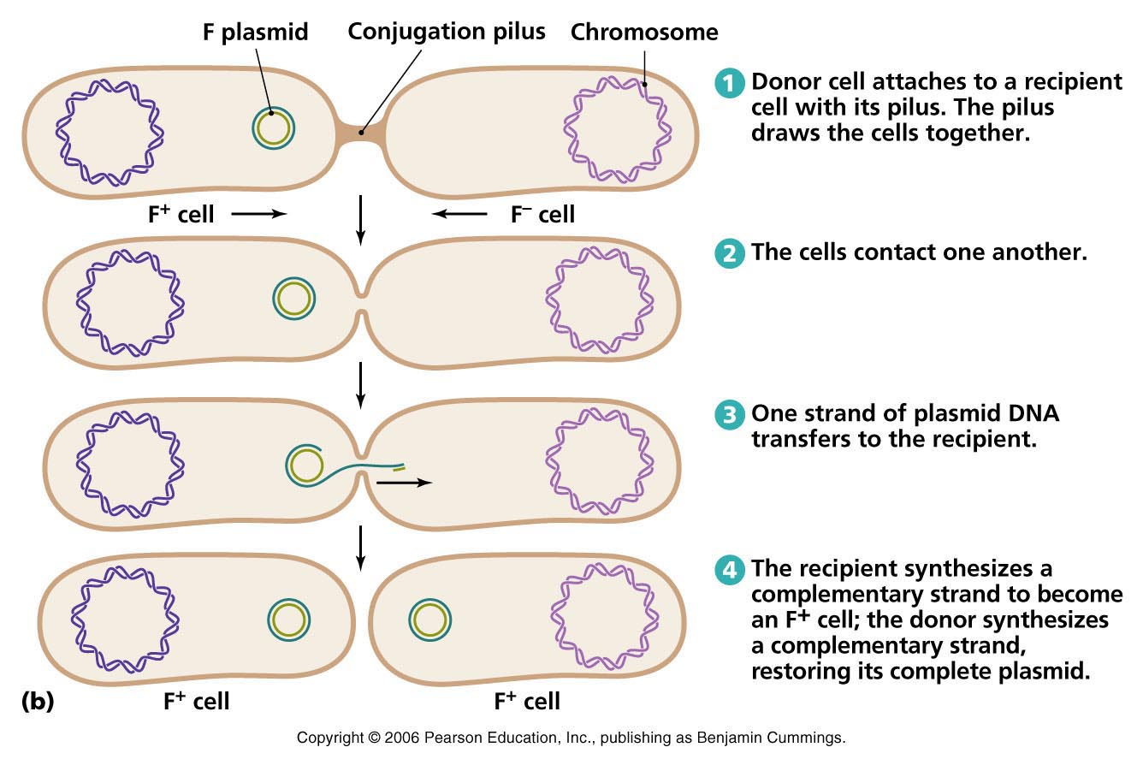
Conjugation
Bacteria with F plasmid can form a sex pilus (aka conjugation bridge or conjugation pilus) with another bacteria and share a plasmid.
Other bacteria now has genetic material it didn’t before

Slide 15
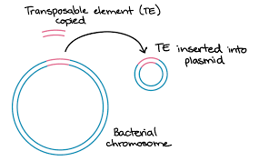
Transposons (“jumping genes”)

